Slide 1
Accelerating the just transition – insights from the IPCC Sixth Assessment Reports Youba Sokona IPCC Vice Chair
Subsidiary Body Event
First Global Dialogue and
Investment Focused Event
Under the Sharm El Sheikh
Mitigation Ambition and
Implementation Work
Program
Bonn, 03-05 Jun 2023

Slide 2
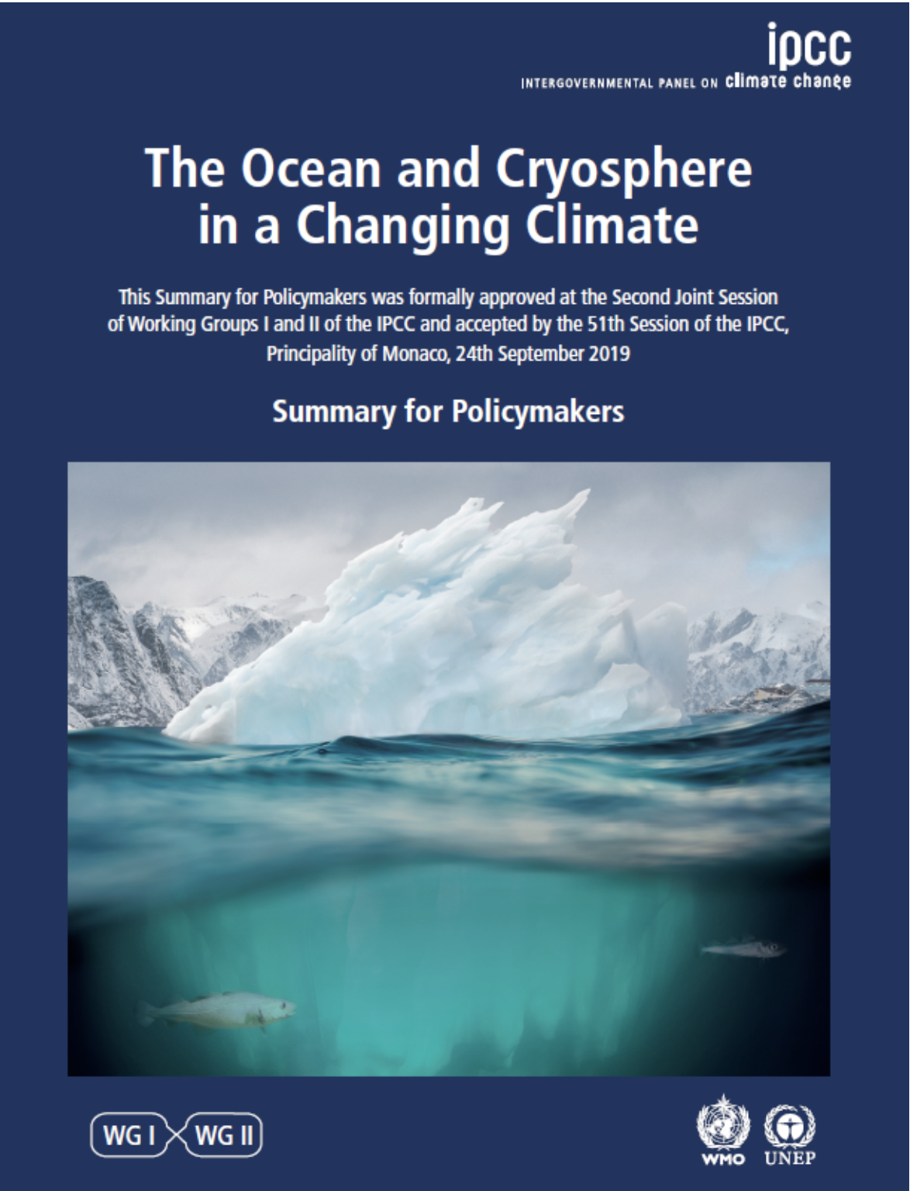
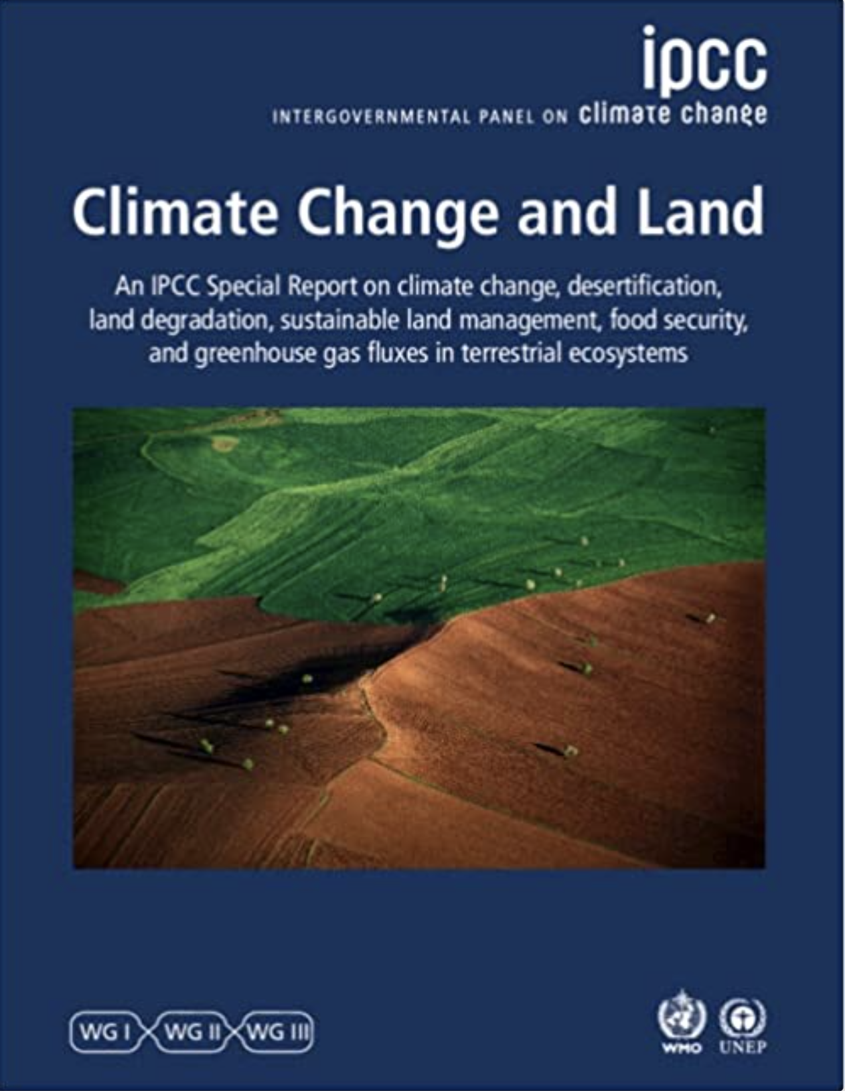
The State of Knowledge about Climate Change and how we can act?
WGI
WGII
WGIII
Special Report
AR6 Climate Change 2021:
The Physical Science Basis
Climate Change 2022:
Impacts, Adaptation and Vulnerability
Climate Change 2022:
Mitigation of Climate Change
Ocean and Cryosphere in a Changing Climate
Climate Change and Land
Global Warming of 1.5 ºC
Sixth Assessment Report | Synthesis Report

Slide 3
We are not on track to limit warming to 1.5 °C.
Notes:
Emissions in 2019 were about 12% higher than they were in 2010 and 54% higher than in 1990.
We are not on track to limit warming to 1.5°C.
[NEXT SLIDE]

Slide 4
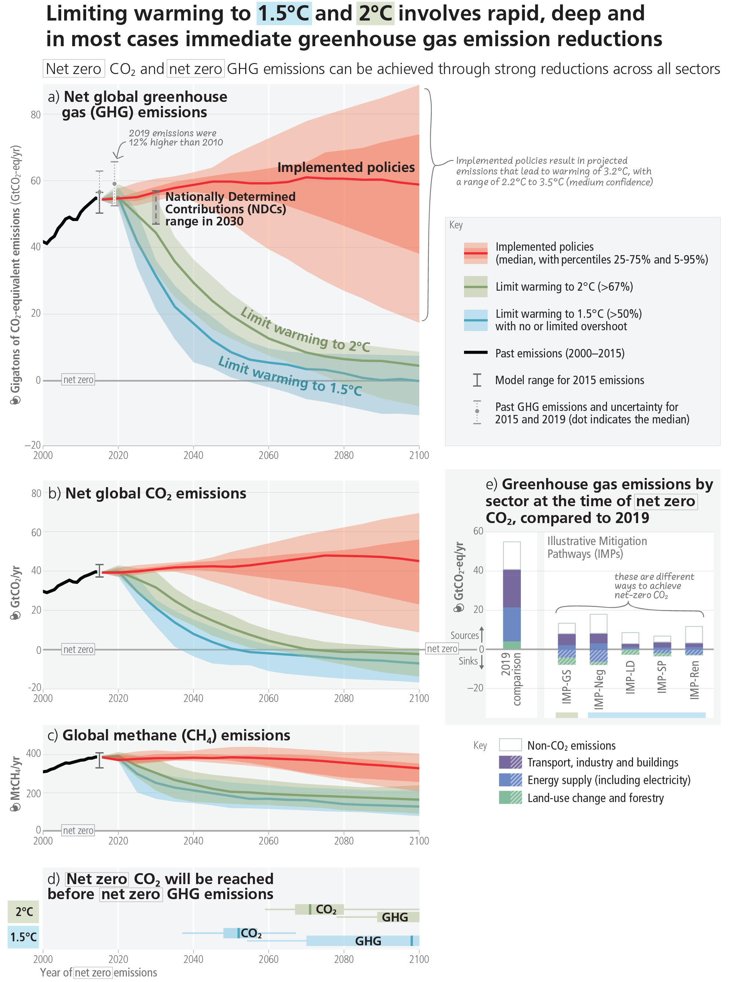
we are not doing nearly enough to avoid dangerous impacts let alone achieve the targets of Paris Agreement

Slide 7
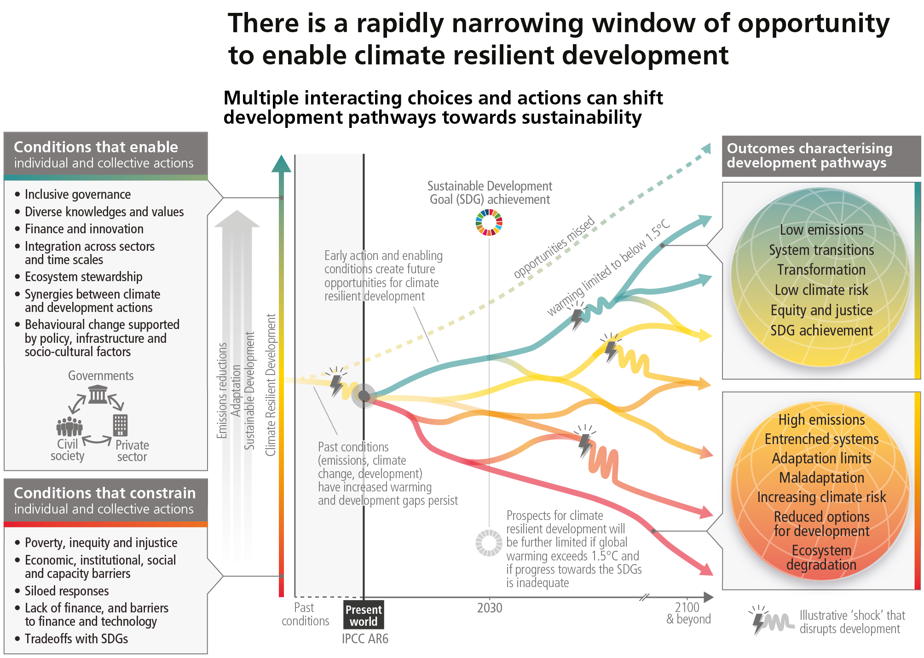

Slide 8
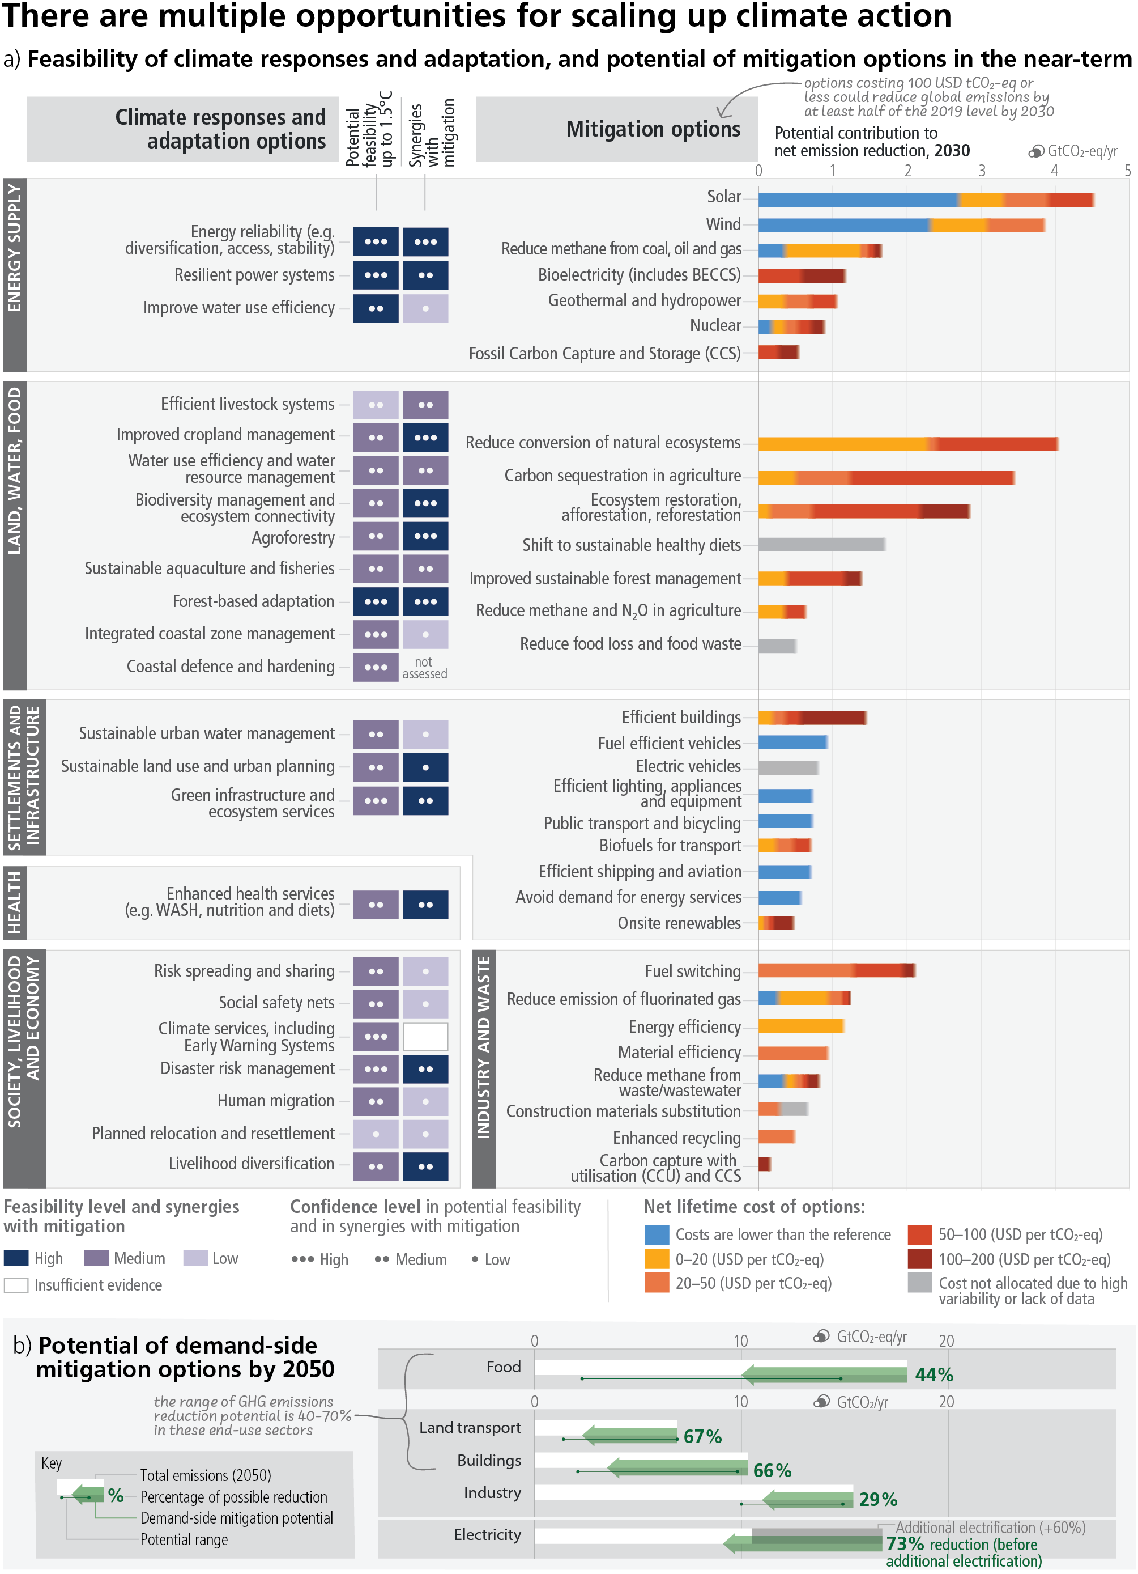
So many of the solutions are: a) already available today, and b) benefits us in so many ways addressing health, equity, justice and even economic concerns while increasing resilience and accelerating the transition to a clean energy future
There are options available in every
sector that can at least halve
emissions by 2030

Slide 10
TT
There are multiple opportunities for scaling up climate action
a) Feasibility of climate responses and adaptation and potential of mitigation in the near-term

Slide 11
There are multiple opportunities for scaling up climate action

Slide 12
Thank you for your attention

