Slide 1

Conceptualizing NAMAs within Green Growth Plans
Ben Sims
Regional Officer
Global Green Growth Institute

Slide 2
CONTENTS
Introduction
Approach and mission
Workstreams
Snapshot of GGGI approach
Portfolio summary
GGGI’s focus in East Asia and the Pacific
Green growth planning and NAMAs
Future role of GGGI in NAMA programmes
Case study one: Indonesia
Case study two: Ethiopia

Slide 3
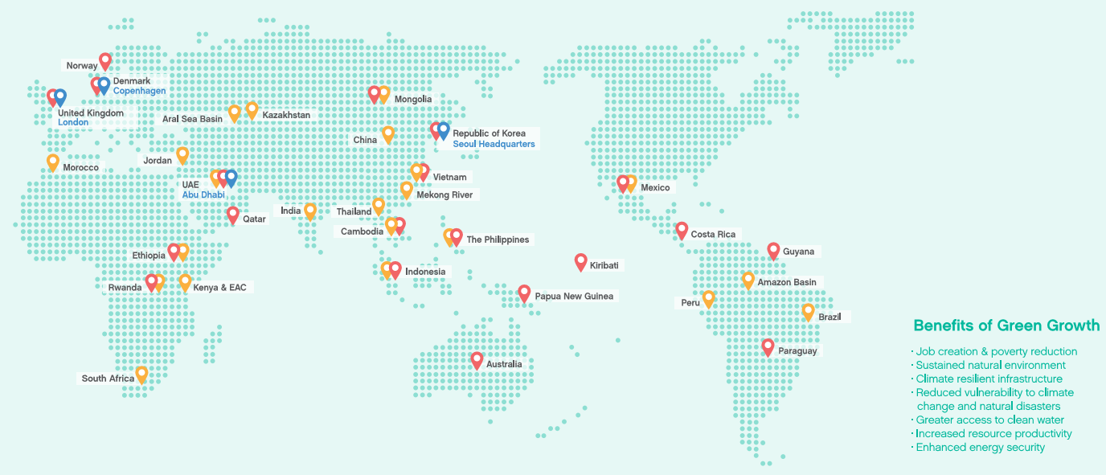
INTRODUCTION
Goals
GGGI partners with countries to help them build economies that
grow strongly, and are more efficient and sustainable in the use of natural
resources, less carbon intensive, and more resilient to climate change.
Member states and Operations

Slide 4

APPROACH AND MISSION
An equitable and sustainable growth trajectory that leapfrogs traditional modes of high-cost, resource-intensive growth
GREEN GROWTH
Country Programmes
Successful green growth outcomes
Increased resilience to climate change and sustainable management of environmental resources
Evidence
Strategic investments and policy implementation for green growth
Partner organization projects
High-cost, resource-intensive growth
Green growth projects varying in scale and content that results in sustainable economic development
Growing evidence on the viability and advantage of green growth as a national strategy

Slide 5
WORKSTREAMS
Partner Country
Knowledge Development and Management
(KDM)
Public-Private Cooperation
(PPC)
Green Growth Planning & Implementation
(GGP&I)
GGGI Country Program

Slide 6
SNAPSHOT OF GGGI APPROACH
1
2
3
Scoping
Green Growth Plan Development and
Capacity Building
Implementation
2
Analysis of country’s growth and development plans
Sector by sector diagnostic and prioritization of opportunities
Assessment of overall potential impact on the economy
Financial analysis of costs and investment requirements
Analysis and consultation on appropriate institutions, policies and capacity
Development of investment plans

Slide 7
PORTFOLIO SUMMARY
Green Growth
Planning
Agriculture
Adaptation
Energy
Cambodia
Jordan
Mongolia
Philippines
Philippines
Kazakhstan
Jordan
Kazakhstan
Pacific Islands
Mongolia
China – Yunnan Province
Kazakhstan
Mexico
East Africa
Mexico
UAE
Ethiopia
Morocco
South Africa
Morocco
Vietnam
Indonesia
Forestry
Industry
Urban Planning
Transport
Water
Scoping
Brazil
Thailand
Rwanda
China
Kazakhstan
Delivery
Columbia
Mongolia
Mekong
Peru
Peru
Philippines

Slide 8
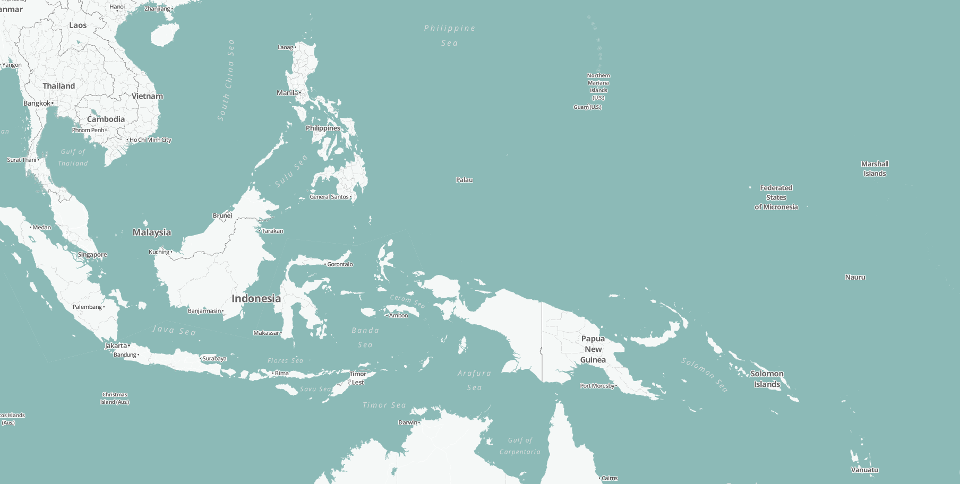

EAST ASIA AND THE PACIFIC
Mekong
Country | Sector
Cambodia | Green Growth Planning
Indonesia | Green Growth Planning
Pacific Islands | Green Growth Planning
Philippines | Green Growth Planning; Adaptation
Thailand | Mitigation
Vietnam | Green Growth Planning
Thailand
Vietnam
Cambodia
Philippines
Indonesia
Pacific Islands

Slide 9
FUTURE ROLE IN NAMA PROGRAMMES
As the mandate of the Global Green Growth Institute (GGGI) is to achieve transformational green growth in the countries with which it partners, GGGI could assist to design and implement NAMAs.
GGGI is at an early stage in terms of NAMA support and future assistance could include:
Technical capacity
Mainstreaming low carbon growth opportunities
Providing advice on institutional frameworks
Investment opportunities
Private sector participation

Slide 10

CASE STUDY ONE: INDONESIA

Slide 11
INDONESIA
Green Growth Framework and Assessment
Green technology transfer
Project proposals (i.e. solar PV development in East Kalimantan)
Indicator development (MRV)
Green Growth for Indonesia
Development of a Green Growth Roadmap with tools and methodolologies to support policy and planning processes
Green growth mainstreamed in planning & investments
1A
“To promote
Green Growth in Indonesia that recognises the value of natural capital, improves resilience, builds local economies and is inclusive and equitable”
1
1B
Green Growth Assessment of Capital Projects across a variety of sectors
1C
Development of innovative mechanisms to drive investment towards green growth sectors
REDD+ for green growth
Institutional Capacity Building
2
2
To ensure that REDD+ finance, programs and policies catalyze green growth
3CK
Green growth implementation in
Central Kalimantan Province
Regional engagement
3
3EK
Green growth implementation in
East Kalimantan Province

Slide 12
CASE STUDY TWO: ETHIOPIA

Slide 13
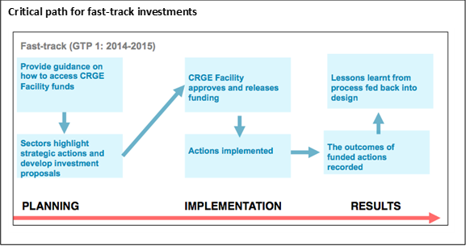
ETHIOPIA
Ethiopia’s Climate Resilient Green Economy (CRGE) Initiative
Sectoral Reduction Mechanism (SRM)
Pipeline for delivering projects resulting in GHG reductions
Finance for fast-track investments
Methodology for reporting results (MRV)

Slide 14
Thank you.
ben.sims@gggi.org
+82 10 9530 9920
www.gggi.org

