Slide 1

Methodological Choice and
Key Categories Analysis

Slide 2
Foreword, Copyright and Disclaimer
These presentation materials to explain the contents of the 2006 IPCC Guidelines:
are based on the presentations (except presentation on QA/QC) delivered by the Technical Support Unit of the Task Force on National Greenhouse Gas Inventories of the Intergovernmental Panel on Climate Change (IPCC TFI TSU) in the Africa Regional Workshop on the Building of Sustainable National Greenhouse Gas Inventory Management Systems, and the use of the 2006 IPCC Guidelines for National Greenhouse Gas Inventories (Swakopmund, Namibia, 24-28 April 2017);
have not been subject to a formal IPCC review process http://www.ipcc.ch/pdf/ipcc-principles/ipcc-principles-appendix-a-final.pdf; and
will be updated from time to time.
If you wish to use these presentation materials in some way or other (e.g., use some or all of these slides in your presentation at a workshop), please inform the TFI TSU through http://www.ipcc-nggip.iges.or.jp/mail. Also read the notes in the following websites.
Copyright: http://www.ipcc.ch/home_copyright.shtml
Disclaimer: http://www.ipcc.ch/home_disclaimer.shtml
The CGE acknowledges the inputs from, and expresses its appreciation to, the IPCC TFI TSU.
Consultative Group of Experts (CGE)
2
Training Materials for National Greenhouse Gas Inventories

Slide 3
Outline
1. Methods: Tier 1, 2, 3
2. Key Category
3. How to define Key Categories: Approach 1, 2
4. Conclusion
Consultative Group of Experts (CGE)
3
Training Materials for National Greenhouse Gas Inventories

Slide 4
Methods: Tier 1, 2, 3
Tiers: A tier represents a level of methodological complexity.
Usually three tiers are provided:
Tier 1 is the basic method,
Tier 2 - intermediate and
Tier 3 - most demanding in terms of complexity and data requirements
Tiers 2 and 3 are sometimes referred to as higher tier methods and are generally considered to be more accurate
Consultative Group of Experts (CGE)
4
Training Materials for National Greenhouse Gas Inventories

Slide 5
Methodological Choice
Methodological choice for individual source and sink categories is important in managing overall inventory uncertainty (it is lower when emissions and removals are estimated using the most rigorous methods)
However, these methods generally require more extensive resources for data collection, so it may not be feasible to use more rigorous method for every category (therefore it is good practice to identify those categories that have the greatest contribution to overall inventory)
By identifying these key categories in a systematic and objective manner, inventory compilers can prioritise their efforts and improve their overall estimates (it is good practice to use results of key category analysis as a basis for methodological choice to improve inventory quality and to increase confidence in the GHG estimates)
Consultative Group of Experts (CGE)
5
Training Materials for National Greenhouse Gas Inventories

Slide 6
Key Category
A key category is one that is prioritised within the national inventory system because its estimate has a significant influence on a country’s total inventory of greenhouse gases in terms of:
  - the absolute level,
  - the trend, or
  - the uncertainty in emissions and removals.
Consultative Group of Experts (CGE)
6
Training Materials for National Greenhouse Gas Inventories

Slide 7
Key Category
Key categories should be the priority for countries during inventory resource allocation for data collection, compilation, quality assurance/quality control and reporting.
In general, more detailed higher tier methods should be selected for key categories.
Consultative Group of Experts (CGE)
7
Training Materials for National Greenhouse Gas Inventories

Slide 8
How to Define Key Categories
Disaggregate categories to the lowest possible level:
to sub-category (e.g., to a fuel type – liquid, gaseous, solid)
to individual gas (use GWP).
Apply two Approaches:
  Approach 1 – Level and Trend Assessment
  Approach 2 – Level/Trend + Uncertainty Assessment
Consultative Group of Experts (CGE)
8
Training Materials for National Greenhouse Gas Inventories

Slide 9
Key Categories: Approach 1, 2
Approach 1 – Level and Trend Assessment:
  Key categories - 95% cumulative effect
Approach 2 – Level/Trend + Uncertainty Assessment:
  Key categories - 90% cumulative effect
Removals: expressed as positive numbers
(inclusion/exclusion)
Consultative Group of Experts (CGE)
9
Training Materials for National Greenhouse Gas Inventories

Slide 10
Example of Level Assessment
 |  |  | Emission/ Removal
1A1 | Fuel Combustion Activities - Energy Industries: Solid | CO₂ | 10000
1A1 | Fuel Combustion Activities - Energy Industries: Liquid | CO₂ | 200
1A2 | Fuel Combustion Activities - Manufacturing Industries and Construction: Solid | CO₂ | 1300
1A2 | Fuel Combustion Activities - Manufacturing Industries and Construction: Gas | CO₂ | 123
1A3a | Fuel Combustion Activities - Transport - Civil Aviation | CO₂ | 5502
3A2 | Manure Management | CH₄ | 543
3B1a | Forest Land Remaining Forest Land | CO₂ | -2345
3B1b | Land Converted to Forest Land | CO₂ | 879
Consultative Group of Experts (CGE)
10
Training Materials for National Greenhouse Gas Inventories

Slide 11
Example of Level Assessment
 |  |  | Emission/ Removal | Absolute
1A1 | Fuel Combustion Activities - Energy Industries: Solid | CO₂ | 10000 | 10000
1A1 | Fuel Combustion Activities - Energy Industries: Liquid | CO₂ | 200 | 200
1A2 | Fuel Combustion Activities - Manufacturing Industries and Construction: Solid | CO₂ | 1300 | 1300
1A2 | Fuel Combustion Activities - Manufacturing Industries and Construction: Gas | CO₂ | 123 | 123
1A3a | Fuel Combustion Activities - Transport - Civil Aviation | CO₂ | 5502 | 5502
3A2 | Manure Management | CH₄ | 543 | 543
3B1a | Forest Land Remaining Forest Land | CO₂ | -2345 | 2345
3B1b | Land Converted to Forest Land | CO₂ | 879 | 879
 |  |  |  | 20892
Consultative Group of Experts (CGE)
11
Training Materials for National Greenhouse Gas Inventories

Slide 12
Example of Level Assessment
 |  |  | Emission/ Removal | Absolute | Level
1A1 | Fuel Combustion Activities - Energy Industries: Solid | CO₂ | 10000 | 10000 | 47.9%
1A1 | Fuel Combustion Activities - Energy Industries: Liquid | CO₂ | 200 | 200 | 1.0%
1A2 | Fuel Combustion Activities - Manufacturing Industries and Construction: Solid | CO₂ | 1300 | 1300 | 6.2%
1A2 | Fuel Combustion Activities - Manufacturing Industries and Construction: Gas | CO₂ | 123 | 123 | 0.6%
1A3a | Fuel Combustion Activities - Transport - Civil Aviation | CO₂ | 5502 | 5502 | 26.3%
3A2 | Manure Management | CH₄ | 543 | 543 | 2.6%
3B1a | Forest Land Remaining Forest Land | CO₂ | -2345 | 2345 | 11.2%
3B1b | Land Converted to Forest Land | CO₂ | 879 | 879 | 4.2%
 |  |  |  | 20892
Consultative Group of Experts (CGE)
12
Training Materials for National Greenhouse Gas Inventories

Slide 13
Example of Level Assessment
 |  |  | Emission/ Removal | Absolute | Level
1A1 | Fuel Combustion Activities - Energy Industries: Solid | CO₂ | 10000 | 10000 | 47.9%
1A3a | Fuel Combustion Activities - Transport - Civil Aviation | CO₂ | 5502 | 5502 | 26.3%
3B1a | Forest Land Remaining Forest Land | CO₂ | -2345 | 2345 | 11.2%
1A2 | Fuel Combustion Activities - Manufacturing Industries and Construction: Solid | CO₂ | 1300 | 1300 | 6.2%
3B1b | Land Converted to Forest Land | CO₂ | 879 | 879 | 4.2%
3A2 | Manure Management | CH₄ | 543 | 543 | 2.6%
1A1 | Fuel Combustion Activities - Energy Industries: Liquid | CO₂ | 200 | 200 | 1.0%
1A2 | Fuel Combustion Activities - Manufacturing Industries and Construction: Gas | CO₂ | 123 | 123 | 0.6%
 |  |  |  | 20892
Consultative Group of Experts (CGE)
12
Training Materials for National Greenhouse Gas Inventories

Slide 14
Example of Level Assessment
 |  |  | Emission/ Removal | Absolute | Level | Cumulative
1A1 | Fuel Combustion Activities - Energy Industries: Solid | CO₂ | 10000 | 10000 | 47.9% | 47.9%
1A3a | Fuel Combustion Activities - Transport - Civil Aviation | CO₂ | 5502 | 5502 | 26.3% | 74.2%
3B1a | Forest Land Remaining Forest Land | CO₂ | -2345 | 2345 | 11.2% | 85.4%
1A2 | Fuel Combustion Activities - Manufacturing Industries and Construction: Solid | CO₂ | 1300 | 1300 | 6.2% | 91.6%
3B1b | Land Converted to Forest Land | CO₂ | 879 | 879 | 4.2% | 95.8%
3A2 | Manure Management | CH₄ | 543 | 543 | 2.6% | 98.4%
1A1 | Fuel Combustion Activities - Energy Industries: Liquid | CO₂ | 200 | 200 | 1.0% | 99.4%
1A2 | Fuel Combustion Activities - Manufacturing Industries and Construction: Gas | CO₂ | 123 | 123 | 0.6% | 100.0%
 |  |  |  | 20892
Consultative Group of Experts (CGE)
14
Training Materials for National Greenhouse Gas Inventories

Slide 15
Approach 1 : Trend
The trend assessment identifies categories whose trend is different from the trend of the total inventory, regardless whether category trend is increasing or decreasing, or is a sink or source.
Categories whose trend diverges most from the total trend should be identified as key, when this difference is weighted by the level of emissions or removals of the category in the base year.
Consultative Group of Experts (CGE)
15
Training Materials for National Greenhouse Gas Inventories

Slide 16
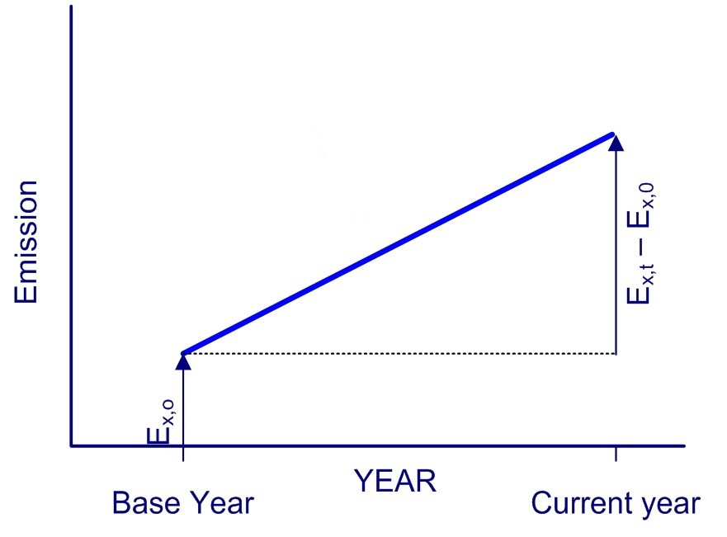
Category Significance
Overall Trend
Category Trend
16

Slide 17
17

Slide 18
Approach 2: Level/Trend + Uncertainty
L and T - the level and trend assessment,
U - the uncertainty for category x in year t
Consultative Group of Experts (CGE)
18
Training Materials for National Greenhouse Gas Inventories

Slide 20
Qualitative Analysis
Besides a quantitative analysis, there is a qualitative analysis of categories.
Some hints:
Mitigation techniques and technologies
Expected growth
No quantitative assessment of uncertainty performed
Completeness (incomplete inventory gives incorrect results)
Consultative Group of Experts (CGE)
20
Training Materials for National Greenhouse Gas Inventories

Slide 21
Results
Consultative Group of Experts (CGE)
21
Training Materials for National Greenhouse Gas Inventories

Slide 22
Example

Slide 24
Conclusion
Key categories are extremely important:
Mistakes will lead to significant under-/over- estimates
Improvements will significantly improve overall inventory quality
Higher tiers (Tier 2 and Tier 3) should be used for estimating key categories
Resources of national inventory compilers are (in many cases) limited → focus on key categories
Consultative Group of Experts (CGE)
24
Training Materials for National Greenhouse Gas Inventories

Slide 25
Thank you

