Slide 1

National GHG Inventories:
Scope and General Principles, and
2006 IPCC Guidelines and Relationship to Earlier IPCC Guidelines

Slide 2
Foreword, Copyright and Disclaimer
These presentation materials to explain the contents of the 2006 IPCC Guidelines:
are based on the presentations (except presentation on QA/QC) delivered by the Technical Support Unit of the Task Force on National Greenhouse Gas Inventories of the Intergovernmental Panel on Climate Change (IPCC TFI TSU) in the Africa Regional Workshop on the Building of Sustainable National Greenhouse Gas Inventory Management Systems, and the use of the 2006 IPCC Guidelines for National Greenhouse Gas Inventories (Swakopmund, Namibia, 24-28 April 2017);
have not been subject to a formal IPCC review process http://www.ipcc.ch/pdf/ipcc-principles/ipcc-principles-appendix-a-final.pdf; and
will be updated from time to time.
If you wish to use these presentation materials in some way or other (e.g., use some or all of these slides in your presentation at a workshop), please inform the TFI TSU through http://www.ipcc-nggip.iges.or.jp/mail. Also read the notes in the following websites.
Copyright: http://www.ipcc.ch/home_copyright.shtml
Disclaimer: http://www.ipcc.ch/home_disclaimer.shtml
The CGE acknowledges the inputs from, and expresses its appreciation to, the IPCC TFI TSU.
Consultative Group of Experts (CGE)
2
Training Materials for National Greenhouse Gas Inventories

Slide 3
What are national GHG inventories?
Estimates of all emissions (and removals) of particular gases from given sources from a defined region in a specific period of time.
Here we are dealing with:
  Greenhouse Gases,
  National Estimates,
  Annual Estimates.
Consultative Group of Experts (CGE)
3
Training Materials for National Greenhouse Gas Inventories

Slide 4
Why?
Scientific Understanding
  Input to models
  Understand link between environmental pollution and effects to sources of pollution
Policy
  Before any pollution problem can be efficiently controlled we need to know the sources and amounts emitted
  To help develop cost-effective policy
  To monitor progress towards policy goals
  To inform the public
Consultative Group of Experts (CGE)
4
Training Materials for National Greenhouse Gas Inventories

Slide 5
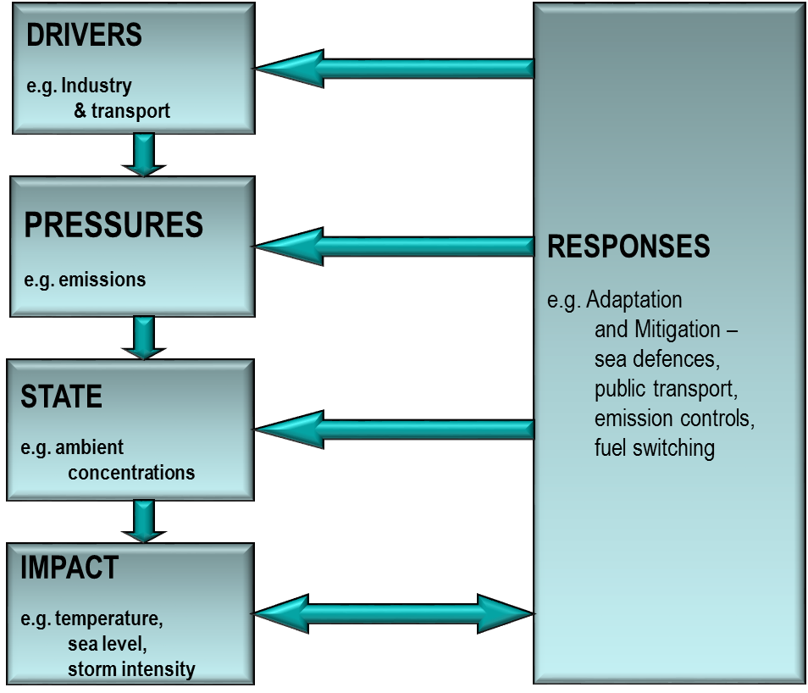
DPSIR
Consultative Group of Experts (CGE)
5
Training Materials for National Greenhouse Gas Inventories

Slide 6
Why do we need inventory guidelines?
Any international agreement to limit climate change must set emission limits/targets/aims and monitor progress in an open and transparent way
Currently, most national emissions can only be estimated, not measured and so we need a consensus on the best way of doing this.
  Cannot measure all sources (e.g. road transport would be impractical; Remote sensing techniques not available)
To do this we need reliable, generally accepted methods and guidelines
Consultative Group of Experts (CGE)
6
Training Materials for National Greenhouse Gas Inventories

Slide 7
How?
Make estimates based on parameters associated with emission rates
  CO₂ from fuel depends on carbon in fuel
  CO₂ proportional to amount of fuel burnt
  Changes on stocks of carbon in forests give emissions (or removals) of CO₂
Where:
  E = Emission
  EF = Emission Factor
  AD = Activity Data
Consultative Group of Experts (CGE)
7
Training Materials for National Greenhouse Gas Inventories

Slide 8
Credibility
As these are estimates we need to ensure they are credible
Verification
  Checking that the numbers are correct – that they reflect the true emissions
Validation
  Checking that the estimates are compiled correctly in the way they are supposed to be done
  Needs standard methodologies and inventory management
Consultative Group of Experts (CGE)
8
Training Materials for National Greenhouse Gas Inventories

Slide 9
Good Practice (1)
Assists countries in producing inventories that are accurate in the sense of being neither over- nor underestimates so far as can be judged, and in which uncertainties are reduced as far as possible
  Gives a way to manage uncertainties
  Identifies main “KEY” categories to focus resources
  Documentation provides transparency
Consultative Group of Experts (CGE)
9
Training Materials for National Greenhouse Gas Inventories

Slide 10
Good Practice (2)
IPCC Good Practice gives guidance on
  Approaches to Data Collection
  Uncertainty Evaluations
  Key Category Analysis and Methodological Choice
  Recalculations
  Quality Control and Quality Assurance
  Review
  Documentation
Consultative Group of Experts (CGE)
10
Training Materials for National Greenhouse Gas Inventories

Slide 11
Good Practice (3)
Supports the development of inventories that are:
  Transparent
  Documented
  Consistent over time
  Complete
  Comparable
  Assessed for uncertainties
  Subject to quality control and assurance
  Efficient in the use of resources available to inventory agencies
  In which uncertainties are gradually reduced as better information becomes available
Consultative Group of Experts (CGE)
11
Training Materials for National Greenhouse Gas Inventories

Slide 12


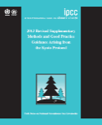
Evolution
Guidelines have evolved from 1996 to 2006
Development of Good Practice Guidance (GPG) was a major step forward
  Complete, consistent, comparable, transparent,
  and accurate inventories taking account of available resources
  Major change was from 1996 LUCF to GPG LULUCF
2006 Guidelines [2.5 years work, 250 authors]
  Have 4 sectors
  Have improved methods and default data
  Cover more greenhouse gases and methods
  Integrate GPG
  Require similar resources
  Do not pre-empt accounting choices
  The best globally applicable methods
Consultative Group of Experts (CGE)
12
Training Materials for National Greenhouse Gas Inventories

Slide 13
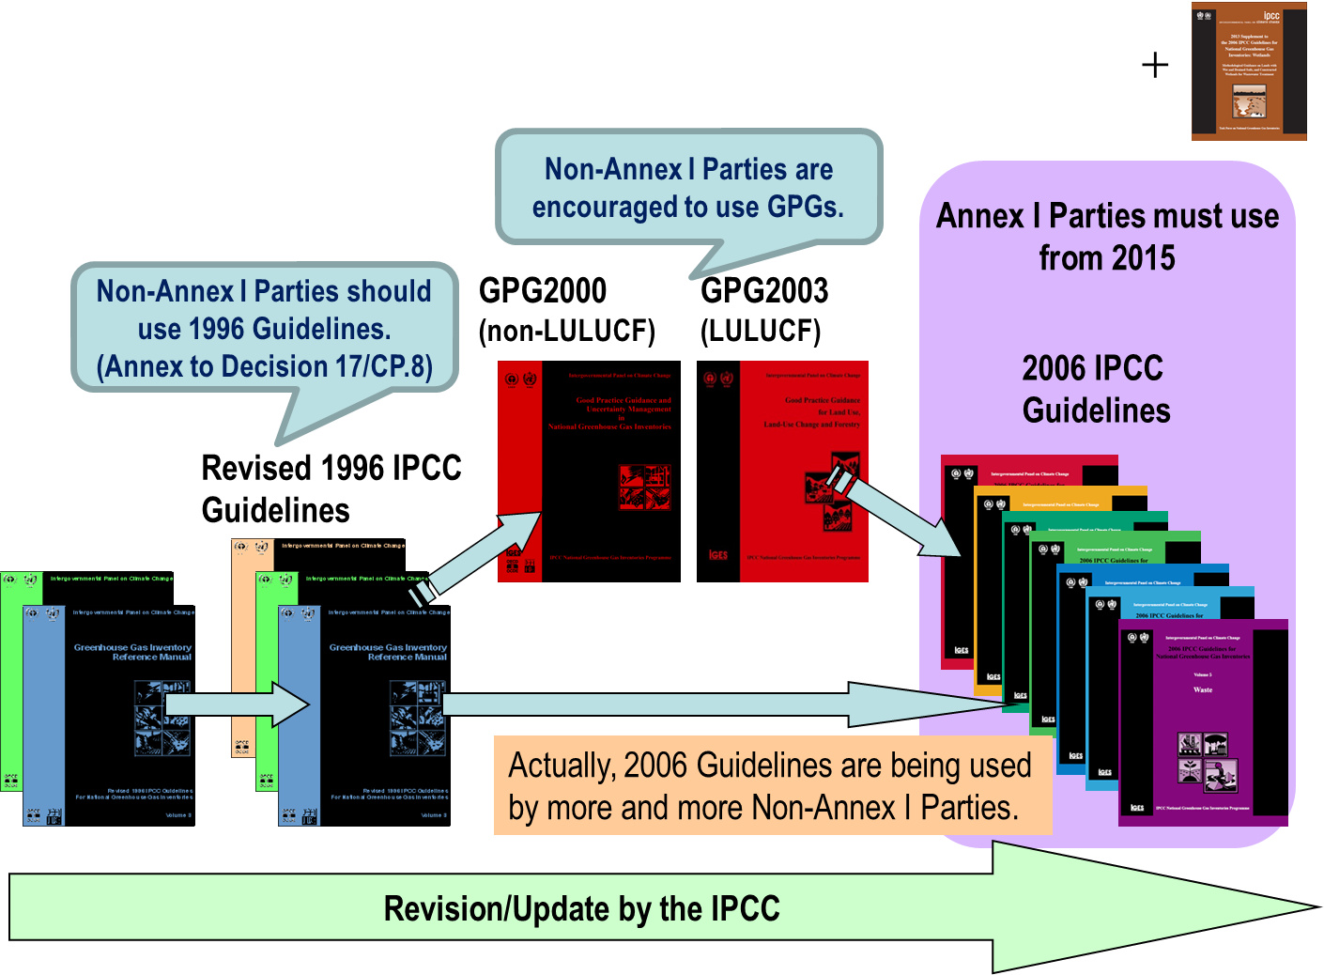

IPCC Inventory Guidelines
New Supplementary Guidance in 2013
Consultative Group of Experts (CGE)
13
Training Materials for National Greenhouse Gas Inventories

Slide 14
2006 Guidelines being used by NAI Parties
At the 42nd Session held in June 2015, the Subsidiary Body for Implementation (SBI) of the UNFCCC concluded under the agenda item on “Reporting from Parties not included in Annex I to the Convention”:
  “The SBI noted the requests from non-Annex I Parties for further technical support aimed at improving their domestic capacity to facilitate continuity in meeting reporting requirements through training on the use of the 2006 IPCC Guidelines for National Greenhouse Gas Inventories, …” (FCCC/SBI/2015/10, paragraph 29)
Consultative Group of Experts (CGE)
14
Training Materials for National Greenhouse Gas Inventories

Slide 15
Methodological approaches unchanged
In General:
  Energy
  Based on carbon content of fuel
  Fugitive (leaks) use emission factors
  Industrial Processes
  Based on chemistry of process
  Some use mass balance of product used
  Land Use
  Stock changes ⇒ Emissions/Removals
      Inputs (e.g. growth) - outputs (e.g. decay, harvest)
      Total Stock at end minus Total stock at beginning
  Agriculture
  Based on understanding of processes
  Waste
  Tracks carbon (fossil & biogenic) in waste
Consultative Group of Experts (CGE)
15
Training Materials for National Greenhouse Gas Inventories

Slide 16
GPG and Sectoral Guidance
Good Practice inventories are defined as “those that contain neither over- nor under-estimates so far as can be judged, and in which uncertainties are reduced as far as is practical”
GPG retains consistency with Revised 1996 Guidelines and is updated and expanded in the 2006 Guidelines
  Approaches to Data Collection
Consultative Group of Experts (CGE)
16
Training Materials for National Greenhouse Gas Inventories

Slide 17
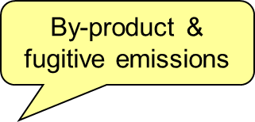
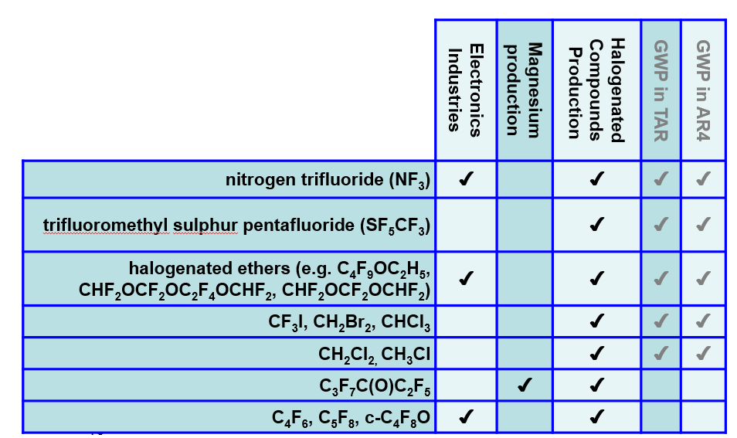
“New” gases in 2006 Guidelines
- Sources Identified in 2006 Guidelines
Consultative Group of Experts (CGE)
17
Training Materials for National Greenhouse Gas Inventories

Slide 18
Direct and Indirect Emissions: CO₂ and N₂O
2006 Guidelines “CO₂ Emissions”
2006 Guidelines “CO₂ Emissions” do not include this automatically
2006 Guidelines give methods to calculate this
2006 Guidelines includes ALL NH₃ & NO_{x} Emissions
Consultative Group of Experts (CGE)
18
Training Materials for National Greenhouse Gas Inventories

Slide 19
Estimation of Actual Annual Emissions
In the 1996 Guidelines and Good Practice Guidance for a few sources, the simplest methodology estimates a “potential emission” rather than the actual annual emission.
  This “potential emission” assumes all the emissions from an activity occur in the current year, ignoring the fact they will occur over many years (e.g. methane emissions from waste in landfills occurs over decades as the decay processes take place).
In the 2006 Guidelines, simple default methods estimate emissions when they occur, thus removing the need for potential emissions.
The removal of potential emission estimates also allows the emission reductions of abatement techniques to be properly estimated and ensures that the Tier 1 methods are compatible with higher tier methods. The areas where this occurred are:
  Actual emissions of fluorinated compounds
  Methane from landfills
Consultative Group of Experts (CGE)
19
Training Materials for National Greenhouse Gas Inventories

Slide 20
“New” Guidance in 2006 Guidelines
Consultative Group of Experts (CGE)
20
Training Materials for National Greenhouse Gas Inventories

Slide 21
New Methodology Reports
The TFI has developed two additional methodology reports in response to the invitations from UNFCCC:
  2013 Supplement to the 2006 IPCC Guidelines for National Greenhouse Gas Inventories: Wetlands (Wetlands Supplement)
    To fill gaps in the coverage of wetlands and organic soils in the 2006 IPCC Guidelines
  2013 Revised Supplementary Methods and Good Practice Guidance Arising from the Kyoto Protocol (KP Supplement)
    To update and augment the existing Chapter 4 of the GPG- LULUCF
The Wetlands Supplement and KP Supplement were adopted/accepted by the IPCC Plenary at its 37th Session (IPCC 37) in Batumi, Georgia, 14-18 October 2013, and published on the TFI website in February 2014.
Wetlands Supplement
KP Supplement
Consultative Group of Experts (CGE)
21
Training Materials for National Greenhouse Gas Inventories

Slide 22
2019 Refinement to the 2006 IPCC Guidelines (1)
TFB at its 26th Meeting in Ottawa (28-29 August 2014) concluded that:
  2006 IPCC Guidelines provide a technically sound methodological basis of national greenhouse gas inventories; however,
  to maintain their scientific validity, certain refinements may be required, taking into account scientific and other technical advances that have matured sufficiently since 2006.
Consultative Group of Experts (CGE)
22
Training Materials for National Greenhouse Gas Inventories

Slide 23
2019 Refinement to the 2006 IPCC Guidelines (2)
IPCC decided at its 44th session in Bangkok on 17-20 October 2016 to prepare a Methodology Report to refine the 2006 IPCC Guidelines with the following format and title:
  The format should be one single Methodology Report comprising an Overview Chapter and five volumes following the format of the 2006 IPCC Guidelines for National Greenhouse Gas Inventories (2006 IPCC Guidelines).
  The title of the Methodology Report should be “2019 Refinement to the 2006 IPCC Guidelines for National Greenhouse Gas Inventories”.
Consultative Group of Experts (CGE)
23
Training Materials for National Greenhouse Gas Inventories

Slide 24

2019 Refinement to the 2006 IPCC Guidelines (3)
Will be completed in May 2019.
Aim:
  to provide an updated and sound scientific basis for supporting the preparation and continuous improvement of national GHG inventories;
  not to revise the 2006 IPCC Guidelines, but update, supplement and/or elaborate the 2006 IPCC Guidelines where gaps or out-of-date science have been identified.
Format and Structure:
  Same as the 2006 IPCC Guidelines (= Overview Chapter and 5 Volumes) so as to make it easier for inventory compilers to use the 2019 Refinement in conjunction with the 2006 IPCC Guidelines.
Consultative Group of Experts (CGE)
24
Training Materials for National Greenhouse Gas Inventories

Slide 25
2019 Refinement to the 2006 IPCC Guidelines (4)
To be developed by approximately 200 authors from all over the world.
Three review stages are planned:
  Expert Review of First Order Draft: Dec 2017 – Feb 2018
  Government/Expert Review of Second Order Draft: Jul – Sep 2018
  Government Review of Final Draft: Jan – Mar 2019
Scope and outline approved by the IPCC at its 44th Session (Oct 2016, Bangkok, Thailand) are included in Decision IPCC/XLIV-5.
  http://www.ipcc.ch/meetings/session44/p44_decisions.pdf
Other relevant documents:
  Report of the Scoping Meeting (Aug 2016, Minsk, Belarus)
  http://www.ipcc-nggip.iges.or.jp/meeting/meeting.html
  Presentations at a side event during COP-22 (Nov 2016, Marrakech, Morocco)
  http://www.ipcc-nggip.iges.or.jp/presentation/presentation.html
  Overall schedule of production of IPCC Reports including 2019 Refinement
  http://www.ipcc.ch/activities/pdf/ar6_schedule.pdf#page=2
Consultative Group of Experts (CGE)
25
Training Materials for National Greenhouse Gas Inventories

Slide 26
Various Tools – Supporting Materials
Emission Factor Database (EFDB)
IPCC Inventory Software
Primer for 2006 IPCC Guidelines
Reports of Expert Meetings
http://www.ipcc-nggip.iges.or.jp/EFDB/
http://www.ipcc-nggip.iges.or.jp/software/index.html
http://www.ipcc-nggip.iges.or.jp/support/support.html
http://www.ipcc-nggip.iges.or.jp/meeting/meeting.html
Consultative Group of Experts (CGE)
26
Training Materials for National Greenhouse Gas Inventories

Slide 27

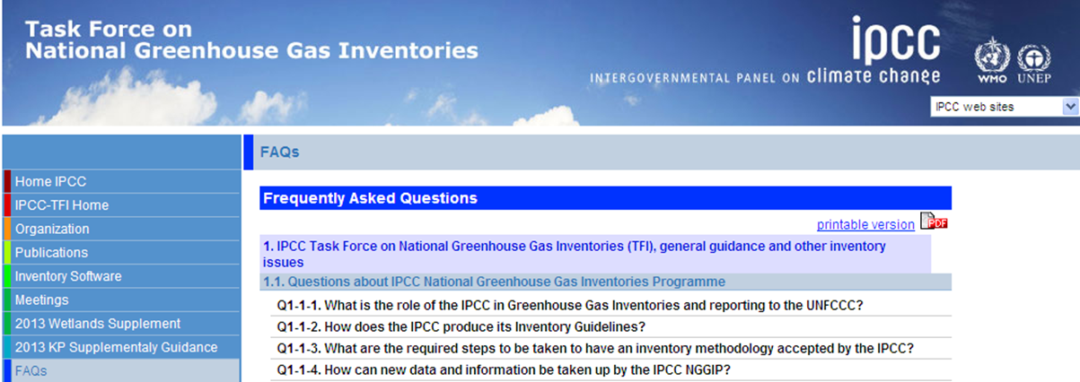
Various Tools – FAQ Website
Answers to frequently asked questions (FAQs) such as:
  Q1-3-2: “What is the difference between accuracy and precision? Does uncertainty assessment relate to both?”
  Q2-10: “According to the IPCC Guidelines CO2 Emissions from the combustion of biomass are reported as zero in the Energy sector. Do the IPCC Guidelines consider biomass used for energy to be carbon neutral?”
      Continuously updated
  For example, a new set of Q&As on the use of 2006 Guidelines in other areas has been recently added following a relevant expert meeting.
Consultative Group of Experts (CGE)
27
Training Materials for National Greenhouse Gas Inventories

Slide 28
Summary
Emission inventories have several uses.
  They help understand problems and are a key to policy development as well as reporting and monitoring progress towards targets.
They are estimates and cannot be completely measured.
Inventory management and “good practice” is as important as the emission estimation itself.
The same basic methodological approaches are used from 1996 Guidelines, through GPG 2000 & GPG LULUCF to 2006 Guidelines.
The 2006 Guidelines maintain, with improvements, the methods of earlier guidelines and integrate GPG.
The 2006 Guidelines provide improved guidance in some areas, more and improved default data.
  Wider coverage of gases
  Additional sources covered
  All estimates are now of actual annual emissions (“potential” emissions not needed)
  Categories simplified and clarified in some areas
The 2006 Guidelines do not pre-empt accounting choices – all the information needed is retained.
Consultative Group of Experts (CGE)
28
Training Materials for National Greenhouse Gas Inventories

Slide 29
Thank you

