Slide 1
Contributions to the UNFCCC secretariat
Climate Change Conference
Bonn, Germany, 16-26 May 2016

Slide 2
Contributions to the Trust Fund for the Core Budget of the UNFCCC
• Contributions due 1 January
• Received on time: 5%
• Received today: 40%
• Result: serious cash flow problems

Slide 3
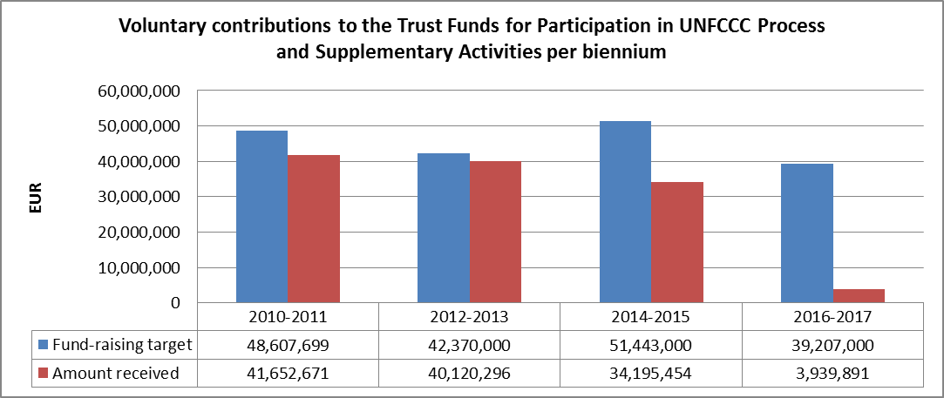
Contributions to the Trust Fund for Supplementary Activities and the Trust Fund for Participation in the UNFCCC process
Notable decline in voluntary contributions for supplementary activities and for participation in the UNFCCC Process over the last 3 biennia
Contributions for 2014-2015 biennium were lower by EUR 7.5 million compared to 2010-2011 despite increased requirements

