Slide 1


LEDS Global Partnership and
Asia LEDS Partnership
Knowledge sharing platforms that support the design and implementation of NAMAs
UNFCCC Regional Workshop
Singapore, August 13, 2013
John Bruce Wells, Asia LEDS Partnership Secretariat

Slide 2
Purpose of this Presentation
Discuss how Low Emissions Development Strategies (LEDS) can be a foundation for Nationally Appropriate Mitigation Actions (NAMAs)
Introduce global and regional knowledge sharing approaches on green growth and sustainability (that will be discussed more on Wednesday morning)

Slide 3
What are LEDS?
Low emission development strategies, or LEDS, are country-led strategic planning frameworks to promote climate-resilient economic growth while simultaneously reducing greenhouse gas (GHG) emissions over the long term. LEDS carries the same general meaning as low-carbon development strategies, low-emission climate-resilient development strategies, and green growth strategies. While LEDS focus on reducing GHG emissions, effective LEDS frameworks should work to ensure that climate-resilient and adaptation are fully considered in near- and long-term planning.

Slide 4
Goal of a LEDS
Meet economic and social development goals
while reducing or slowing GHG emissions
Green Growth Pathway
.
.
Business as Usual
Growth
GDP
.
Emissions
.
(current emissions level)
Low Emission Pathways
(today)
Time

Slide 5




LEDS in the UNFCCC Negotiations
Copenhagen Accord (2009): “A low emission development strategy is indispensable for sustainable development”
Cancun Agreement (2010): “Decides that developed countries should develop low carbon strategies or plans…” “Encourages developing countries to develop low carbon development strategies or plans in the context of sustainable development…”
Durban Platform (2011): “Invites developed country Parties to submit information related to progress towards the formulation of their low-emission development strategies…” “Encourages developing country Parties to develop low-emission development strategies, recognizing the need for financial and technical support by developed country Parties...”
Doha Outcome (2012): Reaffirms prior statements; “Requests technical workshops and material to build capacity in the preparation, submission and implementation of nationally appropriate mitigation actions, as well as in the formulation of low emission development strategies…”

Slide 6
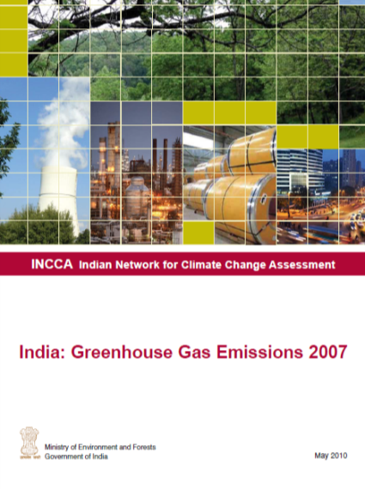
❶ Organization | ❷ Data | ❸ Analysis | ❹ Plans | ❺ Actions
2. Assess the Current Situation:
Confirm Development Goals
Collect Economic and Other Resource Data
GHG Inventory

Slide 7
❶ Organization | ❷ Data | ❸ Analysis | ❹ Plans | ❺ Actions
3. Analytical Decision-making:
BAU Scenario Analysis
Analyze Low Emissions Pathways/ Scenarios
Assess Low Emission Options
.
.
Growth
.
.
(today)
Time

Slide 8
❶ Organization | ❷ Data | ❸ Analysis | ❹ Plans | ❺ Actions
4. Prioritize and Plan:
Implementation Plans for Portfolio of Actions
Prioritized Near-term Actions
Financing Plan

Slide 9
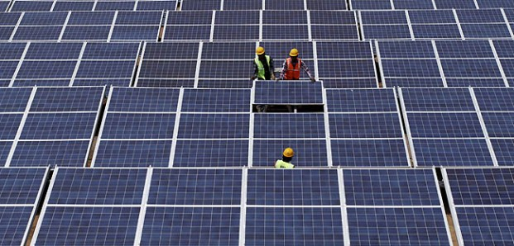
❶ Organization | ❷ Data | ❸ Analysis | ❹ Plans | ❺ Actions
5. Implement and Monitor:
Implement Actions and Policies
Secure Financing
Monitoring Systems to Measure Implementation Progress

Slide 10
“Developing a LEDS” |  |  |  | “Implementing a LEDS”
❶ Organization | ❷ Data | ❸ Analysis | ❹ Plans | ❺ Actions
Of course, it’s never as simple as this:
Not all countries have just one “LEDS” document
  e.g., National Action Plan on Climate Change, 5-year plan, report of Expert Group on Low Carbon Strategies for Inclusive Growth…
These steps aren’t always taken sequentially
The process of developing and implementing a LEDS is iterative
Integrating across ministries is a common challenge

Slide 11
LEDS & NAMAs
Work in each
of these five stages
supports the development
of NAMAs

Slide 12
LEDS Global Partnership –
Advancing Climate-Resilient Low Emission Development
Mission
Scale up climate-resilient low emission development around the world through mobilizing and leveraging collective Harness the collective knowledge and resources of governments, practitioner, donors and international organizations
Objectives
Strengthen support for climate-resilient low emission development in all regions
Mobilize capacity and advance peer-to-peer learning and collaboration on climate-resilient low emission development across countries, international institutions and practitioners
Improve coordination of climate-resilient low emission development activities at the country, regional and global level
LEDS GP Catalyzes Action & Collaboration Across more than 110 Countries and International Organizations

Slide 13
LEDS Global Partnership Structure
Steering Committee
Developing Country | Regional Platform | Donor Officials
Sponsorship sub-committee
Secretariat
Knowledge Management | Program Delivery | Global Forums and Peer Learning
Regional Platforms
African Climate & Development Society
Asia LEDS Partnership
Latin American & Caribbean LEDS Platform
Eastern European LEDS
Platform
Work Streams
LEDS Planning
Facilitators/Champions
Analysis & Tools
Analysts/Experts
Finance
Implementers/Finance Agencies
Sectors
Energy, AFOLU, Transport, & Waste officials and experts

Slide 14
Work Stream Activities
LEDS Planning
LEDS Analysis Methods and Tools
Development impact assessment
Platform for Climate Smart Planning*
Green Growth Best Practices*
New advisory service
Facilitator training/peer learning*
Linking national/sub-national LEDS
Integrating LEDS with climate resilient development
Finance
Finance expert assistance and matchmaking
Climate financing training
National finance strategy support & case studies
Dialogue with finance ministries & investors
Sectors
Energy
Transport
Waste
Agriculture, Forestry, and Land-Use
* Affiliated Programs

Slide 15
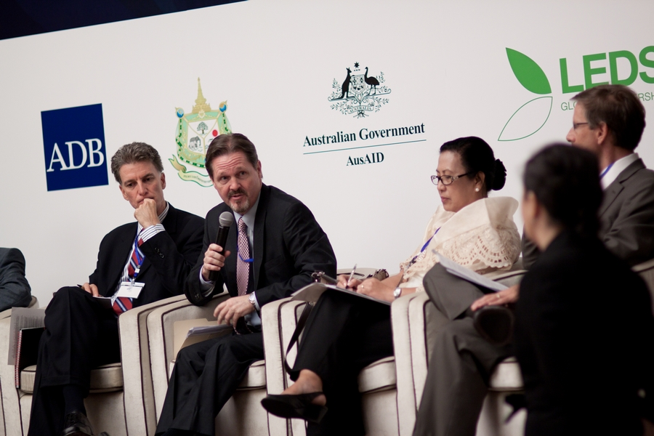

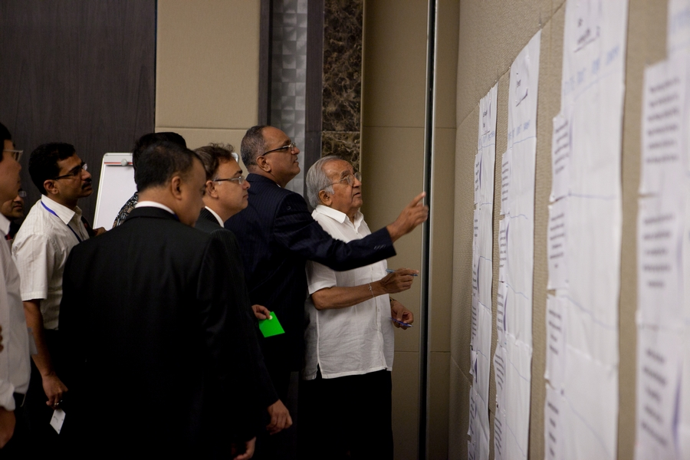
What is the Asia LEDS
Partnership?
Voluntary regional network comprised of organizations and individuals active in designing, promoting, and/or implementing LEDS in Asia
Launched during 1st Asia LEDS Forum in 2012 – 170+ participants from 17 Asia-Pacific countries
Participants agreed on shared vision of “Asia as a region of robust economic progress and low greenhouse gas emissions, with countries adopting and implementing LEDS and green growth practices”

Slide 16




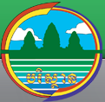







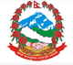






Who is in the Asia LEDS
Partnership?
Members: Organizations and individuals from Asian governments, multilateral agencies, donors, international NGOs, academic and research community, and businesses
Co-Chairs: Government of Indonesia and USAID
Steering Committee: 23 individuals with balanced representation from Asian governments and international development organizations / NGOs
Secretariat: USAID Low Emissions Asian Development program

Slide 17
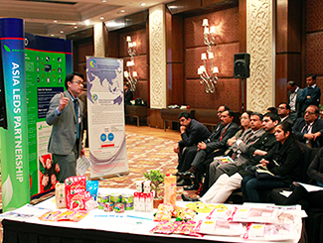
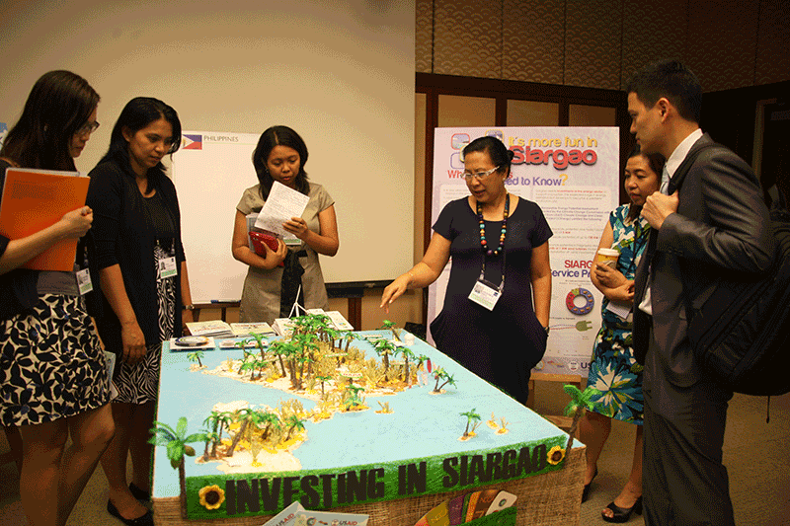
What are our objectives?
Information exchange, coordination, and collaboration among countries, donors, and other partners working on LEDS
Identify and disseminate LEDS tools, models, approaches, and best practices
Promote capacity building of practitioners in designing and implementing LEDS and green growth
Build awareness, support, and leadership for LEDS across Asia

Slide 18
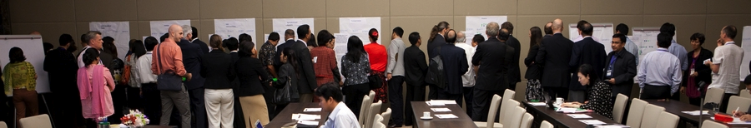
Member-driven Priorities: 2013
Latest knowledge on financing strategies and how to access LEDS financing
LEDS analysis and planning tools and methods to assist with decision-making and impact assessment
Sector-specific LEDS best practices
Knowledge sharing systems
Coordination

Slide 19
Illustrative and Planned
Activities in Priority Areas
Financing
2013
Report on available climate finance in 11 Asian countries (March 2013)
2014 and Beyond
Support integrated database on climate financing in Asia
Finance advisory network under LEDS GP (ongoing)
Sub-regional Climate Financing Workshop in South Asia with mitigation and adaptation focus (August 2013)
Regional Climate Financing Forum to link government officials with private investors (April 2013)
Hands-on training on more in-depth issues in climate finance
Expand finance advisory network under LEDS GP
Sub-regional Climate Financing Workshop in Southeast Asia

Slide 20
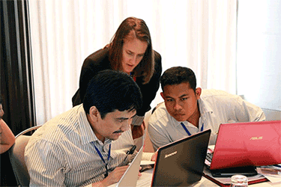
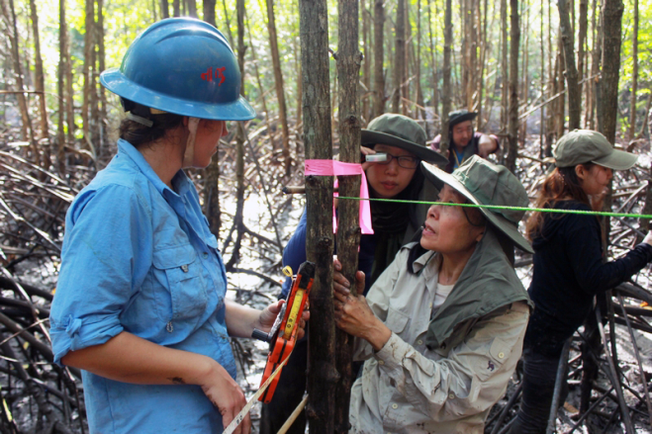
Illustrative and Planned
Activities in Priority Areas (cont)
Analysis and planning tools and methods
2013
Training on tool selection and usage (e.g., for policy instruments, assessment of mitigation options, communications)
2014 and Beyond
Offer additional technical and skills training according to member demand
Establish Asia LEDS Training Center hosted at the Asian Institute of Technology, as a regional open-source platform for green growth training
Catalogue development impact assessment tools (e.g., for economic, environmental, social, public health impacts)

Slide 21
Illustrative and Planned
Activities in Priority Areas (cont)
Knowledge-sharing and coordination
2013
Leverage member experience, expertise, training, etc. to share best practices
South-South learning sessions at global and regional events
Hold second annual Asia LEDS Forum to strengthen LEDS community in Asia and promote collaboration and learning – Asia LEDS Forum 2013: September 30 – October 4 in Manila!
2014 and Beyond
Launch online Asia LEDS Knowledge Portal and member website to facilitate ongoing sharing and learning
Support direct South-South exchanges (Latin America and Africa)
Asia LEDS Forum as regular annual gathering for LEDS practitioners in Asia

