Slide 1
Overview of NAMAs listed in UNFCCC Registry
- Expressed support needs
Sudhir Sharma, URC
5th June 2014
Bonn, Germany
Sudhir Sharma
Senior Climate Change Expert
UNEP Risø Centre
Technical University of Denmark
sudr@dtu.dk

Slide 2
Session description
Support for preparing and implementing NAMAs

Slide 3
NAMAs submitted to
UNFCCC Registry
  41 NAMAs seeking support uploaded in the UNFCCC Registry
    13 seeking support for development.
    28 seeking support for implementation.
  A mix of Investment plans in low carbon options and Strategy development
  NAMA - database reports (05 June 2014)
  - 98 NAMAs ( 90 under development, 8 under implementation)
  - Most of NAMAs are either implementation of policy/programms or development of strategies.
Notes:
Their aspirations consist of a range of Energy & Emission reduction goals
GHG emission reduction of 25% below 1990 levels by 2020
Efforts to remain GHG neutral
GHG reduction of 36.1 % - 38.9 % below its BAU emissions in 2020 (Brazil)
GHG reduction of 20% below its BAU emissions in 2020 (Chile)
Reduce CO2 emissions per unit of GDP by 40–45% by 2020 compared to 2005
77% of total electric capacity installed will be from renewable sources and 20 % of fuel consumption from biofuels by 2020.
Reduce CO2 emissions (except agriculture) per unit of GDP by 20–25% by 2020 compared to 2005
GHG emissions reduction by 26 % by 2020 (Indonesia)
GHG reduction of 20% below its BAU emissions in 2020 (Israel)
Long-term transformational effort to achieve carbon neutrality as a country by 2020 (maldives)
GHG reduction of 40% below 2009 level (Marshal Islands)
GHG reduction of 30% below its BAU emissions in 2020 (Mexico)
Renewable energy represents at least 33% of total energy used and zero net deforestation by 2020 (Peru)
GHG emissions reduction by 30 % below BAU by 2020 (south Korea)
GHG emissions reduction by 35 % compared with the base year 1990, by 2020 (Moldova)
GHG emissions reduction by 16 % below BAU by 2020 (Singapore)
GHG emissions reduction by 34 % below BAU by 2020 (South Africa)
GHG emission reduction of 28% below 1990 levels by 2020 (Serbia)
Develop a low-emission development strategy. Reduce transmission & distribution losses by 15% in 2030 (Gambia)

Slide 4
NAMAs seeking Support for Preparation
Total 13 requests for support with a total support request of 1.3 million USD
All NAMAs request grants
Some indicate the contribution of the government
Direct use of Financial support is requested for:
  Consultancy fees
  Buying equipment’s,
  Expenses for developing elements of the proposal – MRV, estimation of detailed costs and financing arrangements, GHG emissions estimation and defining activities of the proposal, including studies and analysis.
Technical support – focus is on support for developing and implementing policy and regulatory framework.

Slide 5
NAMAs seeking Support for implementation
28 requests with a total requested support of around USD 5 billion
A few submissions also provide information on capacity building and technical support needs in terms of finance.
Type of financial support requested – covers a whole range from Grants, concessional loans, loans, equity, guarantees, etc.
Support requested for -
  Investments;
  Measures to create conducive investment environment;
  Developing and implementing policy/regulatory framework; etc.
  Capacity building and awareness raising

Slide 6
NAMAs seeking Support for Implementation
In some cases investment is requested for demonstration activities.
Grants requested for:
  Institutional and human capacity development
  Strengthening regulatory and policy framework,
  Creating infrastructure to implement regulations and
  policies, such as testing labs etc.
  Subsidizing the initial investment cost for new technologies.
Though clarity on NMM still to emerge
– Some submission have considered carbon
finance to support certain components of NAMA.

Slide 7
Some observations
Support is needed not only for costs to achieve additional GHG reduction benefits but also for “base costs”.
Though submissions are not sufficiently clear on what type of finance is requested for which activities:
  It seems recognition exists that "base costs" will be covered by FDI, Loans (private sector), Equity etc; and
  Grants or guarantees for additional costs required for adopting low carbon options or covering risks of adopting low cost carbon options.
Those developed with support, have greater information.

Slide 8
Some observations (2)
Additional information to increase third party understanding:
  Further clarity on what kind of financial support is needed for actions included in NAMAs.
  Private sector role or involvement in implementing NAMAs.
  Though information on sustainable development benefits is provided – further clarity on country contribution to implementing NAMAs would provide clarity on country ownership.

Slide 9
Support for NAMAs
9 entries in Registry for support to NAMAs, including one from GEF.
Some are for all countries, and some for specific regions (EU-Africa infrastructure fund)
Most for NAMA preparation (German IKI)
Three for NAMA Implementation - NAMA Facility, EU-Africa Infrastructure fund, EU-Latin America Investment Fund.
A number of initiatives to support NAMA development
– through bilateral and multilateral funds.
The amount of funds available is not listed
Fund for implementation provide support as grant, equity, guarantees, etc.

Slide 10





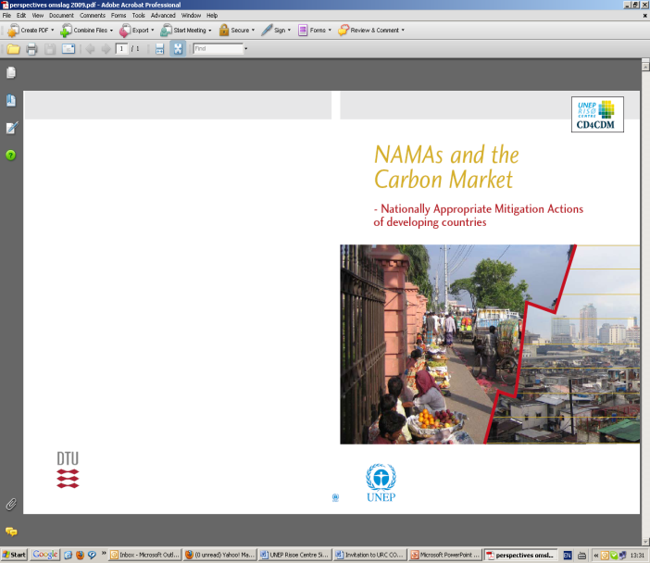








Thank you!!
More information:
sudr@dtu.dk: NAMA coordinator
http://uneprisoe.org

