Slide 1
The NAMA registry Report to SBI 40
Notes:
Hello and welcome to this side event on the NAMA registry.

Slide 2
Summary
Background
Mandate for the registry
Registry development timeline
Registry fundamentals
Operation of the Registry
Overview of content
Secretariat activity
Challenges and opportunities
Notes:
I’ll start by going over a little background before discussing the operation of the registry in 2013 and highlighting some of the challenges and opportunities ahead for the registry in 2014

Slide 3
Mandate for the registry
The COP decided to establish a registry to record nationally appropriate mitigation actions (1/CP.16)
The COP also decided that the registry should be developed as a dynamic, web-based platform managed by a dedicated team in the secretariat (2/CP.17)
Participation is voluntary and only the registry contains only information that has been submitted specifically for recording.
Notes:
The mandate to establish the NAMA registry came at COP 16
And at COP17 it was agreed that the registry would be developed as a dynamic, web-based platform managed by the secretariat

Slide 4
Registry development timeline
Interim facility: August 2012
Fully functional prototype: April 2013
First release of the web based registry: October 2013.
Second release of the web based registry: March 2014.
Notes:
The timeline for the registry is as follows………

Slide 5
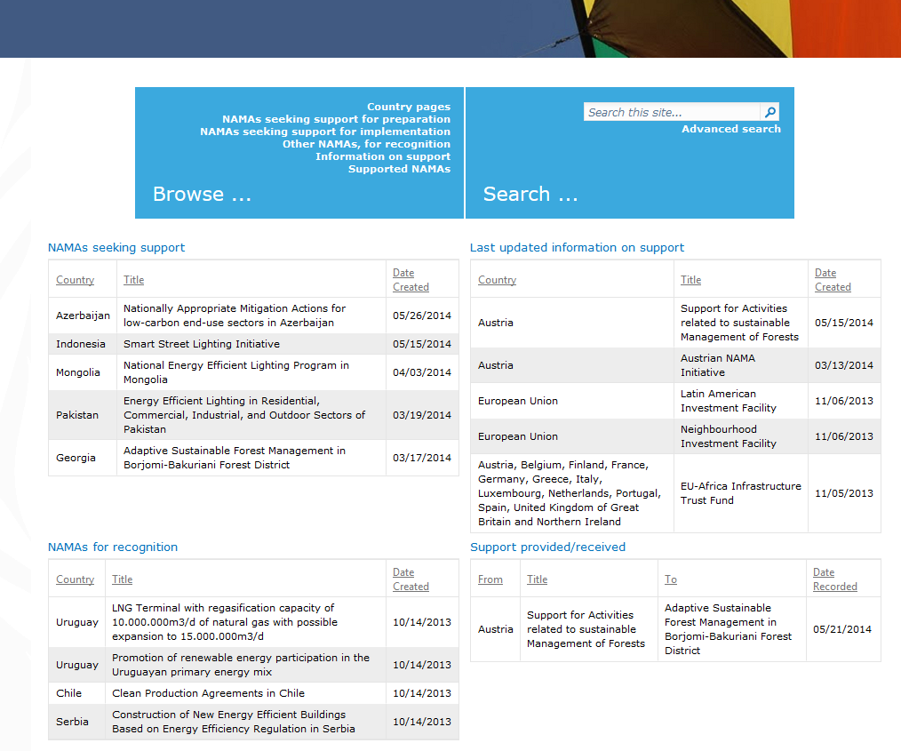
Registry fundamentals: Open registry
Notes:
This is what the public version of the registry looks like. Anyone with an internet connection can access the registry and browse and search the information that is there …

Slide 6
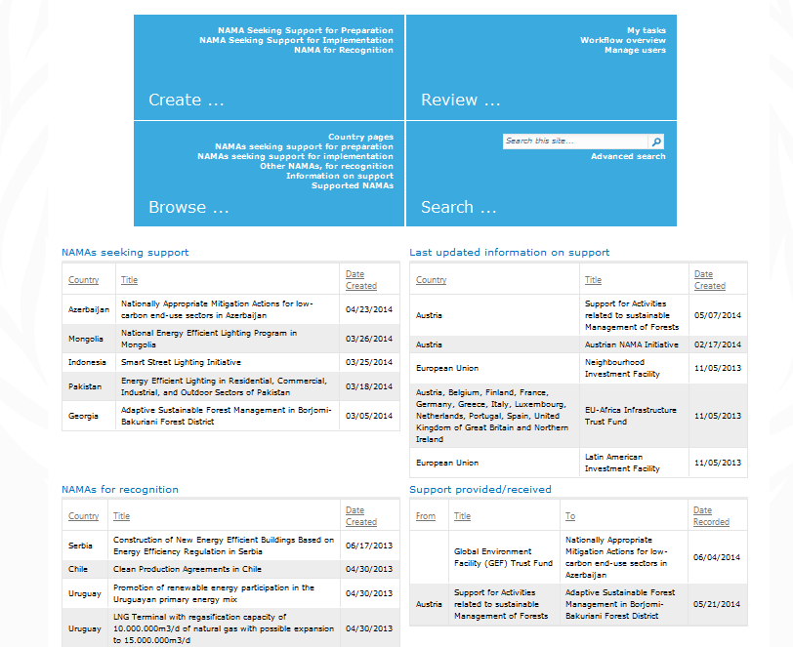
Closed registry
Notes:
This is what the registry looks like to

Slide 7
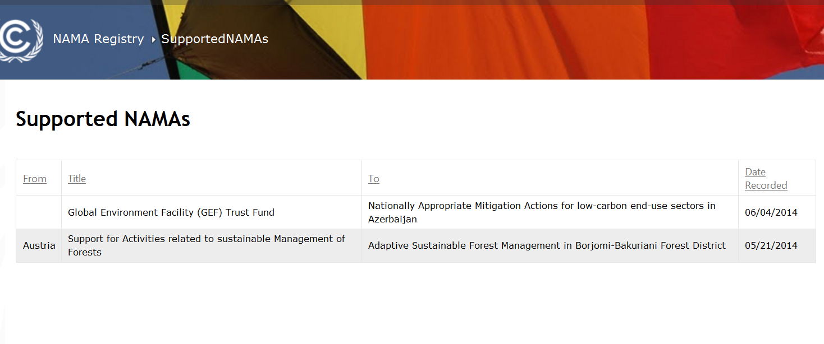
Open registry
Notes:
This is what the registry looks like to

Slide 8
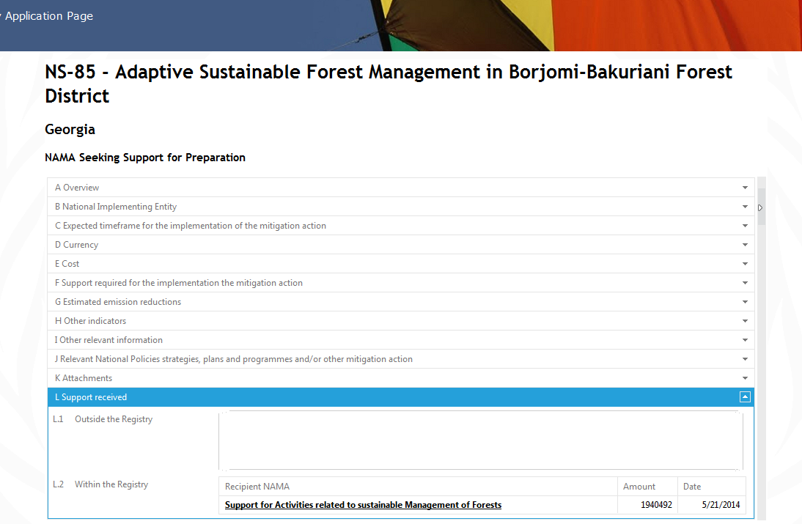
Open registry
Notes:
This is what the registry looks like to

Slide 9
Overview of registry content in 2014
These statistics are as at 14 April 2014
Further analysis is available in the annual report of the registry
Notes:
It is important to bear in mind that……

Slide 10
Overview of registry content in 2014: Summary of registry participation
NAMAs
Number of NAMA approvers | 77
Number of NAMA developers | 5
Number of NAMA entries | 44
Support
Number of support editors | 25
Number of support entries | 9

Slide 11
Overview of registry content in 2014: Registry participation characterised by NAMA approver access rights
By region, 30%-60% of developing countries requested access rights
Notes:
By region between 30% and 60% of non-Annex I parties are participating.

Slide 12
Overview of registry content in 2014: Registry participation characterised by NAMA entries
Significantly fewer have gone the step further of creating an entry in the registry
Notes:
However, that level of interest is not yet translating into entries in the registry10% or less of Parties with entries by region. Note that this is a corrected figure from the one that appears in the report. There was an error in this graph.

Slide 13
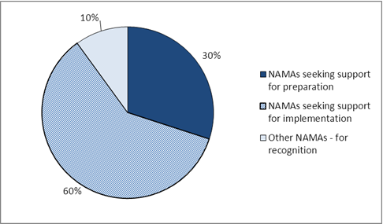
Overview of registry content in 2014: Characterization of NAMA entries by type
The majority of NAMA entries are seeking support and the majority of these are seeking support for implementation
Notes:
The majority of NAMAs entries in the registry are those seeking support for implementation.

Slide 14
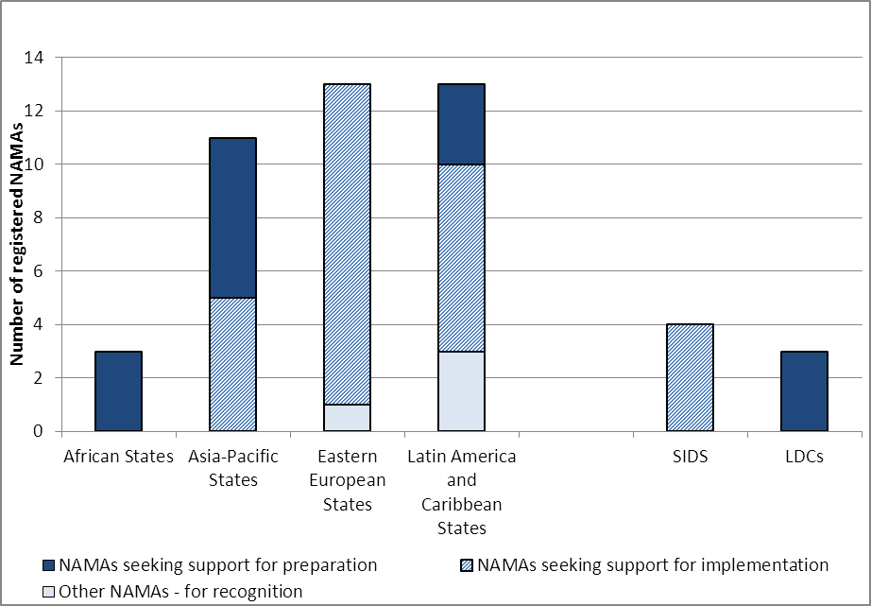
Overview of registry content in 2014: Characterization of NAMA entries by type
Types of support needed is different by region
Notes:
Different regions have different profiles in terms of the support they are seeking, African states are seeking support more for preparation whereas eastern european states are seeking support more for implementation

Slide 15
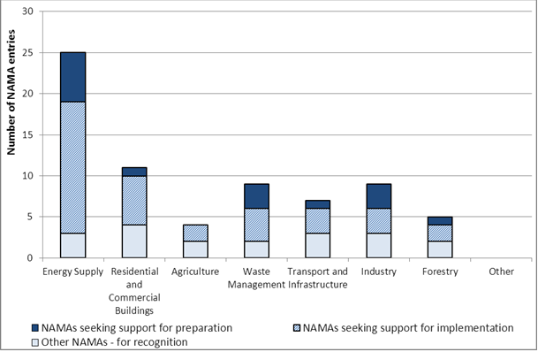
Overview of registry content in 2014: Characterization of NAMAs by sector
The energy supply sector is the sector relevant to most NAMA entries
Notes:
So looking in more detail at the types of NAMAs entered in the registry so far, the sectoral breakdown of entries shows that the energy sector is most relevant to most NAMA entries, over half of the NAMAs entered so far include the energy sector

Slide 16
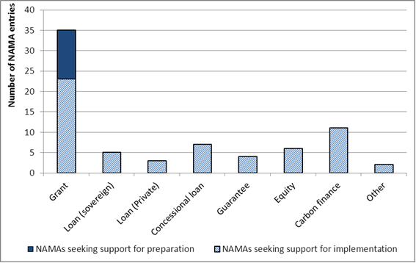
Overview of registry content in 2014: Type of financial support sought
Grant funding is the type of financial support most commonly sought by NAMAs
Notes:
Looking at the type of support sought, most NAMAs are seeking financial support in the form of grant funding. Note that this is a measure of frequency rather than a measure of quantity. We can’t separate out the amount of support by type because more than one type of support can be sought by a NAMA.

Slide 17
Overview of registry content in 2014: Extent of matching
For a match to be recorded, both the NAMA and the source of support should have an entry
Both Parties have to agree on the type and amount of support (e.g, the registry seeks confirmation from the counterpart)
To date, only two matches have been recorded in the registry:
NS-85 (“Adaptive Sustainable Forest Management in Borjomi-Bakuriani Forest District”), by Georgia, received support from Austria (EUR 1.940.492)
NS-95 (“Nationally Appropriate Mitigation Actions for low-carbon end-use sectors in Azerbaijan”), received support from the GEF (USD 100.000)
Notes:
Looking at the type of support sought, most NAMAs are seeking financial support in the form of grant funding. Note that this is a measure of frequency rather than a measure of quantity. We can’t separate out the amount of support by type because more than one type of support can be sought by a NAMA.

Slide 18
Challenges and opportunities
Limited use and level of participation: the registry needs to contain a critical mass of information to be effective
Improving information accuracy and completeness : registry content needs to be reliable and complete
Limitations of final registry design: Functionality of registry determined by Parties but the secretariat received limited feedback from Parties on the design of the registry, in particular on the templates used for creating entries
Notes:
From the secretariat’s perspective we can see three main challenges for the registry at this point.

Slide 19
Challenges and opportunities
It is recommended that Parties and others who may benefit from the registry:
Find ways to increase their level of participation in the registry, including obtaining access rights and creating registry entries. For developing country Parties , the ability to decentralize the preparation of NAMAs through NAMA developer access rights may facilitate participation
Take steps to ensure that their entries in the registry are accurate, complete and up-to-date
Continue to provide the secretariat with suggestions for improving the registry, with their related capacity-building needs and to make use of relevant technical resources
Notes:
Our recommendation is that……Parties and others who may benefit from the registry.

Slide 20
Challenges and opportunities
The secretariat will continue to support for the registry, within the restrictions of mandate and budget:
Capacity building through regional NAMA workshops
Development of technical resources requested by Parties
Outreach activities with potential providers of support and proponents of supported NAMAs
Providing direct support to individual registry users
Improving the registry platform
Notes:
Finally…….

Slide 21
Annual report on registry operation: FCCC/CP/2013/INF.2 Report on the extent of matching: FCCC/SBI/2014/INF.10 To view the registry visit: http://unfccc.int/cooperation_support/nama/items/8184.php

