Slide 1
- The NAMA Facility - Experience with Providing Support for the Implementation of NAMAs
NAMA work programme – SBI in-session workshop
5 June 2014, Bonn
Ben Lyon, DECC
Norbert Gorißen, BMUB
Notes:
First facility to provide earmarked support for NAMA implementation and to define transparent selection criteria.
One of the first three entries on support available in the NAMA Registry (IKI, BMZ, NAMA Facility)

Slide 2
NAMA Facility: Rationale
Direct impact: delivering climate change mitigation on the ground → Contribute to closing the global emissions gap pre-2020 (ADP WS II)
Providing tailor-made finance to developing countries for implementing mitigation projects
Encouraging increased ambition by selecting the most ambitious and promising projects through open and competitive calls and a set of transparent selection criteria
Beyond the NAMA Facility: A joint learning opportunity
Supporting the development and further improvement of a strong pipeline of transformational and bankable NAMA projects
Mobilizing up-scaled climate finance by demonstrating the successful implementation of ambitious and transformational mitigation projects
Demonstrating a framework for providing tailor-made results-based mitigation finance and providing lessons learned for the international discussions on climate finance and the international climate finance architecture (GCF)
Notes:
The objectives of the NAMA Facility are two-fold:

Slide 3
Means of Support
Provides support for the implementation of parts of a NAMA = NAMA Support Project
Focus on most ambitious parts with a high potential for supporting transformational change
Notes:
In terms of the means of support, the NAMA Facility finances NAMA Support Projects
The idea behind this term is that most NAMAs will be sector-wide programs, which are implemented through a variety of measures and financed through a variety of financing sources.
Such measures might include
regulatory measures to put in place enabling environments for low-carbon investments from the private sector or
measures which can be financed using commercial loans or national funds.
However, for some measures, which are particularly innovative or ambitious, it might be difficult to access commercial or private sector funding.
These are exactly the measures, which the NAMA Facility is looking to finance.
Hence, NAMA Support Projects are the most ambitious or innovative parts of an overarching sector-wide NAMA.

Slide 4
Selection Criteria of the NAMA Facility
The selection of NAMA Support Projects is based on three sets of criteria:
Eligibility criteria
Qualified delivery organisation
Ambition Criteria
Potential for transformational change
Feasibility Criteria
International and national embeddedness
Project structure
Mitigation ambition
Financial ambition
Sustainable development co-benefits
Log-frame and M&E
Project finance
Time-frame for implementation
Endorsement by national government
Endorsement by qualified delivery organisation
Readiness for implementation
ODA eligibility
Adequate financing volume
Notes:
The focus of the NAMA Facility is to support the implementation of truly ambitious NAMA which show a strong potential for transformational change.
The selection process is guided by three sets of criteria.
The general eligibility, (like project volume between 5-15 mio; involvement of qualified DO, letter of support, readiness to implement)
Ambition, consisting of potential for transformational change, mitigation ambition, financial ambition and co-benefits,
Feasibility, consisting of national and international embeddedness, project structure, log-frame and M&E as well as project finance
The selection criteria are published up-front an available online. To facilitate a common understanding of terms, sub-questions are provided.

Slide 5
Project Cycle of the NAMA Facility
STEP 1 – Project Outline
Call for NAMA Support Project Outlines by NAMA Facility
National government (with DO endorsement) or
DO (with national government endorsement)
Submission of NAMA Support Project Outlines
Verification of general eligibility criteria and
evaluation against ambition and feasibility criteria by TSU
In addition an external assessment of the TSU’s project evaluation is conducted
Pre-selection of the most ambitious outlines by the NAMA Facility Board
Appraisal mandate for pre-approved NAMA Support Projects
STEP 2 – Project Proposal
In-depth appraisal and
submission of NAMA Support Project proposals
FC: DO and national implementing partner(s) (e.g. national development bank)
TC: DO and national implementing partner(s) (e.g. sector ministry)
Evaluation against ambition and feasibility criteria by TSU
Final NAMA Support Project approval by the NAMA Facility Board
Implementation mandate for approved NAMA Support Projects
STEP 3 – Project Implementation
TSU Technical Support Unit
of the NAMA Facility
DO delivery organisation
FC financial cooperation
TC technical cooperation
NAMA Support Project implementation
Notes:
In open calls the Facility invites national governments as well as qualified delivery organisations to submit NAMA support projects outlines:
Generally, the selection and implementation of NAMA support projects follows a 3-step process
STEP 1: Based on submissions of Outlines for NAMA support projects → Project proposals are appraised by the Facility’s TSU against general eligibility criteria, ambition criteria as well as feasibility → Pre-approval and appraisal mandate of project outlines by the Board
STEP 2: For pre-approved projects: in-depth project appraisal by the delivery organisation and submission of proposals for NAMA support projects → Final approval of NAMA support project by the Board
STEP 3: NAMA support project implementation through delivery organisation

Slide 6
The First Call for NAMA Support Project Outlines – Basic Facts
47 NAMA Support Project Outlines submitted
Wide geographical and sectoral coverage
Four projects pre-selected for funding:
Chile - Self-Supply Renewable Energy in Chile (SSRE)
Colombia - Transit Oriented Development NAMA
Costa Rica - Low Carbon Coffee NAMA
Indonesia - Sustainable Urban Transport Program (SUTRI NAMA)
The NAMA Facility has fully committed its initial funds of 70 Mio. €
The TSU arranged feedback calls with submitters of non-successful projects, which can resubmit their outline during the second call.
Notes:
Closer look at first call
Background information: in detail pre-selected projects
Chile’s Self-Supply Energy NAMA aims to reduce greenhouse gas emissions by fostering Self-Supply Renewable Energy systems (SSRE). The programme has been developed with two components: a financial component that develops a bankable project pipeline and provides incentives for financing of and investments in SSRE systems, and a technical support component, which aims to improve awareness and local capacities in self-supply renewable energy system technologies.
The Colombia Transit-Oriented Development (TOD) NAMA supports the transformation of urban development in Colombia. The Colombian government believes that a more holistic approach to transport planning and deployment is required, with better coordination of land-use and transport systems, and integration with social housing policy. By changing land use and travel patterns the NAMA will cut driving growth by 25%-36%, improve air quality and reduce annual greenhouse gas emission by 1-1.5 MMTCO2 compared to BAU in 2025.
The Costa Rica Low Carbon Coffee NAMA offers technical and policy advice to change production and processing practices and incentivize private sector investments as well as financial support instruments like grants, concessional loans or guarantees for coffee farmers and millers in order to acquire greenhouse gas-efficient fertilizer and milling technologies.
The Sustainable Urban Transport Program (SUTRI NAMA) will transform urban transport in Indonesia with a mix of capacity-building and investment measures. In selected cities, a Sustainable Urban Transport Fund (SUTF) will co-fund the implementation of transport demand management (TDM) measures, such as building ‘park and ride’ facilities, sidewalks and bicycle networks, and introduce private vehicle restrictions.

Slide 7
Projects selected: Rationale for providing support
to the Mexican EcoCasa Programme (NAMA Facility‘s Pilot Project):
Early mover on NAMAs
Sustainable Housing NAMA was well developed and ready to start its implementation
Embedded into an ambitious national climate policy and high political commitment
Wise combination of FC and TC as well as RE and EE measures
Potential for transforming the building sector in Mexico
Notes:
What are the rationales to provide support to the NAMAs currently supported by the NAMA Facility?
Pilot activity in Mexico:
Mexico: early mover on NAMAs
Housing NAMA thus far developed to start implementation
Embedded into an ambitious national climate policy
NAMA shows potential for transformational change
Results of first call:
The four pre-selected NAMAs performed well against the selection criteria and provided a convincing overall presentation of the NAMA Support Project.
On ambition, they scored between 18 and 24 points out of 25.
All four projects showed a very high level of feasibility, with some minor aspects that require further clarification during the in-depth appraisal.

Slide 8
Projects selected: Rationale for providing support
to NAMAs pre-selected during the first call (Chile, Colombia, Costa Rica, Indonesia)
Fulfilled the eligibility criteria (28/47 outlines did not)
Performed high on ambition and feasibility
Focus on the Colombian TOD NAMA:
Very strong performance on ambition (24/25)
Strong and convincing outline of the transformative aspects of the NSP
Strong embeddedness with national policy framework
Combined with a good feasibility of the project

Slide 9
Lessons Learned: general observations
Availability of earmarked funds for NAMA implementation provided a strong stimulus to national governments to further develop their NAMAs
An impressive project pipeline exists across all geographical regions and a variety of sectors → need for additional funding for NAMA implementation
NAMAs are a successful instrument for targeting sectors like transport (Colombia, Indonesia) and agriculture (Costa Rica), for which CDM and JI were not well suited

Slide 10
Lessons Learned: project pipeline
High level of ambition, strong commitment of national governments
Challenge I: feasibility of projects
well-developed project structure, a theory of change and a concept for project finance
Challenge II: early involvement of financial actors
structuring and in-depth preparation of financial support mechanisms
→ Further readiness measures are required to enhance the bankability of the existing pipeline
Notes:
A detailed analysis of all outlines submitted has shown that:
NAMA Support Projects presented to the Facility feature a high level of ambition and a strong commitment of national governments.
Nevertheless, many NAMA Support Project Outlines showed weaknesses with regard to their feasibility, specifically concerning a well-developed project structure, a theory of change and a concept for project finance.
An overall challenge seems to be the early involvement of financial actors during the process of developing a NAMA and accordingly the structuring and in-depth preparation of financial support mechanisms.

Slide 11
Integrating the lessons learned into the NAMA Facility‘s processes and documents
General Information Document now includes more detailed guidance clarifying processes and selection criteria
Outline Template was restructured and now includes more concrete sub-questions to allow for a better understanding of the requirements and to ensure comparability of information
2nd call will be open for a longer time-span
Selection criteria on the overall eligibility, ambition and feasibility remain unchanged
Notes:
Based on the lessons learned, we introduced changes to the NAMA Facility‘s processes and documents

Slide 12
Second Call for NAMA Support Projects
The € 70m from the initial replenishment has been fully committed
BMUB and DECC have committed additional funds of € 50 million in 2014
A second call started on April 7th and will be open until July 15th 2014
Information on the second call is available at www.nama-facility.org or write to contact@nama-facility.org
Call for projects
April 7th – July 15th
Evaluation of NAMA Support Projects according to criteria
Communication of results
4th quarter 2014
Notes:
What is on the agenda for 2014?
The initial replenishment of € 70 mio. have been fully committed.
In light of the successful first call, the governments of Germany and the UK decided to provide additional funds of € 50 million to enable the NAMA Facility to hold a second call.
The second call will close on July 15th.
Information on the second call as well as background documents with regard to the vision of the NAMA Facility are available on the NAMA Facility website.
This includes:
an up-dated version of the General Information Document
the template for NAMA Support Project Outlines to be used during the second call
Lessons Learned during the first call

Slide 13
Thank you for your attention!
For further information please go to
www.nama-facility.org
or contact the Technical Support Unit at contact@nama-facility.org

Slide 14
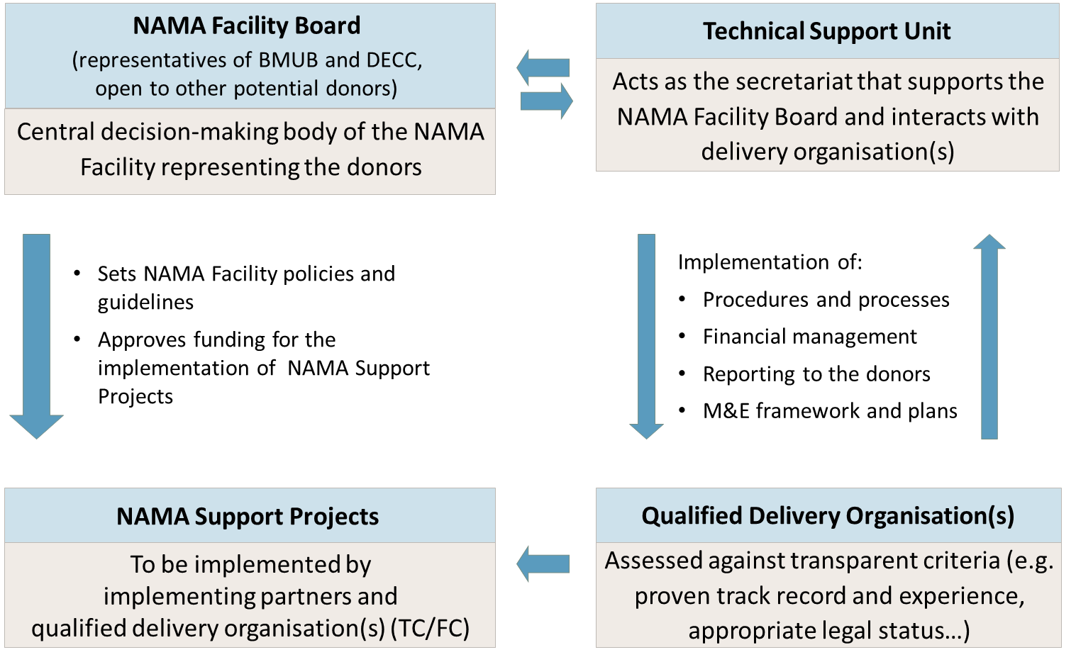
Governance

Slide 15
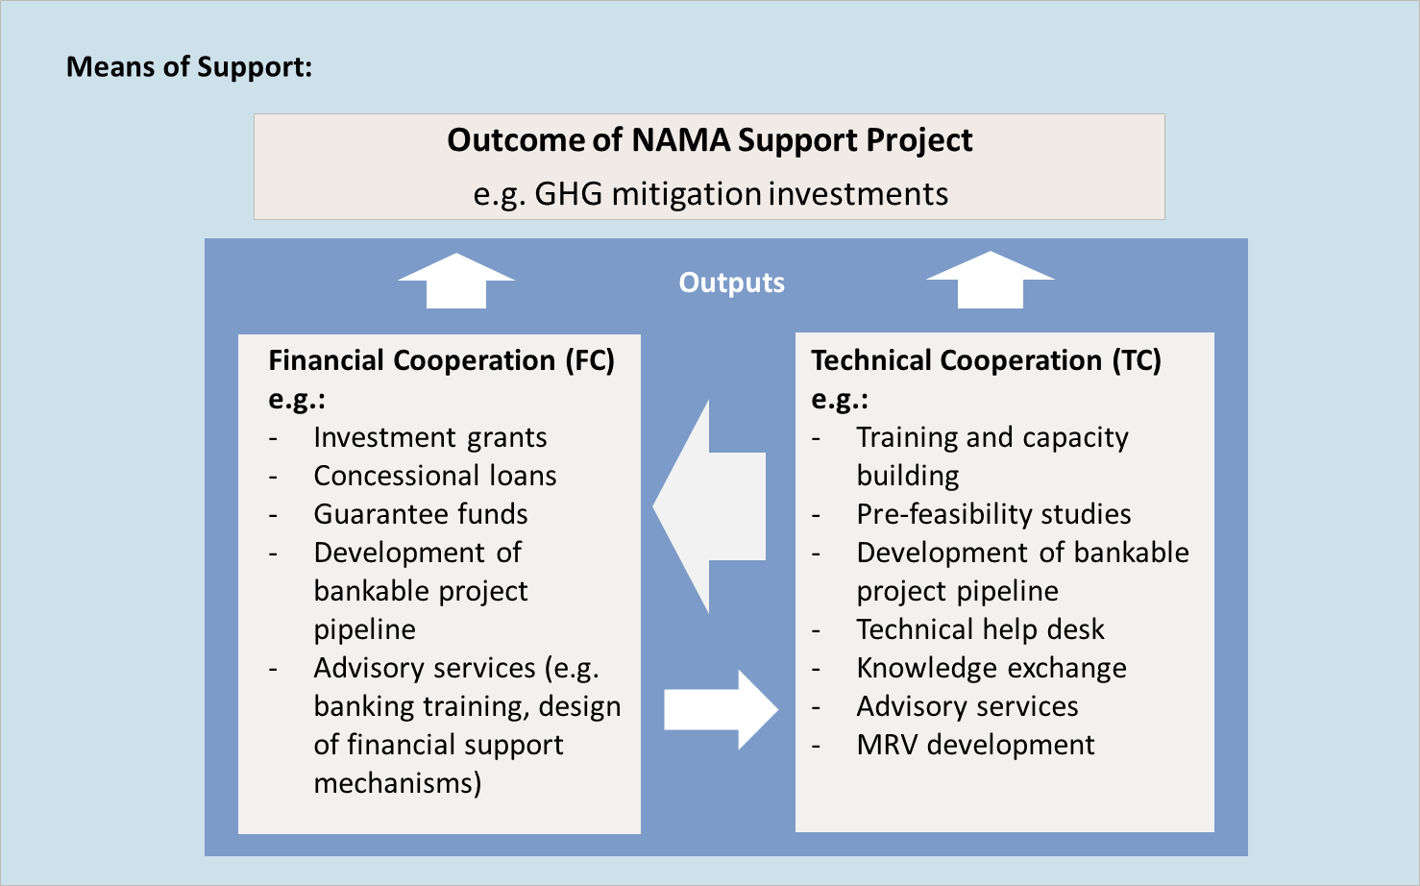
Means of Support
Notes:
Given their focus on implementation, NAMA Support Projects should focus on financial support (e.g. grants, concessional loans, guarantees), which serve to mobilize capital investments.
Technical assistance and capacity development for building up the relevant institutional and regulatory capacities in partner countries during NAMA implementation will be considered for support where they are combined with or closely linked to financial instruments
The wise combination of FC and TC should serve to maximise the transformational impact of the NAMA.

