Slide 1
la plataforma de explotación y la planta de transformación termoeléctrica- el país reducirá los gastos en la importación de combustibles para consumo interno. Este contenido ha sido publicado originalmente por Diario EL COMERCIO en la siguiente dirección: http://www.elcomercio.com/actualidad/negocios/machala-power-a-manos-del.html. Si está pensando en hacer uso del mismo, por favor, cite la fuente y haga un enlace hacia la nota original de donde usted ha tomado este contenido. ElComercio.com
FOCAM
NAMA OF THE EFFICIENT COOKING
PROGRAMME IN ECUADOR

Slide 2
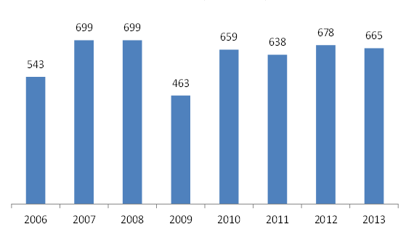
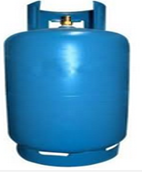
NAMA OF THE EFFICIENT COOKING PROGRAMME IN ECUADOR, NAMA-ECP
LPG 's Subsidy in Million of USD
Ecuador imports Liquefied Petroleum Gas (LPG) to meet part of the domestic energy demand, mostly in the residential sector (92%) for cooking and water heating
92% RESIDENTIAL
1% TRANSPORT
2% AGRICULTURAL & MINING
5% INDUSTRY

Slide 3
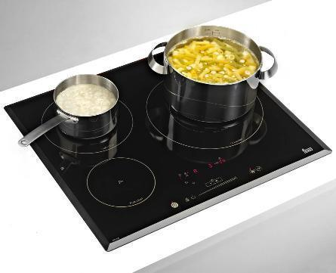
NAMA OF THE EFFICIENT COOKING PROGRAMME IN ECUADOR, NAMA-ECP
The ECP aims to replace 3 million LPG (Liquefied Petroleum Gas) stoves with electricity based induction cooktops. This program has four major components:
The substitution of imported fossil fuel by national produced hydroelectricity,
The removal of the LPG subsidies,
The development of local industry,
The green house gas (GHG) emissions reduction.
GOALS
O
U
T
P
U
T
S
Strengthening of the National Transmission Line (NTL) and Distribution System (NDS) to operate at 220 volts.
Preliminary studies to for the introduction of new technology
Local Technology development and dissemination (communication).
Introduction of clean environmental technology (induction cooktops).
Electric power service to households without access to electricity.
Mid-term and impact studies.
Workforce Reinsertion Plan
Developing of MRV system

Slide 4
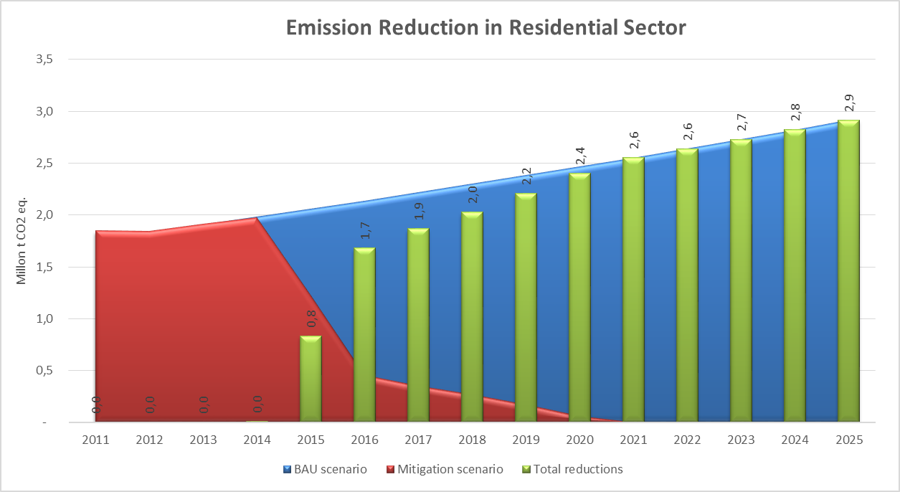
LEAP OUTCOME
 | 2014 | 2015 | 2016
Number of cook stoves | 195,000 | 1,330,000 | 1,475,000
Garner | 195,000 | 1,525,000 | 3,000,000
2014 – 2030
2.5 million t CO2 per year.
40.8 million t CO2 eq. accumulated to 2030.

Slide 5
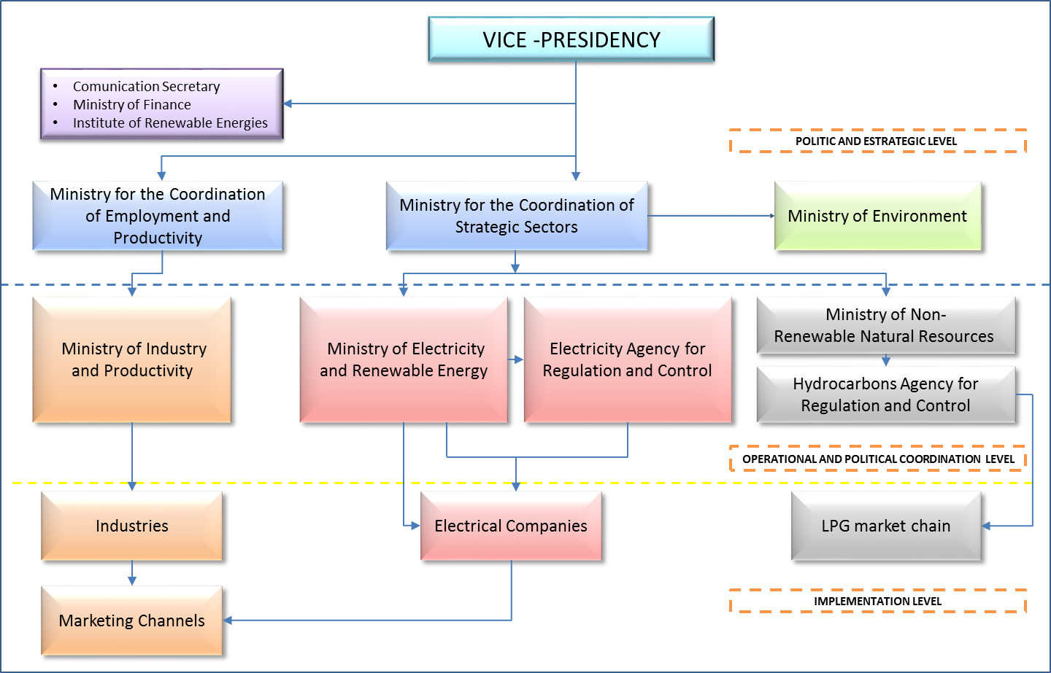
INSTITUTIONAL ARRANGEMENT

Slide 6
NATIONAL POLICY CONTEXT
Article 414 of 2008 Constitution
Objective 7 of National Plan for Good Living 2013 - 2017
1815 and 495 (ICCC)
Executive Decrees
Policy 3 of National Environmental policy
Ministerial Agreements : 095:ENCC, 033:REDD+, 089:NAMAS, 103:REDD+ Register, 128-133:PDOTs GADs, CdA:GADP, 248:NPCC, 264:Carbon-neutral Recognition.
UNDERSECRETARY OF CLIMATE CHANGE
Knowledge and information management
Improving growth and structure change of Energy and Productive Matrix
Formulation of supportive policies and regulations.
Recording, approving and monitoring of mitigation and adaptation actions
Coordination with local governments

Slide 7
FINANCIAL ASSESSMENT OF NAMA
Governmental Investment
Low interest loans for multilateral banking
Climate funds through GCF or other climate change initiatives
Public-private associations
GOVERNMENT FINANCING |  | ADDITIONAL EXTERNAL FINANCING REQUIRED
Distribution and Transmission Networks | 1.134.670.000,00 | Electric power service to households without access to electricity. | 70.983.460,00
Preliminary studies to for the introduction of new technology. | 336.000,00 | Workforce reinsertion plan | 25.000.000,00
Technology and other facilities founds | 1.075.695.520,00 | A Mid-term and impact studies. | 930.000,00
Technology development and dissemination. | 13.080.000,00 | Design of a consistent MRV system. | 400.000,00
Administrative Expenditure | 2.077.000,00 | TOTAL | 97.313.460,00
TOTAL | 2.225.858.520,00

Slide 8
FINANCIAL RISK AND BARRIER ANALYSIS
GENERAL THREATS | MEASURES/MEANS OF IMPLEMENTATION
MARKET OBSTACLES
Current market conditions that encourage the use of LPG technology for cooking | Upgrade technological and industrial development with a Promoting Program of the National Production . Mass media campaign and information technology induction cookers . Gradual reduction Strategy of LPG subsidy .
INSTITUCIONALS OBSTACLES
Limited organizational capacity to fulfill the agency working . | Model Management with monitoring mechanism agreed and institutionalized
TECHNICAL OBSTACLES
Retrofitting networks in development stage . | Plan Implementation to strengthen the distribution system
SOCIAL AND CULTURAL OBSTACLES AND HUMAN BEHAVIOR
Users risk acceptance of the new technology . | Mass media and information campaign about the technology benefits
Lack of the strategy definition Workforce reinsertion plan to be implemented with current LPG distribution chain in Ecuador . | Impact employment study of the current string of GLP . Definition and implementation of the training plan , associativity and reintegration for people who currently belong to the LPG chain.

Slide 9
MRV PLAN/ARRANGEMENT FOR NAMA
 | NAMA PROMOTER | IMPLEMENTING ENTITIES | FUNDING ENTITIES | REGULATORY ENTITIES
ENGAGEMENT LEVEL | MAE | MCPEC-MIPRO MEER MRL | MINFI DONORS MULTILATERAL-BANKING | MICSE ARCH ARCONEL INER
M |  | X |  | X
R | X | X | X | X
V |  |  | X | X
Since 2013, the Ministry of Environment (MAE) through the LECB program has been working in coordination with the Ministry of Electricity and Renewable Energy (MEER), in the development of studies and documents to present the ECP as a National Appropriate Mitigation Action.

Slide 10
SUSTAINABLE DEVELOPMENT BENEFITS OF NAMA
Beyond the environmental effect of reducing GHG emissions, the NAMA Support Project presented has the potential to contribute to the achievement of the following sustainable development co-benefits:
Self-supply Energy
Ecuador imports most of its needs for LPG which is used at the residential level at subsidized prices
Social Development
The elimination of the subsidy will enable the Government of Ecuador to use the funds for social development programs
Development of local industry
The total demand for induction cooktops and pots (as settled in the ECP project) will be provided by local private industry.
Workforce reinsertion
People currently working in the LPG value chain will be able to have alternative job opportunities. It is expected to improve their quality of life and employment
Elimination of the illegal gas trade Ecuador’s borders
It is assumed that 20 % of the national consumption of LPG is lost through illegal trade.

Slide 11
THANK YOU
christian.parra@ambiente.gob.ec
ec.05.03.2014.11:00

