Slide 1
Climate Finance as a Catalyst for Leveraging Private Sector Financing in the Energy Sector: Examples in Latin America
Carlos A. Cordova
UNFCCC LAC Regional Workshop on NAMAs (Nationally Appropriate Mitigation Actions)
September 14-15, 2015
Santiago, Chile

Slide 2


Overview of Climate Finance
Climate Finance: financial resources invested in mitigation and adaptation measures through financial instruments including loans, grants and guarantees, which have helped leverage additional private finance
Sources: public, private & intermediaries
Instruments: range of tools, mechanisms and modalities
Uses: mitigation vs. adaptation
Readiness: plan, access, deliver, monitor

Slide 3
Public Sources & Intermediaries
US$ 137 Billion, or 42%, of total $331 Billion climate finance flows in 2014 (Source: CPI Global Landscape of Climate Finance, 2014)
Ministries & Government Agencies
  Bilateral Aid agencies
  Export Credit Agencies
  UN institutions
Development Finance Institutions
  Multilateral Development Banks (MDB)
  National Development Banks (NDB)
  Bilateral Financial Institutions (BFI)
Climate Funds
  Global Environment Facility (GEF)
  Adaptation Fund (AF)
  Climate Investment Funds (CIF)
  Green Climate Fund (GCF)
  National strategies & policy frameworks conducive to investment
  Technical assistance, financial instruments & specialized knowledge
  Grants & loans at concessional terms (finite lifetime, sectoral focus)

Slide 4
Private Sources & Intermediaries
US$ 193 Billion, or 58%, of total $331 Billion climate finance flows in 2014
Project Developers: national/regional utilities, independent power producers, renewable energy
Corporate Actors: manufacturers, corporate end-users
Private Households: family level economic entities, high net worth individuals
Institutional Investors: insurance companies, pension funds, endowments
Commercial Financial Institutions
Private Equity, Venture Capital & Infrastructure Funds

Slide 5
Uses of Climate Financing
91% mitigation
Renewable energy generation
7% adaptation
Water supply management
Climate-resilient infrastructure
Coastal protection
Disaster risk reduction
AFOLU & natural resource management
AFOLU & livestock management
Sustainable transport
Energy efficiency in industry and buildings

Slide 6
Climate Financing Instruments to Leverage Private Sector Investment
  Policy Incentives:
  Feed-in tariffs
  Tradeable certificates
  Tax incentives
  Clean energy subsidies
  Risk Management:
  Guarantees
  Insurance policies
  Contract-based instruments
  Grants:
  Cash transfers
  In-kind support
  Low-cost project debt:
  Concessional loans
  Capital Instruments at commercial terms:
  Project-level market rate debt
  Project-level equity
  Balance sheet financing
Address investor-specific needs
Align public and private interests
Enable scaled-up investments

Slide 7
Climate Finance Readiness
  “Capacity of countries to plan for, access, deliver and monitor climate finance, both international and domestic, in ways that are catalytic and fully integrated with national development priorities and achievement of the MDGs” (Source: UNDP, 2012)

Slide 8
Climate Finance Readiness Process
Access
Deliver
Monitor
Plan
Capacity to plan for the supply, management and use of climate finance resources
National capacity to combine vs. blend resources for access to wider range of financial instruments
Capacity to deliver finance, implement and execute activities at the regional, national or local level.
National capacities and systems for monitoring and evaluating the impact of climate finance on mitigation and adaptation goals
Effective: assess climate finance flows
Traditional: multilateral implementing entities (e.g. GEF)
National system: financial oversight & management
Tracking financial expenditures on climate change activities within and outside the national budget
Efficient: prioritize climate actions and match priorities with resources
Direct: accredited entities from recipient countries (e.g. Adaptation Fund)
Execution services: procurement, contracting, hiring
Database systems & information-collection processes
Equitable: integrate resources over time
Enhanced: national fund management with international fund oversight (e.g. GCF)
Coordination among entities: macro level alignment with national development strategies
Developing indicators & assessment processes
Notes:
Tools available for identifying the resource flows required for priority activities:
Investment and financial flows assessment
Climate public expenditure and institutional review
Climate Finance Options
Training (e.g. E-learning)

Slide 9
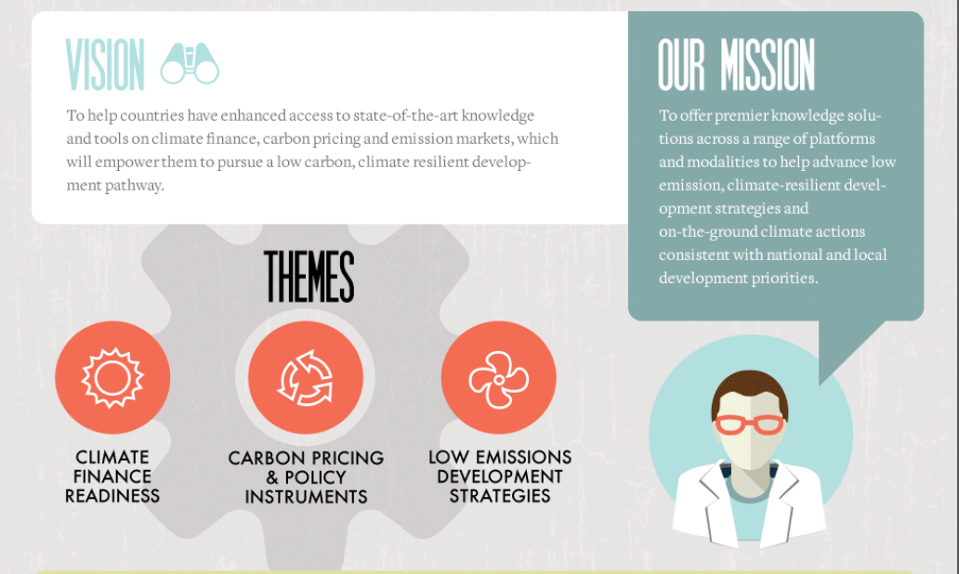


How Can We Help?

Slide 10
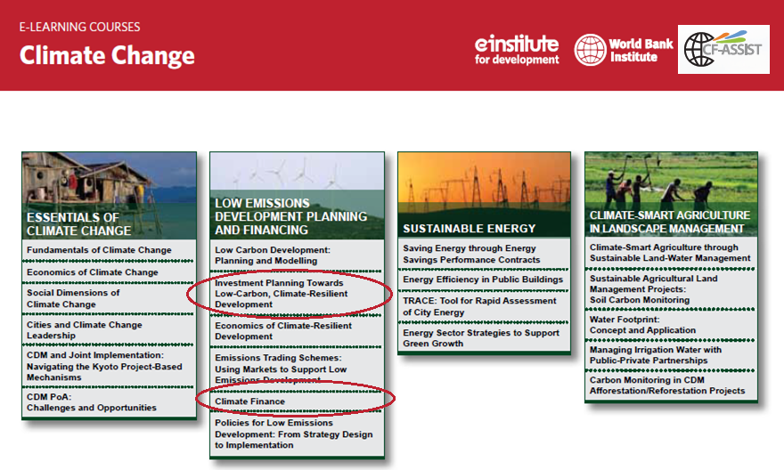
Climate Finance Solutions through E-learning

Slide 11

Climate Finance Solutions through Collaborative Partnerships
LAC LEDS Network: Launched in Alajuela, Costa Rica (Nov 2012), followed by webinar series on LEDS for the Spanish-speaking LEDS community and a web-based open community of practice to promote information sharing, networking and online collaboration among Latin American LEDS practitioners and policymakers

Slide 12


Climate Finance Solutions through Global & Regional Fora
Latin American & Caribbean Carbon Forum: Annual event that brings together a range of private and public sector stakeholders to explore solutions for mobilizing climate finance and to discuss alternative pathways to low carbon development in the region
Carbon Expo: Largest global, multi-sectoral climate finance and carbon market platform for facilitating innovation, promoting enhanced understanding of new policy instruments and identifying ways to access and leverage climate finance.

Slide 13
Other World Bank Climate Finance Readiness Initiatives

Slide 14

Climate Investment Funds: CTF
The CTF fund it’s a $5.3 billion Clean Technology Fund (CTF), a funding window of the Climate Investment Funds, to provide scaled-up financing to middle income countries to contribute to the demonstration, deployment and transfer of low carbon technologies with a significant potential for long-term greenhouse gas emissions savings.
The CTF differs significantly from other mitigation-focused, multilateral climate instruments by focusing on drive down technology costs, and stimulate private sector participation, and catalyze transformative change that can be replicated elsewhere.

Slide 15
CTF and the Private Sector
The private sector is a key player in the CTF, with 30% of all investment plan allocations going to private sector projects and programs specified in these plans. In 2013, the CIF embarked on new financing paths that put greater emphasis on reducing barriers to private sector participation.
The Dedicated Private Sector Programs (DPSP) under the CTF were created to finance operations that can deliver scale and speed while maintaining country priorities. The DPSP are currently in their second phase and have allocated a total of $ 508.5 million to eight programs reaching countries as diverse as Chile, Colombia, Indonesia, Mexico, Turkey, Haiti , Honduras, Ghana, and Mali.

Slide 16

Chile’s Solar Power and Energy Efficiency Example:
The government of Chile has designed a plan that taps $200 million from the Clean Technology Fund (CTF) ) to address key risk, cost, and liquidity barriers by providing concessional financing and technical assistance intended to stimulate the development of Chile’s solar power and energy efficiency markets, therefore stimulating, securing and enhancing private sector investment.

Slide 17
Thank you!
For more info, contact:
Carlos Cordova ccordova@worldbank.org
World Bank Group
1701 18th St NW
Washington, DC 20006

