Slide 1
Risk management instruments to mobilize private finance

Slide 2
Outline
The implications of risk
The different types of risk
Risk mitigation instruments
Risk coverage gaps
AfDB experience

Slide 3
The implications of risk
Risk is the most important factor which prevents projects from finding financial investors;
Risk is the most important factor which prevents investors from raising the returns investors demand;
Higher financial returns are required to cover higher risks;
Risk and risk perceptions vary from project to project, technology to technology, industry to industry, and country to country;
Low carbon/ climate resilient (green/clean investments) can suffer higher risk perceptions due to their dependence on public policy and, often, relative immaturity of technologies, markets, and industries;
(Reference: CPI, 2013)
3
Notes:
Definition of risk: “The chance that an investment's actual return will be different than expected. Risk includes the possibility of losing some or all of the original investment”
Variations in project risk explains much of the difference in financing cost

Slide 4
The different types of risk
Political, policy and social risk (PPS-risk):
(Reference: CPI, 2013)
Notes:
Additional risk for green investments
Permitting/siting: some technologies (wind, concentrated solar, hydro) are highly site specific
Policy: High reliance on public support for technologies not yet commercially mature
Reputation/Social opposition: some technologies (wind, hydro) face high social opposition

Slide 5
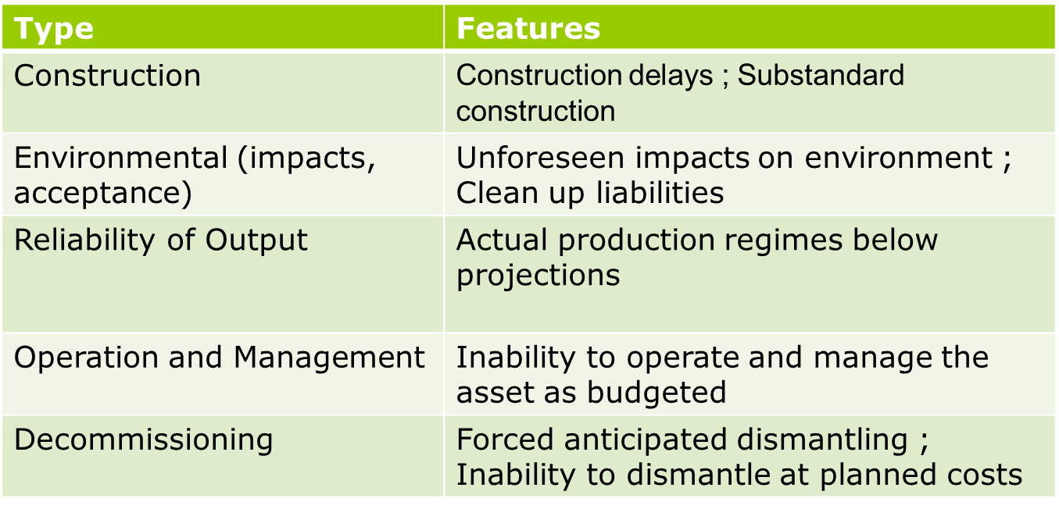
The different types of risk
Technical and physical risk (TP-Risk)
Reference (CPI, 2013)
Notes:
Additional risk for green investments
Environmental (impacts/acceptance) – uncertainty due to novelty of most RE technologies
Realiability of output – increased risk due to natural variability, inetremittency …

Slide 6
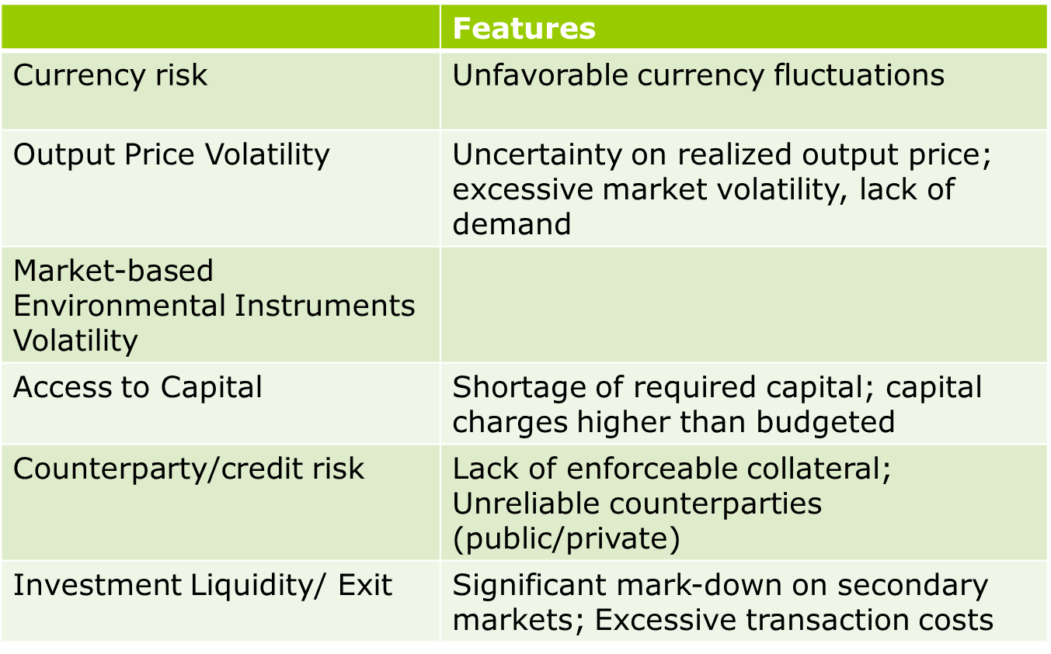
The different types of risk
Commercial and market risk (CM-risk)
(Reference: CPI, 2013)
Notes:
Additional risk for green investments
Output price volatility– high risk due to long horizon of investments and lack of commercial maturity;
Market based environmental instruments volatility – uncertainty on realized GHG/pollutant externalityproces, excessive market volatility
Investment liquidity/exit – niche and specialized market; lack of dedicated investors/markets
Volatility in policy driven asset prices
e

Slide 7
The different types of risk – I am not convinced by this category – suggest you drop this slide
Outcome risk (O-risk)
Reference: CIP, 2013
Notes:
Additional risk for green investments
Co-impacts – secondary targets of Green Growth/creation of local job-industries /energy security
Public budget impact – production support policies spur excessive growth that inflates policies’ cost

Slide 8
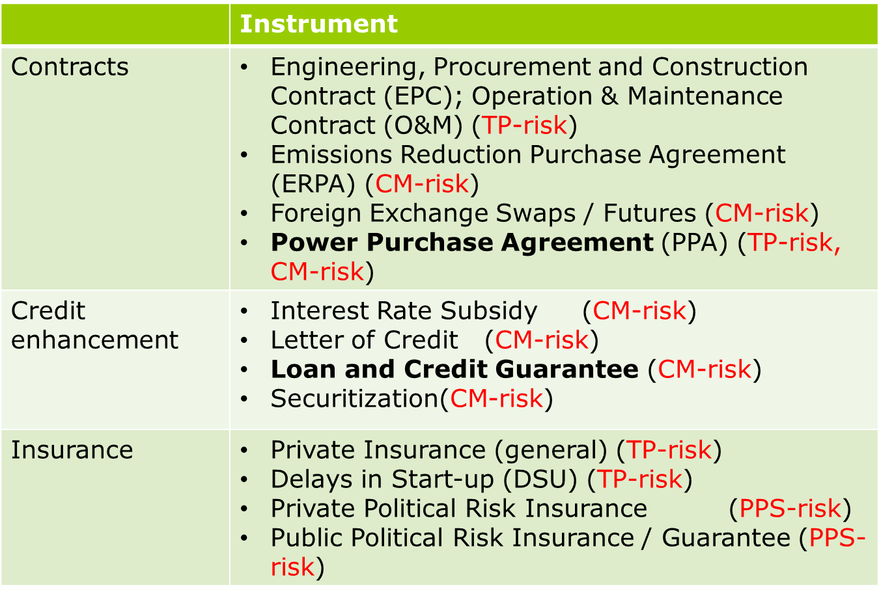
Risk mitigation instruments
(Reference:CPI, 2013)
Notes:
Description of instruments the Bank has implemented some of them in the case studies which follow:
Power Purchase Agreement:
Provider: Public/Private
Risk type: Technical, Physical Risk
Description: A Power Purchase Agreement is a legal contract between an electricity generator (provider) and a power purchaser (typically a utility). It is used to cover uncertainty of the seller related to expected revenues of the project (which hamper its viability), or when the purchaser wants to secure supply of power at a predefined price (to know of any potential constraints for budget in advance).
Loan and Credit Guarantee
Provider: Public/Private
Risk type: Commercial, Market Risk
Description:
Loan Guarantees - Contractual obligation by which a guarantor assumes the responsibility of assuring payment or fulfillment of a borrower’s debt or obligation, in case of default. Loan guarantees can refer to a private agreement with a bank, or to an agreement in which the government is the guarantor of the debt’s obligation. They can be direct, to intermediaries that provide finance directly to project developers, or counter-guarantees, to intermediaries that issue guarantees for the benefit of lending institutions.
Partial Credit Guarantees - Provided by Development Financial Institutions (both multilateral and some bilateral) at commercial rates to cover private lenders against the risk of debt service default by government or public (and recently private) sector borrowers, versus the payment of a guarantee-fee. “Partial” is intended for a guarantee coverage amount lower than 100% of the principal and/or interest. PCGs can be used for any commercial debt instruments (loans, bonds) provided by any private institution, and are flexible with regards to the balance of risk sharing of the borrower’s credit.

Slide 9
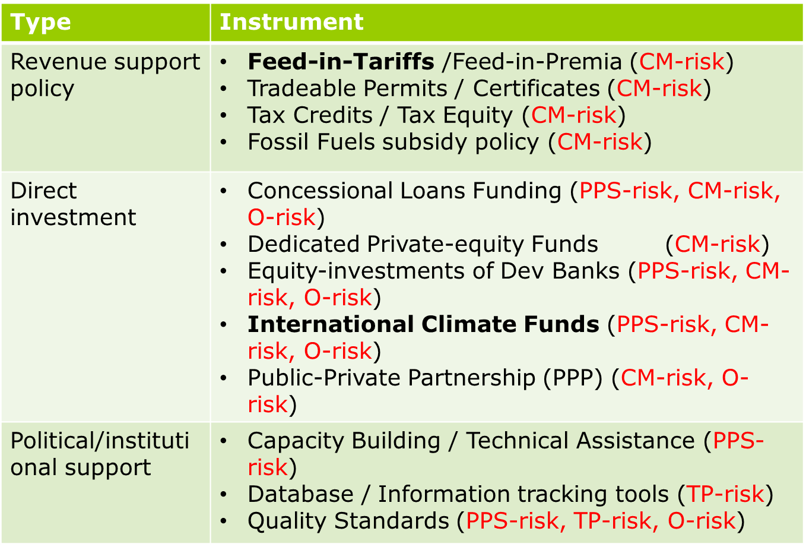
Risk mitigation instruments
(Reference: CPI,2013)
Notes:
Description of instruments the Bank has implemented some of them in the case studies which follow:
Feed-in-Tariffs
Provider: Public
Risk type: Commercial, Market Risk
Description: FiT are policies that provide price certainty and long-term contracts to energy producers in order to help investment in renewable energy. Usually FiTs are accompanied by a "tariff digression” mechanism that decreases the tariff over time. FiP are composed of both a premium (like FiT) and the market value of electricity, exposed to market fluctuations. Risks related to market fluctuations are thus only partially addressed.
Concessional loan
Provider: Public
Risk type: Commercial, Market Risk
Description: In a concessional loan, while the principal loan amount needs to be paid back, the interest rate payments are still significantly reduced and can include a longer repayment period or even a gracing period
International climate funds
Provider: Public
Risk type: Commercial, Market Risk
Description: International Climate Funds are operating entities whose mission is to finance projects, programs, and policies, mainly in developing countries, related to global climate change mitigation and adaptation.
Public Private Partnership
Provider: Public/Private
Risk type: Commercial, Market Risk
Description: A Public-Private Partnership is a contractual agreement between a public agency and a private sector entity for the execution of a project, service, or facility for the use of the general public. Public-Private Partnerships provide for the sharing of resources (skills and assets), risks, and rewards between the public and the private sector

Slide 10
Risk coverage gaps
In Africa the level of perceived risk is high across most risk categories:
Political, policy and social risk: Political instability, poorly designed and implemented policies
Physical and technical risk: harsh working environments, access to technology, equipment, skilled labour
Commercial and market risk: perceived weakness of domestic financial markets

Slide 11
MDB role
MDBs play a vital role by providing concessional resources from donor funds to improve access to capital
In the process, MDBs implement checks and balances to ensure donor funds do not create adverse impacts
MDBs promote correct risk allocation – objective is to allocate risks to those entities best able to manage specific risk
Hence, MDBs can leverage private finance through instruments such as Public Private Partnerships, apportioning and reducing risk to private sector
Scale matters: Programmatic level interventions are preferred to Project level interventions and give more opportunity to manage risk

Slide 12
AfDB experience
For large scale projects, risk transfer approach is adopted most frequently (instruments include loan guarantees, political risk insurance and public co-investments);
Targeted lines of credit and the Sustainable Energy Fund for Africa (SEFA) provide examples of how small-to-medium scale green projects can be supported and new sources of capital attracted;
Other programmatic instruments being deployed include providing concessionary finance linked with technical assistance, to commercial banks to incentivize them to lend to renewable energy and energy efficiency opportunities, especially small to medium scale opportunities. (e.g Bank is in discussion with two Nigerian banks to extend lines of credit - which blend concessional climate finance - to incentivize the banks to take on additional risk)

Slide 13
Case study 1: Morocco’s Ouarzazate I Concentrated Solar Power (CSP) Project ($1.3B)
Strong public support
A favorable regulatory and renewable energy policy framework established to encourage private sector engagement
A special­ized entity (MASEN) set-up to manage CSP projects.
A purchasing power agreement drawn up between MASEN and the Power Utility.
Significant IFI contribu­tion
IFIs provided significant concessional financing, which contributed to driving down the levelized cost of energy by approximately a quarter. The IFI financing also included resources from climate funds (CTF). In addition, IFIs provided institutional and specialized technical support.
Well-designed public private partnership
MASEN’s role in the public-private partnership is innovative: It acts as both equity investor and power purchaser (off-taker) and thus has the ability to align public and private objectives. The risk allocation is also appropriate: the private developer bears construction and operational risk while the Government of Morocco bears electricity market (revenue) risk.

Slide 14
Case study: Menengai Geothermal Development Project
Kenya recognized that investors are reluctant to take geothermal exploration risk (and in the event investors take the risk the tariff becomes high). Hence, considering the country’s well-developed energy policy, including feed-in tariffs, Kenya established the Geothermal Development Company (GDC) which is responsible for the developing geothermal fields, in specific steam production – which the private sector will subsequently use to produce electricity.
For GDC’s development of the Menengai Field, the government of Kenya provided USD 247 m while the African Development Fund provided USD 125m blended with USD 25m from the Scaling-up Renewable Energy Program – one of the Climate Investment Funds – alongside other IFI funding (AFD USD 72 m, EIB USD 38 m, IDA being finalized).
This investment in drilling and steam production laid the foundation for private sector investment in (Independent Power Producers) IPPs. The procurement for the IPP projects (capacity of approximately 400 MW) is currently underway.
Going forward, in 2014, as the IPPs are established, African Development Fund Partial Risk Guarantees of approximately USD 100 m are also envisaged to provide investors with comfort on the steam supply by GDC to the IPPs under the aegis of the steam supply agreements.

Slide 15
Thank you

Slide 16
Climate Finance Facilities – the Goals
The Environment and Climate Division managed 94% of the climate finance flows channeled by the Bank in 2013.
The Division mobilizes innovative environmental mechanisms and currently manages and oversees the implementation of several climate finance instruments including:
Enabling Environment
They are used for
Co-financing during project development phase
Piloting low emissions and climate resilient development solutions while scaling up renewable energy.
Unlocking private sector investments in small and medium sized clean energy and energy efficiency projects.
Greening Bank projects and programs through co-financing.

Slide 17
Sustainable Energy Fund for Africa ( SEFA)
SEFA is an AfDB-managed Multi-donor Trust Fund (~USD 75m) designed to unlock private sector investments in Renewable Energy (RE) and Energy Efficiency (EE) projects.
Key features:
Pan-African mandate with no regional or technology constraints
Promotion of private sector participation (IPPs or PPPs)
Targeting the missing-middle (small / medium sized projects USD 10 – 200m)
Early stage advisory to project developers to bring projects to bankability
Strong origination and due diligence capacity anchored in dedicated team
Ability to support upstream activities (policy, regulatory, capacity, knowledge)
Through 3 areas of focus / financing
Project preparation – TA grants & in-house (Secretariat) advisory
Equity investments – through PE Fund (AREF managed by Berkeley Energy)
Enabling environment – TA grants & in-house (Secretariat) advisory

Slide 18
Summary of Typical Risks and Mitigating Factors
Risks | Mitigants
Sponsor’ financial strength | → Equity paid-in before debt; KYC, seasoned management
Fuel, Raw Material | → Long-term supply contract
Management Capacity | → O&M agreement
Market Risk /Demand risk | → Off-take contract / minimum revenues guarantees
Cash Flow (stable/risky) | → Loan/Equity ratio / debt structuring (step-ups, cash sweeps)
Interest Rate Risk | → Hedging methodologies, derivatives, fixed rates
Environmental & Social | → E&S action plan ; community outreach ; social programs, communications
Political Risk | GUARANTEES!
The Partial Risk Guarantee
Notes:
The overall “riskiness” of a business enterprise is the result of a variety of components.

Slide 19
Private Sector Window – Financial Products and Services
1
2
3
4
LENDING INSTRUMENTS
Fixed Spread Loans
Including local currency
GUARANTEES
EQUITY
RISK MANAGEMENT PRODUCTS
Partial Credit Guarantee
Direct/Indirect
Subordinated Debt
Mezzanine Debt
Convertible Debt
Interest Rate Swaps
Cross Currency Swaps
Commodity Indexed Swaps
5
6
8
TRADE FINANCE PROGRAM
TECHNICAL ASSISTANCE FUNDS
AFFILIATED
PARTNERS
Lines of Credit
Risk Participation Agreements
Soft Commodity Finance Facility
African Legal Support Fund
Fund for African Private Sector Assistance
African Water Facility
Clean Technology Fund
Africa Guarantee Fund
GuarantCo
African Export-Import Bank

