Slide 1
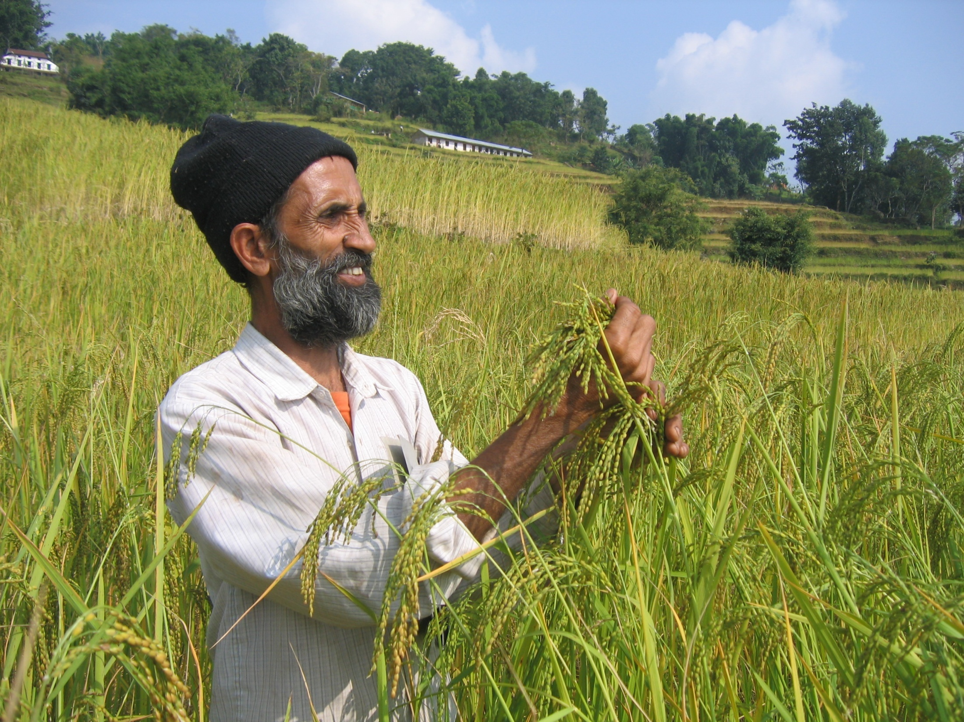


Addressing gaps and challenges: How to sustainably upscale the development of adaptation technologies
Emile Frison, Sp. Representative of the Director General, Bioversity International
Technical Executive Committee, UNFCCC. Bonn, 4 March 20134
Notes:
COVER SLIDE
To change the picture:
Right click on the photo
Click on change picture
If you need a specific CRP logo, replace the general CGIAR logo at the upper right.

Slide 2
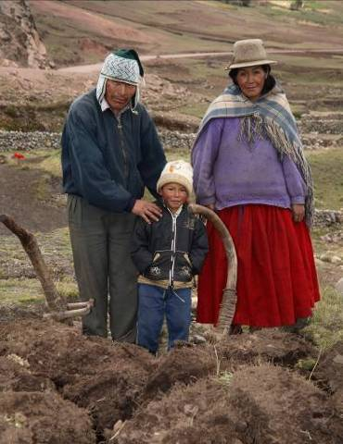
How can agriculture meet today’s and tomorrow’s challenges?
We need to adapt...
Agricultural systems that
produce more and better food
under harsher conditions
while protecting the environment
If we want to focus on the needs of the poor and hungry
→ we need a different paradigm
Notes:
2-LINE TITLE AND BULLETS
If you have long headers, please use this slide. Font size and spacing between the two lines have been customized.

Slide 3
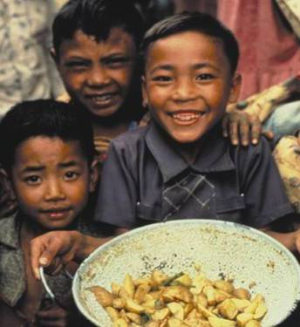
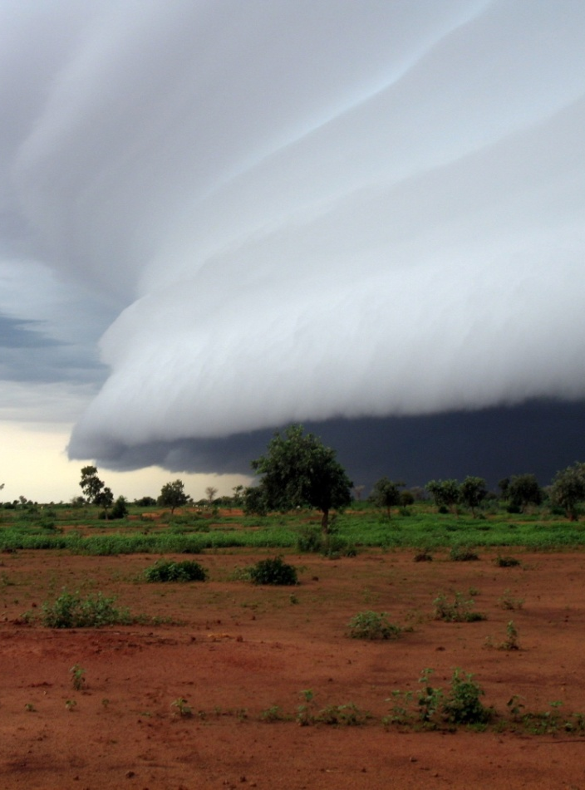
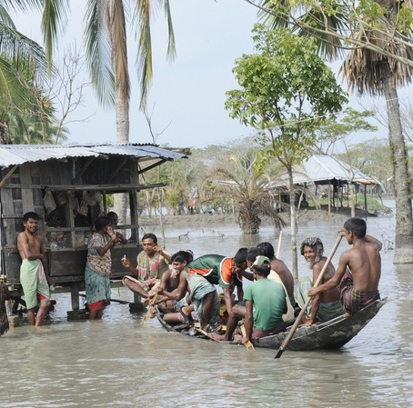
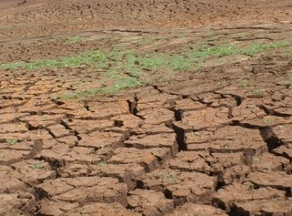
Climate change:
Not in isolation!
We must address better nutrition, ecosystem services as well as less predictable seasons
Notes:
2-LINE TITLE AND TEXT
If you have long headers, please use this slide. Font size and spacing between the two lines have been customized.

Slide 4
Adaptation research for productivity, nutrition, stability, resilience and ecosystem services:
→ Participatory research

Slide 5
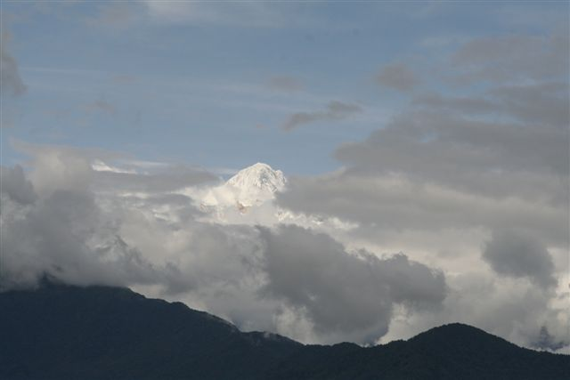
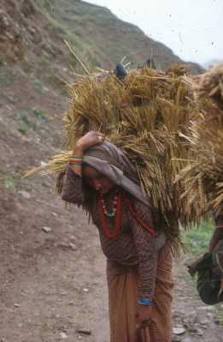


Farmers’ management of genetic diversity for adaptation
Participatory plant breeding to improve disease resistance in the local cold tolerant rice and barley landraces in high mountain agricultural sites in Nepal
Sthapit, Jarvis, Skinner, Murray, 2012

Slide 6
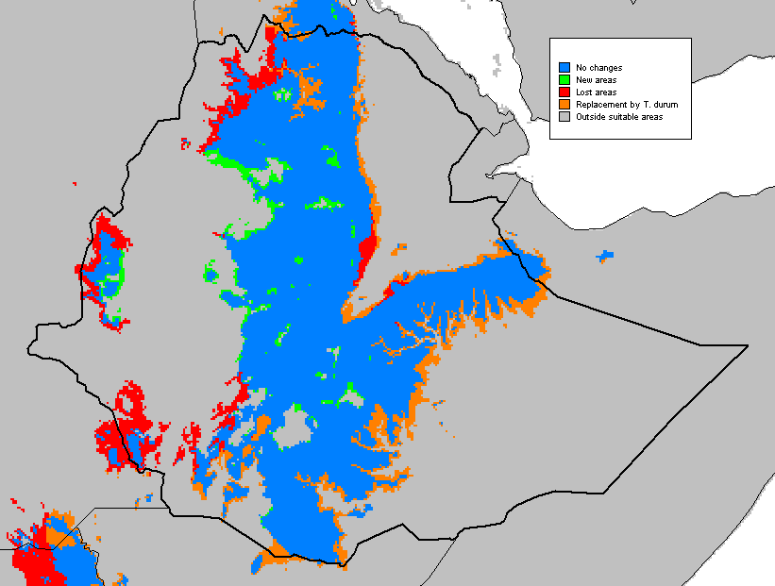

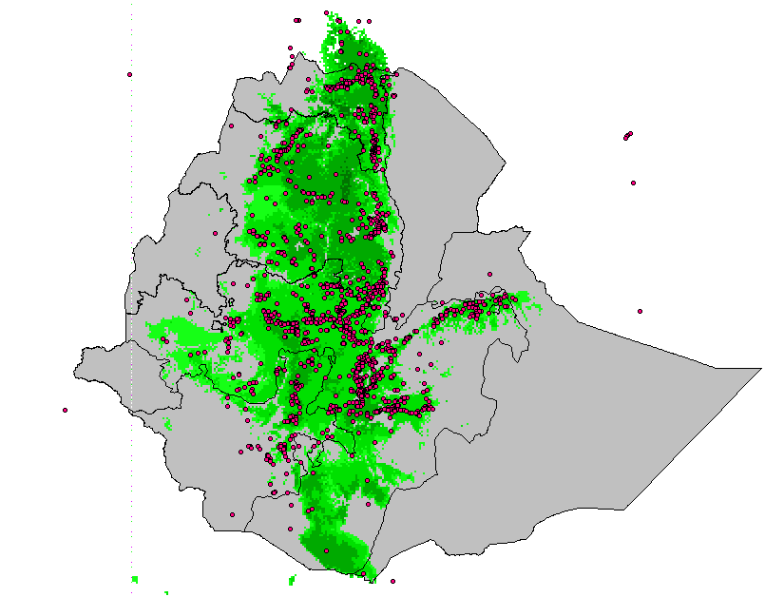
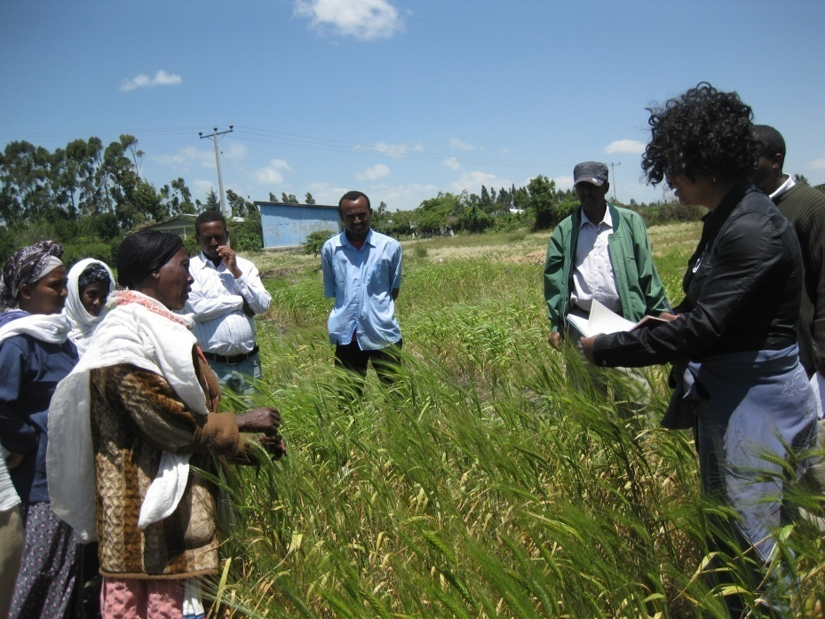
“Seeds for Needs” project promotes adaptation to climate change by women farmers in Ethiopia and PNG
  Projection of future climates in target regions
  Develop climate profile of genebank accessions
  Match current and future environmental conditions of target regions
Participatory evaluation by farmers

Slide 7
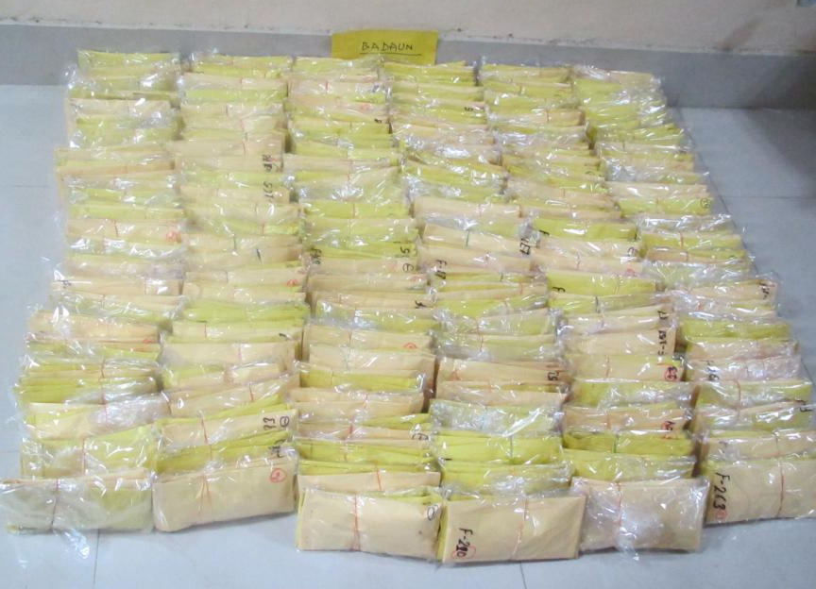
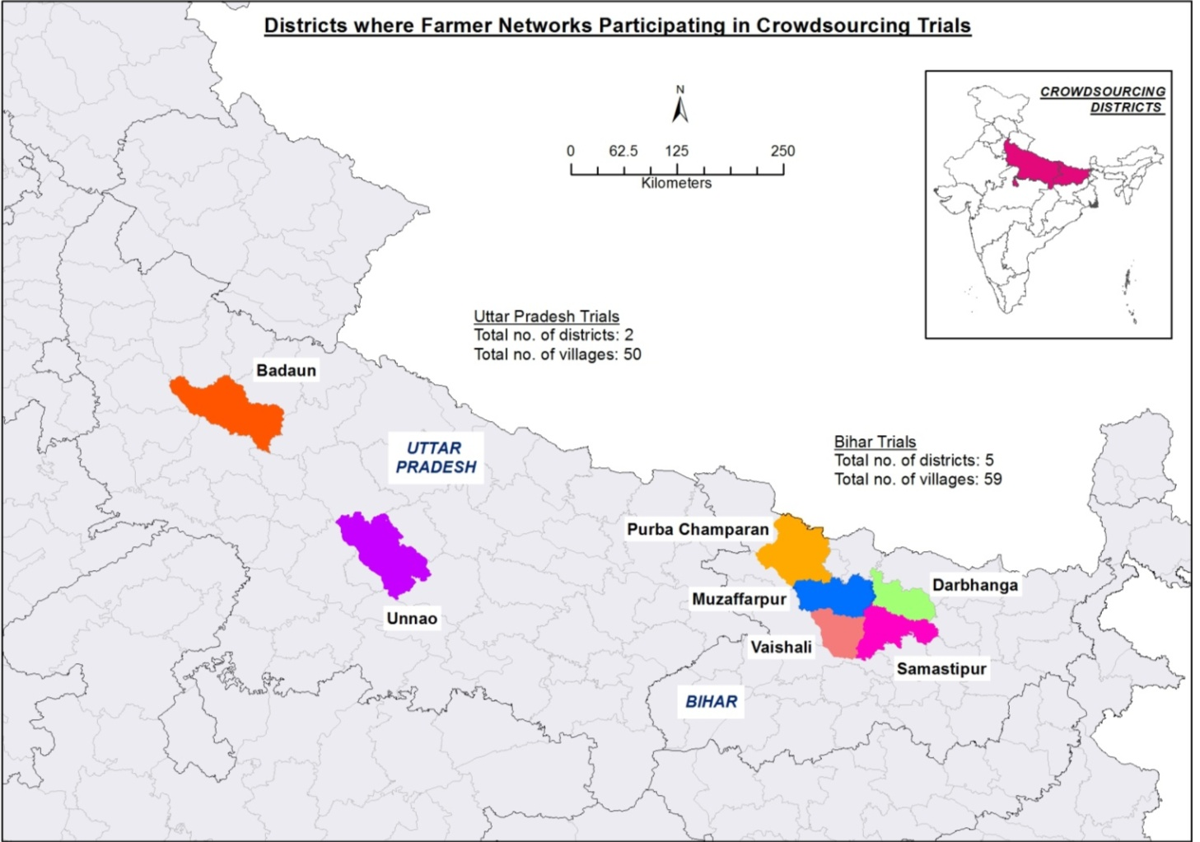
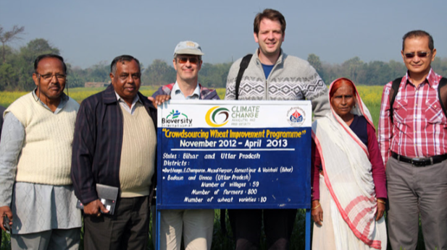
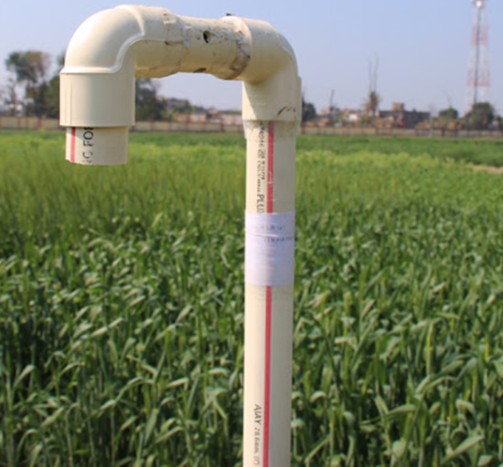
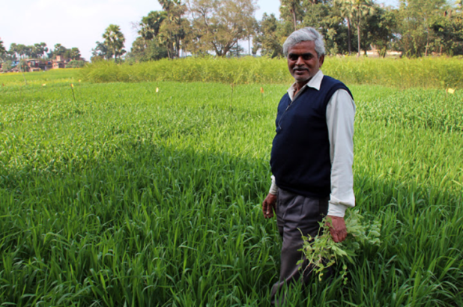
Broadening the genetic base of crop cultivation and empowering farmers for climate change adaptation through crowdsourcing
State = 2; Districts = 7; Villages = 109; Farmers = 800; Varieties = 10 (combination of 3 varieties/trial, each combination is unique
Citizen science approach scales out participatory crop research.

Slide 8
Objective: Integrating across outcomes
Notes:
8

Slide 9
Conservation and availability of genetic resources for adaptation

Slide 10
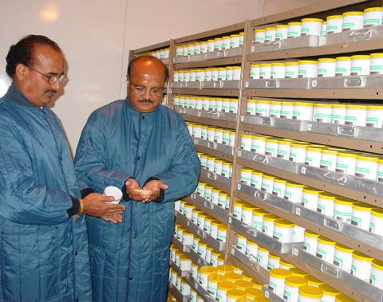
Genetic resources collections
Over 7 million accessions maintained in >1400 collections
CGIAR collections: >700.000 accessions held in trust in 11 collections
Major source of diversity for breeding adapted varieties

Slide 11
In situ conservation, on farms and in the wild, of agricultural and forest biodiversity:
ensures the continued evolution and adaptation to changing conditions

Slide 12
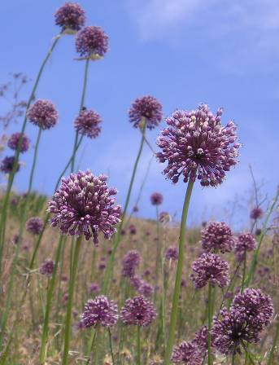
Crop Wild Relatives: precious source of traits
Underrepresented in collections
Difficult to maintain ex situ
→ Need
Targeted collecting
In situ conservation strategies
Notes:
Project brings together five countries: Armenia, Bolivia, Madasgacar, Sri Lanka and Uzbekistan and is funded by UNEP/GEF.
Partners: FAO, Botanic Gardens International, UNEP’s World Conservation Monitoring Centre, World Conservation Union and the Information and Coordination Centre for Biological Diversity.
Aim of the project is to protect natural populations of crop wild relatives while setting a precedent for conservation that the rest of the world can follow. Countries participating in the project contain some of the world’s biodiversity hotspots. Most of these countries had identified wild relatives as a priority for conservation but were unable to do much in the way of conservation because they lacked resources.
The project has three goals: 1) Develop national and international information systems on crop wild relatives that include data on species biology, ecology, conservation status, distribution etc; 2) Build capacity of national partners to use this information to develop and implement conservation approaches to crop wild relatives; 3) Raise awareness of the potential of crop wild relatives for improving agricultural production among policy makers, conservation managers, plant breeders, educators and local users.

Slide 13
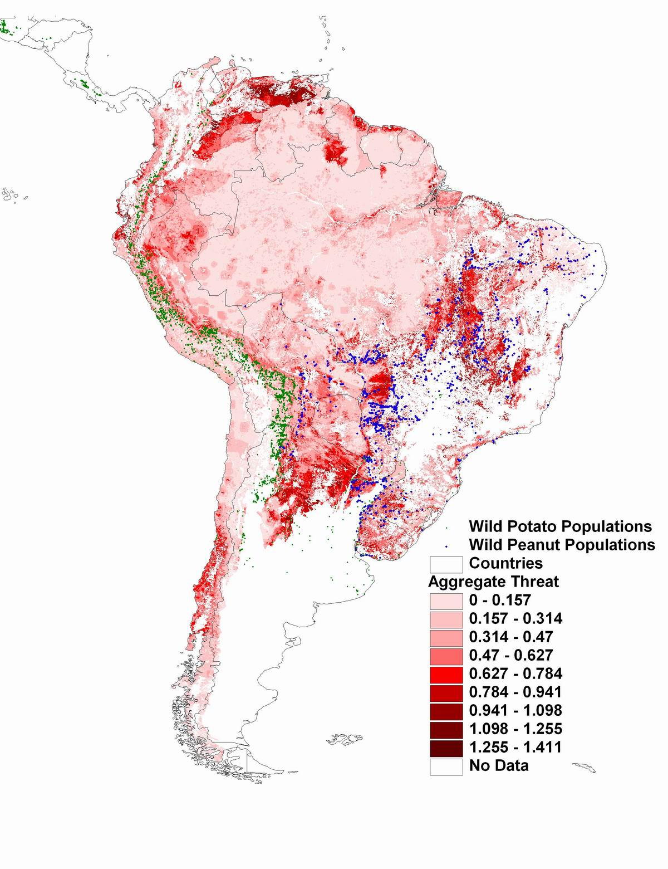
Climate change threats to crop wild relatives
Use existing data for accessions
Combine with climate change model GIS data
Identify areas of greatest threat
Notes:
Map is from
Assessment of threats to ecosystems in South America
Andy Jarvis, Jerome L. Touval, Mauricio Castro Schmitz, Leonardo Sotomayor and Glenn Graham Hyman
Journal for Nature Conservation (in Press) with potato and peanut added.
Dark red is aggregated threats to ecosystem (climate change, deforestation, agriculture, urban expansion etc)
Green dots are wild potato accessions.
Blue dots are wild peanut accessions.
Same sorts of process for climate change.
13

Slide 14
Thank you
Notes:
THANK YOU/FINAL SLIDE

