Slide 1
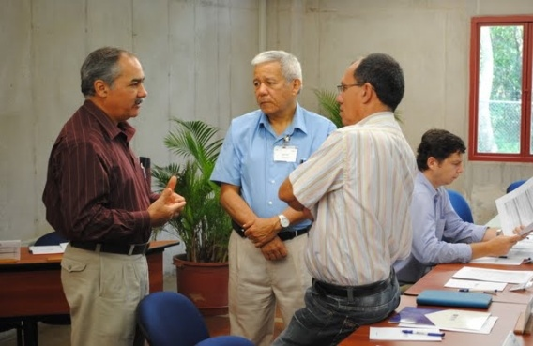
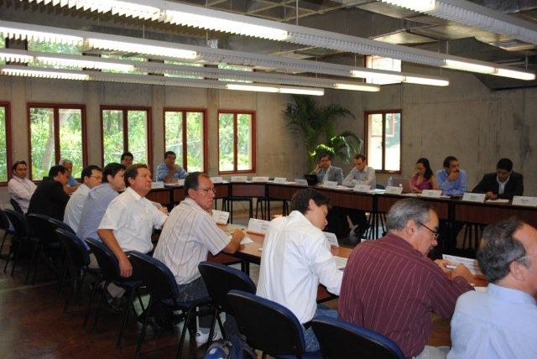
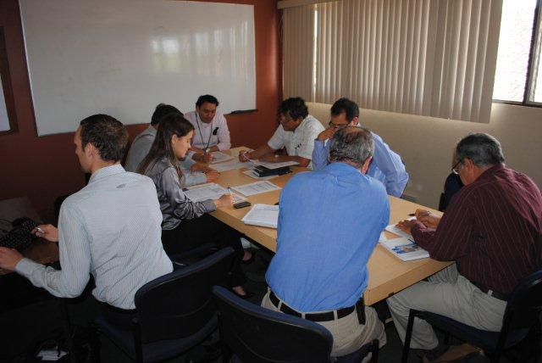
The TNA Process in Costa Rica Experiences and lessons learned
Francisco Sancho
Advisor TNA
francisco.sancho@consultor.incae.edu

Slide 2
Low Carbon Strategy in Costa Rica Carbon neutrality by 2021
Long-term strategic line for climate change
Goal of zero emissions (year of reference)
Country branding and international cooperation strategy
Change of production and consumption patterns, cooperation strategy
The TNA contributes in institutional design, regulatory and financial framework, and human and institutional capacity building.
Provides strategic lines of action is current streamlining of the National Climate Change Strategy for next 15 years

Slide 3
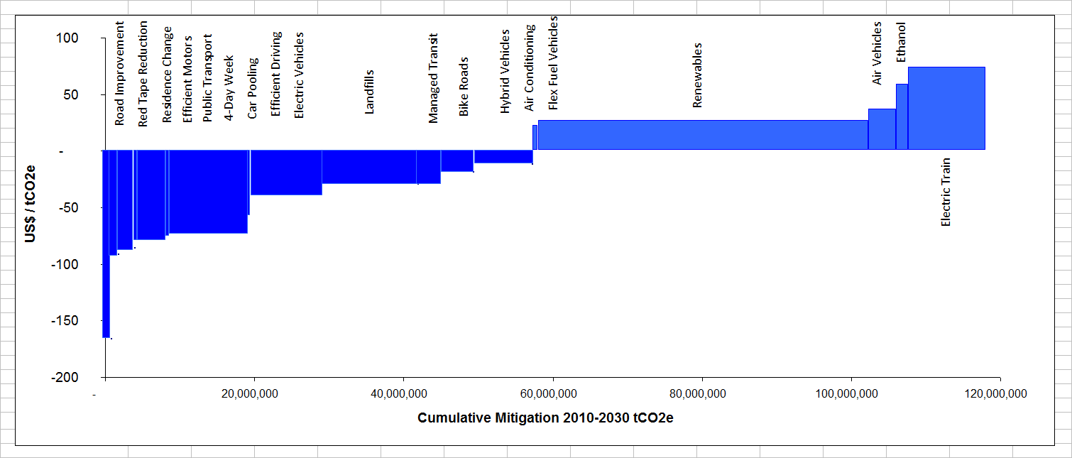
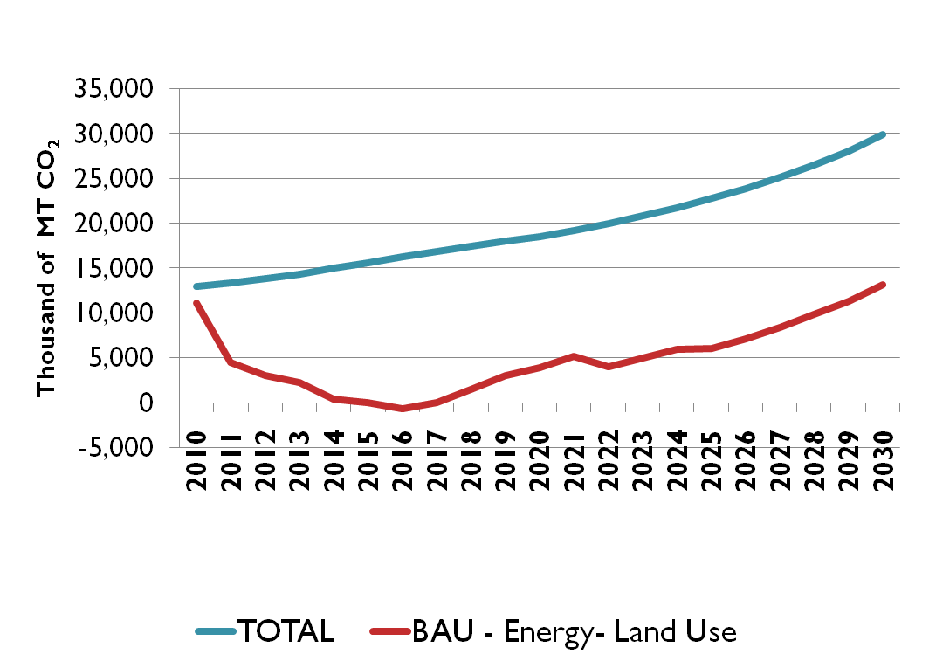
NEEDS showed requirement to streamline technology options
Source: MINAET-DSE-INCAE-FUNDECOR
National Economic, Environment and Development Study for Climate Change (NEEDS) shows that with identified technologies under C-Neutral country reaches in 2030 emissions similar to 2010

Slide 4
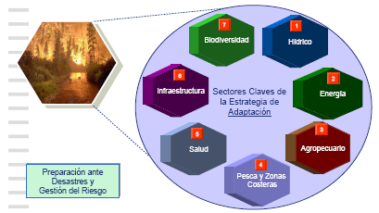
Priority Sectors in National Climate Change Strategy (NCCS)
Key sectors for mitigation
Key sectors for adaptation
Sector prioritization based on inventory of GEI´s, vulnerability studies and sectoral strategies and NCCS

Slide 5
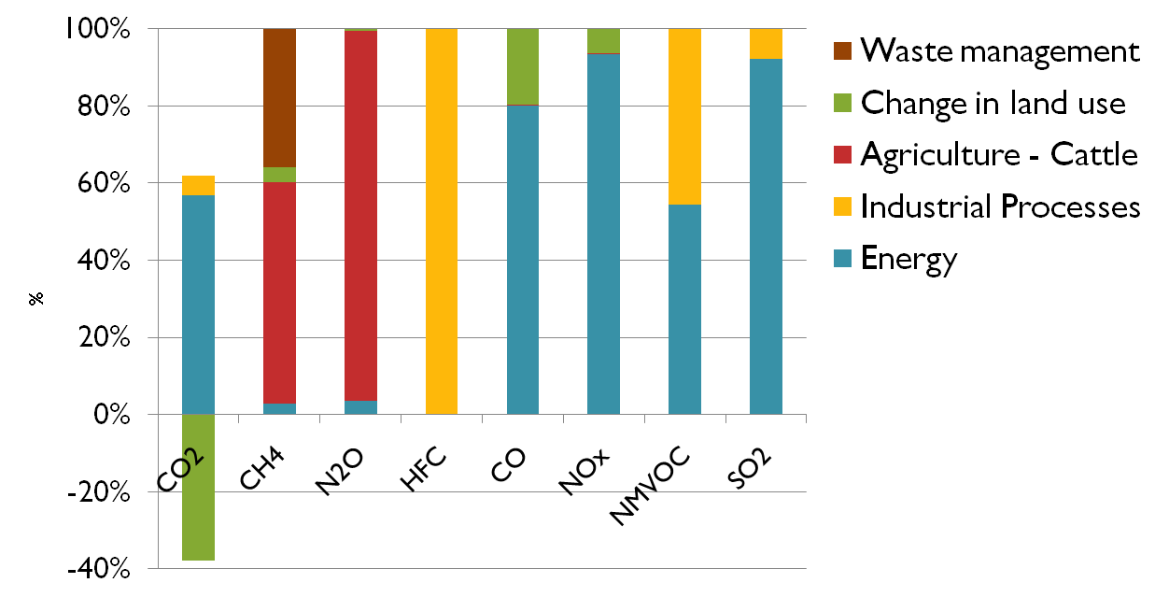
Sources of green house gases emissions
Energy main source: transportation of 64% energy consumption
Source: Instituto Meteorológico Nacional
Carbon dioxide (CO₂), methane (CH₄), nitrous oxide (N₂O), halocarbons (HFCs), carbon monoxide (CO), nitrogen oxides (NOx), other volatile hydrocarbons (NMVOC), sulfur dioxide (SO₂)

Slide 6
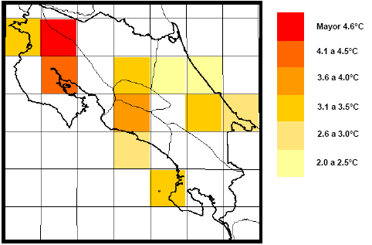
Expected Variation in Rain and Temperature in next 100 years
Annual rain variation
Annual temperature variation

Slide 7
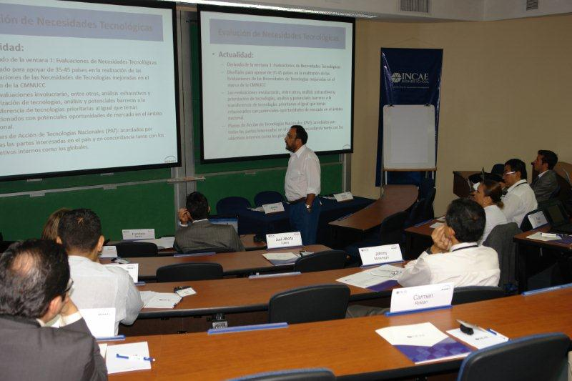
Prioritization of Sectors y Subsectors
Topic | Sector | Sub-sector
Mitigation | Energy | Public transport
 |  | Private transport
 |  | Electric efficiency and conservation
 | Industry | Cement
 |  | Efficient power consumption
 | Waste Management | Energy production industry
 |  | Utilization of methane in water treatment plants
 | Agriculture and Livestock | Recognition scheme for environmental services
 |  | Farming systems to reduce methane
Adaptation | Infrastructure | Road construction standards
 |  | Popular housing
 |  | Protection of bridges with green barriers
 | Water | Irrigation
 |  | Human consumption
 |  | Hydropower production
 | Forestry | Protection of forest environmental service payments
 |  | Watershed management
 |  | Corridors
 | Institutional | Definition of adaptation policy
 |  | Institutional Design for adaptation
Workshop in September 2010: Conformation of stakeholders network and prioritization of sectors and subsectors.

Slide 8
Criteria for Sector and Subsectors Prioritization
Mitigation |  |  | Vulnerability
Importance in social, economic and environmental situation | A: High M: Medium B: Low |  | Importance in social, economic and environmental situation | A: High M: Medium B: Low
Contribution of Greenhouse Gases | A: High M: Medium B: Low |  | Degree of risk or level of potential impact to climate change | A: High M: Medium B: Low
Horizon of technology readiness | C: Short-term M: Medium Term L: Long Term |  | Horizon of technology readiness | C: Short-term M: Medium Term L: Long Term
Scale of investment required | A: High M: Medium B: Low |  | Scale of investment required | A: High M: Medium B: Low
Preparation depends on transfer of technology, market development, new institutional design and development of human capacity | A: High M: Medium B: Low |  | Preparation depends on transfer of technology, market development, new institutional design and development of human capacity | A: High M: Medium B: Low
Source: MINAET-INCAE

Slide 9
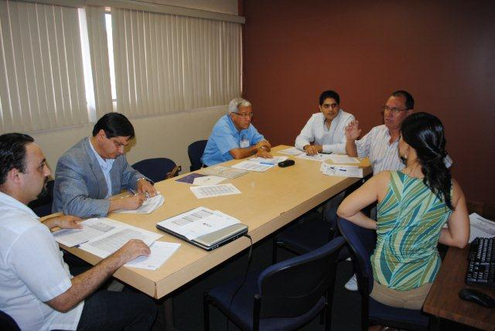
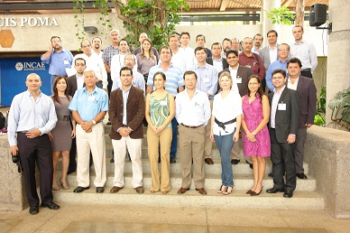
Technology Prioritization
Workshop for prioritization of technologies in April 2011
This workshop showed results of research and evaluation through sectoral team working.
Discussion around identified technologies allowed familiarization by all stakeholders.
Evaluation followed a multi-criteria matrix to prioritized technologies

Slide 10
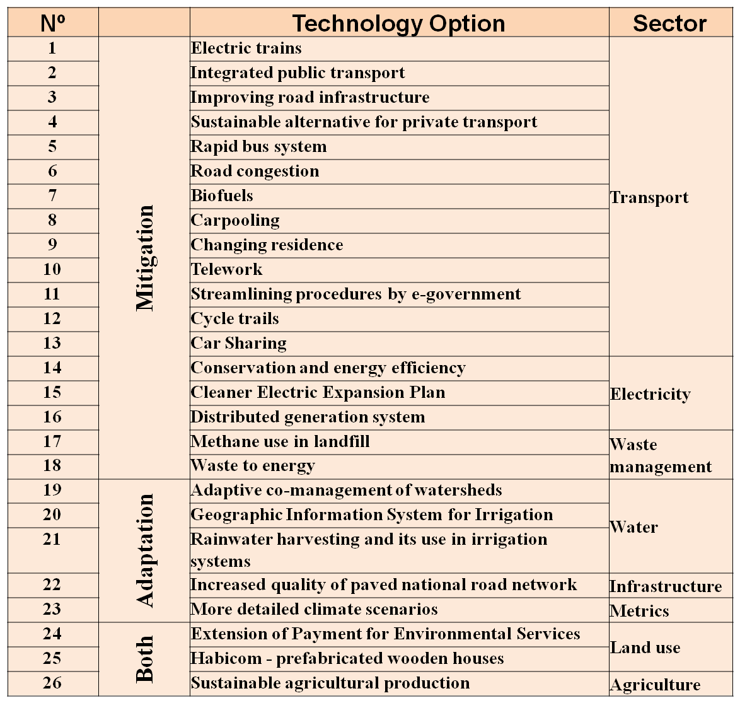
Technology Portfolio

Slide 11
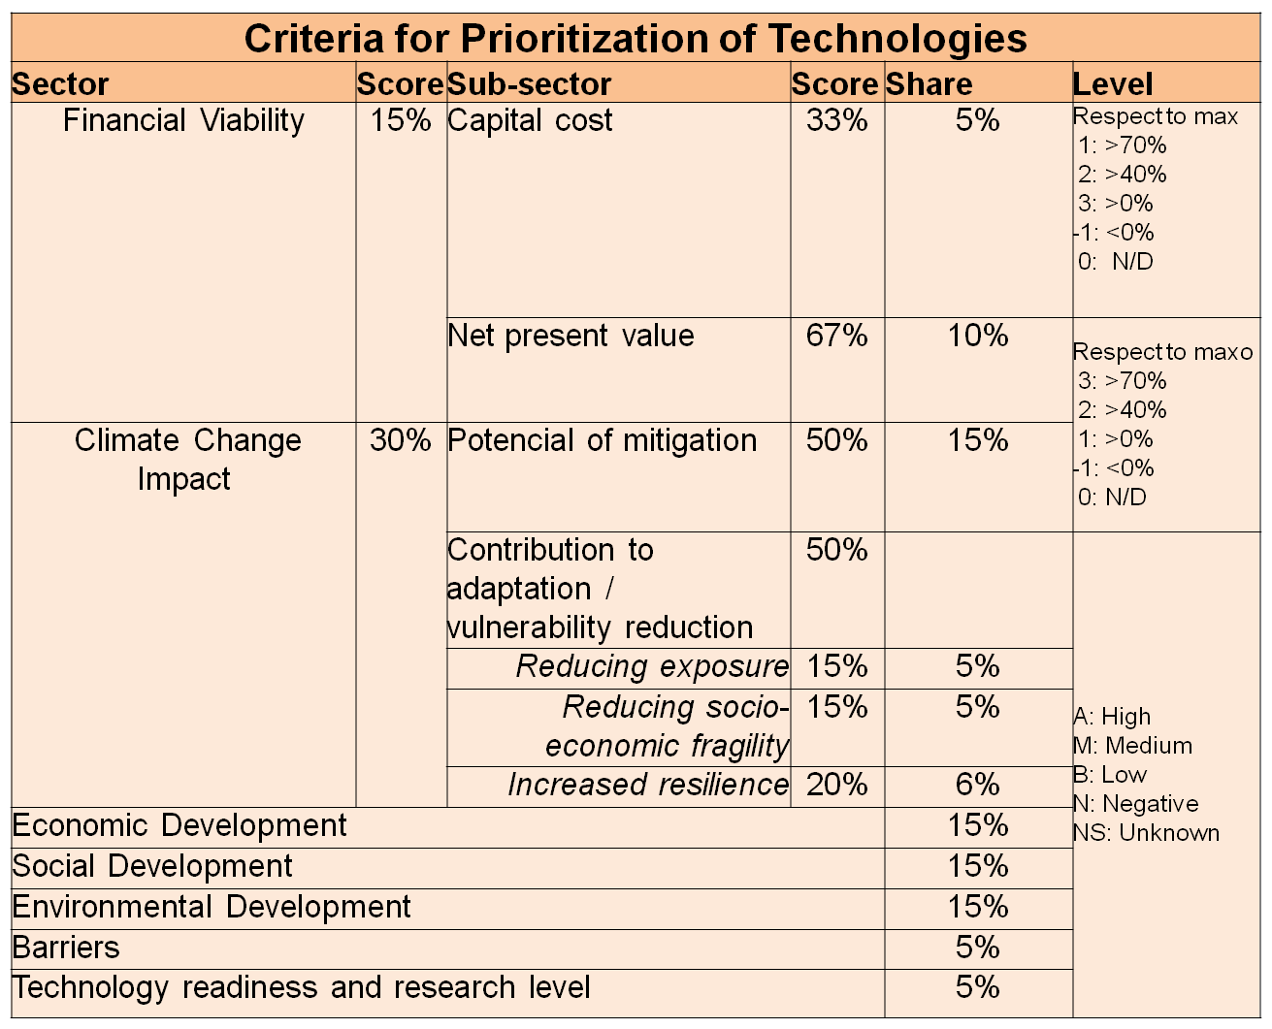
Multi-criteria Analysis

Slide 12
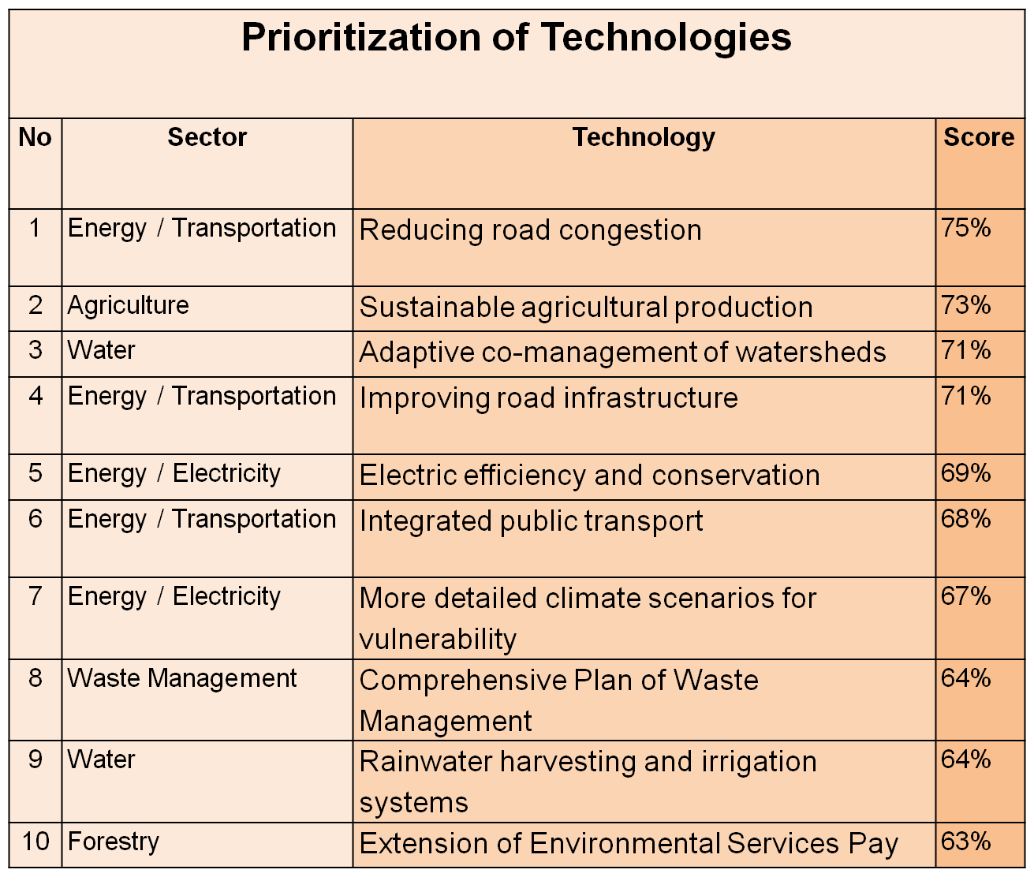
Results of Prioritization Process

Slide 13
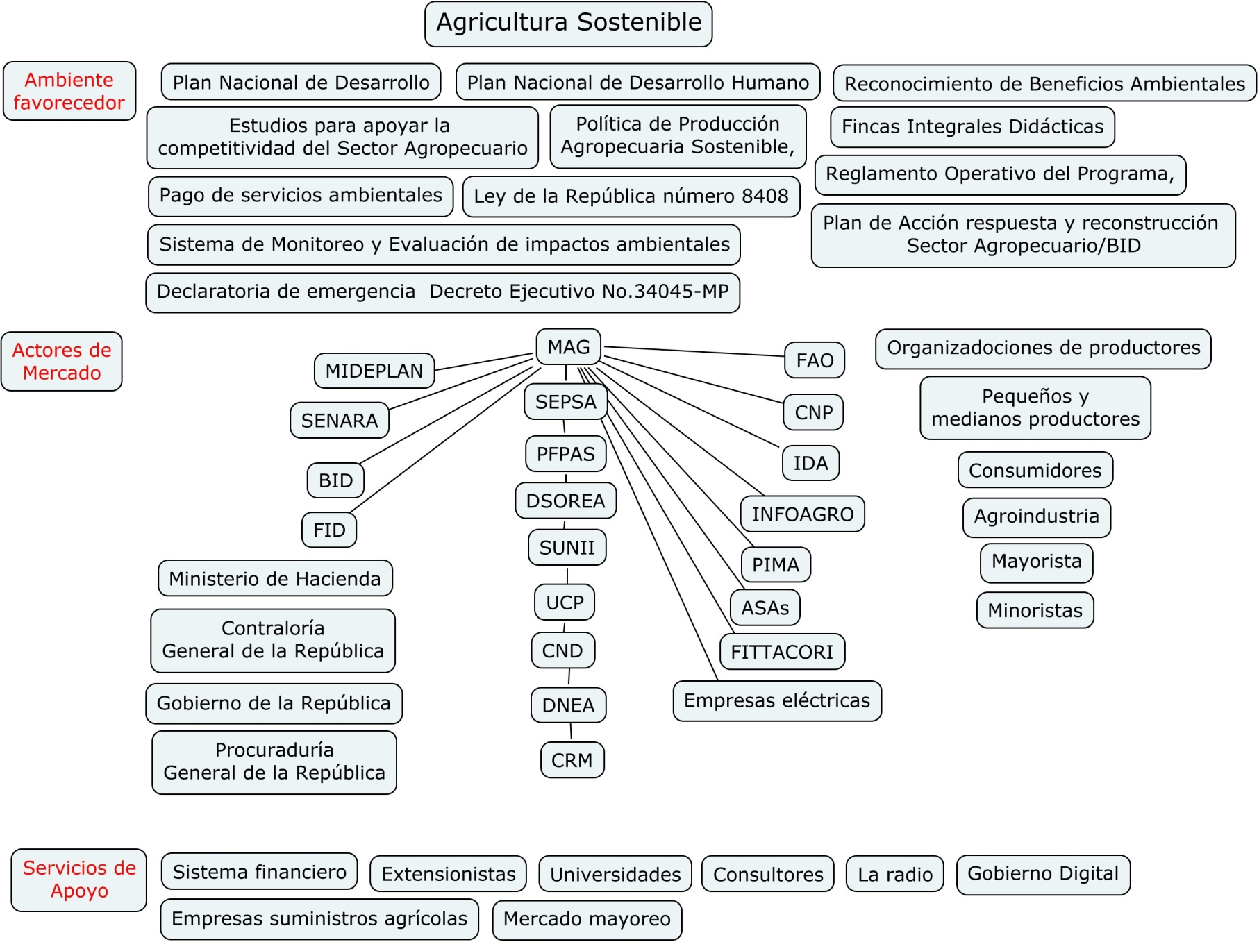
TNA is in barrier analysis phase based on the mapping of markets and posed to stakeholders validation

Slide 14
Lessons Learned in Costa Rica
TNA overall methodology and technical support provide good framework for the assessment but need to incorporate country specificities.
Regional workshops are needed for capacity building (economic evaluation, climate change methodologies, participative process)
Knowledge exchange among country teams and experts change has to be increased.

Slide 15
Lessons Learned in Costa Rica
Stakeholder involvement is key ( consultation meetings, workshops, studies, sectoral teamwork and feedback).
Some technologies are better treated as packages (as programs) rather than individually.
Barrier analysis defines scope of technology transfer strategy.
TNA has to be seen as one element of country’s set of studies for CC decision making (building on and complementing other efforts).

Slide 16
The TNA Process in Costa Rica
Thank you
Francisco Sancho
TNA Advisor
francisco.sancho@consultor.incae.edu

Slide 17
Annex Example of Some Identified Barriers in the Map

Slide 18
Policies
Program with specific policy and specific Law but overall fostering of sustainable agriculture has not a comprehensive policy and incentive scheme
Opening of the economy and trade agreements reduce policies with incentives for agriculture

Slide 19
Environmental Services Pay
The PSA and other laws for incentives have an environmental and forest vision and are not intended for sustainable agriculture.

Slide 20
Technology Phase
Program in diffusion stage, deployment was in pilot project with 16.000 farmers involved in the program from around 50.000 in the country.

Slide 21
Cultural barriers in farmers
Weakness and little experience in farming organizations.
Difficult to generate changes in living conditions of people.
Farmer organizations showed little interest in training.
Far from target audience: women, indigenous, rural youth.

