Slide 1
Update on Poznan Strategic Programme on Technology Transfer
Prepared for
Technology Needs Assessment Workshop
(1-2 June 2011)
By
Dr. Robert Dixon
Team Leader, Climate and Chemicals

Slide 2
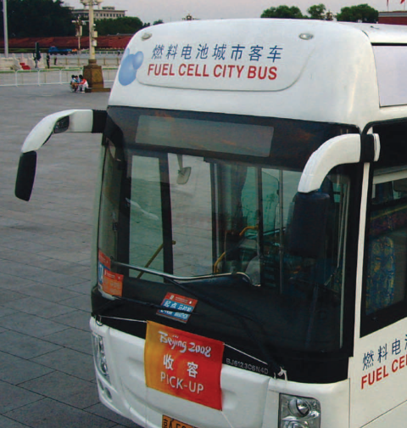
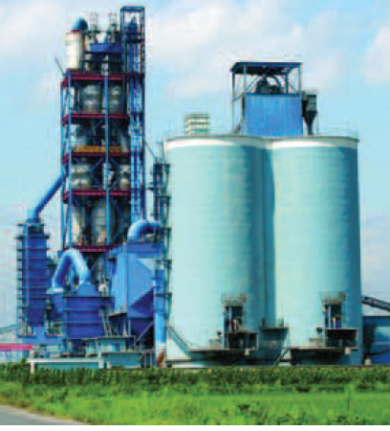
GEF: Leader in Financing Technology Transfer
GEF Trust Fund invested almost $3 billion in over 150 countries
Mitigation
Adaptation
Technology Needs Assessments (TNAs)
National Communications to the UNFCCC
Largest multilateral public-sector tech transfer mechanism
Financed demonstration, deployment, diffusion, and transfer of more than 45 environmentally sound technologies
Conference of the Parties (COP) of UNFCCC has given a mandate on technology transfer to GEF
Poznan Strategic Programme on Technology Transfer

Slide 3
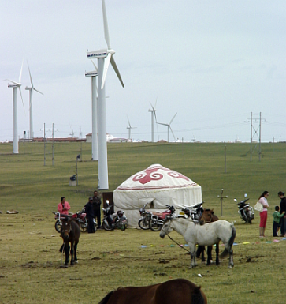
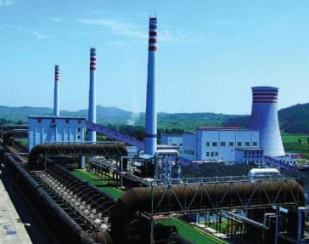
GEF’s Role in Financing Technology Investments
Catalytic
Leveraged more than $17 billion in co-financing on its $3 billion of investments
Innovative
Leader in financing new, emerging technologies and practices
Pioneer in supporting market-based approaches (e.g., ESCOs) and innovative financial instruments
Cost-effective
Over 2.5 billion tonnes of CO₂ avoided
Amounts to slightly over $1/tonnes CO₂

Slide 4
Poznan Strategic Program on Technology Transfer
Funding level
$35 million from GEF Trust Fund in GEF-4
$15 million from SCCF
Support for Technology Transfer Pilot Projects
14 projects were selected for support in 2009
Their implementation is ongoing
Support for TNAs
Project was approved in 2009
Country-level assessment is ongoing
Long-Term Program on Technology Transfer
Plus dissemination
Publication on Poznan Program (GEF 2010) downloadable from: http://www.thegef.org/gef/node/3856

Slide 5
Poznan Program Country Coverage
Turkey & Cook Islands: Hydrogen energy installations for small islands (UNIDO)
Russian Federation: HCFC phase-out, HFC-free, energy efficient AC & Refrigeration (UNIDO)
Jamaica: Small scale wave power (UNDP)
China: Green truck demonstration (WB)
Russian Federation
Mexico: Local wind technologies (IDB)
Mongolia
Thailand: South-South technology transfer: ethanol from cassava (UNIDO)
Moldova
Kazakhstan
Turkey
Georgia
China
Mexico
Jamaica
Nepal
Cuba
Lebanon
Bhutan
Colombia & Kenya: SolarChill commercialization & transfer (tbc)
Morocco
Senegal
Azerbaijan
Bangladesh
Guatemala
El Salvador
Nicaragua
Costa Rica
Peru
Bolivia
Jordan
Dominican Republic
Ethiopia
Colombia
Mali
Cote d’Ivoire
Sudan
Sri Lanka
Thailand
Laos
Kenya
Cambodia
Viet Nam
Cambodia: Agricultural residue biomass to energy (UNIDO)
Brazil
Ghana
Rwanda
Chile: Local solar technologies (IDB)
Cook Islands
Chile
Malawi
Indonesia
Sri Lanka: Bamboo processing (UNDP)
Mauritius
Code d’Ivoire: Solid waste composting (AfDB)
Argentina
Jordan: Irrigation technology (IFAD)
Brazil: Renewable CO₂ capture & storage from sugar industry (UNDP)
Senegal: Typha-based thermal insulation production (UNIDO)
Pilot Projects
TNA Project – First Round Countries (15)
TNA Project – Second Round Countries (21)

Slide 6
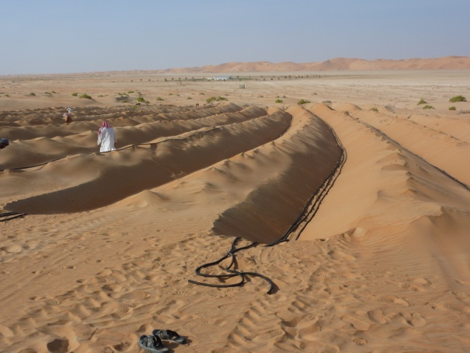
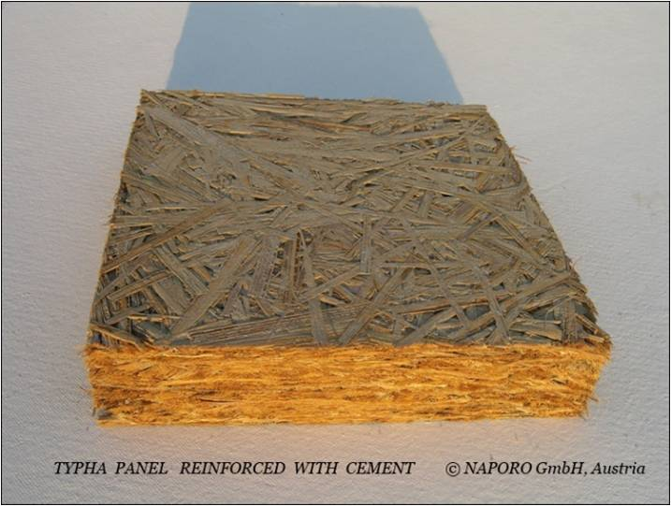
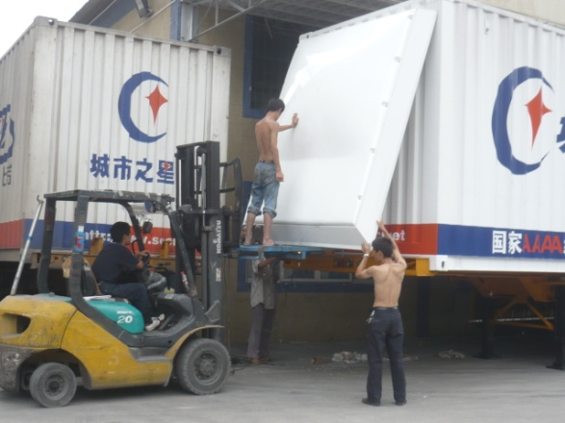
Technology Transfer Pilot Projects
16 countries, 6 Agencies
Total GEF funding of $58 million
Co-financing of $195 million
Feature South-South TT and international collaboration
Address mitigation and adaptation
Innovative and diverse technologies:
Renewable energy: solar, biomass, wind, wave, and hydrogen
Energy efficiency: construction and insulation materials such as bamboo and typha, HFC-free energy efficient appliances
Transport: green trucks
Waste management: solid waste composting for energy recovery
Carbon capture & storage (CCS): renewable CCS from sugar industry
Water management: membrane drip irrigation
dHRS irrigation technology (for Jordan) reference: DTI-r
Typha panel for construction (for Senegal) reference: UNDP
Aerodynamic part for freight truck (for China) reference: World Bank

Slide 7
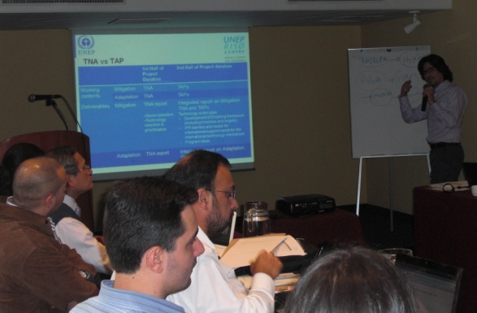
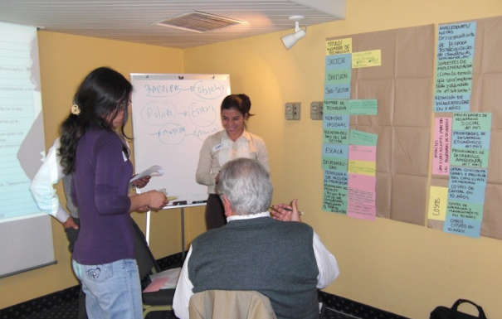
TNA project
Objective:
to provide targeted financial and technical support to assist 35–45 countries in developing and/or updating their TNAs within the framework of Article 4.5 of UNFCCC
Progress:
Approved for implementation by UNEP in November 2009, for GEF funding of $9 million
15 first round countries selected for Phase I
Additional 21 countries selected
See UNEP’s presentation

Slide 8
Long-Term Program on Technology Transfer
Support Climate Technology Centres and a Climate Technology Network:
at global, regional, national levels
may involve technical assistance, training, information sharing, knowledge management, reflecting UNFCCC discussions
Conduct Pilot Technology Projects to Foster Innovation and Investments:
to demonstrate innovative technologies
to support deployment and diffusion to catalyze investments
Develop a Public-Private Partnership for Technology Transfer:
to facilitate private sector engagement to support innovative financial instruments or business models for technology deployment
Support Technology Needs Assessments (TNAs): to target low- & medium-income countries to conduct and/or update TNAs
GEF as a Catalytic Supporting Institution for Technology Transfer

Slide 9
Key Features of Long-Term Program
Consistent with and support the Technology Mechanism agreed in Cancun at COP16
Approved by the GEF Council
May be funded by:
STAR (elements 1, 2, and 4)
Global and Regional Set-Aside (elements 1 and 4)
PPP fund (element 3)
additional voluntary contributions (element 2)

Slide 10
Dissemination
Ministerial meeting on climate technology transfer (April 2011)
COP16 side event on technology transfer
Publications of Poznan programme, case studies and lessons learned
Google-GEF partnership development
Website update
Knowledge management initiative for tech transfer (ongoing)
Publication on EST Transfer (GEF 2010) downloadable from: http://www.thegef.org/gef/pubs/tech-transfer-case-studies-2010

Slide 11
GEF-5 Outlook and Technology Transfer
Record replenishment level achieved for GEF-5 (2010-2014)
$4.34 billion total
$1.4 billion for climate change mitigation
GEF climate change strategy guided by 3 principles:
Responsiveness to Convention guidance
Consideration of national circumstances of recipient countries
Cost-effectiveness in achieving global environmental benefits
Entire GEF climate change portfolio supports technology transfer
6 objectives range from demonstrations of innovative, low-carbon technologies to investments and enabling activities

Slide 12
Tech Transfer Embedded in GEF-5 Mitigation Strategy
6 CCM objectives address different aspects of technology transfer
Sectors: energy efficiency, renewable energy, transport, urban systems, LULUCF

Slide 13
Thank you very much
For further information, please contact:
Robert K. Dixon
Leader, Climate & Chemicals Team
Email: rdixon1@thegef.org
Chizuru Aoki
Climate Mitigation Cluster Coordinator
Senior Technology Transfer Officer
E-mail: caoki@thegef.org
GEF Tech Transfer Website (under development): http://www.thegef.org/gef/TT
Notes:
13

