Slide 1
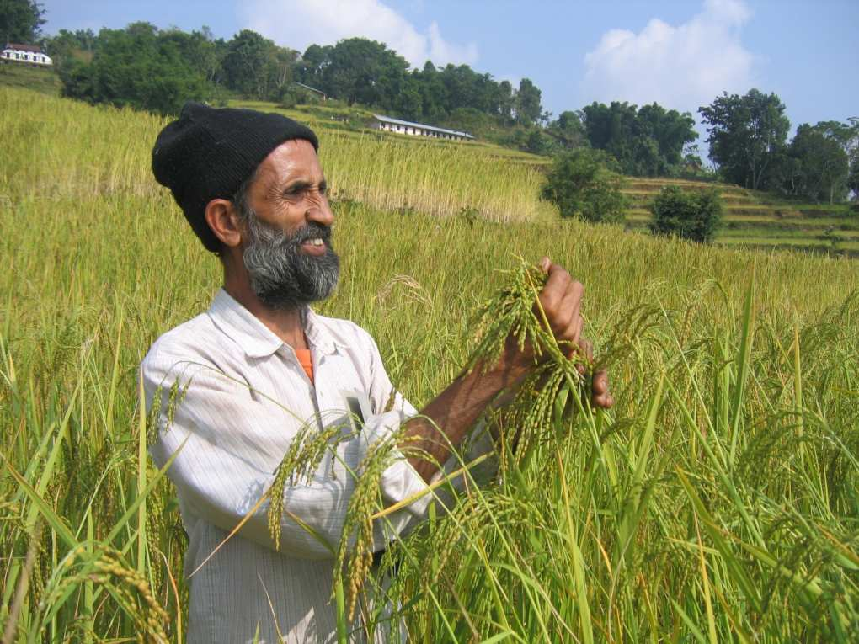


Reaching food and nutrition security while adapting to climate change: a research agenda
Emile Frison, Director General, Bioversity International
Technical Executive Committee, UNFCCC. Bonn, 27 June 2013
Notes:
COVER SLIDE
To change the picture:
Right click on the photo
Click on change picture
If you need a specific CRP logo, replace the general CGIAR logo at the upper right.

Slide 2
The challenges
we face

Slide 3
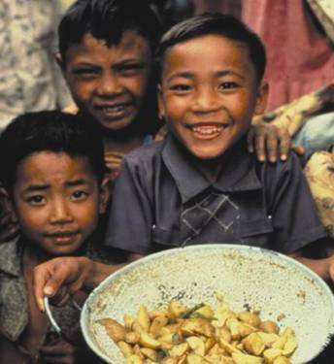
Feeding a growing population
By 2050...
World population will grow
to 9.2 billion = growth of 37%
Food production must increase by more than 60% ...
and be sustainable
Notes:
TEXT + PICTURE ON THE RIGHT
To change the photo
-Right click on the photo
- Click on change

Slide 4
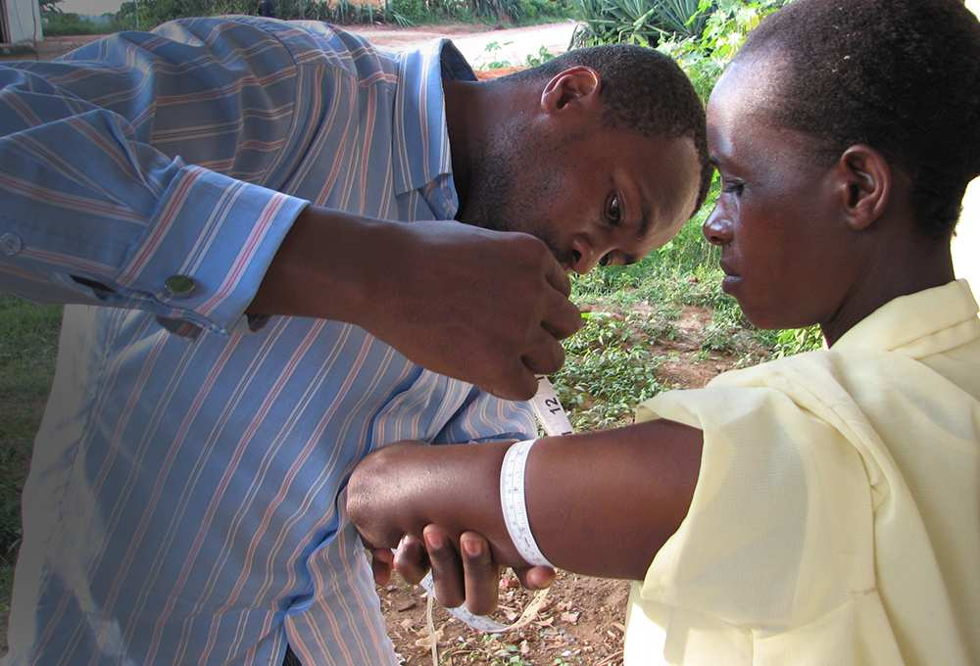
Triple burden of malnutrition
Hunger or Undernutrition : Almost 1 billion people suffer from hunger and 3.5 million young children die of undernutrition every year.
Hidden hunger: Young children and women are among those most at risk of developing micronutrient deficiencies.
Overnutrition and obesity: More than 1.2 billion people are overweight globally. This number is rising quickly and dramatically everywhere.
Increasingly in low income countries, under- and overnutrition exist side-by-side along with micronutrient deficiencies (the triple burden).
Notes:
Hunger or undernourishment: Almost 1 billion people suffer from hunger or lack of food. Undernutrition is directly or indirectly responsible for 3.5 million young child deaths every year, and at least 35% of the disease burden in under 5 year old children. Severe acute malnutrition contributes to the deaths of 1 million children under five worldwide each year.
Hidden hunger (due to micronutrient deficiencies): Micronutrient deficiencies can contribute to high rates of morbidity and mortality and even moderate levels of deficiency can have detrimental effects on human health and economic growth. Young children and women are among those most at risk of developing micronutrient deficiencies. The three most common forms of micronutrient malnutrition are iron, vitamin A and iodine deficiency.
Obesity (overnutrition): More than 1 billion people are overweight globally, and this number is rising quickly and dramatically everywhere. In fact, in terms of numbers, obesity is now mainly a problem of the poor everywhere. Increasingly in low income countries, under- and overnutrition exist side-by-side along with micronutrient deficiencies (the triple burden).
Citations:
http://www.unscn.org/en/home/why-nutrition-is-important.php#double_burden_of_malnutrition
[1][1] Lim, SS. et al. (2012). A comparative risk assessment of burden of disease and
injury attributable to 67 risk factors and risk factor clusters in 21 regions, 1990—2010: a systematic analysis for the Global Burden of Disease Study 2010. The Lancet 2012;380:2224
http://www.thelancet.com/journals/lancet/article/PIIS0140-6736%2812%2961766-8/abstract
Maternal and child undernutrition: global and regional exposures and health consequences
Robert E Black, Lindsay H Allen, Zulfiqar A Bhutta, Laura E Caulfield, Mercedes de Onis, Majid Ezzati, Colin Mathers, Juan Rivera The Lancet 19 January 2008 (Volume 371 Issue 9608 Pages 243-260 DOI: 10.1016/S0140-6736(07)61690-0)
http://www.thelancet.com/journals/lancet/article/PIIS0140-6736(07)61690-0/abstract

Slide 5
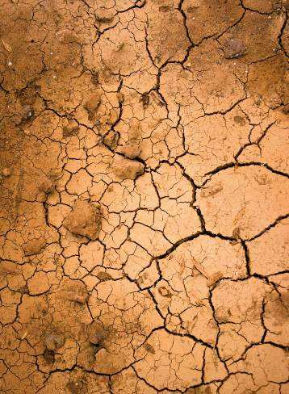
Climate change
Temperature rises
Changes in growing conditions
New pests and diseases
Water scarcity and desertification
→ Strong impact on agriculture
Notes:
TEXT + PICTURE ON THE RIGHT
To change the photo
-Right click on the photo
- Click on change

Slide 6
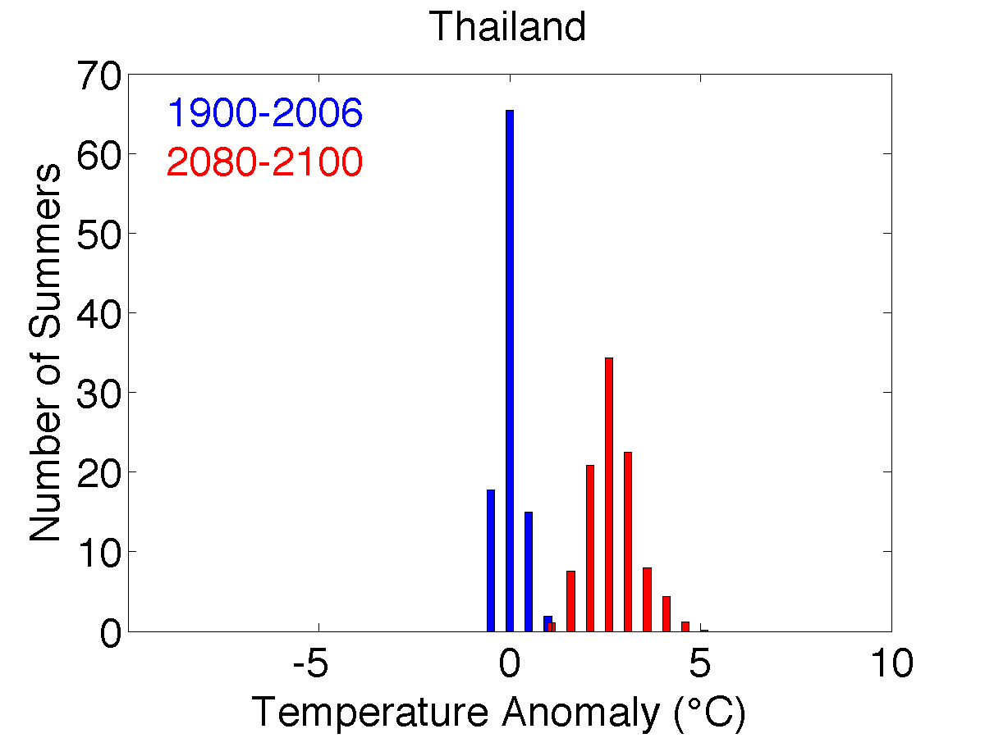
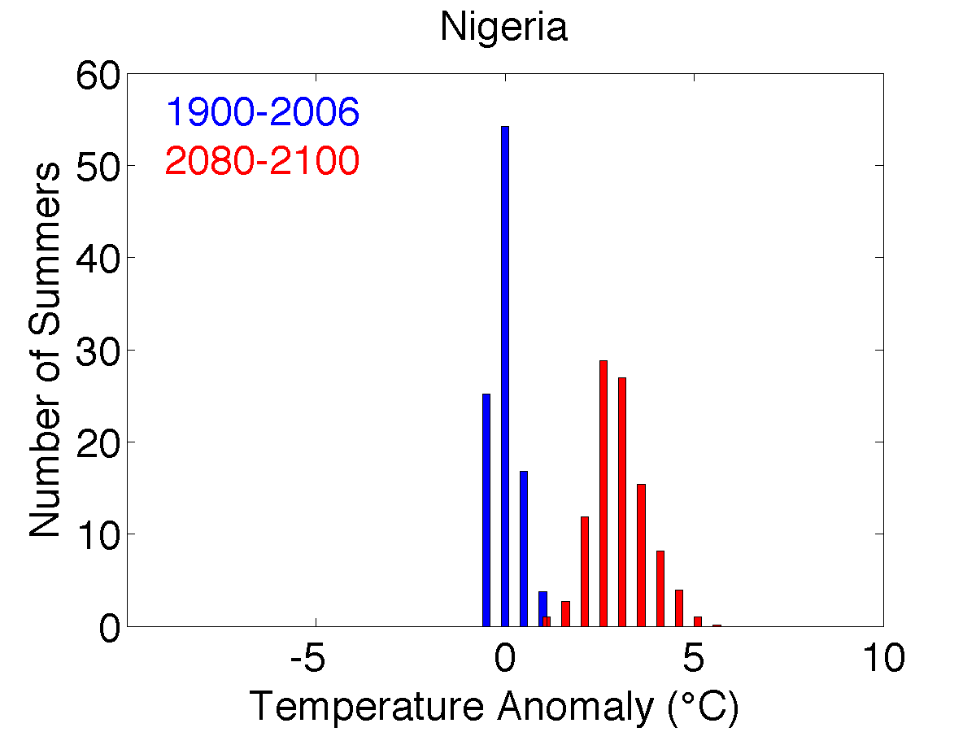
Entirely new climates?
Global warming creates new climates
Coolest summers in 2090 will be warmer than the hottest summer now.
Notes:
CHART
This is a sample chart. For all charts (pie, bar, line, column, etc.), please make sure to use the Bioversity International colour palette, automatically available in the colour selection as the first colour theme (first row).

Slide 7
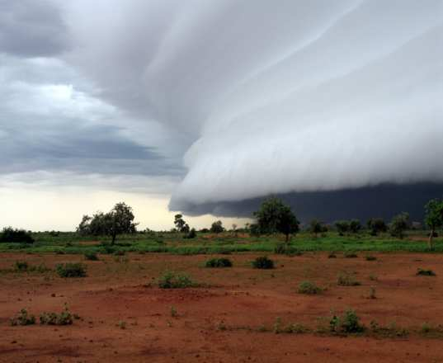
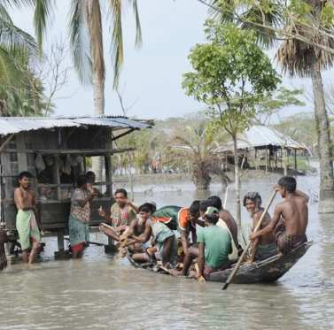
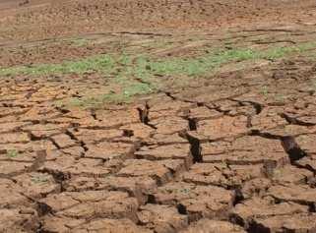
Climate change: more extreme events
Less predictable seasons, greater risks…
Notes:
2-LINE TITLE AND TEXT
If you have long headers, please use this slide. Font size and spacing between the two lines have been customized.

Slide 8
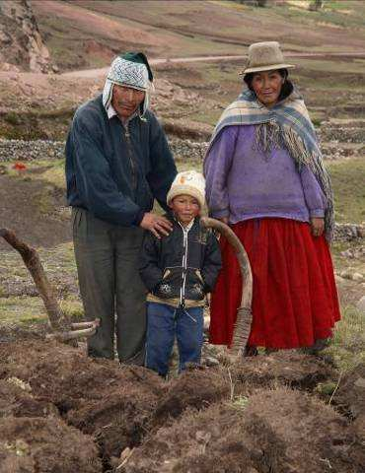
How can agriculture meet these challenges?
We need to adapt...
Agricultural systems that
produce more and better food
under harsher conditions
while protecting the environment
If we want to focus on the needs of the poor and hungry
→ we need a different paradigm
Notes:
2-LINE TITLE AND BULLETS
If you have long headers, please use this slide. Font size and spacing between the two lines have been customized.

Slide 9
Adaptation research for productivity, nutrition, stability, resilience and ecosystem services

Slide 10
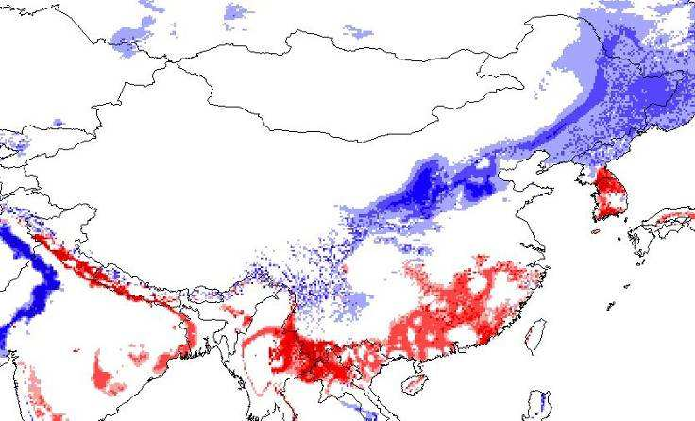
Changing conditions
Soybean 2055
Less suitable
More suitable
Notes:
Just how far are conditions going to change.
Examples of Soybean and Peanut

Slide 11
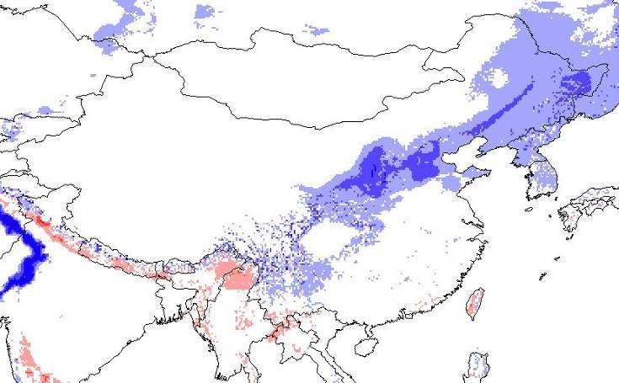
Changing conditions
Peanut 2055
Less suitable
More suitable
Notes:
Map created by Andy Jarvis, from Lane and Jarvis study. Changes in suitability for peanut. The most suitable belt for peanut moves north and west, away from the current peanut-producing areas. Will breeders create new varieties, adapted to those areas? Or will peanut farming itself move?

Slide 12
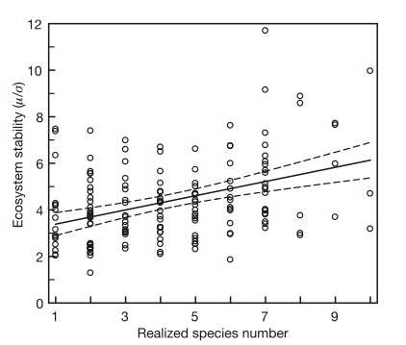
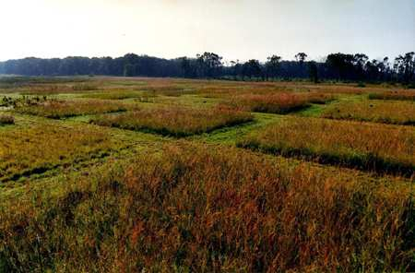
Diversity and stability
Long-term plots
University of Minnesota
Notes:
Tilman et al. (2006) Biodiversity and ecosystem stability in a decade-long grassland experiment. Nature 441: 629-632
One measure of stability is lower variation year on year.
Graph shows stability measured as variance that year divided by overall variance for plots with different numbers of species. The slope is positive, with more species having significantly lower temporal variation in variability! That is, more temporal stability.

Slide 13
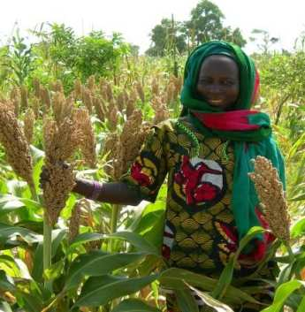
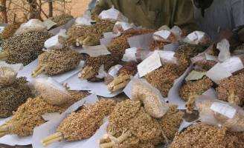
Minimizing risk for unpredictable environmental conditions in Burkina Faso
Unpredictable rainfall
Variety diversity
4-5 traditional sorghum varieties per farm (1.2 ha) and 23 per community with any two plants drawn at random within a farm differed in 69% (within a community 91%)
(Sawadogo et al., 2005 and 2006)
Notes:
13

Slide 14
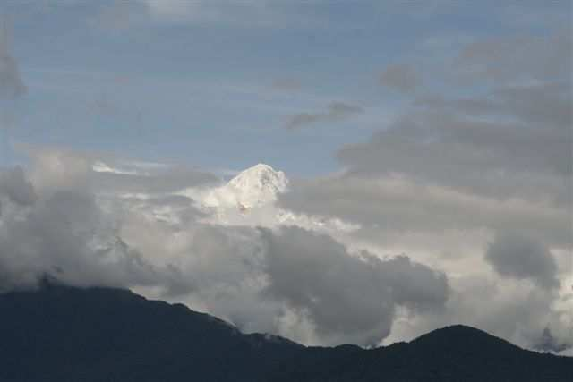
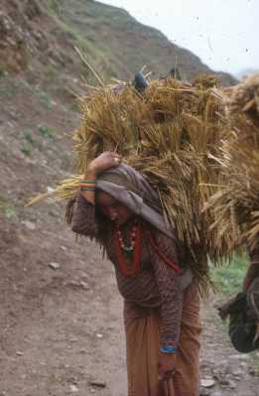


Farmers’ management of genetic diversity for adaptation
Participatory plant breeding to improve disease resistance in the local cold tolerant rice and barley landraces in high mountain agricultural sites in Nepal
Sthapit, Jarvis, Skinner, Murray, 2012

Slide 15
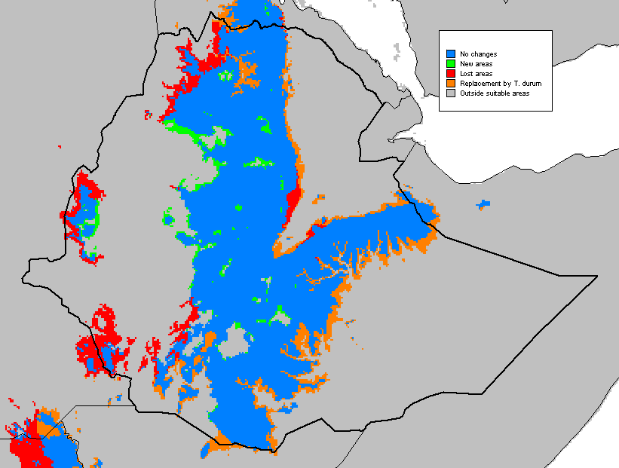

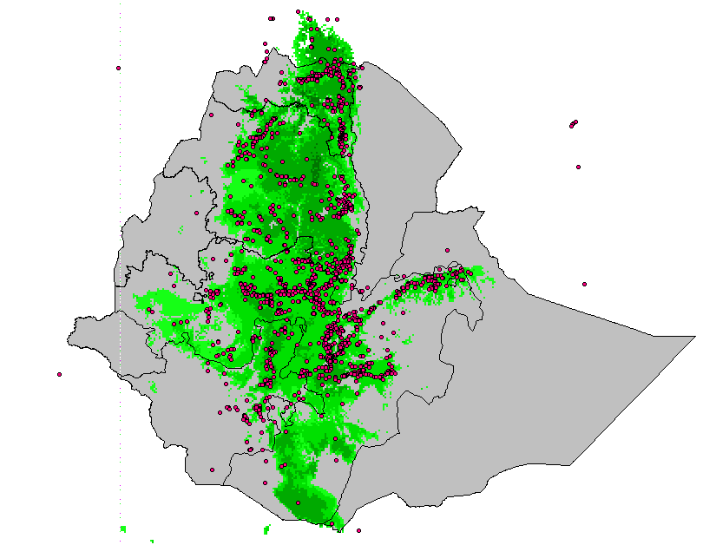
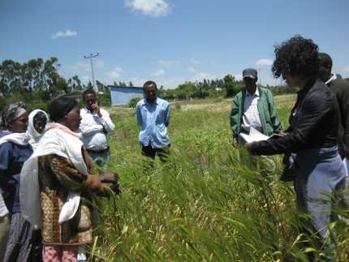
“Seeds for Needs” project promotes adaptation to climate change by women farmers in Ethiopia and PNG
  Projection of future climates in target regions
  Develop climate profile of genebank accessions
  Match current and future environmental conditions of target regions
Participatory evaluation by farmers

Slide 16
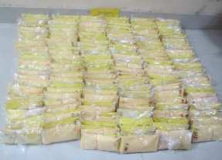
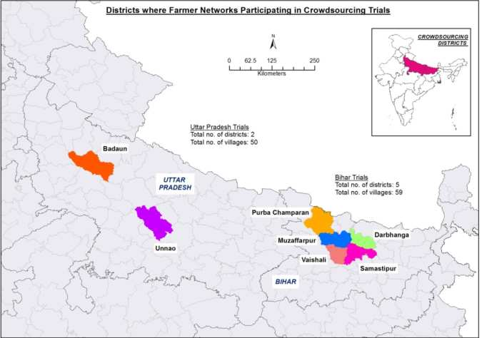
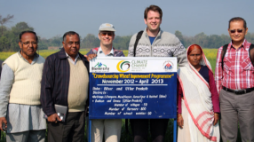
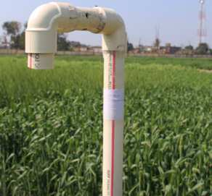
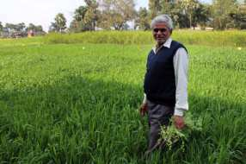
Broadening the genetic base of crop cultivation and empowering farmers for climate change adaptation through crowdsourcing
State = 2; Districts = 7; Villages = 109; Farmers = 800; Varieties = 10 (combination of 3 varieties/trial, each combination is unique
Citizen science approach scales out participatory crop research.

Slide 17
Objective: Integrating across outcomes
Notes:
17

Slide 18
Conservation and availability of genetic resources for adaptation

Slide 19
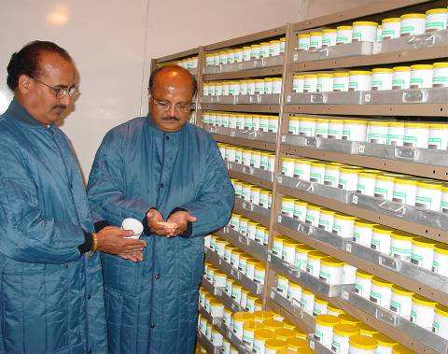
Genetic resources collections
Over 7 million accessions maintained in >1400 collections
CGIAR collections: >700.000 accessions held in trust in 11 collections
Major source of diversity for breeding adapted varieties

Slide 20
In situ conservation, on farms and in the wild, of agricultural and forest biodiversity:
ensures the continued evolution and adaptation to changing conditions

Slide 21
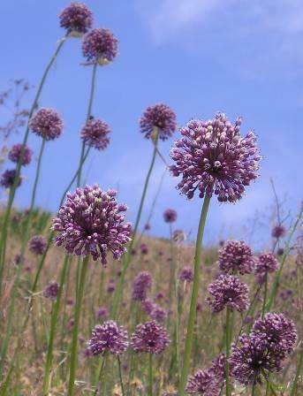
Crop Wild Relatives: precious source of traits
Underrepresented in collections
Difficult to maintain ex situ
→ Need
Targeted collecting
In situ conservation strategies
Notes:
Project brings together five countries: Armenia, Bolivia, Madasgacar, Sri Lanka and Uzbekistan and is funded by UNEP/GEF.
Partners: FAO, Botanic Gardens International, UNEP’s World Conservation Monitoring Centre, World Conservation Union and the Information and Coordination Centre for Biological Diversity.
Aim of the project is to protect natural populations of crop wild relatives while setting a precedent for conservation that the rest of the world can follow. Countries participating in the project contain some of the world’s biodiversity hotspots. Most of these countries had identified wild relatives as a priority for conservation but were unable to do much in the way of conservation because they lacked resources.
The project has three goals: 1) Develop national and international information systems on crop wild relatives that include data on species biology, ecology, conservation status, distribution etc; 2) Build capacity of national partners to use this information to develop and implement conservation approaches to crop wild relatives; 3) Raise awareness of the potential of crop wild relatives for improving agricultural production among policy makers, conservation managers, plant breeders, educators and local users.

Slide 22
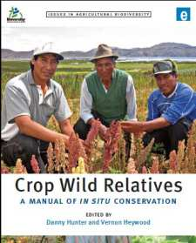
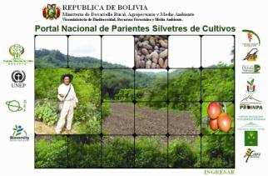
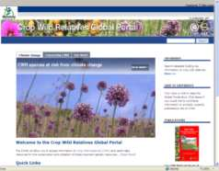
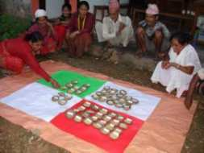
In situ conservation of crop wild relatives: a critical source of traits for climate adaptation
Capacity building and conservation actions
Public awareness
National Information Systems
International Information System
Manual of In Situ Conservation
Five megabiodiverse country partners: Armenia, Bolivia, Madagascar, Sri Lanka and Uzbekistan
Wild relatives of 35 priority crops
Notes:
Bioversity has implemented a major project on in situ conservation of CWR and developed a global CWR portal which allows access to information about CWR in the participating countries. The project developed the capacity in the 5 countries in implementation conservation activities, raised awareness about CWR at polciy maker level and also internationally. It documented the conservation status of CWR for over 35 priority crops.

Slide 23
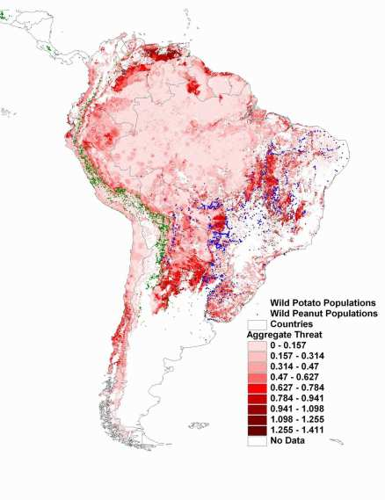
Climate change threats to crop wild relatives
Use existing data for accessions
Combine with climate change model GIS data
Identify areas of greatest threat
Notes:
Map is from
Assessment of threats to ecosystems in South America
Andy Jarvis, Jerome L. Touval, Mauricio Castro Schmitz, Leonardo Sotomayor and Glenn Graham Hyman
Journal for Nature Conservation (in Press) with potato and peanut added.
Dark red is aggregated threats to ecosystem (climate change, deforestation, agriculture, urban expansion etc)
Green dots are wild potato accessions.
Blue dots are wild peanut accessions.
Same sorts of process for climate change.
23

Slide 24
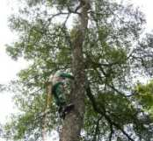
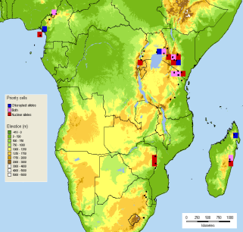
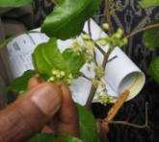
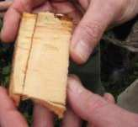
Conservation strategy for Prunus africana
Analysis of patterns of variation in genotype and chemotype
Phylogeographic study
Development of conservation and management guidelines
Mapping of priority conservation zones based on diversity from chloroplast and nuclear DNA analysis
Priority zones for in situ conservation of genetic diversity of Prunus africana
Collaboration with Austrian University and member countries of the Subsaharan Network on Forest Genetic Resources (SAFORGEN)

Slide 25
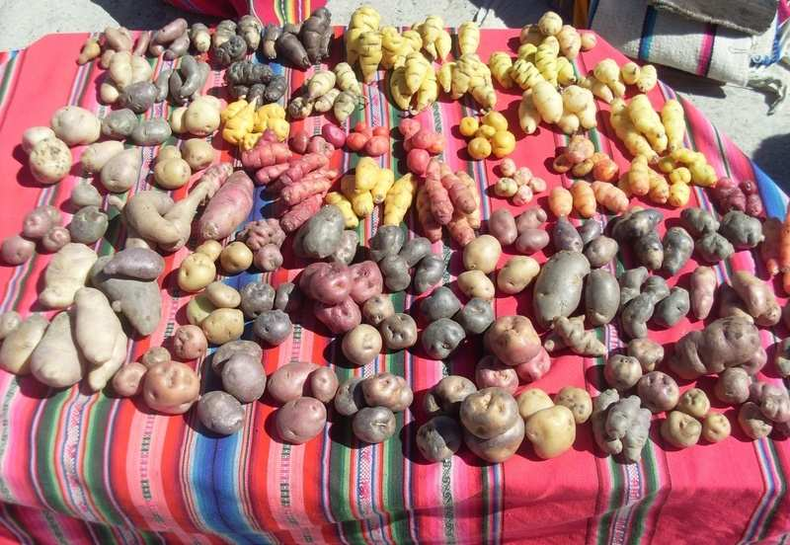
Improving the availability of plant genetic resources
Information: need to know what is where
A supportive policy environment
Notes:
TEXT + PICTURE ON THE RIGHT
To change the photo
-Right click on the photo
- Click on change

Slide 26
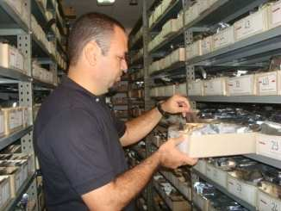
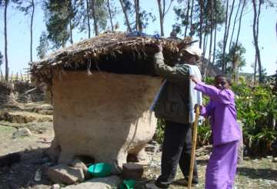

Knowing what is available
How can we facilitate access to valuable traits ?
  By linking genebank accessions to geographic/climate data
  By adding new functionality for selection to informatics systems (GENESYS portal )
Genebanks worldwide hold 7.4 million accessions (FAO SOW2, 2010)
Uncounted traditional collections held by farmers
Notes:
This work should take into account the fact that climate change is likely to affect the survival of genetic resources on-farm and in-situ in the wild (for example, of CWR). To prevent their loss, a strategic proportion of these materials will need to be collected and added to ex-situ collections. Designing a strategy for collecting to maximize the genetic diversity conserved for a given investment is a research question with both genetic and economic parameters. Enriching information of genebank accessions with climatic data of the site of collection will facilitate the search for specific traits needed for adaptation to climate change. Studies and actions should also focus on increasing the usefulness of and facilitating access to ex-situ collections for climate change adaptation, including reintroductions of materials after the natural disasters that are predicted to become more frequent. While putting materials in long term storage is cost effective, they are not so easy to access. The linkages between in situ/on farm and ex-situ conservation need to be strengthened to avoid genetic erosion and ensure the availability of diversity to users. In addition to using projections of climate change, environmental characteristics of collection sites and informatics to facilitate matching appropriate seeds to future needs, Bioversity should analyze other ways genebanks can become more proactive in contributing to the adaptation of agriculture to future conditions.

Slide 27
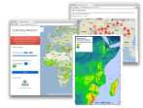

Global Web Portal(s) for
Agrobiodiversity
ex situ PGR and in situ/on farm ABD
Related
Germplasm Platforms
Geographical Atlases
of PGR Accessions
Related ABD Monitoring & Use
FAO, ITPGRFA PID/SMTA, WIPO systems
GBIF, GeoBON, Conservation Int’l
Breeding & Agroecological information
Other Global ABD monitoring systems
GBIF Internet Publishing Toolkit (IPT)
PGR/ABD Registries
National (NBPGR, GRIN, etc.)
Regional Networks (e.g. EURISCO)
Crop-Specific (e.g. MGIS, IRIS, etc.)
Mobile Phone Data Collection
GBIF IPT
PGR Data Standards
Global data identifiers
Descriptors
Crop Ontology
Web service formats
in situ/on farm
Agrobiodiversity Data
ex situ PGR
Genebank MIS
GRIN-Global
Other Genebank MIS: e.g. SDIS

Slide 28
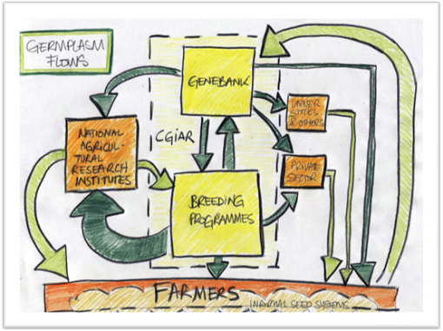
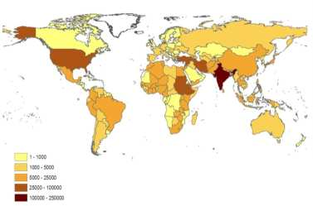
Supportive policies for access to and use of genetic resources
Implementation of the International Treaty on Plant genetic Resources for Food and Agriculture (ITPGRFA)
Improving the functioning of the ITPGRFA
National policies that support the use of diversity

Slide 29
Thank you
Notes:
THANK YOU/FINAL SLIDE

