Slide 1
ALU Software
Stephen M. Ogle, Ph.D.
Research Scientist and Associate Professor
Colorado State University
Natural Resource Ecology Laboratory
Fort Collins, Colorado USA

Slide 2
ALU Software Scope & Design
Primary Purpose: support reporting of GHG emissions to the UNFCCC
GHG Inventory Software Program
Developed for LULUCF and Agriculture Sectors
Based on IPCC methods (1996 GL and 2000-2003 GPG)
Emphasis on incorporation of good practices
Accommodates IPCC Tier 1 methods but allows compilers to advance inventory with the Tier 2 method capability
User-interface guiding compiler through inventory process of data entry and calculations
Notes:
Some introductory material on the design of ALU

Slide 3
Reporting
Ultimate goal of a national GHG inventory is to report emissions to the UNFCCC
Reporting is generally done in spreadsheets
Maps can be useful for illustrating variation in emissions across a country
Goals:
provide emission reports that conform to the norm for NAI party reporting (i.e., spreadsheet)
facilitate the development of emission maps to the extent that activity data and/or emission factors vary spatially
Notes:
Some more introductory material

Slide 4
Data Management
Agriculture and LULUCF require considerable data
Relational database structure with efficient storage of data
Goals:
assign emission factors automatically to activity data
relate activity data and emission factors directly to calculations
Notes:
Some more introductory material

Slide 5
Tier 1 and Tier 2 Methods
Tier 1 is acceptable for reporting but default emission factors can lead to significant biases
Tier 2 is encouraged for key categories
Limited strata for assigning Tier 2 factors in spreadsheets
Goals:
facilitate application of Tier 2 methods from activity data compilation to assignment factors
provide more opportunity for stratifying the land base or livestock population
Notes:
Some more introductory material

Slide 6
Quality Assurance/Quality Control
Important step which often uncovers errors by compiler
Also can allow input of third parties who may have knowledge of other data relevant for the inventory
Goal: provide an utility that facilitates QA/QC
Interface displays data which can be validated as QA/QC is completed
Export QA/QC data for ease of distribution for review
Notes:
Some more introductory material

Slide 7
Uncertainty Estimation
Inventories following good practice “contain neither over- nor under-estimates so far as can be judged, and which uncertainties are reduced as far as is practicable” (IPCC GPG 2000)
Difficult to evaluate if uncertainty is not estimated
Uncertainty is sometimes an after-thought for compilers
Goal: encourage the compilation of uncertainty data with the activity data collection and development of Tier 2 emission factors
Notes:
Some more introductory material

Slide 8
Document Inventory & Archive
Institutional memory requires documentation
Data archive is needed to ensure data are maintained
With back-ups
Goal:
provide a utility that facilitates documentation
Note pad that can be exported
Documentation boxes for Tier 2 factors
make archiving easier for the compiler
Notes:
Some more introductory material

Slide 9
Some other issues
Consistency in time series: encourage the recalculation and consistent application of methods across a time series
Complete land representation: facilitate use of remote sensing-based products to achieve a complete representation of managed land base
Enhanced livestock characterization: facilitate use of remote sensing-based products to achieve a complete representation of managed land base
Mitigation analysis: facilitate mitigation analysis using the inventory as the baseline
Notes:
Some more introductory material

Slide 10
ALU software structure

Slide 11
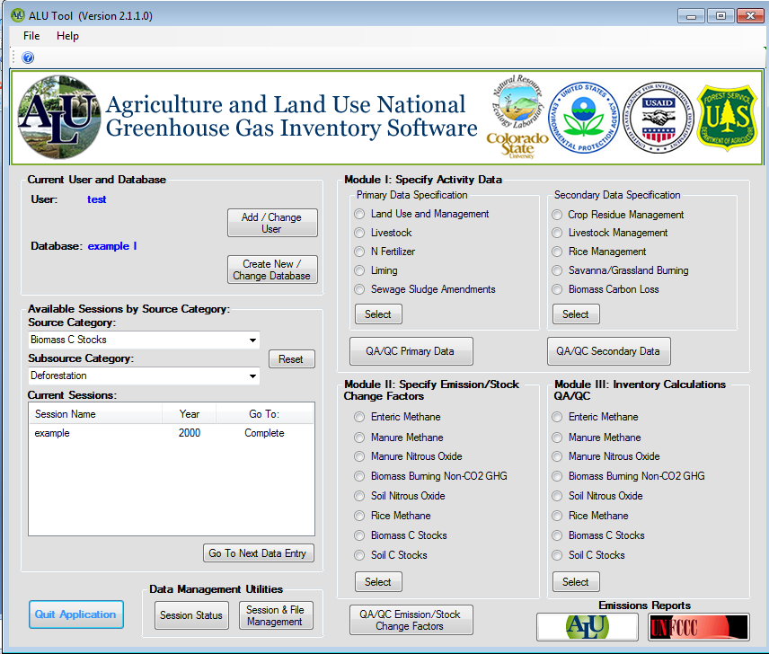
Module I:
Activity data entry
Module II:
Assign Emission
Factors
Module III:
Complete Emission Calculations

Slide 12
ALU Livestock Session

Slide 13
Module I-Primary Data: Enter Livestock Statistics

Slide 14
Select Climate
Region
Total
Enter enhanced
animal population numbers
Enter basic
animal population numbers

Slide 15
Select Climate and Livestock Categories
Enter Populations
Enter Population Totals

Slide 16
Select Climate Livestock Category and Population
Select Subcategory
Enter Subcategory Totals

Slide 17
Select Basic and Enhanced Categories
Select Manure Management Systems
Enter % of manure management system

Slide 18
QA/QC for Primary Data

Slide 19
Livestock Management Secondary Data

Slide 20
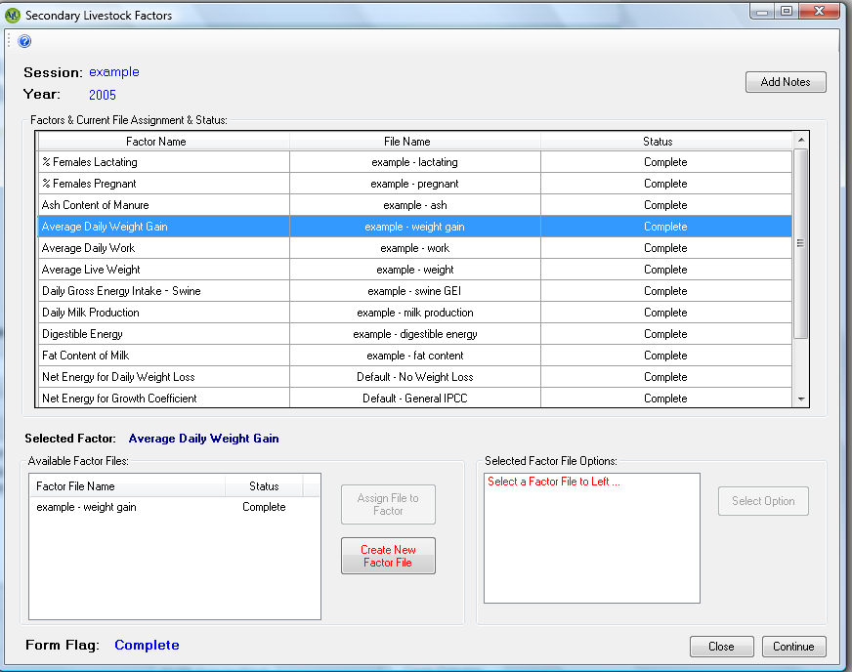
Factors/Data needed to estimate gross energy intake
Available factor files

Slide 21
Module II: Enter Emission Factors for Enteric Methane

Slide 22
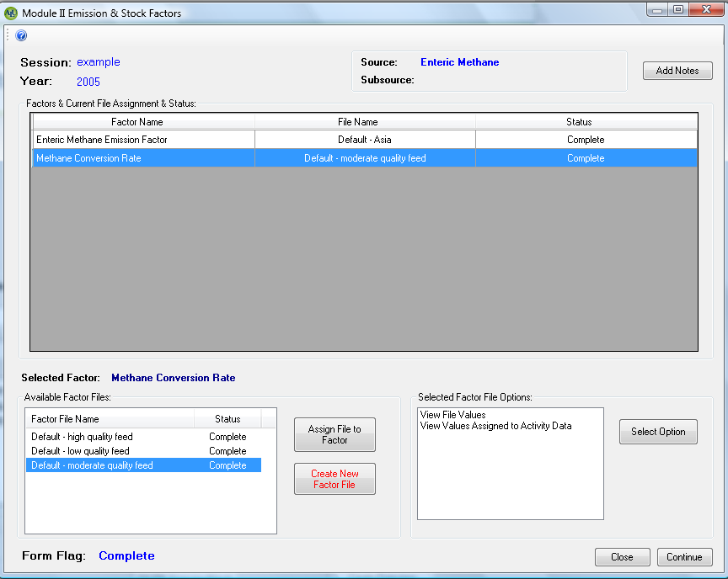
Factors needed to estimate enteric methane emissions
Available factor files
Additional options

Slide 23
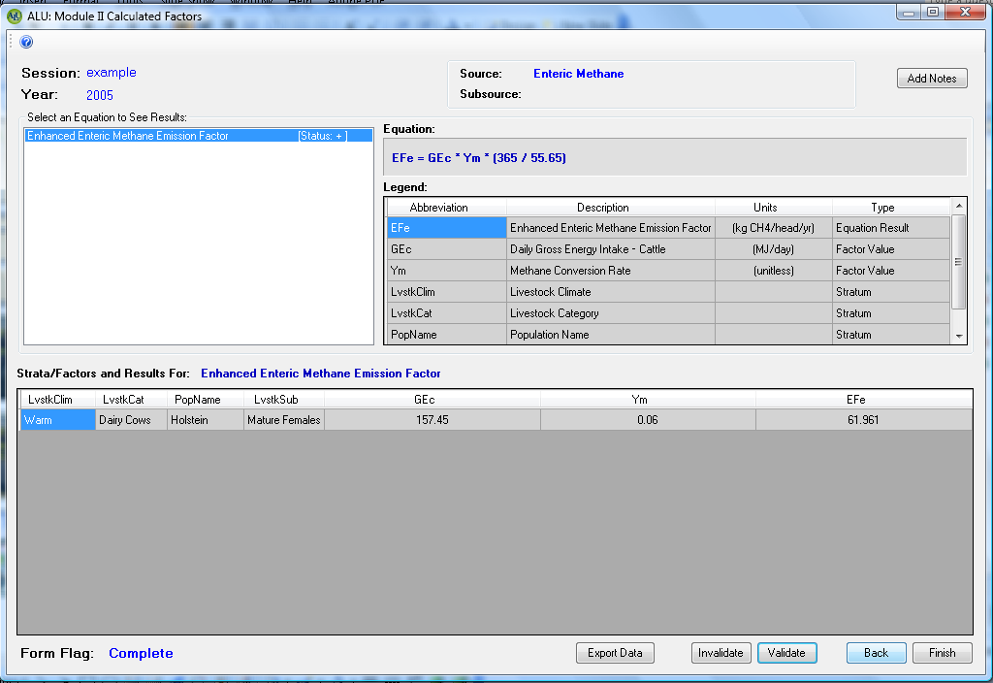
Equation and Legend
Calculation
Review results for enteric methane emissions

Slide 24
Module III: Estimate Emissions for Enteric Methane

Slide 25
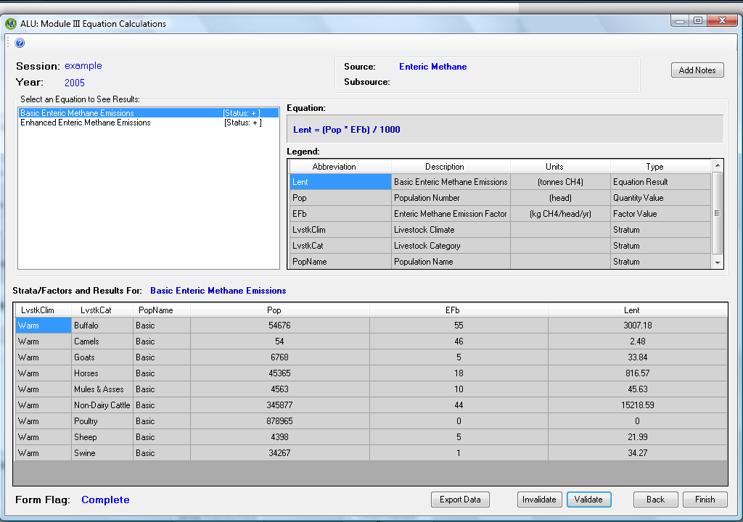
Equation and Legend
Calculation
Review results for enteric methane emissions

Slide 26
Create Emissions Report

Slide 27
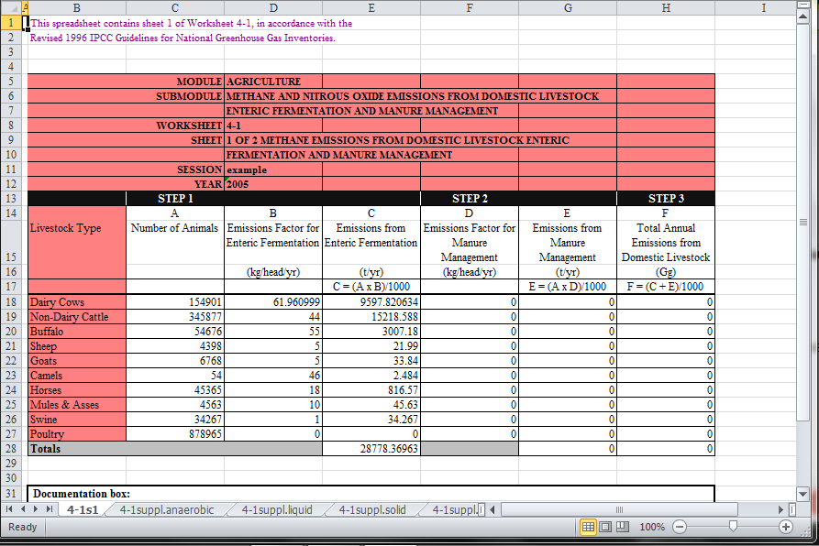

Slide 28
ALU Mitigation Analysis

Slide 29
Scope of Analysis
Analyze the potential change in greenhouse gas emissions from changing management of land and livestock
Use existing inventory in ALU as the baseline
Include multiple source categories influenced by practice
Within Agricultural and Land Use, Land Use Change and Forestry sectors
Biophysical potentials produced by ALU, but projections can be informed by economic forecasts of commodity production and consequences for management of land and livestock

Slide 30
Approaches for Mitigation Analysis
Whole Session Approach
Focus on all practices
Maximum utility
Assesses all drivers of emissions and mitigation potential
i.e., Population growth, economic growth and technology
Practice-Based Approach
Focus on specific practice
Focuses on technology as a driver of emissions and mitigation potential

Slide 31
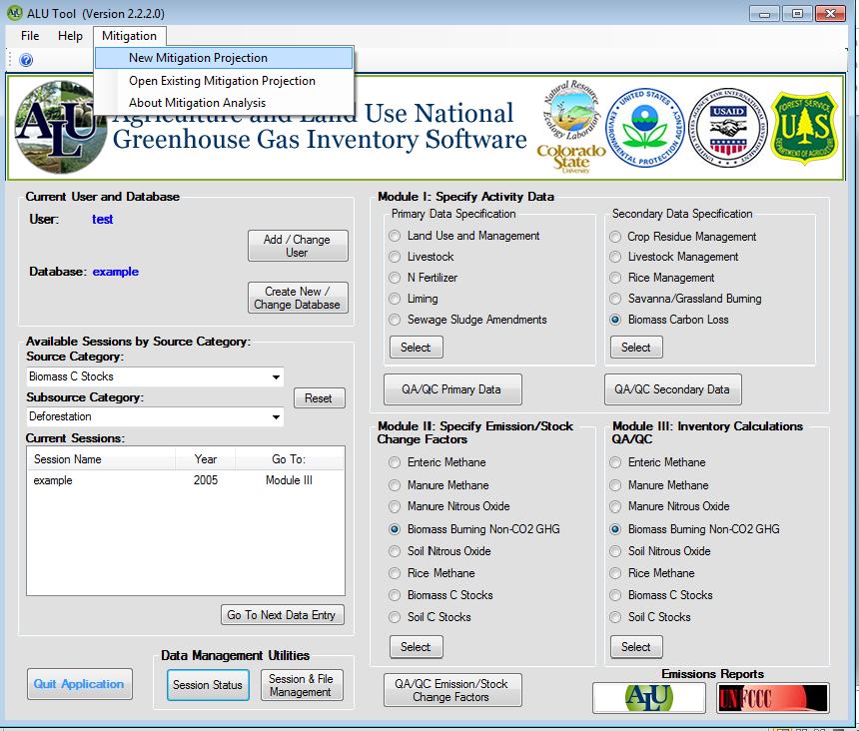
Start mitigation analysis from task bar

Slide 32
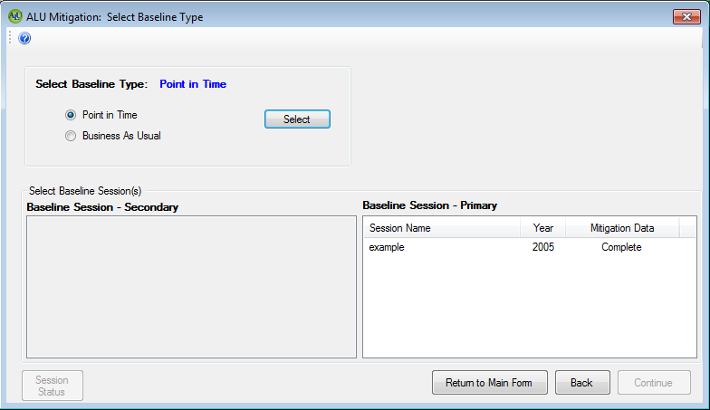
Select baseline type
Select baseline session

Slide 33
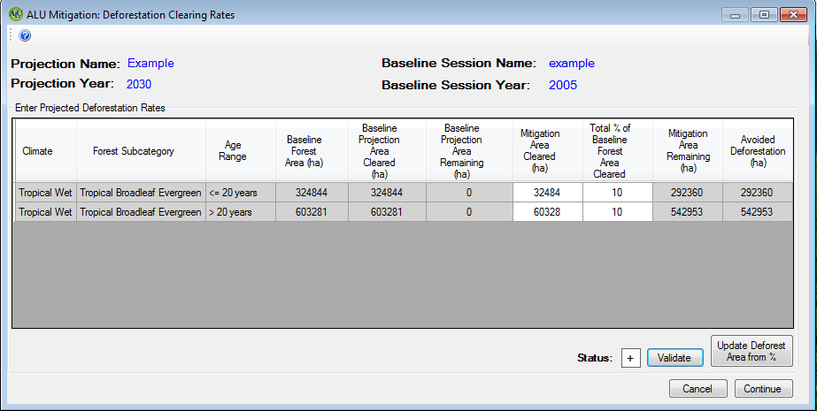
Enter Mitigation Projection

Slide 34
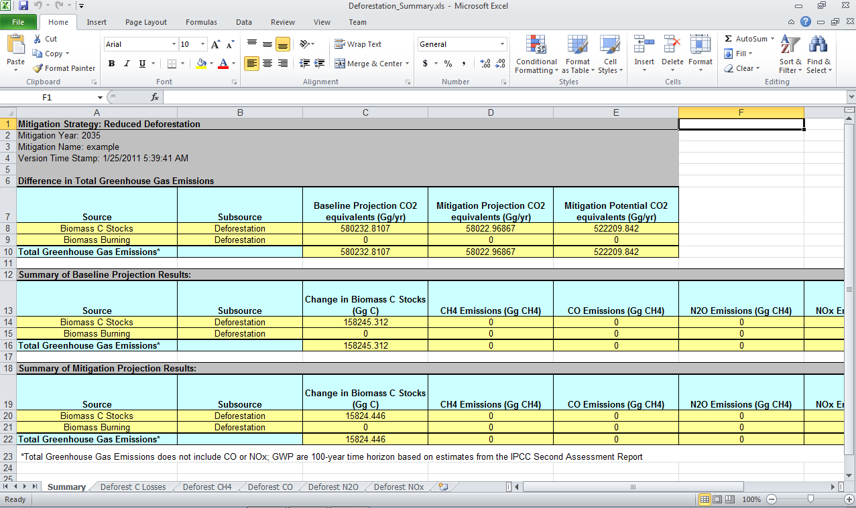

Slide 35
Data Entry Flow

Slide 36
Data Entry Flow
Data is entered in a specific sequence
Building on the previous data entry in each step
Pre-requisite data entry
System is locked until session is initiated
Each step will open another part of system as valid data are entered
Data do not have to be complete but must be valid
Prevents errors

Slide 37
Validation Checks
Validation checks after each step
Ensure internal data integrity
Identifies steps that are not complete or influenced by a change in data
Types of errors
Missing data
Inappropriate characters
Inappropriate data
Invalid land areas
Invalid livestock totals
Invalid lime or N fertilizer totals

Slide 38
Validation Checks
Program System Flags
“+” means that data entry passed the validation
“-” means that data entry has not passed validation
Program system will reset flags if you make changes in the data
Session flags can be viewed by clicking the “Session Status” button on main window of program

Slide 39
ALU software
Free download from:
www.nrel.colostate.edu/projects/ghgtool/software.php

