Slide 1

Industrial Processes and Product Use (IPPU)

Slide 2
Foreword, Copyright and Disclaimer
These presentation materials to explain the contents of the 2006 IPCC Guidelines:
are based on the presentations (except presentation on QA/QC) delivered by the Technical Support Unit of the Task Force on National Greenhouse Gas Inventories of the Intergovernmental Panel on Climate Change (IPCC TFI TSU) in the Africa Regional Workshop on the Building of Sustainable National Greenhouse Gas Inventory Management Systems, and the use of the 2006 IPCC Guidelines for National Greenhouse Gas Inventories (Swakopmund, Namibia, 24-28 April 2017);
have not been subject to a formal IPCC review process http://www.ipcc.ch/pdf/ipcc-principles/ipcc-principles-appendix-a-final.pdf; and
will be updated from time to time.
If you wish to use these presentation materials in some way or other (e.g., use some or all of these slides in your presentation at a workshop), please inform the TFI TSU through http://www.ipcc-nggip.iges.or.jp/mail. Also read the notes in the following websites.
Copyright: http://www.ipcc.ch/home_copyright.shtml
Disclaimer: http://www.ipcc.ch/home_disclaimer.shtml
The CGE acknowledges the inputs from, and expresses its appreciation to, the IPCC TFI TSU.
Consultative Group of Experts (CGE)
2
Training Materials for National Greenhouse Gas Inventories

Slide 3
Outline
IPPU importance
What is the IPPU Sector?
IPPU Categories:
    2A: Mineral Industry
    2B: Chemical Industry
    2C: Metal Industry
    2D: Non-Energy Products from Fuels & Solvent Use
    2E: Electronics Industry
    2F: Product Uses as Substitutes for Ozone Depleting Substances
    2G: Other Product Manufacture and Use (Electrical Eq., Military Apps, Medical Apps)
4. IPPU Activity Data
5. Conclusion
Consultative Group of Experts (CGE)
3
Training Materials for National Greenhouse Gas Inventories

Slide 4
Importance for Non-Annex I Parties
IPPU sector is considered to be less significant compared to Energy and AFOLU
Situation varies from country to country
IPPU sources may become significant in the future as developing countries’ economies and industries grow
Inclusion of F-gases estimates can contribute significantly to the IPPU emissions and influence the total estimates
IPPU emissions estimation is important to find opportunities for GHG abatement
4

Slide 5
IPPU Sector
IPPU – GHG emissions:
  1. Industrial Processes
  2. Product Use
1. Industrial Processes that chemically or physically transform materials releasing GHG:
  - chemically: NH₃ + O2 = 0.5 N₂O↑ + 1.5 H₂O (nitric acid production)
  - physically: CaCO₃ + (Heat) = CaO + CO₂↑
2. Product Use: GHGs are used in products such as refrigerators, foams or aerosol cans
  Note: significant time can elapse between the manufacture of the product and the release of GHG. The delay can vary from a few weeks (e.g., for aerosol cans) to several decades (e.g., rigid foams). In refrigeration a fraction of GHG used in the products can be recovered at the end of product’s life and either recycled or destroyed.
Consultative Group of Experts (CGE)
5
Training Materials for National Greenhouse Gas Inventories

Slide 6
IPPU Sector
Not IPPU:
Emissions from Fuel combustion in Industrial Sector for energy purposes (e.g., cement production) → Energy Sector
Fugitive emissions in Oil/Gas industries → Energy Sector
Solvents & other products incineration without energy recovery → Waste Sector
Consultative Group of Experts (CGE)
6
Training Materials for National Greenhouse Gas Inventories

Slide 7
Demarcation: IPPU vs. Energy
Combustion emissions from fuels obtained from the feedstock for an IPPU process will normally be allocated the source category in which the process occurs (these source categories are normally 2B and 2C). However, if the derived fuels are transferred for combustion in another source category, the emissions should be reported in the appropriate part of the Energy Sector (normally 1A1 or 1A2).
Example:
if blast furnace gas is combusted entirely within the Iron and Steel industry (whether for heating blast air, site power needs or for metal finishing operations) the associated emissions are reported in the IPPU source subcategory 2C1. If part of the gas is delivered to a nearby brick works for heat production or a main electricity producer then the emissions are reported in the Energy source subcategories (1A2f or 1A1a).
Box 1.1 Chapter 1, Volume 3 2006 IPCC Guidelines
Consultative Group of Experts (CGE)
7
Training Materials for National Greenhouse Gas Inventories

Slide 8
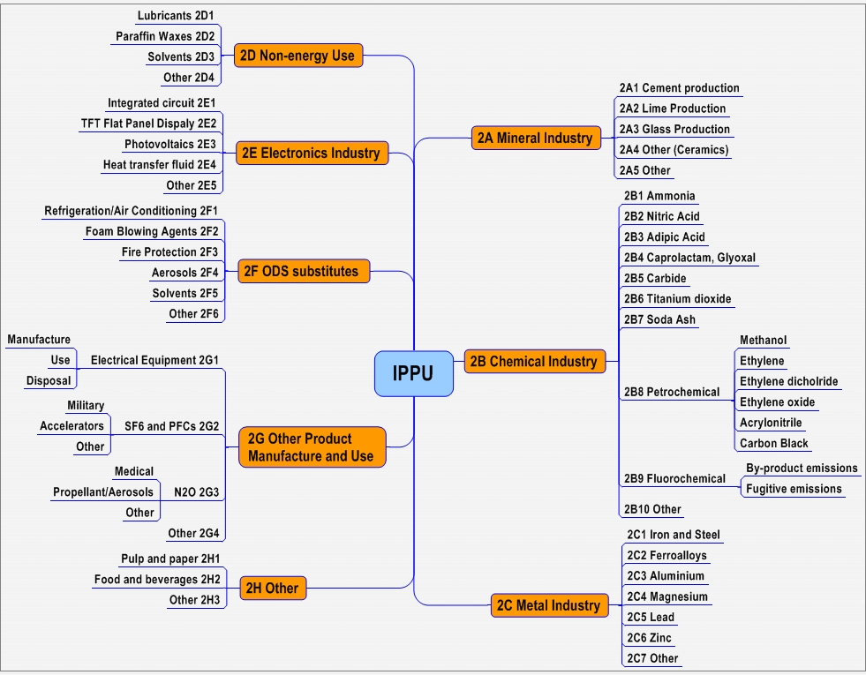
Consultative Group of Experts (CGE)
8
Training Materials for National Greenhouse Gas Inventories

Slide 12
IPPU Gases (CO₂, CH₄, N₂O, HFCs, PFCs, SF₆ and NF₃)
A wide variety of gases:
  CO₂, CH₄, N₂O
  HFCs, PFCs, SF₆
  Other halogenated gases
  Ozone/aerosol precursors (e.g., NMVOCs)
H₂O and gases controlled by the Montreal Protocol (e.g., CFCs, HCFCs) are not included
Under the UNFCCC, non-Annex I Parties:
  should report CO₂, CH₄ and N₂O
  are encouraged to report HFCs, PFCs, SF₆ and precursors
  Inclusion of F-gases is important because of their high global warming potential (GWP), substantial use in industrial processes and in households, significant opportunities for GHG abatement
Consultative Group of Experts (CGE)
12
Training Materials for National Greenhouse Gas Inventories

Slide 13
2A: Mineral Industry
Transformation of carbonate-contained compounds – limestone, dolomite, etc. (CaCO₃, MgCO₃, Na₂CO₃)
CO₂ Emissions
Code | Category | Default EF
2A1: | Cement Production | 0.51 t CO2/t clinker
2A2: | Lime Production | 0.75 t CO2/t lime
2A3: | Glass Production | 0.20 t CO2/t glass
2A4: | Other Process Uses of Carbonates
2A4a: | Ceramics | Chapter 2.5
2A4b: | Other Uses of Soda Ash | 0.41 t CO2/ t soda ash
2A4c: | Non Metallurgical Magnesia Production | 0.52 t CO2/t magnesite
2A4d: | Other
2A5: | Other
Consultative Group of Experts (CGE)
13
Training Materials for National Greenhouse Gas Inventories

Slide 14
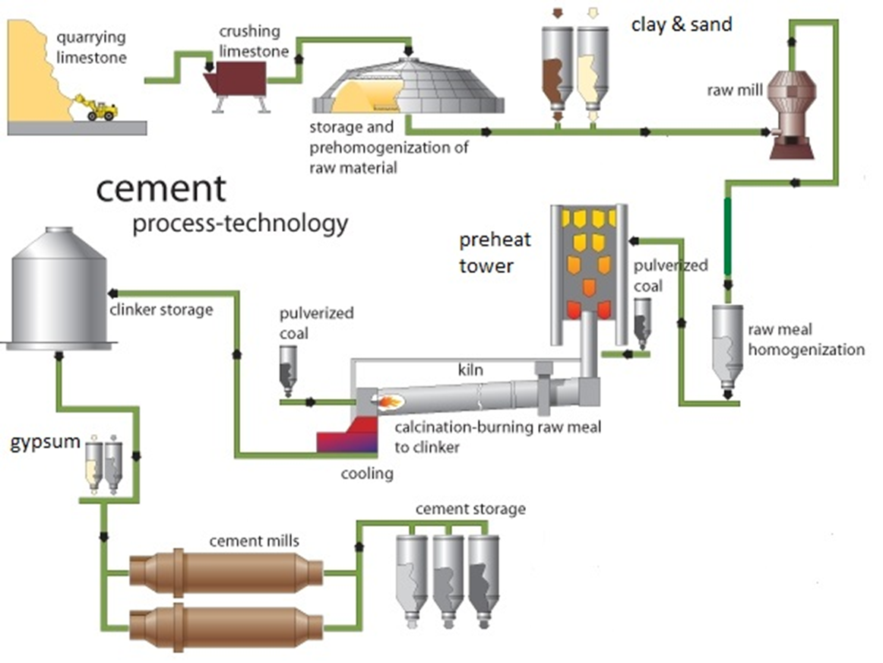
2A1: Cement Production
Calcination: CaCO3 +(Heat) = CaO+CO2 (IPPU)
Combustion: Coal/Gas+O2=CO2 +(Heat) (Energy)
14
Image: applied from DCMAC: http://www.dscrusher.com/solutions/production-line/sand-cement-cogeneration-production-line.html (as of March, 1 , 2015)

Slide 15
CO₂ from Cement Production (Tier 1)
CO₂ Emissions = AD clinker production x EF clinker
CO₂ Emissions = [Σ(M_{c,i} x C_{Cl,i}) – Im + Ex] x EF_{Clc}
    M_{c,i} - mass of cement produced of type i, tonnes
    C_{Cl,i} - clinker fraction of cement type i, fraction
    Im - imports for consumption of clinker, tonnes
    Ex - exports of clinker, tonnes
    EF_{Clc} - emission factor for clinker, tonnes CO₂/tonne clinker
Default EF_{Clc} = 0.52 tonnes CO₂/tonne clinker
(corrected for cement kiln dust (CKD))
Consultative Group of Experts (CGE)
15
Training Materials for National Greenhouse Gas Inventories

Slide 16
CO₂ from Cement Production (Tier 1)
To estimate clinker production:
  National-level data should be collected on:
    Cement production by type (Portland, masonry, etc.)
    Clinker fraction by cement type
  If detailed information on cement type is not available, multiply total cement production by:
    Default Ccl = 0.75 (if blended/‘masonry’ is much)
    Default Ccl = 0.95 (if all is essentially ‘Portland’)
  Data should be obtained on the amount of clinker imported and exported
Consultative Group of Experts (CGE)
16
Training Materials for National Greenhouse Gas Inventories

Slide 17
CO₂ from Cement Production (Tier 2)
    Tier 2 includes a correction addition for emissions associated with Cement Kiln Dust (CKD) not recycled to the kiln which is considered to be ‘lost’ and associated emissions are not accounted for by the clinker:
    CO2 Emissions = M_{cl} x EF_{cl} x CF_{CKD}
    CFCKD = 1 + (Md / Mcl) * Cd * Fd * (EFc / EFcl)
        CFCKD - emissions correction factor for CKD, dimensionless
        Md - weight of CKD not recycled to the kiln, tonnes
        Mcl - weight of clinker produced, tonnes
        Cd - fraction of original carbonate in the CKD (i.e., before calcination),
        fraction
        Fd - fraction calcination of the original carbonate in the CKD, fraction
        EFc - emission factor for the carbonate, tonnes CO₂/tonne carbonate
        EFcl - emission factor for clinker uncorrected for CKD, tonnes CO₂/
        tonne clinker (i.e., 0.51)
Consultative Group of Experts (CGE)
17
Training Materials for National Greenhouse Gas Inventories

Slide 18
CO₂ from Cement Production (Tier 3)
Limestones and shales (raw materials) also may contain a proportion of organic carbon (kerogen); other raw materials (e.g., fly ash) may contain carbon residues, which would yield additional CO₂ when burned
Detailed plant-level data on the carbonate raw materials is needed
Consultative Group of Experts (CGE)
18
Training Materials for National Greenhouse Gas Inventories

Slide 19
2B: Chemical Industry
Code | Category | Default EF
 |  | CO2 | N2O | CH4
2B1: | Ammonia Production | X
2B2: | Nitric Acid Production |  | X
2B3: | Adipic Acid Production |  | X
2B4: | Caprolactam, Glyoxal and Glyoxylic Acid Production |  | X X X
2B5: | Carbide Production SiC CaC2 | X X |  | X
2B6: | Titanium Dioxide Production | X
2B7: | Soda Ash Production | X
Consultative Group of Experts (CGE)
19
Training Materials for National Greenhouse Gas Inventories

Slide 20
2B: Chemical Industry
Code | Category | Default EF
 |  | CO₂ | CH₄ | F-gases
2B8: | Petrochemical and Carbon Black Production
2B8a: | Methanol | X | X
2B8b: | Ethylene | X | X
2B8c: | Ethylene Dichloride and Vinyl Chloride Monomer | X X | X
2B8d: | Ethylene Oxide | X | X
2B8e: | Acrylonitrile | X | X
2B8f: | Carbon Black | X | X
2B9: | Fluorochemical Production
2B9a: | By-product Emissions |  |  | X
2B9b: | Fugitive Emissions |  |  | X
Consultative Group of Experts (CGE)
20
Training Materials for National Greenhouse Gas Inventories

Slide 21
2B1: Ammonia Production
CO₂ associated with urea production & use:
  1996 GL: all these emissions were implicitly included in CO₂ from Ammonia Production
  2006 GL: CO₂ recovered in the ammonia production process for urea production should be deducted from CO₂ emissions from 2B1 Ammonia Production
CO₂ emissions from urea use/incineration should be reported in the category where they occur, e.g.:
  Use of urea-based catalysts (Energy – Road Transport)
  Urea application to agricultural soils (AFOLU)
  Incineration of urea-based products (Waste)
Thus, now, proper account can be taken for urea produced in ammonia plants
Consultative Group of Experts (CGE)
21
Training Materials for National Greenhouse Gas Inventories

Slide 22
2C: Metal Industry
Code | Category | CO2 | CH4 | F-gases
2C1: | Iron and Steel Production | X | X
2C2: | Ferroalloys Production | X | X
2C3: | Aluminium Production | X |  | X
2C4: | Magnesium Production | X |  | X
2C5: | Lead Production | X
2C6: | Zinc Production | X
2C7: | Other
Consultative Group of Experts (CGE)
22
Training Materials for National Greenhouse Gas Inventories

Slide 23
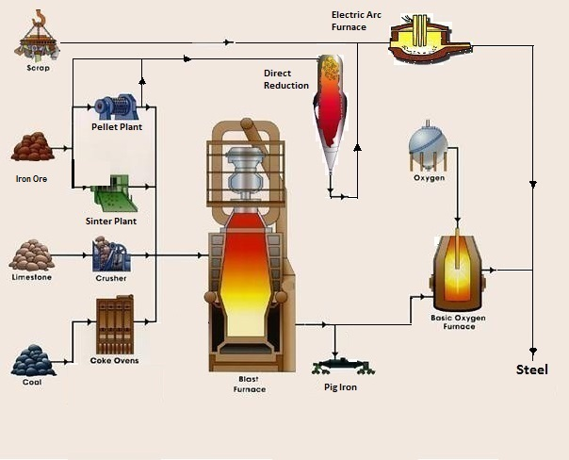
Image: applied from MetalPass http://www.metalpass.com/metaldoc/paper.aspx?docID=251 (as of March, 1 , 2015)
Coke production: (Energy)
Coal + (Heat) = Coke + Carbon Dioxide
Iron Production: + Iron Ore = Iron + Carbon Dioxide (IPPU)
Coke
Combustion: + Oxygen = Carbon Dioxide + (Heat) (IPPU)

Slide 24
2C1: CO₂ from Iron and Steel Production (Tier 1)
CO₂ emissions from Iron & Steel production:
CO2 Emissions = Σ(AD_{i} x EF_{i})
AD_{i} - quantity of material i, tonnes
EF_{i} - emission factor for production of material i,
tonnes CO₂/tonne material i produced
Material i | Default EF | Global average default EF for Steel
 | tonne CO2/tonne material i
Crude steel from Basic Oxygen Furnace | 1.46 | 1.06
Crude steel from Electric Arc Oxygen Furnace | 0.08
Crude steel from Open Hearth Furnace | 1.72
Pig iron not converted to steel | 1.35 | (If activity data on steel production for each process is not available, multiply total steel production by this EF)
Direct reduced iron | 0.70
Sinter | 0.20
Pellet | 0.03
Coke Oven (should be reported in Energy) | 0.56

Slide 25
2C1: CO₂ from Iron and Steel Production (Tier 2)
25

Slide 26
2C3. Aluminium production – PFCs Emissions
Tier 1 uses technology-based default EFs for 4 main production technologies: Centre-Worked Prebake (CWPB), Side-Worked Prebake (SWPB), Horizontal Stud Søderberg (HSS) and Vertical Stud Søderberg (VSS)
Tier 2 based on direct measurements of PFCs for 4 technologies and 2 different methods: Slope and Overvoltage (relationship between anode effect and performance)
Consultative Group of Experts (CGE)
26
Training Materials for National Greenhouse Gas Inventories

Slide 27
2D: Non-Energy Products from Fuels and Solvent Use
GHG emissions from use of non-energy products (lubricants, waxes, greases, solvents) other than:
    - combustion for energy purposes;
    - use as feedstock or reducing agent;
    - incineration of waste oils/lubricants with/without energy recovery (Energy/Waste Sector).
A small proportion of non-energy products oxidises during use
Focus on direct CO₂ emissions and substantial NMVOC/CO emissions which eventually oxidise to CO₂ in the atmosphere
Code | Category | CO2 | NMVOC, CO
2D1: | Lubricant Use | X
2D2: | Paraffin Wax Use | X
2D3: | Solvent Use |  | X
2D4: | Other (asphalt production and use) |  | X
Consultative Group of Experts (CGE)
27
Training Materials for National Greenhouse Gas Inventories

Slide 28
2E: Electronics Industry
Code | Category
2E1: | Integrated Circuit or Semiconductor
2E2: | TFT Flat Panel Display
2E3: | Photovoltaics
2E4: | Heat Transfer Fluid
2E5: | Other
Gases: CF4, C2F6, C3F8, c-C4F8, c-C4F8O, C4F6, C5F8, CHF3, CH2F2, nitrogen trifluoride (NF3), sulfur hexafluoride (SF6)
Electronics industry:
several advanced electronics manufacturing processes utilise fluorinated compounds for plasma etching silicon containing materials, cleaning reactor chambers, and temperature control. The specific electronic industries include semiconductor, thin-film-transistor flat panel display (TFT-FPD), and photovoltaic (PV) manufacturing
Consultative Group of Experts (CGE)
28
Training Materials for National Greenhouse Gas Inventories

Slide 29
2F: Fluorinated Substitutes for ODS
Code | Category | HFCs | PFCs
2F1: | Refrigeration and Air Conditioning | X | X
2F1a: | Refrigeration and Stationary Air Conditioning | X | X
2F1b: | Mobile Air Conditioning | X | X
2F2: | Foam Blowing Agents | X | X
2F3: | Fire Protection | X | X
2F4: | Aerosols | X | X
2F5: | Solvents | X | X
2F6: | Other Applications | X | X
Consultative Group of Experts (CGE)
29
Training Materials for National Greenhouse Gas Inventories

Slide 30
2F: Fluorinated Substitutes for ODS
Applications or Sub-applications - major groupings of current and expected usage of the ODS substitutes
Actual emissions vs. Potential emissions (2006 vs.1996)
Prompt emissions (within 2 years) and Delayed emissions
Bank – total amount of substances contained in existing equipment, chemical stockpiles, foams, other products not yet released to the atmosphere (+ExIm)
Approaches:
    Emission Factor (a) and Mass-balance (b)
    Tier 1 and Tier 2
Consultative Group of Experts (CGE)
30
Training Materials for National Greenhouse Gas Inventories

Slide 31
Actual emissions vs. Potential emissions
The 2006 IPCC Guidelines provide with methods for estimating actual emissions of ODS substitutes in contrast to potential emissions approach (1996 IPCC Guidelines) taking into account the time lag between consumption of ODS substitutes and emissions.
Potential emissions approach assumes that all emissions from an activity occur in the current year (manufacture + import - export - destruction), ignoring the fact they will occur over many years, thus estimates may become very inaccurate
Example. A household refrigerator emits little or no refrigerant through leakage during its lifetime and most of its charge is not released until its disposal, many years after production. Even then, disposal may not entail significant emissions if the refrigerant and the blowing agent in the refrigerator are both captured for recycling or destruction
Use of actual emissions allows to:
  accurately estimate emissions of ODS substitutes
  proper address emission reductions of abatement techniques
Consultative Group of Experts (CGE)
31
Training Materials for National Greenhouse Gas Inventories

Slide 32
Bank
Emissions
Exports of
Gas
Imports of Gas
Imports of
Exports of Gas
Bank of Gas in
Gas in
in Equipment
Equipment
Equipment
Manufacture of
Gas
Consultative Group of Experts (CGE)
32
Training Materials for National Greenhouse Gas Inventories

Slide 33
Bank
Where delays in emission occur, the cumulative difference between the chemical that has been consumed in an application and that which has already been released is known as a bank (refrigeration and air conditioning, fire protection, closed-cell foams).
    Example. Blowing agent still present in foamed products which may have already been land-filled is still part of the bank, since it is chemical which has been consumed and still remains to be released.
Estimating the size of a bank in an application is typically carried out by evaluating the historic consumption of a chemical and applying appropriate emission factors. It is also sometimes possible to estimate the size of bank from a detailed knowledge of the current stock of equipment or products.
    Example. In mobile air conditioning - the automobile statistics may be available providing information on car populations by type, age and even the presence of air conditioning. With knowledge of average charges, an estimate of the bank can be derived without a detailed knowledge of the historic chemical consumption, although this is still usually useful as a cross-check.
Consultative Group of Experts (CGE)
33
Training Materials for National Greenhouse Gas Inventories

Slide 34
..it is good practice to consider the number and relevance of sub-applications, the data availability, and the emission patterns…for rigorous emissions estimates, inventory compilers are likely to favour estimating emissions for each sub-application separately.. (Tier 2)
Consultative Group of Experts (CGE)
34
Training Materials for National Greenhouse Gas Inventories

Slide 35
2F: Sub-applications
Consultative Group of Experts (CGE)
35
Training Materials for National Greenhouse Gas Inventories

Slide 36
2F: Chemicals and blends
Consultative Group of Experts (CGE)
36
Training Materials for National Greenhouse Gas Inventories

Slide 37
2F: Blends
37

Slide 38
2F: Tiers / Approaches and Data
Consultative Group of Experts (CGE)
38
Training Materials for National Greenhouse Gas Inventories

Slide 39
2F4 / 2F5: Solvents / Aerosols
For prompt emissions (solvents, aerosols):
GHG Emissions = St*EF + St-1*(1-EF)
  S – quantity of chemical sales in current and previous year t, t-1
  EF = 1 for two years (100%), default EF - 0.5/0.5
Consultative Group of Experts (CGE)
39
Training Materials for National Greenhouse Gas Inventories

Slide 40
2F2: Foams Blowing Agents
Open foams (GHG immediate release):
GHG Emissions = Mt
    Mt - total HFC used in manufacturing new open-cell foam in year t, tonnes
Closed foams (GHG delayed release):
GHG Emissions = Mt*EFFYL+ Bankt*EFAL + DLt – RDt
    Mt - total HFC used in manufacturing new closed-cell foam in year t
    EFFYL - first year loss emission factor
    Bankt - HFC charge blown into closed-cell foam manufacturing between
    year t and year t-n
    EFAL - annual loss emission factor
    DLt - decommissioning losses or remaining losses of chemical at the end of
    RDt - HFC emissions prevented by recovery and destruction
Consultative Group of Experts (CGE)
40
Training Materials for National Greenhouse Gas Inventories

Slide 41
2F2: Closed Foams: Emission Factors
Consultative Group of Experts (CGE)
41
Training Materials for National Greenhouse Gas Inventories

Slide 42
2F1: Refrigeration / Air Conditioning
Tier 2b (Mass-Balance):
Emissions = Annual Sales of New Refrigerant – Total Charge of New Equipment+
+ Original Total Charge of Retiring Equipment - Amount of Intentional Destruction
in estimating Annual Sales of New Refrigerant, Total Charge of New Equipment, and Original Total Charge of Retiring Equipment, inventory compilers should account for imports and exports of both chemicals and equipment.
Tier 2a (Emission factor):
Emissions = Econtainers + Echarge + Elifetime + Eend-of-life
Econtainers = RM* c/100
Echarge = M * k/100
Elifetime = B *x/100
Eend-of-life = M * p/100 * (1- n/100)
EFs: c, k, x, p, n
Consultative Group of Experts (CGE)
42
Training Materials for National Greenhouse Gas Inventories

Slide 43
2F1: Refrigeration/AC: Emission Factors
43

Slide 44
Need help?
No worries!
The IPCC Software will work out!
The IPCC Inventory Software enables you to estimate actual emissions even if you do not have historic data.
(!) But you need to have the data on:
  Year of introduction of chemical
  Domestic production of chemical in current year
  Imports of chemical in current year
  Exports of chemical in current year
  Growth rate of sales of equipment that uses the chemical
Consultative Group of Experts (CGE)
44
Training Materials for National Greenhouse Gas Inventories

Slide 45
Example 1. In Country X the production of a specific refrigerant (HFC-143a) is 800 tonnes with an additional 200 tonnes in imported equipment, making a total consumption of 1 000 tonnes in 2005.
Based on the consumption pattern and knowledge of the year of introduction of the refrigerant (1998), it can be estimated that emissions will be 461 tonnes assuming the development of banks over the previous seven years.
The bank in 2005 is estimated at 3 071 tonnes.
Consultative Group of Experts (CGE)
45
Training Materials for National Greenhouse Gas Inventories

Slide 46
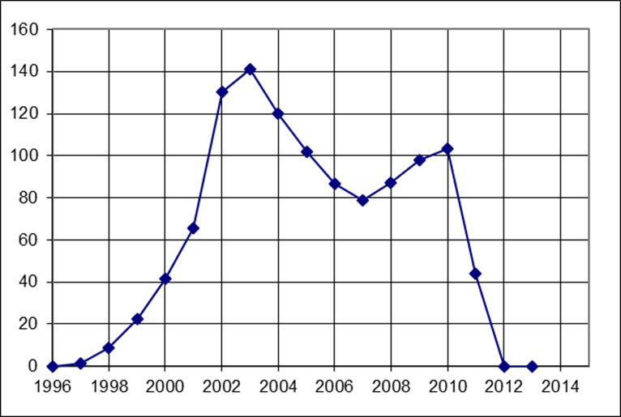
Example 2. Country X imported only the refrigerant HFC-134a in years 1997-2003 (there is no production and export). Based on the consumption pattern, it can be estimated that in 2013 there were no GHG emissions taking into account development of the bank and emissions from retired equipment
Consultative Group of Experts (CGE)
46
Training Materials for National Greenhouse Gas Inventories

Slide 47
2G: Other Product Manufacture and Use
Code | Category | Code | Category
2G1 | Electrical Equipment | 2G2c | Other
2G1a | Manufacture | 2G3 | N₂O from Product Uses
2G1b | Use | 2G3a | Medical Applications
2G1c | Disposal | 2G3b | Propellant for Pressure
2G2 | SF₆/PFCs from Other Uses | 2G3c | Other
2G2a | Military Applications | 2G4 | Other
2G2b | Accelerators
SF6 and PFCs: electrical equipment: gas insulated switchgear and substations (GIS), gas circuit breakers (GCB), high voltage gas-insulated lines (GIL), gas-insulated power transformers (GIT). Military equipment: ground and airborne radar, avionics, missile guidance systems, ECM (Electronic Counter Measures), sonar, amphibious assault vehicles, other surveillance aircraft, lasers, SDI (Strategic Defense Initiative), stealth aircraft. PFCs for cooling electric motors, e.g., in ships and submarines. Cosmetic and medical applications, research particle accelerators.
N2O: Medical applications, Auto-racing, Propellant in aerosol products
Consultative Group of Experts (CGE)
47
Training Materials for National Greenhouse Gas Inventories

Slide 48
IPPU Activity Data: Cross-Checks
Consultative Group of Experts (CGE)
48
Training Materials for National Greenhouse Gas Inventories

Slide 49
IPPU Activity Data: Cross-checks / QC
The CO₂ completeness check
Feedstock balance check
Potential emissions approach for estimating HFCs, PFCs, or SF₆
Consultative Group of Experts (CGE)
49
Training Materials for National Greenhouse Gas Inventories

Slide 50
IPPU Activity Data: Data Collection – RAC
      Where to get:
      Regulation for phase-out of CFCs and HCFCs
      Government Statistics
      Refrigerant Manufacturers and Distributors
      Disposal Companies
      Import/Export Companies
      Manufacturer Association
      Marketing Studies
What to get:
schedule of phase out for charging of brand new equipment and for servicing
number of equipment disposed of for each type of application
all virgin refrigerants sold for charging new equipment and for servicing in the different sectors
equipment produced on a national level using HFC refrigerants (for all sub-applications)
number of equipment using HFCs (imported and exported)
HFC refrigerants recovered for re-processing or for destruction
average equipment lifetime
initial charge of systems
Consultative Group of Experts (CGE)
50
Training Materials for National Greenhouse Gas Inventories

Slide 51
IPPU Activity Data: Confidentiality
Data providers might restrict access to information because
it is confidential, unpublished, or not yet finalized
Find solutions to overcome their concerns by:
  explaining the intended use of the data
  agreeing, in writing, to the level at which it will be made public
  identifying the increased accuracy that can be gained through its use in inventories
  offering cooperation to derive a mutually acceptable data sets
  and/or giving credit/acknowledgement in the inventory to the data provided
Consultative Group of Experts (CGE)
51
Training Materials for National Greenhouse Gas Inventories

Slide 52
Conclusion
Diversity of sources and gases in the IPPU Sector
  Difficult to exhaustively include all sources & gases
  At least major sources & gases (key categories) must be included
Care to Activity Data:
  Difficult to collect activity data (input/output data, plant-specific data)
  Data allocation and Double-counting
  Confidential data from private companies
Various opportunities for GHG abatement
  Capture and abatement at plants (N₂O destruction at nitric acid production plants)
  Recovery at the end of product’s life and subject to either recycled or destroyed (HFCs in refrigerators)
Consultative Group of Experts (CGE)
52
Training Materials for National Greenhouse Gas Inventories

Slide 53
Thank you

