Slide 1
IPCC Inventory Software

Slide 2
Foreword, Copyright and Disclaimer
These presentation materials to explain the contents of the 2006 IPCC Guidelines:
are based on the presentations (except presentation on QA/QC) delivered by the Technical Support Unit of the Task Force on National Greenhouse Gas Inventories of the Intergovernmental Panel on Climate Change (IPCC TFI TSU) in the Africa Regional Workshop on the Building of Sustainable National Greenhouse Gas Inventory Management Systems, and the use of the 2006 IPCC Guidelines for National Greenhouse Gas Inventories (Swakopmund, Namibia, 24-28 April 2017);
have not been subject to a formal IPCC review process http://www.ipcc.ch/pdf/ipcc-principles/ipcc-principles-appendix-a-final.pdf; and
will be updated from time to time.
If you wish to use these presentation materials in some way or other (e.g., use some or all of these slides in your presentation at a workshop), please inform the TFI TSU through http://www.ipcc-nggip.iges.or.jp/mail. Also read the notes in the following websites.
Copyright: http://www.ipcc.ch/home_copyright.shtml
Disclaimer: http://www.ipcc.ch/home_disclaimer.shtml
The CGE acknowledges the inputs from, and expresses its appreciation to, the IPCC TFI TSU.
Consultative Group of Experts (CGE)
2
Training Materials for National Greenhouse Gas Inventories

Slide 3
Introduction
The IPCC Inventory Software implements the 2006 IPCC Guidelines for National Greenhouse Gas Inventories. It can also be used for reporting under the 1996 IPCC Guidelines
it allows countries to utilise the improvements in the methodologies and default values since 1996
The IPCC launched the IPCC Inventory Software in 2012
The latest officially published version is available from: http://www.ipcc-nggip.iges.or.jp/software/index.html
Consultative Group of Experts (CGE)
3
Training Materials for National Greenhouse Gas Inventories

Slide 4
IPCC Inventory Software
The IPCC Inventory Software can assist inventory compilers in using the IPCC Guidelines
stand alone software with modest hardware requirements
data entry in worksheets following the 2006 IPCC Guidelines for ease-of-use
it can be used for the whole inventory or just individual categories
allows different parts of the inventory to be developed simultaneously
can be used when reporting 1996 or 2006 Guidelines
provides default data from the 2006 IPCC Guidelines but gives users the flexibility to use their own country-specific information
includes Uncertainty and Key Category Analysis
aids QA/QC
outputs in non-Annex I National Communications format
FREE!
Consultative Group of Experts (CGE)
4
Training Materials for National Greenhouse Gas Inventories

Slide 5
Software Functions
Administration functions: Country, Users, Years
Contains default data
QA/QC: Uncertainty analysis, KCA, Reference Approach
Worksheets for data entry
Data Managers: Land Types and Livestock
Data Export
and
Import
Data Archive
Consultative Group of Experts (CGE)
5
Training Materials for National Greenhouse Gas Inventories

Slide 6
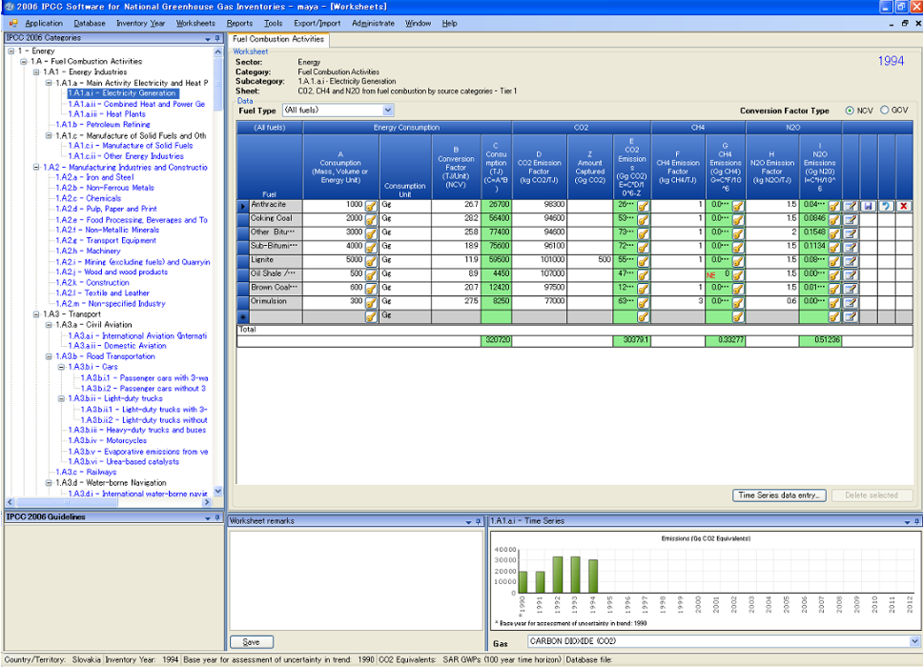
Main menu
Category: Energy
Data Entry
Hierarchical list of categories
Worksheet-based calculations follow 2006 Guidelines
Time Series Display
Status bar contains useful information
e.g. country, inventory year

Slide 7
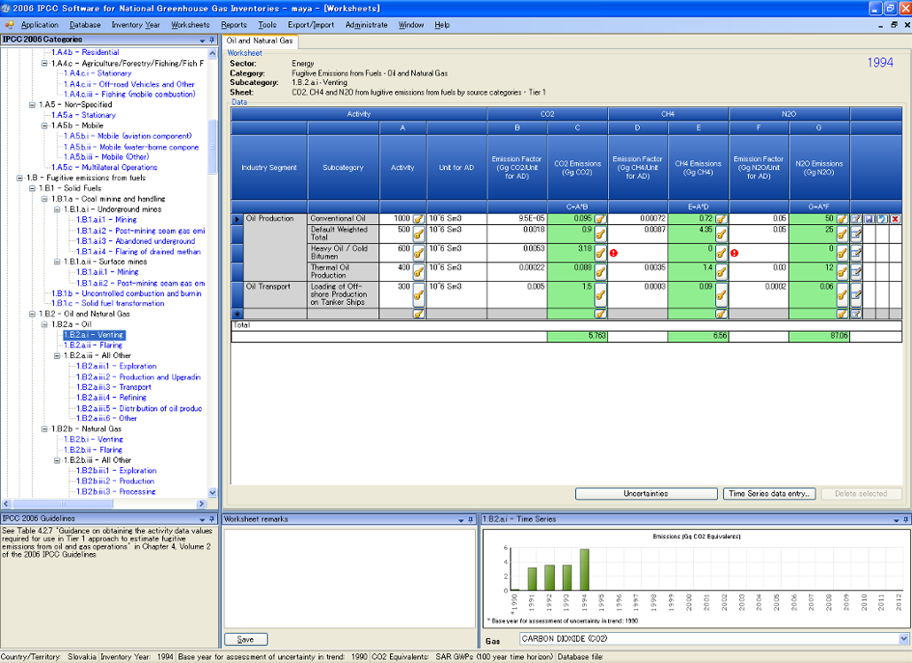
Notation Keys
Available
Defaults Available: can be over-written with country specific data
Uncertainties
Time Series Data Entry

Slide 8
Reports
Report | Level | Contents
Summary | 1.A.1 | Emissions
Short summary | 1.A | Emissions
Sectoral | 1.A.1.a.ii (most disaggregated level) | Emissions
Background | 1.A.1.a.ii (most disaggregated level) | Activity data Emissions
Note: All reports can be exported as MS Excel file
Consultative Group of Experts (CGE)
8
Training Materials for National Greenhouse Gas Inventories

Slide 9
Non-Annex I Reporting Table
The IPCC Inventory Software follows the format of Tables in Annex to Decision 17/CP.8 (Guidelines for the preparation of National Communications from Parties not included in Annex I to the Convention)
Main Menu
→ Export/Import
→ NAI Reporting Tables
Consultative Group of Experts (CGE)
9
Training Materials for National Greenhouse Gas Inventories

Slide 10
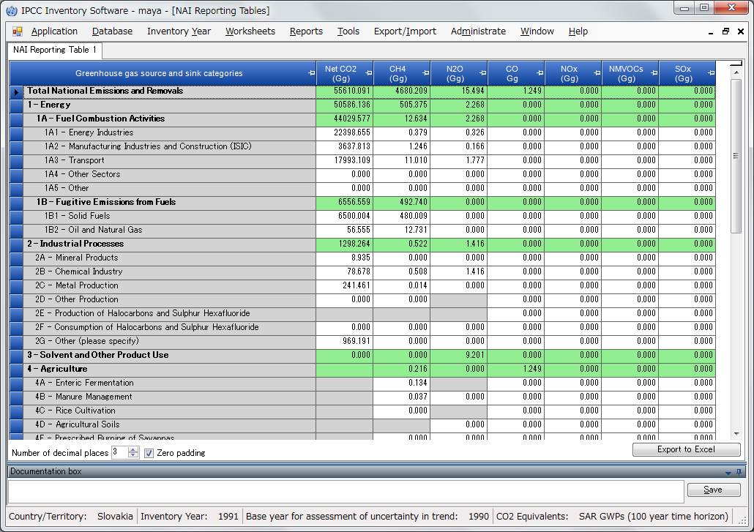
Non-Annex I Reporting Table
Export → NAI Reporting Table

Slide 11
Tools
Uncertainty analysis
Key category analysis
When all values are entered in the worksheet for each sector, these analysis can be performed by following steps:
Main Menu
→ Export/Import
→ Uncertainty Analysis
or Key Category Analysis
click “Refresh” button
Consultative Group of Experts (CGE)
11
Training Materials for National Greenhouse Gas Inventories

Slide 12
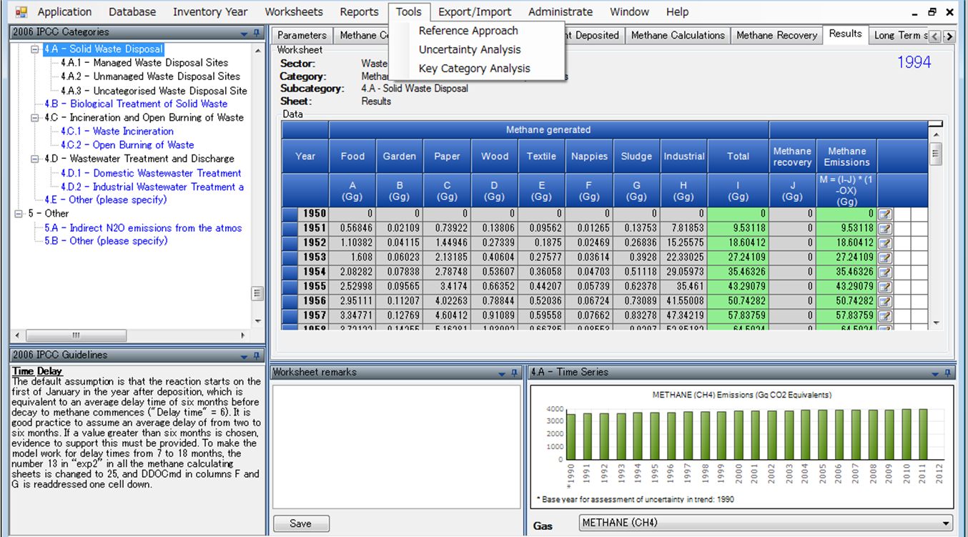
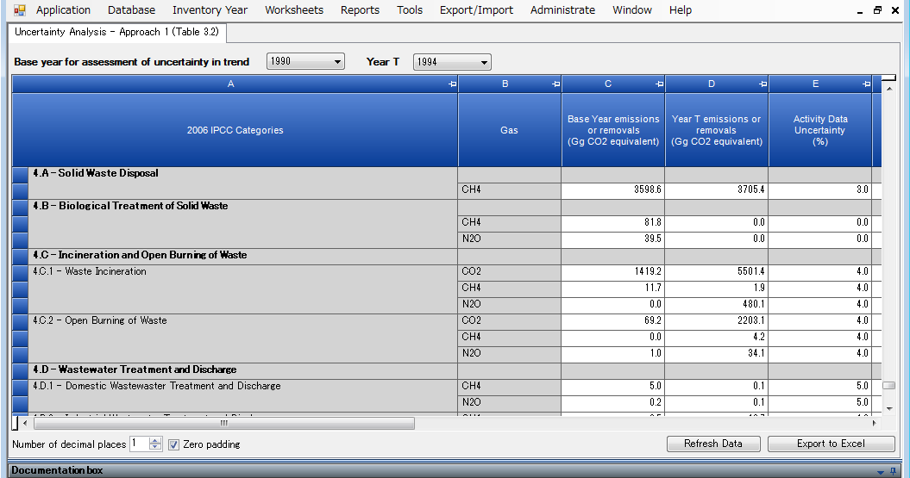
Tools
Click Tools – Uncertainty Analysis
Click “Refresh Data” to perform analysis

Slide 13
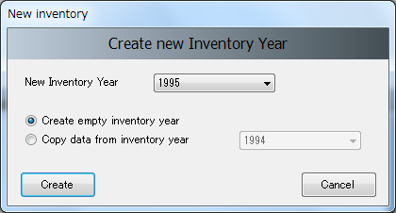
Other basic operations - Year
Inventory Year
Create New year
Select year
Consultative Group of Experts (CGE)
13
Training Materials for National Greenhouse Gas Inventories

Slide 14
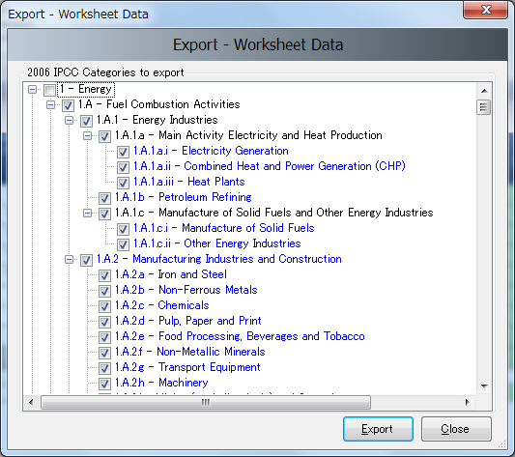
Other basic operations - Export
Export/Import worksheet data as XML file format.
In this example,
Worksheet data for category 1A for year 1994 will be exported.
Consultative Group of Experts (CGE)
14
Training Materials for National Greenhouse Gas Inventories

Slide 15
Multiple Users
Project manager
Sectoral Experts(s)
Distribute updated DB (MDB file)
Distribute empty database
(MDB file)
Compile Sector 1
PM: Initialise Database
PM: Update Database
Compile Sector 2
Combine Databases
(XML File)
Combine Databases
(XML File)
Database
Compile Sector n
Checks, Uncertainty, KCA
Using XML file will reduce the chances of losing or overwriting the database unintentionally
Prepare Outputs
15
Consultative Group of Experts (CGE)
Training Materials for National Greenhouse Gas Inventories

Slide 16
Support
The TSU is supporting the IPCC Inventory Software:
Help Desk E-mail: ipcc-software@iges.or.jp
Web Forum: https://discussions.zoho.com/ipccinventorysoftware/
please, read the User Manual
TSU will maintain the IPCC Inventory Software and is planning to implement the following:
Tier 2 methods
from Version 2.54, the Software implements Tier 2 methods in the 2006 IPCC Guidelines for most categories under Energy, IPPU and Waste Sectors
Livestock categories are under development
Wetlands Supplement
Consultative Group of Experts (CGE)
16
Training Materials for National Greenhouse Gas Inventories

Slide 17
Thank you

