Slide 1

IPCC Emission Factor Database (EFDB)

Slide 2
Foreword, Copyright and Disclaimer
These presentation materials to explain the contents of the 2006 IPCC Guidelines:
are based on the presentations (except presentation on QA/QC) delivered by the Technical Support Unit of the Task Force on National Greenhouse Gas Inventories of the Intergovernmental Panel on Climate Change (IPCC TFI TSU) in the Africa Regional Workshop on the Building of Sustainable National Greenhouse Gas Inventory Management Systems, and the use of the 2006 IPCC Guidelines for National Greenhouse Gas Inventories (Swakopmund, Namibia, 24-28 April 2017);
have not been subject to a formal IPCC review process http://www.ipcc.ch/pdf/ipcc-principles/ipcc-principles-appendix-a-final.pdf; and
will be updated from time to time.
If you wish to use these presentation materials in some way or other (e.g., use some or all of these slides in your presentation at a workshop), please inform the TFI TSU through http://www.ipcc-nggip.iges.or.jp/mail. Also read the notes in the following websites.
Copyright: http://www.ipcc.ch/home_copyright.shtml
Disclaimer: http://www.ipcc.ch/home_disclaimer.shtml
The CGE acknowledges the inputs from, and expresses its appreciation to, the IPCC TFI TSU.
Consultative Group of Experts (CGE)
2
Training Materials for National Greenhouse Gas Inventories

Slide 3
IPCC EFDB
  Library of emission factors/parameters and other relevant data with background documentation
  Default values from IPCC Guidelines
  Data from peer-reviewed scientific papers
  Data from other publications (government reports, industry studies etc.)
  http://www.ipcc-nggip.iges.or.jp/EFDB/
  Communication platform to share data/information on emission factors and other parameters that can be used to estimate greenhouse gas (GHG) emissions/removals
3

Slide 4
IPCC EFDB
  Evolves dynamically: data proposals (e.g. voluntary submissions from inventory compilers and researchers) and data collection efforts (e.g. expert meetings to collect data)
  Open to any data proposals
  Data proposals are considered by Editorial Board of the EFDB for inclusion in the database
  Criteria for inclusion of new data: robustness, applicability and documentation
Annual meeting of the Editorial Board: to consider data proposals and discuss how to enhance/improve the EFDB
  Summary of the meetings available at TFI website
  http://www.ipcc-nggip.iges.or.jp/meeting/meeting.html
4

Slide 5
Growing importance
In the context of National Communications from non-Annex I Parties, the Consultative Group of Experts (CGE) recommended
  Improvement of data quality by enhancement of the sharing of country-specific emission factors through the IPCC Emission Factor Database and among Parties not included in Annex I to the Convention (FCCC/SBI/2011/5/Rev.1)
New reporting guidelines on annual inventories for Annex I Parties
  If Annex I Parties lack country-specific information, they could also use EFs or other parameters provided in the IPCC Emission Factor Database, where available, provided that they can demonstrate that those parameters are appropriate in the specific national circumstances and are more accurate than the default data provided in the 2006 IPCC Guidelines (Decision 24/CP.19)
5

Slide 6
How to access EFDB
Two types of applications are available
  Web application (http://www.ipcc-nggip.iges.or.jp/EFDB/main.php)
  Offline application (e.g. DVD)
The web application is the core of this system. New data will be made available in the web application first
The offline application works with MS Access MDB file, which contains the copy of the web database
  Can be used on a stand-alone PC
  Available for download at the EFDB website
  http://www.ipcc-nggip.iges.or.jp/EFDB/main.php
6

Slide 7
Web application

Slide 8
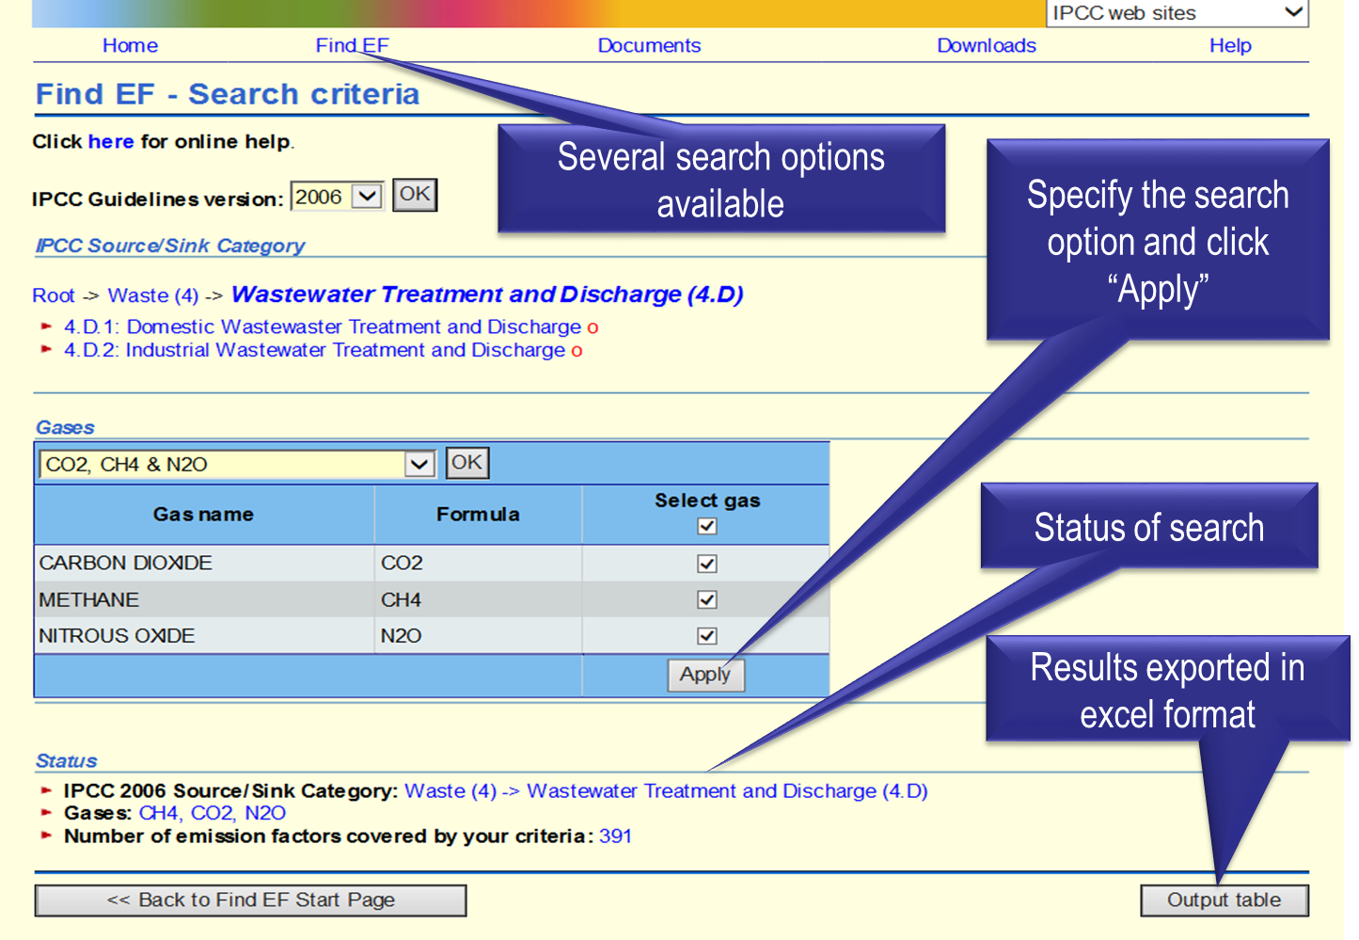
Data search

Slide 9

Populating EFDB
EFDB
Data Provider
Defaults
Accepted Data
Data
Data Meeting
Editorial Board (EB)
TSU
- Initial check of data proposals
- Collection of new data and preparation of data proposals
Data
Data
9

Slide 10
Criteria for inclusion of new data
Robust
  Within the accepted uncertainty, the value is unlikely to change if there was repetition of the original measurement programme or modelling activity
Applicable
  An emission factor can only be applicable if the source and its mix of technology, operating and environmental conditions and abatement and control technologies under which the emission factor was measured or modeled are clear and allow the user to see how it can be applied
Documented
  Access information to the original technical reference must be provided to evaluate the robustness and applicability as described above
10

Slide 11
Enhancement and improvement of EFDB
Populating the EFDB
  Expert meetings to collect data have been organized since 2008
    Focus on specific sectors/categories with the aim to identify, select and approve data for inclusion into the EFDB
    Attended by both data providers and EB members
  Literature search (e.g. peer-reviewed papers)
User-interface is being further improved
11

Slide 12
Thank you

