Slide 1

Time Series Consistency

Slide 2
Foreword, Copyright and Disclaimer
These presentation materials to explain the contents of the 2006 IPCC Guidelines:
are based on the presentations (except presentation on QA/QC) delivered by the Technical Support Unit of the Task Force on National Greenhouse Gas Inventories of the Intergovernmental Panel on Climate Change (IPCC TFI TSU) in the Africa Regional Workshop on the Building of Sustainable National Greenhouse Gas Inventory Management Systems, and the use of the 2006 IPCC Guidelines for National Greenhouse Gas Inventories (Swakopmund, Namibia, 24-28 April 2017);
have not been subject to a formal IPCC review process http://www.ipcc.ch/pdf/ipcc-principles/ipcc-principles-appendix-a-final.pdf; and
will be updated from time to time.
If you wish to use these presentation materials in some way or other (e.g., use some or all of these slides in your presentation at a workshop), please inform the TFI TSU through http://www.ipcc-nggip.iges.or.jp/mail. Also read the notes in the following websites.
Copyright: http://www.ipcc.ch/home_copyright.shtml
Disclaimer: http://www.ipcc.ch/home_disclaimer.shtml
The CGE acknowledges the inputs from, and expresses its appreciation to, the IPCC TFI TSU.
Consultative Group of Experts (CGE)
2
Training Materials for National Greenhouse Gas Inventories

Slide 3
Time Series
An inventory is not just an estimate of a single year. It includes estimates for a number of years (time series of estimates)
Information on historical emissions trend
Tracking the effects of strategies to reduce emissions at the national level
Annual estimates should be comparable
  Should reflect the real annual fluctuations in emissions and removals
Therefore, emissions and removals in time series should be estimated consistently
  Use of the same method and data sources in all years, where possible
However, it is not always possible to use the same method and data sets for the entire time series due to a lack of data
Consultative Group of Experts (CGE)
3
Training Materials for National Greenhouse Gas Inventories

Slide 4
Splicing Techniques
Splicing: combining or joining of more than one method or data series to form a complete time series
Methodological change and refinement
Data gaps
The 2006 IPCC Guidelines provide several splicing techniques
  Overlap
  Surrogate
  Interpolation
  Extrapolation
Selecting a technique requires an evaluation of the specific circumstances and a determination of the best option for the particular case
Consultative Group of Experts (CGE)
4
Training Materials for National Greenhouse Gas Inventories

Slide 5
Overlap
When a new method is introduced but data are not available for early years in the time series (e.g. implementing a higher tier methodology)
Develop a time series based on the relationship (or overlap) observed between the previously used and new method during the years when both can be used
It is preferable to compare the overlap for multiple years to evaluate the relationship between the two methods
If there is no consistent overlap between methods and it is not good practice to use the overlap technique
Consultative Group of Experts (CGE)
5
Training Materials for National Greenhouse Gas Inventories

Slide 6
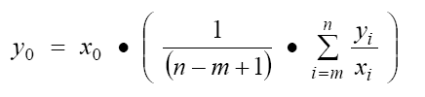
Overlap: Consistent Relationship
y₀: recalculated estimate using the overlap method
x₀ : estimate developed using the previously used method
m,n : overlapping years
6

Slide 7
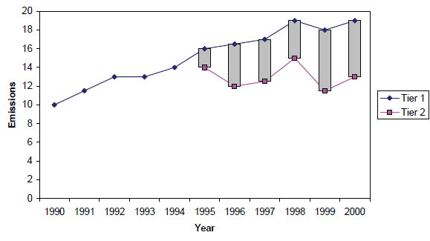
Overlap: Inconsistent Relationship
Consultative Group of Experts (CGE)
7
Training Materials for National Greenhouse Gas Inventories

Slide 8
Surrogate Data
The surrogate method relates emissions or removals to underlying activity or other indicative data
Data (statistical) that is related to the emission (emissions may be proportional to production, vehicle distances travelled and population etc.)
Although the relationship between emissions/removals and surrogate can be developed on the basis of data for a single year, the use of multiple years might provide a better estimate
Consultative Group of Experts (CGE)
8
Training Materials for National Greenhouse Gas Inventories

Slide 9
Surrogate Data
y : emission/removal estimate in years 0 and t
s : surrogate statistical parameter in years 0 and t
Consultative Group of Experts (CGE)
9
Training Materials for National Greenhouse Gas Inventories

Slide 10
Interpolation
When detailed statistics is collected every few years, or it is impractical to conduct detailed surveys on an annual basis
Estimates for the intermediate years in the time series can be developed by interpolating between the detailed estimates when:
Overall trend appears stable
Actual emissions are not substantially different from the values estimated by interpolation
If information on the general trends or underlying parameters is available, then the surrogate data can be used
  It is good practice to compare interpolated estimates with surrogate data as a QA/QC check
Consultative Group of Experts (CGE)
10
Training Materials for National Greenhouse Gas Inventories

Slide 11
Interpolation
Consultative Group of Experts (CGE)
11
Training Materials for National Greenhouse Gas Inventories

Slide 12
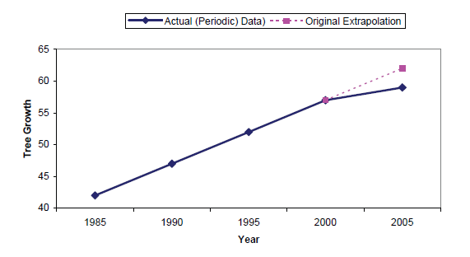
Extrapolation
When data for the base year or the most recent year are not available
The data can be extrapolated assuming that the trend in emissions/removals remains constant over the period of extrapolation
Should not be used if the trend is not constant over time.
Analyse the character of trend – e.g. linear or more complex
Consultative Group of Experts (CGE)
12
Training Materials for National Greenhouse Gas Inventories

Slide 13
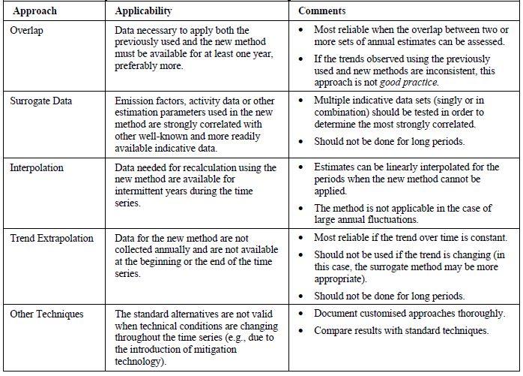
Summary of Splicing Techniques
Each technique can be appropriate in certain situation. It is good practice to perform the splicing using more than one technique before making a final decision
13

Slide 14
Quality of Time Series and Documentation
Comparison of the results of multiple approaches where it is possible to use more than one approach
Plotting and comparing the results of splicing techniques on a graph is useful
If alternative splicing methods produce different results, should consider which result is most realistic
Comparison of recalculated estimates with previous estimates can be a useful check on the quality of a recalculation
  However, higher tier methods may produce different trends than lower tier methods because they more accurately reflect actual conditions
All recalculations and measures taken to improve time series consistency should be documented and reported
  Reason of the recalculation
  Effect of the recalculation on the time series
  Splicing techniques used
Consultative Group of Experts (CGE)
14
Training Materials for National Greenhouse Gas Inventories

Slide 15
Summary
We need consistent estimates of emissions/ removals for all years
Same method and data sources should be applied to all years, if possible
Where this is not possible, inventory compilers should follow the time series consistency guidance to provide consistent estimates for all years
  Overlap/ Surrogate / Interpolation / Extrapolation /etc.
We need to ensure quality of time series
  Quality checks are applied to entire time series
All decisions, methods and reasons should be documented
Consultative Group of Experts (CGE)
15
Training Materials for National Greenhouse Gas Inventories

Slide 16
Thank you

