Slide 1

Uncertainty Analysis in Emission Inventories

Slide 2
Foreword, Copyright and Disclaimer
These presentation materials to explain the contents of the 2006 IPCC Guidelines:
are based on the presentations (except presentation on QA/QC) delivered by the Technical Support Unit of the Task Force on National Greenhouse Gas Inventories of the Intergovernmental Panel on Climate Change (IPCC TFI TSU) in the Africa Regional Workshop on the Building of Sustainable National Greenhouse Gas Inventory Management Systems, and the use of the 2006 IPCC Guidelines for National Greenhouse Gas Inventories (Swakopmund, Namibia, 24-28 April 2017);
have not been subject to a formal IPCC review process http://www.ipcc.ch/pdf/ipcc-principles/ipcc-principles-appendix-a-final.pdf; and
will be updated from time to time.
If you wish to use these presentation materials in some way or other (e.g., use some or all of these slides in your presentation at a workshop), please inform the TFI TSU through http://www.ipcc-nggip.iges.or.jp/mail. Also read the notes in the following websites.
Copyright: http://www.ipcc.ch/home_copyright.shtml
Disclaimer: http://www.ipcc.ch/home_disclaimer.shtml
The CGE acknowledges the inputs from, and expresses its appreciation to, the IPCC TFI TSU.
Consultative Group of Experts (CGE)
2
Training Materials for National Greenhouse Gas Inventories

Slide 3
Introduction
Uncertainty estimates are an essential element of a complete inventory of GHG emissions/removals
Uncertainty: a lack of knowledge of the true value of a variable that can be described as a probability density function (PDF) which describes the range and relative likelihood of possible values
Quantitative uncertainty analysis is performed by estimating the 95 percent confidence interval of the emissions and removals estimates for individual categories and for the total inventory
  95 percent confidence interval is enclosed by the 2.5th and 97.5th percentiles of the PDF
Consultative Group of Experts (CGE)
3
Training Materials for National Greenhouse Gas Inventories

Slide 4
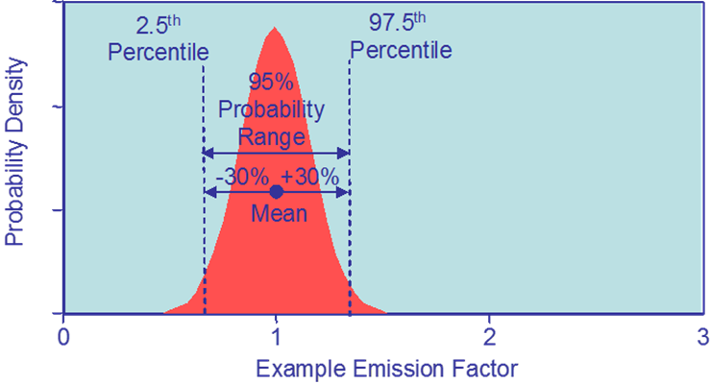
Probability Density Function
Consultative Group of Experts (CGE)
4
Training Materials for National Greenhouse Gas Inventories

Slide 5
Probability Density Function
Consultative Group of Experts (CGE)
5
Training Materials for National Greenhouse Gas Inventories

Slide 6

Specifying Uncertainty
Uncertainty is quoted as the 2.5th and 97.5th percentiles i.e. bounds around a 95 percent confidence interval
This can be expressed, for example:
  234 ± 30%
  26400 (- 50%, + 100%)
Consultative Group of Experts (CGE)
6
Training Materials for National Greenhouse Gas Inventories

Slide 7
Benefits of Uncertainty Analysis
Consultative Group of Experts (CGE)
7
Training Materials for National Greenhouse Gas Inventories

Slide 8
Uncertainty Estimation
Gather Information
Collect uncertainty information on activity data and emission factors
Decide approach to use
Error Propagation
Monte Carlo
Perform Inventory Analysis
Spreadsheet
Software tool
Consultative Group of Experts (CGE)
8
Training Materials for National Greenhouse Gas Inventories

Slide 9
Sources of Uncertainty
Assumptions and methods
The method may not accurately reflect the emissions
Input Data
  Measured values have errors and EFs may not be truly representative
  Lack of data (e.g. use of proxies, extrapolation)
Calculation errors
  Good QA/QC to prevent these
Consultative Group of Experts (CGE)
9
Training Materials for National Greenhouse Gas Inventories

Slide 10
Sources of Data and Information
There are three broad sources of data and information
Information contained in models. Models can be as simple as arithmetic multiplication of AD and EF for each category and subsequent summation over all categories, but they may also include complex process models specific to particular categories
Empirical data associated with measurements of emissions, and activity data from surveys and censuses
Quantified estimates of uncertainties based upon expert judgement
Data collection activities should consider data uncertainties. This will ensure the best data is collected and ensures good practice estimates
Wherever possible, expert judgment should be elicited using an appropriate protocol (e.g. Stanford/SRI protocol)
Consultative Group of Experts (CGE)
10
Training Materials for National Greenhouse Gas Inventories

Slide 11
Methods to Combine Uncertainties
Approach 1: Error Propagation
Simple (standard spreadsheet can be used)
    Guidelines provide equations and explanations
Difficult to deal with correlations
Standard deviation/mean < 0.3
Approach 2: Monte Carlo Method
  More complex (specialised software is used)
    Select random values of input parameters from their pdf and calculate the corresponding emission. Repeat many times and the distribution of the results is the PDF of the result from which mean and uncertainty can be estimated
  Needs information on PDF (mean, width, shape)
  Suitable where uncertainties large, non-normal distribution, complex algorithms, correlations exist and uncertainties vary with time
Consultative Group of Experts (CGE)
11
Training Materials for National Greenhouse Gas Inventories

Slide 12
Error Propagation
Data Calculated using simple equations
Enter Emissions Data
Enter Uncertainties
Consultative Group of Experts (CGE)
12
Training Materials for National Greenhouse Gas Inventories

Slide 13
AD uncertainties based on source of data
EF uncertainties based on defaults in guidelines
Note short list of source/sinks

Slide 14
Illustration of Monte-Carlo Method
Consultative Group of Experts (CGE)
14
Training Materials for National Greenhouse Gas Inventories

Slide 15
Example of Monte Carlo Results
Consultative Group of Experts (CGE)
15
Training Materials for National Greenhouse Gas Inventories

Slide 16
Summary Results
Consultative Group of Experts (CGE)
16
Training Materials for National Greenhouse Gas Inventories

Slide 17
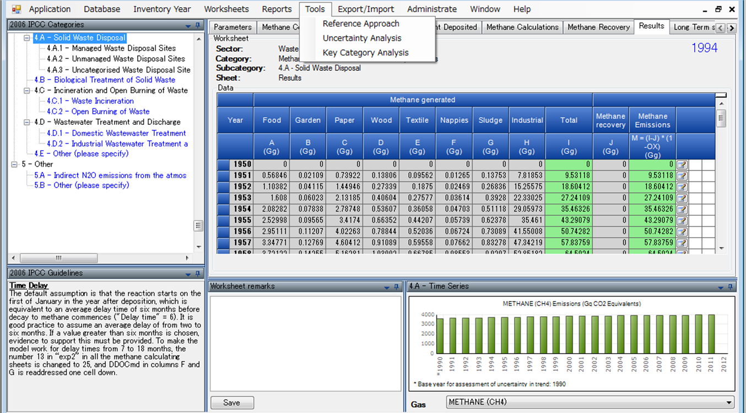
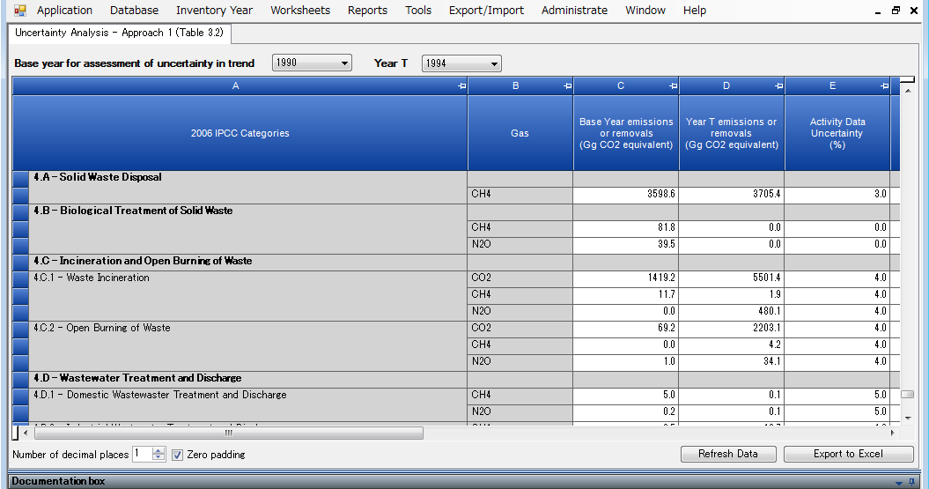
IPCC Inventory Software: Uncertainty Analysis
Click “Uncertainty Analysis”
Click to perform analysis
17

Slide 18
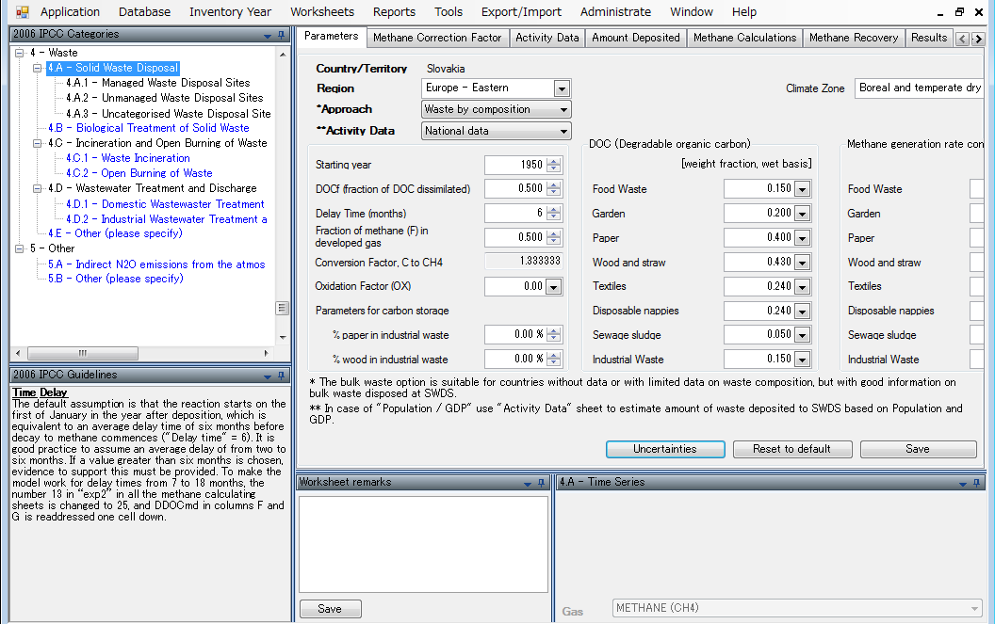
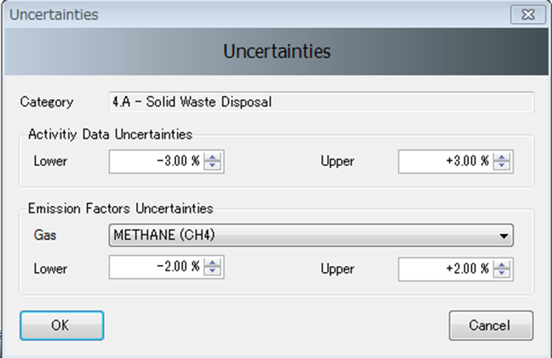
IPCC Inventory Software: Uncertainty Analysis (cont.)
Click to enter AD and EF uncertainties
Consultative Group of Experts (CGE)
18
Training Materials for National Greenhouse Gas Inventories

Slide 19
Summary
Even simple uncertainty estimates give useful information - If they are performed well
Assessment of uncertainty in the input parameters should be part of the data collection
Careful consideration will improve estimates as well as providing input data for uncertainty analysis
If resources limited: effort spent on uncertainty analysis should be small compared with total effort
At its simplest a well planned uncertainty assessment should only take a few extra hours!
  Uncertainty in AD assessed as data collected
  Uncertainty in EFs from guidelines now available
  Aggregate categories/gases to independent groups of sources/sinks
  Use Approach 1
Consultative Group of Experts (CGE)
19
Training Materials for National Greenhouse Gas Inventories

Slide 20
Thank you

