Slide 1
The UNFCCC NAMA Registry Facilitating design and implementation of NAMAs LAC Regional Workshop on NAMAs September 14-15, 2015 Chile

Slide 2
Presentation Outline
Background
Fundamentals of the registry
Operational status of the registry
Diversified role of the registry in the long run
Q/A

Slide 3
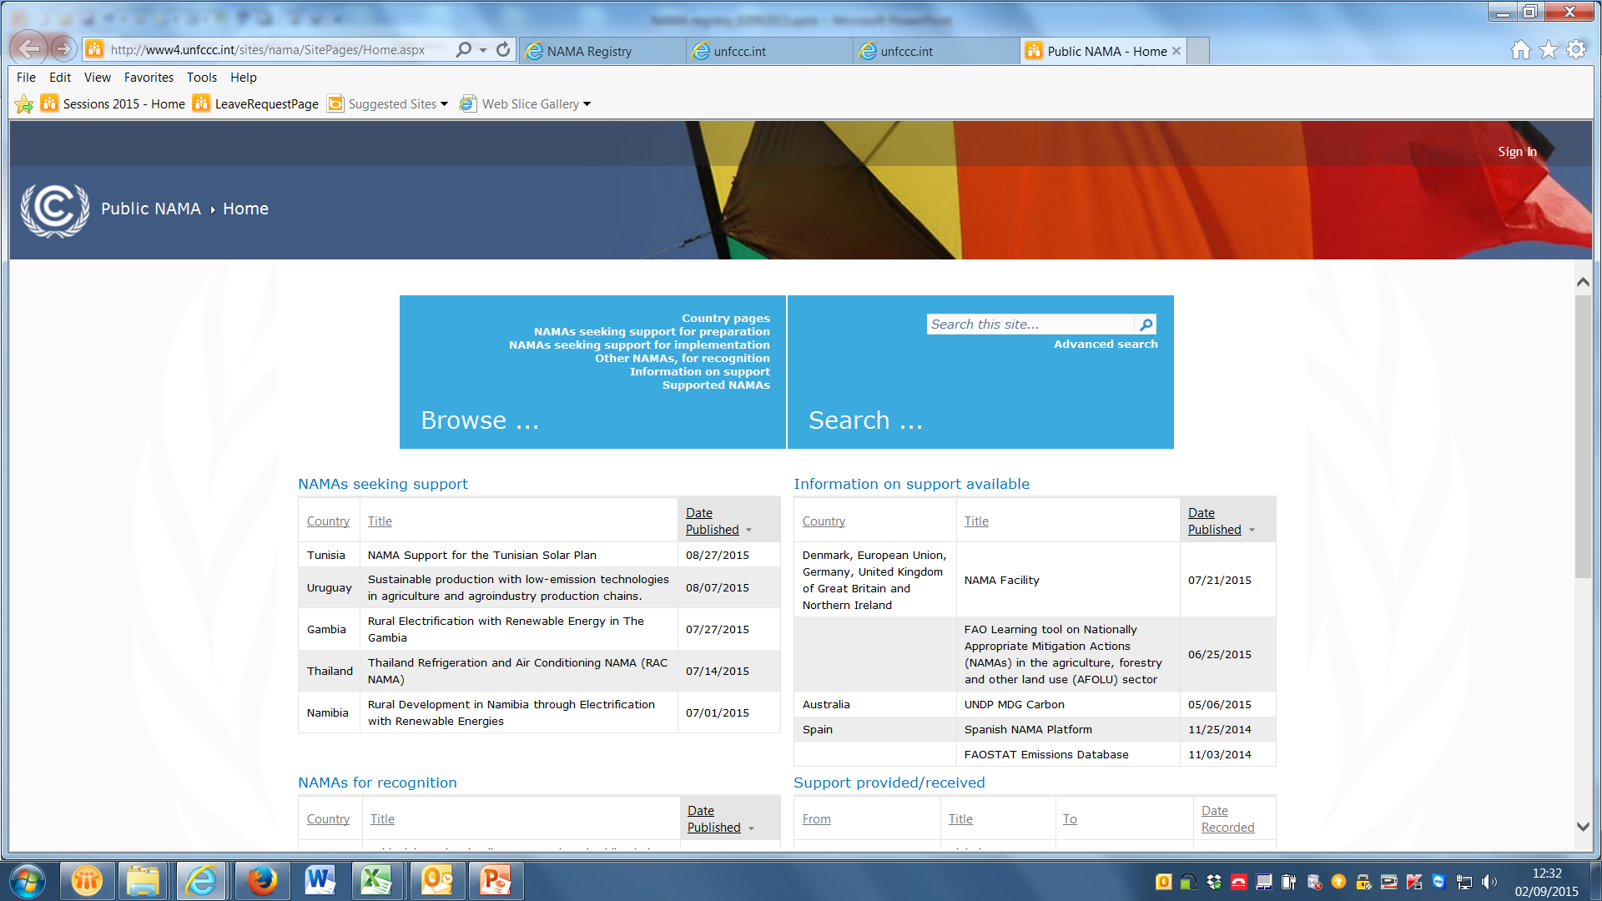
Public webpage of NAMA registry
http://www4.unfccc.int/sites/nama/SitePages/Home.aspx

Slide 4
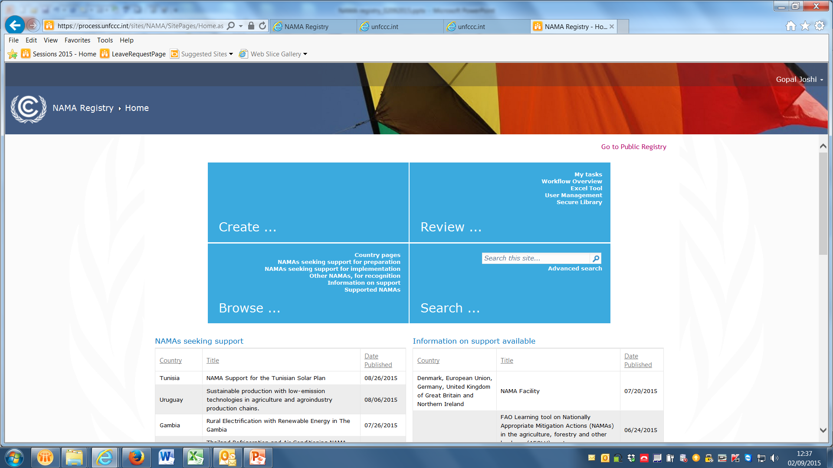
Closed web page of the registry accessible through log in credentials. For this please contact the secretariat.
Interface
Submit NAMAs seeking support
Submit NAMAs for recognition
Browse information
Perform query
Database
NAMAs for support
NAMAs for recognition
Support
Support provided/received

Slide 5
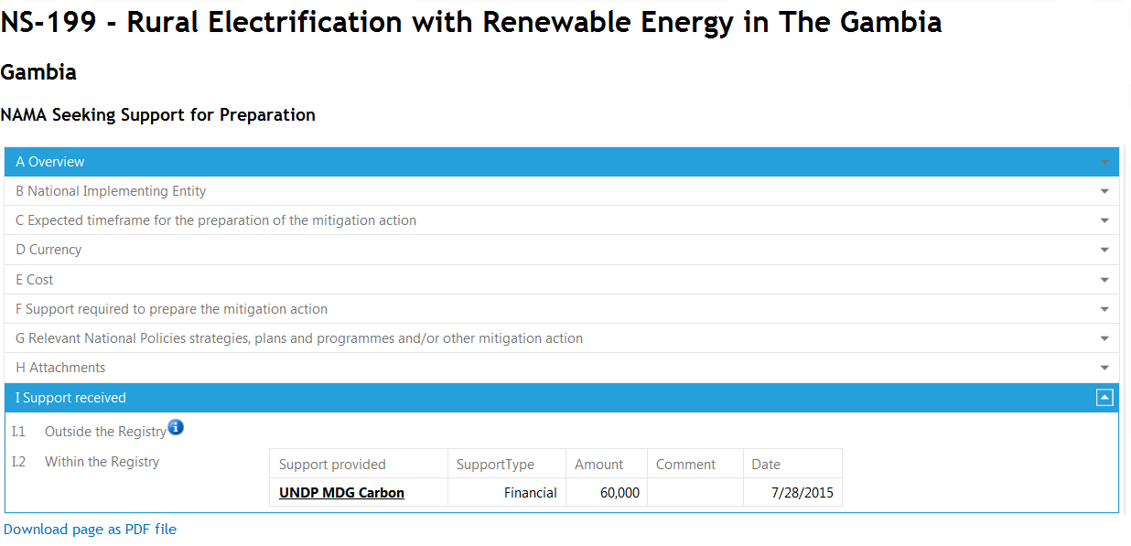

Slide 6
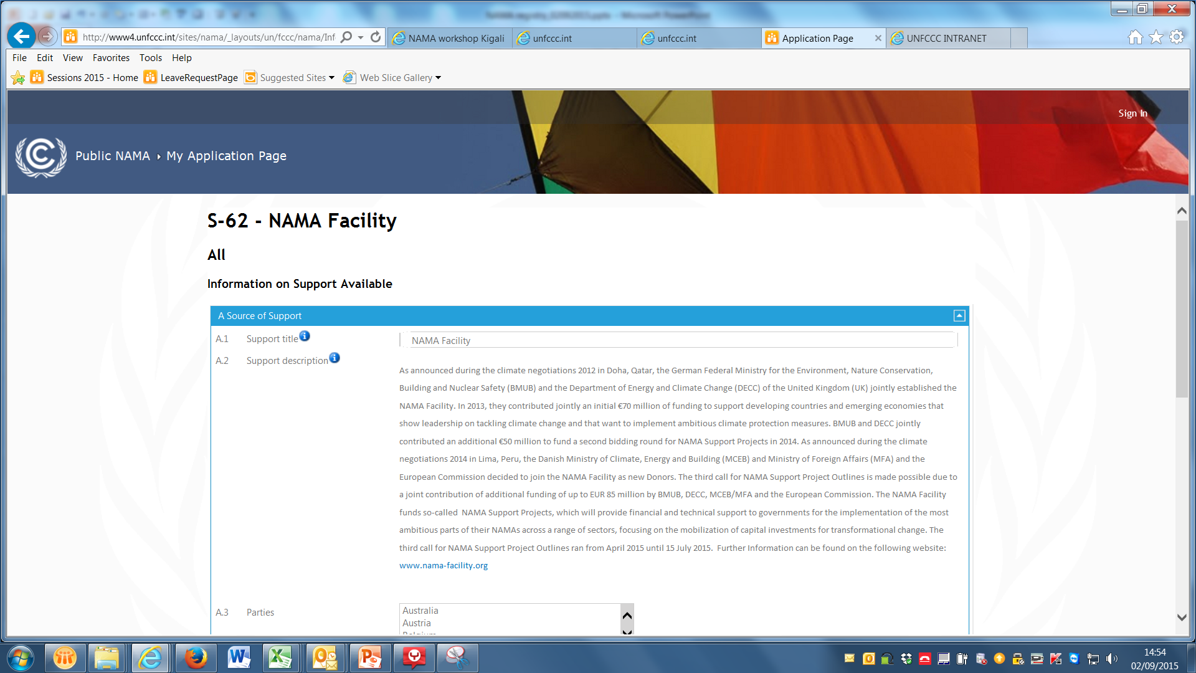

Slide 7
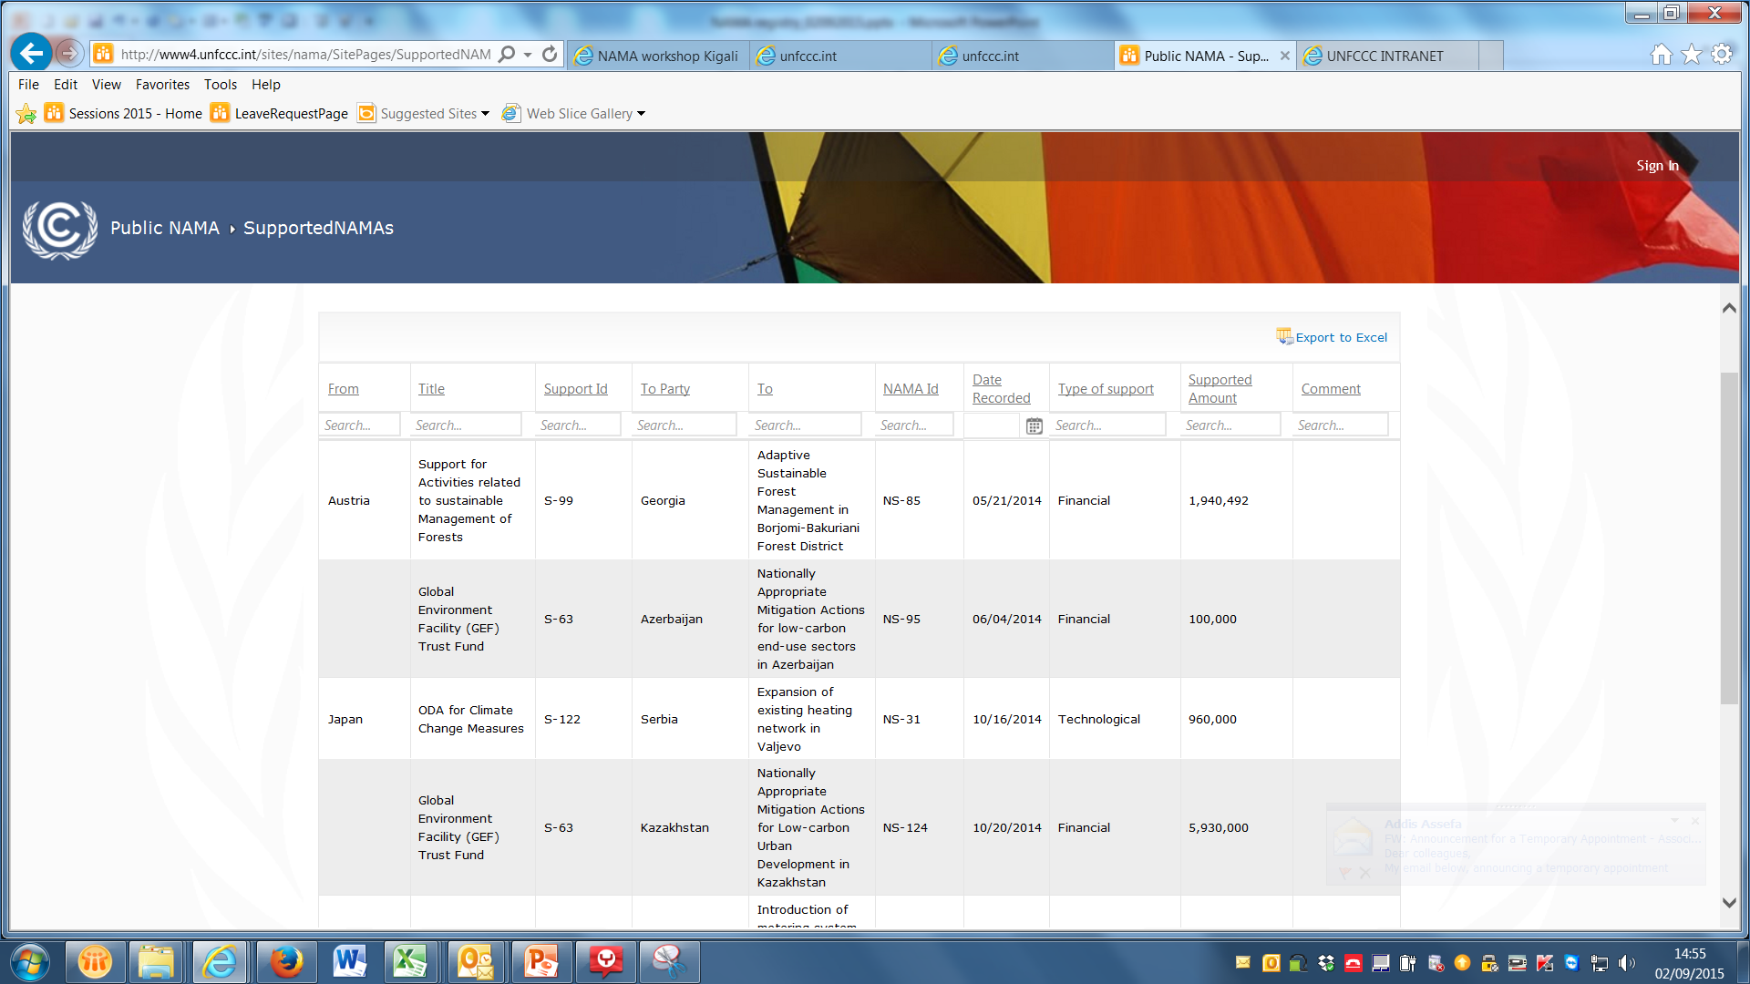

Slide 8
Mandates for the registry
to set up a registry to record nationally appropriate mitigation actions
the registry should be developed as a dynamic, web-based platform managed by a dedicated team in the secretariat
1/CP.16, paragraph 53
2/CP.17, paragraph 45
Participation is voluntary and the registry contains only information that has been submitted specifically for recording.

Slide 9
Functions of the NAMA Registry
The UNFCCC NAMA Registry, a public online platform :
to record :
NAMAs seeking international support
domestically supported nationally appropriate mitigation actions (NAMAs); and
support available/provided for them,
to facilitate the matching of NAMAs with support

Slide 10
History of the registry development
August 2012
Interim facility
April 2013
Fully functional Prototype
October 2013
First release of the web-based registry
March 2014
August 2015
Second release of the web-based registry
Third release of the web-based registry

Slide 11
Registry fundamentals: Users
NAMA Approver
Create/edit NAMA entries
Grant NAMA developer access rights
NAMA Developer
Create/edit NAMA entries
Confirm receipt of support
Support editor
Create entries on support available
Confirm provision of support
Public
Browse & search all content
Confirm receipt of support
Approve entries from developers
Notes:
There are three key types of user for the registry……

Slide 12
NAMA approvers, NAMA developers, support editors : essential roles for an optimized use of the registry
any organization (public or private) that has a programme to support NAMAs.
NAMA Approver :
the UNFCCC focal point, the designated national authority, the lead climate change agency or others, as decided by the Party.
Support editor
NAMA registry
NA Country A
decentralized
NA Country B
Centralized
NAMA developer
NAMA developer
Domestically, NAMA developer access rights can be devolved to subordinated entities, such as project developers, representatives of government agencies, private companies or others, as decided by the Party
The role of NAMA developers can facilitate the creation and the submission of NAMAs.

Slide 13
Obtaining access rights to operate submissions to the NAMA registry
Even if NAMA proposals are not ready to be submitted, obtaining access rights to the NAMA registry ensures:
the possibility of submitting NAMAs timely when proposals are ready;
the inclusion of the nominated NAMA approver/developer or Support editor in the NAMA registry users mailing list that is an additional direct channel for the distribution of support material.
To request access for the registry complete the relevant forms and submit to the secretariat
It is very important that changes in roles of registry users are communicated to the secretariat timely.

Slide 14
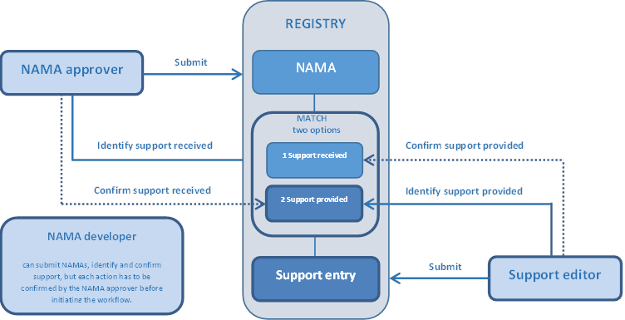
Registry workflow

Slide 15
Operation of the Registry as of September 1, 2015
Overview of registry content in 2015
The statistics are as at September 1, 2015
Further analysis will be available in the third annual report of the registry scheduled for COP 21

Slide 16
Parties and entities have shown great interest to use the registry

Slide 17
More support sought for implementation, Latin American and Caribbean States leading on recording NAMAs

Slide 18
Wider regional and sectoral distribution
Focus on energy supply, energy efficiency and transport and infrastructure
Energy supply through solar, wind, bioenergy, hydropower and cleaner fuels

Slide 19
Support sought for NAMAs by type and regional groups
Regional group by NAMA category | Sum of financial support (USD) | Sum of technology support (USD) | Sum of capacity-building support (USD)
NAMAs seeking support for preparation | 97 477 335 | 34 950 000 | 2 050 100
African States | 9 137 000 | 310 000 | 700 000
Asia-Pacific States | 80 175 335 | 33 840 000 | 600 100
Eastern European States | 100 000 | No entries for this region | No entries for this region
Latin American and Caribbean States | 8 065 000 | 800 000 | 750 000
NAMAs seeking support for implementation | 5 735 140 506 | 1 308 587 438 | 24 713 000
African States | 296 750 000 | 200 000 | 2 900 000
Asia-Pacific States | 877 335 552 | 32 000 000 | 18 550 000
Eastern European States | 2 520 162 000 | 1 081 500 000 | No entries for this region
Latin American and Caribbean States | 2 040 892 954 | 194 887 438 | 3 263 000
Grand total | 5 832 617 841 | 1 343 537 438 | 26 763 100

Slide 20
Type of financial support sought and actions to be implemented

Slide 21
Sources of support recorded in the registry
Source of support | Origin of support | Support available
Climate-related ODA funding | Germany | Grants and concessional loans for the preparation of NAMAs in all countries
International Climate Initiative | Germany | Grants and loans for the preparation of NAMAs in all countries
NAMA facility | Denmark EU Germany/United Kingdom of Great Britain and Northern Ireland | Grants and concessional loans for the implementation of NAMAs in all countries
Global Environment Facility Trust Fund | International | Grants for the preparation and implementation of NAMAs in all countries
EU–Africa Infrastructure Trust Fund | 12 EU countries | Grants, guarantees and equity for the preparation of NAMAs in Eastern European States and in Middle Eastern and North African countries
Neighbourhood Investment Facility | EU | Grants, guarantees and equity for the preparation of NAMAs in Eastern European and North African countries
Latin American Investment Facility | EU | Grants and loans for the implementation of NAMAs in Latin American and Caribbean countries
Austrian NAMA Initiative | Austria | Grants and carbon finance for the preparation of NAMAs in African States, and least developed countries and small island developing States

Slide 22
Source of support | Origin | Support available
Support for activities related to the sustainable management of forest | Austria | Grant for the implementation of NAMAs in the Caucasus region
ODA for climate change measures | Japan | Grants, concessional loans and technical assistance for the preparation of NAMAs in all countries
Inter-American Development Bank (IDB) support for the design, development and implementation of NAMAs in the Latin American and Caribbean region | Regional | Grants, loans and guarantees for the preparation of NAMAs in Latin American and Caribbean countries and small island developing States
Spanish NAMA Platform | Spain | Loans, guarantees, equity and carbon finance for the preparation of NAMAs in all countries
FAOSTAT Emissions Database | FAO | Capacity building and technical support for the preparation of NAMAs in all countries in the sectors of agriculture and forestry
NEFCO Carbon Finance and Funds | NEFCO | Grants and carbon finance for the preparation of NAMAs in Asia and the Pacific, Latin American and the Caribbean countries
UNDP MDG Carbon | Australia | Grant for preparation of NAMAs in Africa, Asia Pacific, LDCs and SIDS
FAO Learning tool on Nationally Appropriate Mitigation Actions in the agriculture, forestry and other land use (AFOLU) sector | Food and Agriculture Organizations of the United Nations | Capacity building support for the preparation of NAMAs in all countries in the agriculture and forestry sectors

Slide 23
Entries on matching of NAMAs with support
Origin | Support sources | NAMAs | Parties | Type of support | Amount of support (USD)
Austria | Support for activities related to the sustainable management of forests (S-99) | Adaptive Sustainable Forest Management in Borjomi-Bakuriani Forest District (NS-85) | Georgia** | Financial | 1 940 492
International | Global Environment Facility Trust Fund (S-63) | NAMAs for low-carbon end-use sectors in Azerbaijan (NS-95) | Azerbaijan | Financial | 100 000
International | Global Environment Facility Trust Fund (S-63) | NAMAs for low-carbon urban development in Kazakhstan (NS-124) | Kazakhstan |  | 5 930 000
Japan | Official development assistance for climate change measures (S-122) | Expansion of existing heating network in Valjevo (NS-31) | Serbia |  | 960 000
Japan | Official development assistance for climate change measures (S-122) | Introduction of metering system and billing on the basis of measured consumption in district heating systems in Serbia (NS-32) | Serbia
Japan | Official development assistance for climate change measures (S-122) | Use of Solar energy for domestic hot water production in Heat plant “Cerak” in Belgrade (NS-33) | Serbia
Spain | Spanish NAMA Platform (S-143) | High Integration Program of Wind Energy (NS-4) | Uruguay
International | NAMA Facility (S-62) | Colombia TOD NAMA (NS-127) | Colombia** | Financial | 18,500,000
International | Inter-American Development Bank (IDB) support for the design, development and implementation of NAMAs in the Latin American and Caribbean region (S-130) | NAMA-Low Carbon Coffee-Costa Rica (NS-72) | Costa Rica** | Financial

Slide 24
Entries on matching of NAMAs with support
Origin | Support sources | NAMAs | Parties | Type of support | Amount of support (USD)
Australia | UNDP MDG Carbon (S-186) | Rural Development in Namibia through Electrification with Renewable Energies (NS-196) | Namibia | Financial, Capacity building, Technological | 70 000
Denmark, European Union, Germany, United Kingdom of Great Britain and Northern Ireland | NAMA Facility (S-62) | Thailand Refrigeration and Air Conditioning NAMA (RAC NAMA) (NS-198) | Thailand | Financial | 120 879
International | Global Environment Facility (GEF) Trust Fund (S-63) | Development of a feed-in tariff NAMA for renewable energy (NS-121) | Sudan | Financial | 3 500 000
Australia | UNDP MDG Carbon (S-186) | Rural Electrification with Renewable Energy in the Gambia (NS-199) | The Gambia | Financial | 60 000
International | Global Environment Facility (GEF) Trust Fund (S-63) | NAMA Support for the Tunisian Solar Plan | Tunisia | Financial | 3 600 000
Note : ** NAMAs under implementation

Slide 25
Secretariat activities to support the registry
Enhancement based on experience and users’ feedback
Support activities
Operation of the registry according with technical standard
Day to day technical support to registry users
Support materials on the use of the registry
Training and demonstration on the use of the registry
Engagement activities to increase the use

Slide 26
Engagement to increase the use of the registry
2014 outreach and support activities increased the amount of information included in the registry:
Increase of 100% in information on support available recorded
Around +30% number of NAMAs recorded
Activities continue in 2015. New submissions of sources of support recently recorded:
FAO NAMA learning tool in the agriculture, forestry and other land use (AFOLU) sector.
UNDP MDG Carbon
CTCN readiness programme (announced)

Slide 27
Ongoing survey of the registry users
The survey’s target audience:
NAMA approvers and Developers that have submitted NAMAs to the registry
Support Editors that have submitted support entries to the registry
The survey objectives:
Obtain information regarding the implementation status of the entries recorded in the registry;
Gather information required to maintain the registry up to date;
Identify inconsistencies and errors recorded in the registry;
Collect feedback about the registry and its functionalities as well as needed support for them.
Please contact Dcassanmagnago@unfccc.int in case you belong to the target audience and have not received indications regarding the survey.

Slide 28
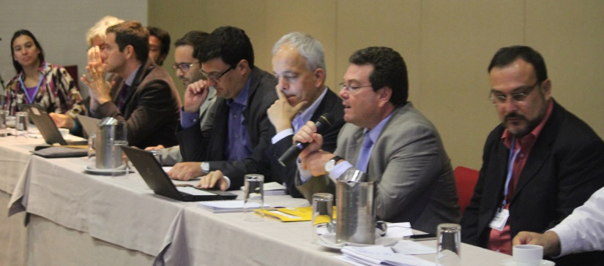
NAMA Market Place for catalyzing collaboration
Looking forward to interacting with international organizations and representatives from the private sector on support opportunities for implementing your NAMAs ?
..NAMA Market place is a platform :
to present NAMA proposals to a panel of public and private investors
to exchange invaluable feedback for NAMA proposals
to receive information on NAMA support programmes
to explore potential for collaboration in the implementation of NAMA proposals

Slide 29
Showcasing how transformational NAMAs are contributing towards moving developing countries along a low-emission development trajectory
NAMA Day in LIMA COP
NAMA Fair in Paris COP

Slide 30
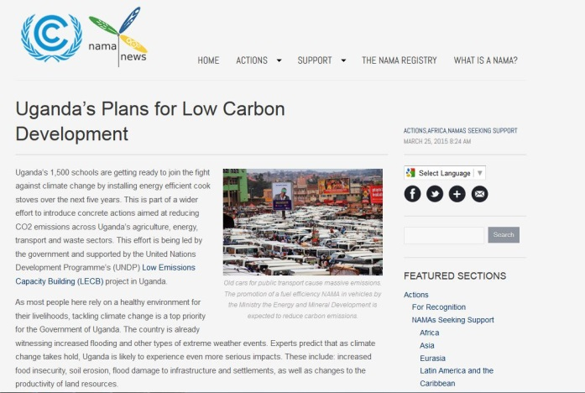
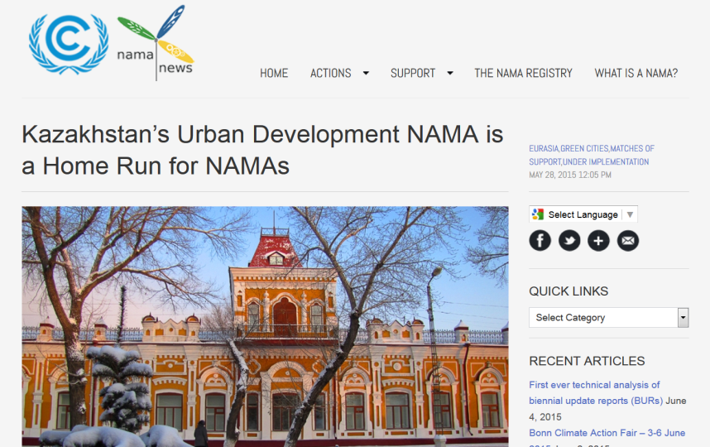
NAMA news to enhance visibility of NAMAs
NAMA news, a website to:
Increase the visibility of NAMAs
Provide updates on NAMA related activities and publications
Share information on support available

Slide 31
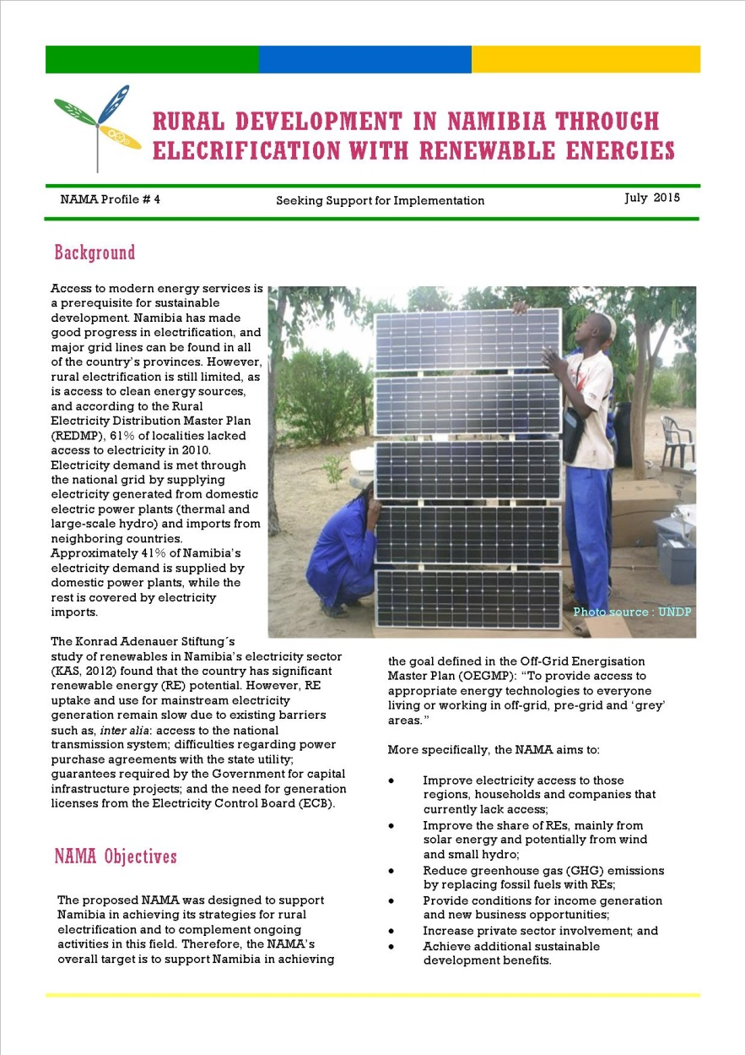
NAMA Profiles to further promote NAMAs
All NAMAs are potential candidates
Need to collect additional information (SD-co benefits, link to national policies..)
Distributed through multiple channels
http://unfccc.int/cooperation_support/nama/items/7598.php

Slide 32
Utilizing the social media to promote NAMAs

Slide 33
Benefits of participating in the registry
Parties and users have already realized the registry’s usefulness as :
Promotion and marketing Platform
To gain visibility for undertaking climate actions on the ground;
Authentic and official source
of information, data and knowledge on NAMAs, and support needed and available for NAMAs.
Information sharing platform
For sharing best practices, technical tools and information for designing and implementing NAMAs
To increase probability for obtaining international support

Slide 34
Expectations from Parties and users
It is recommended that Parties and others who may benefit from the registry:
Find ways to increase their level of participation in the registry, including obtaining access rights and creating registry entries. For developing country Parties, the ability to decentralize the preparation of NAMAs through NAMA developer access rights may facilitate participation
Take steps to ensure that their entries in the registry are accurate, complete and up-to-date
Continue to provide the secretariat with suggestions for improving the registry, with their related capacity-building needs and to make use of relevant technical resources

Slide 35
The registry has a diversified role to play in long run
Acting as submission portal for financial mechanisms under the convention, national and international support agencies;
Official tracking of implementation of international support commitments for mitigation actions under the 2015 climate agreement;
Official tracking of concrete climate actions on the ground (GHG emissions reduction targets/achievement) and associated support needs under the 2015 climate agreement;
1
2
3

Slide 36
The registry has a diversified role to play in long run
Reporting implementation status of NAMAs and associated ex-post impacts (emission reductions and sustainable development benefits);
Recording data with a view to improving emissions statistics and projections;
Showing what works in terms of investment and support;
Compiling and sharing best practices;
4
5
6
7

Slide 37
@NAMAPartnership #NAMARegistry
NAMA news
namanews.org
unfccc.int

Slide 38
Annual report on registry operation: FCCC/CP/2014/INF.1 Report on the extent of matching: FCCC/SBI/2014/INF.24 To view the registry visit: NAMA registry For any query and/or assistance please contact us : NAMA-registry@unfccc.int or NAMA-support@unfccc.int

Slide 39
We would like to hear from you !
What you would like to suggest for further improvements in the registry including technical functionalities and support by the secretariat ?
What are the main challenges preventing more active engagement in the registry of actors developing NAMAs and providing support for them? What actions could be taken by the relevant stakeholders including Parties and UNFCCC secretariat to address those challenges to fulfill the objectives of the registry ?
1
2

