Slide 1
Sustainable development and transformational change impact assessment of policy and actions
LAC Regional Workshop on Nationally Appropriate Mitigation Actions
14-15 September 2015, Santiago, Chile
UNEP DTU Partnership

Slide 2
Outline:
Objectives of two research projects
NAMA SD Framework
NAMA SD tool – example from the Philippines
Understanding TC in NAMAs – concept paper
Case studies of TC
TC Taxonomy – towards a methodology

Slide 3
Two research projects

Slide 4
Objective of the Research Project ‘Measuring SD in NAMAs’, Phase 1
Aim: To improve quantitative and qualitative measurement of the SD outcomes of NAMAs - enhancing understanding of how NAMAs can contribute to meeting national development goals.
Outcomes: Enhanced understanding of the expectations and needs of stakeholders in measuring SD in NAMAs; improved knowledge of early action and lessons learned on measurement of SD in NAMAs through an examination of tools, frameworks and indicators and of how these actions/tools meet the needs of various stakeholders.
Outputs: Literature review, interviews, criteria for NAMA SD Framework, final report
Website: www.namapartnership.org

Slide 5
Methods & data
Literature review: Firstly, we reviewed previously applied tools to assess and measure SD impacts of diverse efforts such as sectoral strategy development, climate change strategy, product lifecycle assessment and project development, to help identify recommendations for approaches to assess SD benefits of NAMAs. Key components of the literature review include:
1) Review of SD tools in general
2) Review of climate change SD tools
Stakeholder interviews: Secondly, to understand the different stakeholder perspectives of developing country governments, donors, private sector and civil society on the needs to measure SD in NAMAs a survey was send to a broad group of NAMA stakeholders. The survey has been circulated to 2056 people in September 2014. The response rate is 16,4 % with 338 answers to the survey. Eight in-depth interviews were conducted with 2 developing country government perspectives, 2 NGO perspectives, 2 private sector perspectives and 2 donor perspectives.

Slide 6
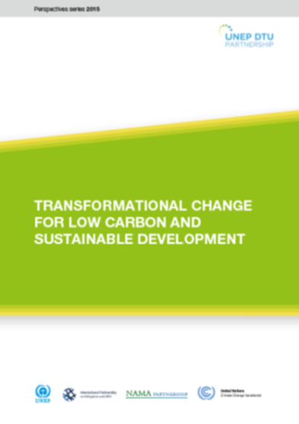
TC in NAMAs
Objective:
To improve the understanding of transformational change (TC) and how to Monitor, Report and Verify (MRV) Nationally Appropriate Mitigation Actions (NAMAs) that may facilitate TC for low emission and sustainable development to achieve the 2ºC target
Phases and outputs:
Phase 1: Understanding transformational change
Output 1: Conceptual paper
Output 2: Case studies
Phase 2: Methodological framework (on-going work)
Output 3: NAMA TC taxonomy
Output 4: Test of tool to 93 NAMAs submitted to UNFCCC Registry by 1 May 2015

Slide 7
NAMA SD framework

Slide 8
Guiding principles
Not prescriptive – focus on what to do, not how to do it, e.g. definitions of sustainable vs. unsustainable are nationally determined
Transparent – all assessments whether qualitative, quantitative or monetary shall be publicly available for review at any
Consistent - indicator based to deliver comparable and structured information about SD co-benefits and negative impacts for all NAMAs across all sectors
Credible – independent review shall ensure that methods are valid and results are reliable
Stakeholder participation – is a right and facilitates good climate governance
Easy to use - the framework should not require much extra effort than is currently practiced for M&E of development outcomes unless required for particular needs to sustainable development

Slide 9
NAMA Sustainable Development Taxonomy
Environmental
Social
Economic
Institutional
Air
Land
Jobs
Health & Safety
Growth
Energy
Capacity Building
Policy & Planning
Water
Natural Resources
Education
Welfare
Technology
Balance of Payment
Domestic MRV System
Laws & Regulation
Air
SOx, NOx, GHG
Odor, Dust, SPM, Fly ash
Noise
Land
Compost
Manure nutrient and other fertilizer
Soil erosion, Salinization, Acidification
Minimum tillage
End of life pollution
Change access/lost access to land
Other
Water
Waste water
Leaks & diesel dumping
Drinking water quality
Water extraction rate
Conservation
Supply, water access
Ecological state
Purification
Other
Natural Resources
Minerals
Species diversity
Plant life
Land cover change
Other
Jobs
Long term jobs
Short term jobs
Sources of income
Other
Health and Safety
Accidents
Crime
Diseases
Number of hospital visits
Sanitation
Food safety
Indoor air pollution
No child labour
Other
Education
Green development related training
Educational services for different groups
Project related knowledge circulation
Other
Welfare
Traffic congestion
Commuting times
Income/asset distribution
Women empowerment
Municipal revenue
Rural upliftment
Energy security
Other
Growth
Investment
Industrial/commercial activities
Economic growth/higher income
Quality of life
Increased tax base
Infrastructure
Production cost
Productivity
Other
Energy
Coverage/availability of supply
Access
Reliability, affordability
Other
Technology
Imported technology
Local technology
Adaptation and viability in local area
Other
Balance of payments
Dependency on foreign sources of energy
Amount of energy produced from clean renewable sources
Decrease in risk of political conflicts
Economic savings for the government
Reduction in energy subsidies
Other
Capacity Building
Land titling processes
Mapping of natural resources and renewable energy potential
Development of competitive procedures
Workshops and trainings
A technical help desk for project developers and other stakeholders
Other
Policy & Planning
Policy Framework for Sustainable, Low‐carbon Urban Transport
Comprehensive Urban Low carbon Mobility Plans
Other
Domestic MRV System
Sub‐national reference levels and MRV systems
Platform for the Generation and Trading of Forest Carbon Credits
Other
Laws & Regulation
Tariff reform
Compliance with laws and regulation on
Promoting and regulating production, sale and use of biofuels and biomass
Decrees for tax benefits for renewable energy projects
Conditions for competitive process for incorporation of new plants
Other

Slide 10
SD assessment framework in the NAMA Cycle
SD Assessment
NAMA cycle
Actors
Ex-ante Assessment
Design of NAMA & Support Program
NAMA Developer & Partners
SD Criteria & Indicators
Transformational change
National Coordination
National Coordinating Body
Quantification & Monetization
Means of Support
International Support Agencies
Procedural Steps
Finance
CS
TT
Alignment with SD goals
Public Participation
Registry
National / UNFCCC Registry
No-Harm Safeguards
National
International
Ex-post Assessment
Implementation of NAMA
National Stakeholders
Monitoring & Reporting
Independent Review
Certification
MRV
National & Independent Entities

Slide 11
Steps | Element | Description
Ex-Ante Assessment | 1. SD criteria & indicators | Identify and describe SD impacts – using the CDM SD taxonomy with one new dimension
 | 2. Transformational change | Indicators of the processes of change for a paradigm shift to low carbon and sustainable development
 | 3. Quantification & Monetization | Units of measurement to track SD impacts towards SD goals are identified and methods to estimate their monetary value are applied
Procedural steps | 4. Alignment with SD goals | SD impact analysis and contribution to SD goals at global, national, and other relevant levels
 | 5. Stakeholder Participation | Guidelines for stakeholder involvement throughout NAMA design and implementation
 | 6. No-Harm Safeguards | Compliance with no-harm safeguards to avoid or mitigate negative impacts
Ex-post Assessment | 7. Monitoring & Reporting | Develop a monitoring plan; How are indicators monitored, by whom, how often? Describe quality assurance procedures. Report the monitoring data to relevant stakeholders at regular intervals.
 | 8. Verification | Independent review of methods and data shall be provided when needed to ensure SD impacts are credible and transparent
 | 9. Certification | Public, private or civil society players may want to define standards for certification of units of GHG reductions with SD impacts

Slide 12
NAMA SD Tool - the case of the Philippines

Slide 13
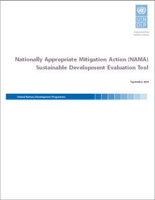
NAMA Sustainable Development (SD) Tool
The SD tool has been designed to evaluate the SD performance indicators for NAMAs and to evaluate the SD results achieved over the lifetime of the NAMA;
Nationally Appropriate Improvements (NAIs) determine the ambition and success of the NAMA;
NAIs are calculated for each intervention, the mean value is determined for each domain, and the overall ambition and success of the NAMA calculated as the mean value over all domains;
The SD tool is currently applied in 7 NAMAs, e.g. ‘Adaptation and Mitigation Initiatives in Philippines Rice Cultivation’.

Slide 14
NAMA SD Tool – Domains, Indicators, Parameters
The SD tool is divided into 4 domains: (i) Environment, (ii) Economic, (iii) Social, (iv) Growth & Development;
Each Domain consists of different indicators but in order to keep maximum flexibility, only those indicators that are relevant and applicable for a specific NAMA are selected;
Each selected indicator is defined through parameters relevant for the specific NAMA;
The parameters are described qualitatively and/or quantitatively;
Quantitative parameters are subject to robust monitoring through the definition of the baseline value, ex-ante estimated intervention target value and ex-post monitored intervention value;
The Nationally Appropriate Improvements (NAIs) are estimated ex-ante, determined ex-post and allow for a transparent evaluation of the sustainable development impacts of the NAMA;

Slide 15
NAMA SD Tool – Domain Environment & Social

Slide 16
NAMA SD Tool – Monitoring

Slide 17
NAMA SD Tool – Monitoring Sheet

Slide 18
Understanding TC in NAMAs

Slide 19
Aim and content of the conceptual paper
The aim of the paper is threefold:
To provide first and general insights into the meaning of Transformational Change
To compile a number of theoretical approaches that could be used for assessment of transformational impacts
To develop theses to guide the case studies
Starting point: Defining transformational change through NAMAs
“Transformational Change through NAMAs is a change
that disrupts established high-carbon pathways, contributes to sustainable development and sustains the impacts of the change (goal dimension),
that is triggered by interventions of actors who innovate low carbon development models and actions, connect the innovation to day-to-day practice of economies and societies, and convince other actors to apply the innovation to actively influence the multi-level system to adopt the innovation process, (process dimension)
that overcomes persistent barriers toward the innovated low carbon development model and/or create new barriers which hinder the transformed system to relapse into the former state (‘low-carbon lock-in’).”

Slide 20
Theoretical approaches to Transformational Change

Slide 21
Elements of transformational NAMAs
Vision
Transformational change starts with an ambitious vision of change.
Experimentation and Innovation
Transformational change involves risky decisions and investments that are not guaranteed to pay off.
Governments can create the protected niches needed to experiment with new solutions.
Actors and Coalitions
Transformational change needs actors of change : innovators, disseminators, advocates, policy-makers.

Slide 22
Theses: Further aspects for NAMAs
Instruments for Barrier Removal
TC-NAMAs overcome persistent barriers.
TC-NAMAs need policy instruments that are tailor-made to circumstance, in order to create a mix of push by markets and pull by policy.
Systemic Change
Transformational change needs to strike a balance between depth of change and connectivity to established practice (and habits) within society.
For Transformational change, a portfolio of interventions is needed that together aim at change in all societal dimensions.

Slide 23
Transformational NAMAs: Layers of Change
Experiment-ation and Innovation
Actors and Coalitions
Vision
Instruments for Barrier Removal
Systemic Change

Slide 24
Case studies

Slide 25
Aim and selection criteria for case studies
The aim of the case studies is twofold:
To share experience and detailed accounts of success stories of transformational change
To inform the development of a methodological framework for assessment of transformational change potential in NAMAs based on the sustainability transition theories to learn, what are the empirically based indicators and success factors.
Selection criteria:
The case studies are focused on successful (as to-date), planned, and country specific interventions with a view to achieve low carbon development
A balance in the choice between developed and developing country cases
The choice of cases must have a clear link to the hypothesized success factors/theoretical approaches selected
Countries with the most ambitious GHG reduction goals will be selected
Maximize the diversity of sectors (including one tackling LULUCF and one tackling transport)
The amount of cases studies will be kept at a maximum of five

Slide 26
Five case studies on TC
Developed country perspectives:
Germany: Energy system transformation - the role of laws and regulatory frameworks for renewable energy
Denmark: The role of wind power towards 100% renewable energy in electricity production by 2050
Developing country perspectives:
Brazil: The drivers of deforestation - a 75% drop over a decade (2005-2014)
Columbia: Sustainable transport in Bogotá – the role of political will & technical solutions at city level
South Africa: The role of state-owned companies to lead an incremental transition away from high-carbon lock-in to a low-carbon future

Slide 27
Towards a methodology

Slide 28
Analytical framework

Slide 29
Taxonomy for assessment of TC potential
Dimensions | Factors | Indicators - based on questions to the cases
Operational definition of transformational change for low-carbon and SD | Goal(s) of transformation | What are the goal(s) and key indicator(s) of transformational change?
 | Process of change | What intervention(s) trigger the change process? Who are the key actors? How will the intervention lead to system change?
 | Low-carbon lock-in | Which barriers are overcome? How will a low-carbon pathway be sustained?
Multilevel context for the socio-technical system transformed | Landscape level | What macro-level trends and changes in the socio-technical system have an impact on the transformation?
 | Regime level | How is the socio-technical regime delineated? What established infrastructure and ways of doing things need to be changed with regard to rules, institutions, practices, behaviour, markets and industry structure?
 | Niche level | What new technologies or policies will trigger the transformational change? Do protected spaces exist for technical, social and organisational experiments and learning?
 | Interactions across levels | What are the key dynamics of change between the three levels?
Phases of transformation – at what stage is the socio-technical system? | Pre-development phase | What are the established high-carbon pathways? Who are the pioneers of change?
 | Take-off phase | What new ideas, concepts, coalitions, regulations and societal acceptance are emerging for low-carbon development?
 | Acceleration phase | How does policy and regulation support change? How does low-carbon solutions challenge established pathways? Is opposition to new solutions increasing or decreasing?
 | Stabilisation phase | Is the low-carbon pathway stable or at risk of relapse? What new barriers hinder relapse?
Management of transformational change interventions – a cyclic process of four governance activities | Strategic | How is the transition arena set up as the institutional core of an intervention in collaboration with a network of innovators?
 | Tactical | What are the driving sustainability and low –carbon visions, agendas and pathways?
 | Operational | How are actors mobilized for executing projects and experiments?
 | Reflexive | How does monitoring and evaluation of the transition process facilitate reflexive learning to modify and adjust transition goals and pathways?

Slide 30
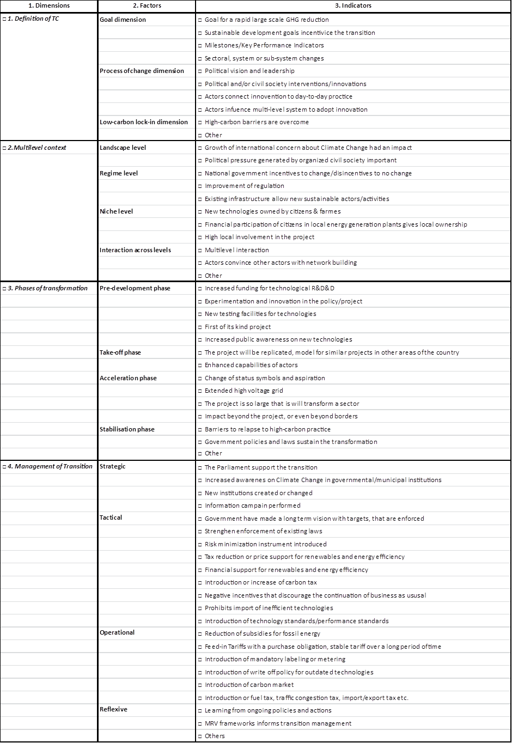
TC Taxonomy

Slide 31
Next steps for development
Discuss usefulness of the TC Taxonomy in stakeholder workshop with users (GCF, NAMA Facility and bilateral donors)
Apply the TC Taxonomy to NAMAs under implementation (for more rich data) for development of Version 2, refinement of indicators
Phase 3: Develop a scoring approach to weigh the criteria and indicators considered most important for TC

Slide 32
Questions & Discussion

Slide 33
For more information, please contact:
Karen Holm Olsen UNEP DTU kaol@dtu.dk
Florian Mersmann
Wuppertal Institute
florian.mersmann@wupperinst.org
Melissa Harris
International Institute for Sustainable Development (IISD)
mharris@iisd.ca
Alexandra Soezer
UNDP
alexandra.soezer@undp.org

