Slide 1

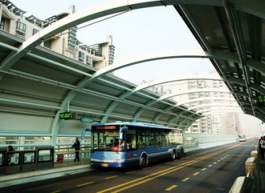
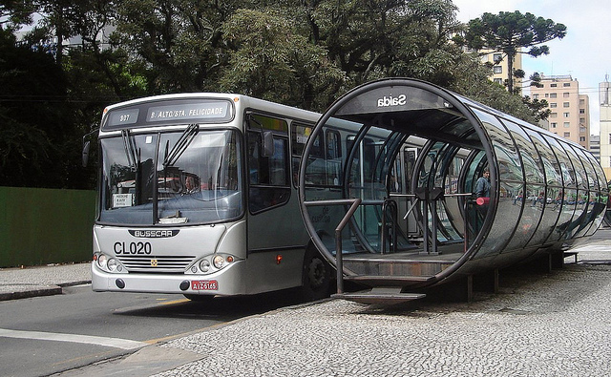
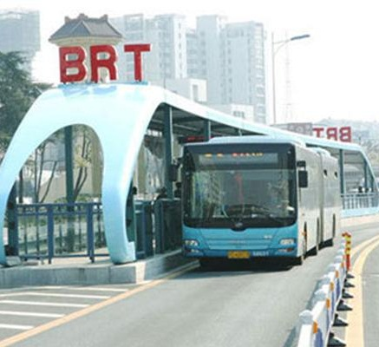

Transport NAMA, Sri Lanka
NAMA Regional Workshop, Bonn, 12th June 2015
Nilmini Ranasinghe
Environment Management Officer
Climate Change Secretariat
Ministry of Environment

Slide 2
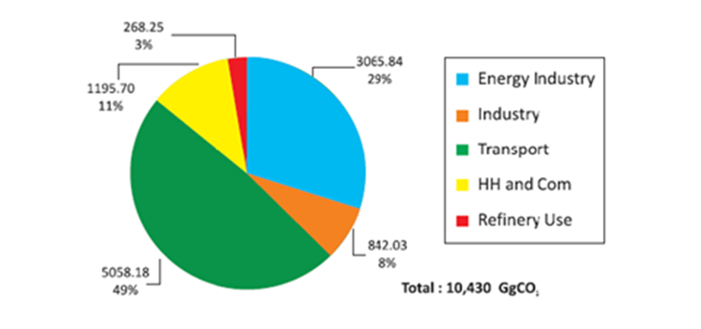
Sri Lankan Transportation Sector
Sri Lanka’s roadways is responsible for 99% of its freight transport and 73% of its passenger transport;
The railways cover a total distance of 1,450 km, extending from Colombo, to every part of the country;
The transportation sector is responsible for majority of Sri Lanka’s CO2 emissions: producing 49% of the total emissions 10,430 GgCO2;
Thus, the transportation sector is a principal area to foster low carbon growth and sustainable development in Sri Lanka.

Slide 3
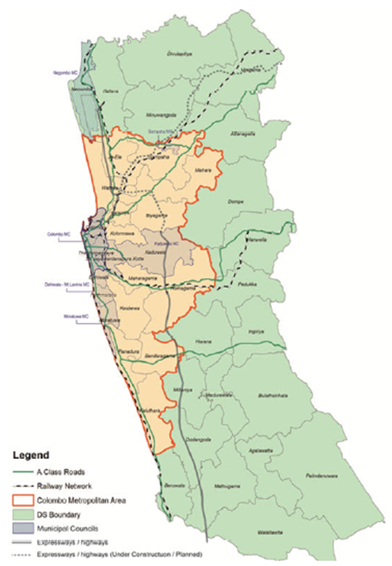
NAMA Objectives – The CMA
Colombo Metropolitan Area (CMA) is the largest metropolitan area in Sri Lanka with a population of 3.7 million as of 2012;
Represents the cultural and financial heart of Sri Lanka
An efficient and effective transportation system in CMA will have a ripple effect across the country leading to further replication and implementation
The CMA transportation sector faces numerous issues, which have prevented it from being the sustainable, efficient machine it should be.

Slide 4
NAMA Objectives
Major problems the transportation system in CMA
  Heavy Traffic Congestion & Consequent Increased Pollution
  Inefficient and Under Connected Public Transport System
Remedial measures being considered by the Sri Lanka Government:
  Development of Bus Rapid Transit (BRT) System on the Galle Road
A BRT, while it can address issues of level of service of the public transport system, the issue of pollution and GHG emissions persists due to the use of conventionally fueled ICE (Internal Combustion Engine) buses
The NAMA combats this issue by introducing electric vehicles; buses, as the vehicle of choice to carry passengers on the BRT
It also aims to develop a model of transportation that once successfully implemented in CMA, can be easily and successfully replicated across Sri Lanka

Slide 5
NAMA Objectives

Slide 6
NAMA Benefits

Slide 7
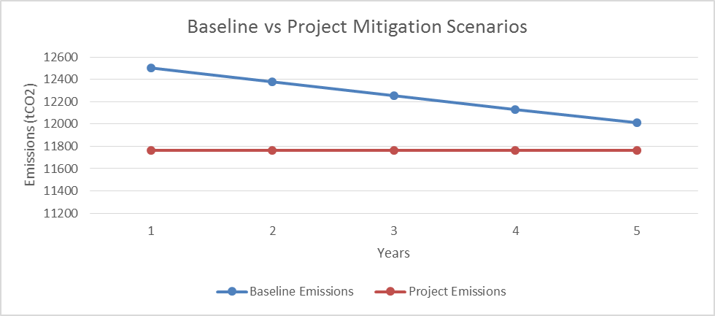
NAMA GHG Emission Reductions
Based on the CDM methodology “AMS-III.C: Emission reductions by electric and hybrid vehicles”:
Even in case of improved technology, the NAMA intervention provides emissions reductions throughout:

Slide 8
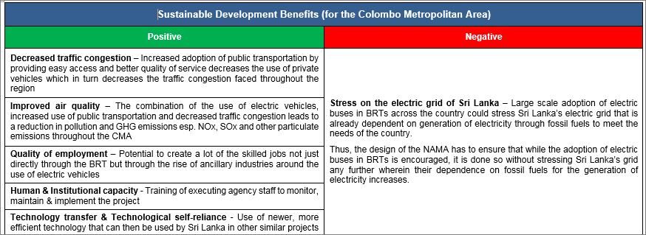
NAMA Targets – SD benefits

Slide 9
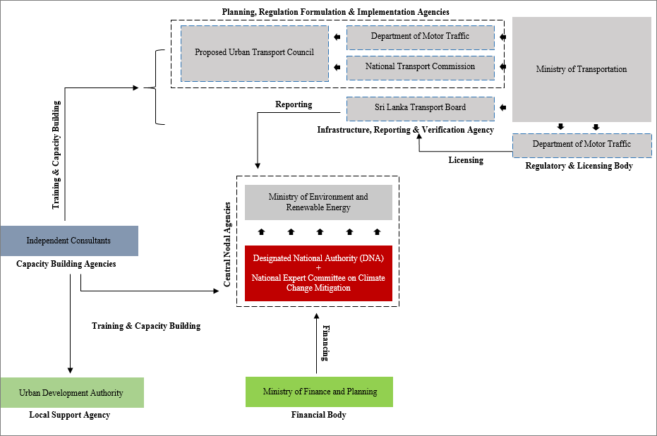
NAMA Arrangement

Slide 10
Finance for Implementation

Slide 11
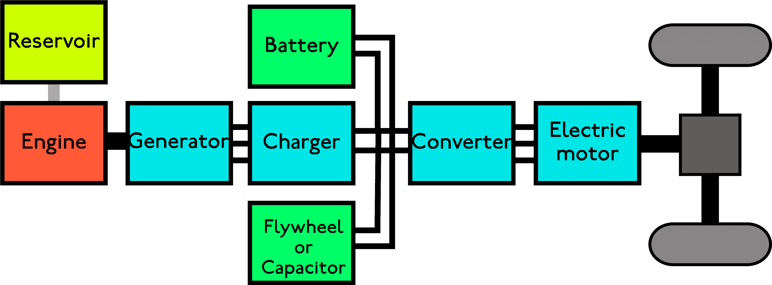
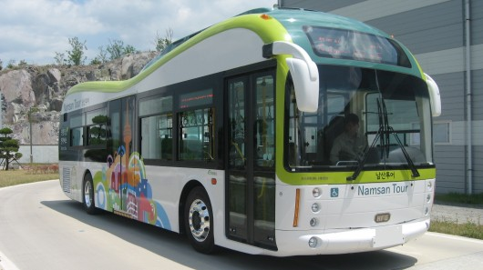
NAMA Technical Details
For the Sri Lanka transport NAMA, we will be looking at viable autonomous electric battery powered bus options:

Slide 12
NAMA Implementation

Slide 13
Director (Climate Change)
Ministry of Environment
Sri Lanka
or
Alexandra Soezer,
MDG Carbon Programme Manager
alexandra.soezer@undp.org

