Slide 1
CDM: Enhancing demand and improving supply
Fatima-Zahra Taibi, UNFCCC secretariat
Regional Workshop on CDM and NAMAs for Latin America and the Caribbean Bogotá, Colombia

Slide 2
A challenging market …
Low international ambition in reducing emissions
Low demand for CERs and current excess supply
CER prices dropped 95% in past few years
Significant challenges in selling issued CERs
Little incentive for new projects
Many buyers looking for more than just the CDM as we know it
A net overall contribution to global mitigation
Assurance of sustainable development benefits

Slide 3
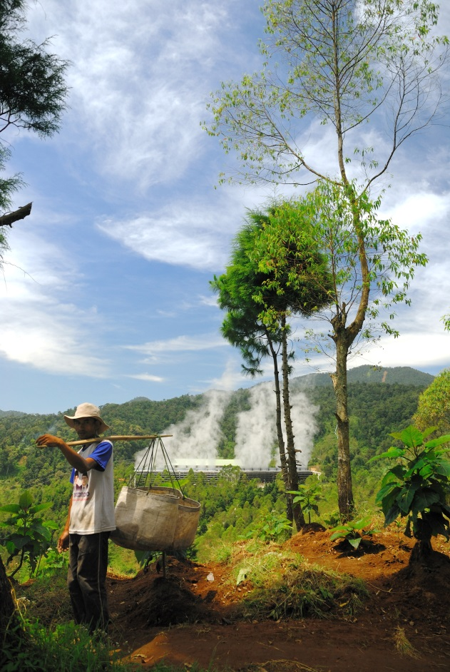
… calls for a change of plan
Shift in thinking to identify new markets and increase CER demand
CDM Executive Board call for nurturing policies to broaden demand and participation in the CDM
Supports the broader objectives of the climate change Convention by facilitating real mitigation action
Supports CDM’s ability to deliver real benefits to developing countries and real emission reductions globally

Slide 4
Increasing demand
Facilitate acceptance of CERs in compliance markets
Emerging trading schemes and ICAO
Emerging approaches (carbon tax, etc.)
Enhanced use of CDM in voluntary markets
By governments and the UN
By private companies and NGOs
Sporting and conference events
Develop CDM for delivering mitigation finance
Results-based finance
Nationally appropriate mitigation actions (NAMAs)

Slide 5
Voluntary cancellation of CERs
Voluntary cancellation = destroying CERs so they may not longer be used for compliance
In practice, achieved by transferring CERs to a cancellation account in the CDM or a national registry
Driven by a number of reasons
By organizations or individuals showing leadership by offsetting emissions
Increase de facto mitigation (in particular governments)
Support developing countries (finance, technology, capacity)
Contribute to closing the pre-2020 ambition gap
Preserve investors’ confidence in UNFCCC mechanisms

Slide 6
Make it easy, visible and recognized!
To promote voluntary cancellation …
Strengthened communication and outreach campaign
Improved recognition of the CERs cancelled
Establish an information platform on CERs available for cancellation
Develop a simple online platform for conducting cancellation (under development)

Slide 7
Initials signs
ADP invited governments to consider reducing the pre-2020 mitigation gap with CERs cancellation
Total gap by 2020 is estimated to be at least 20 billion tonnes CO2 eqv
Potential supply from all registered CDM projects accumulated until 2020: ~8 billion CERs
FIFA World Cup 2014 offsetting with CERs
Carbon pricing initiatives considering use of CERs as offsets (e.g. Mexico, Costa Rica)
Initial contacts with potential cancellers have been positive

