Slide 1
Mitigation in the context of national sustainable development plans and strategies
Regional Workshop on CDM and NAMAs for Latin America and the Caribbean
Bogotá, 31 August – 2 September 2014
Miriam Hinostroza & Karen Olsen
Low Carbon Development Programme
UNEP DTU Partnership

Slide 2
What is SD about??
We need to understand the interactions of several complex sub-systems
Earth systems
Social
Dynamics
Techno-economic
Geopolitical

Slide 3
Environment dimension - Planetary Boundaries
Source: Planetary Boundaries, Rockström et al. Nature. 2009.

Slide 4
What is SD about??
We need to live within planetary boundaries:
Planetary Boundaries | Boundaries quantified
Climate change | CO2 concentration in the atmosphere should be limited to 350 ppm and/or a maximum change of +1 W m-2 in radiative forcing
Biological diversity loss | An annual rate of a maximum of 10 extinctions per million species
Biogeochemical cycles | Nitrogen (N) cycle - limit industrial and agricultural fixation of N2 to 35 Mt N yr-1) Phosphorus (P) cycle (annual P inflow to oceans not to exceed 10 times the natural background weathering of P
Global Freshwater use | Limited to 4000 km3 yr-1 of consumptive use of runoff resources
Land system change | Not more than 15% of the ice-free land surface used as cropland
Ocean acidification | Mean surface seawater saturation state with respect to aragonite at not less than 80% of pre-industrial levels
Stratospheric ozone | Maximum 5% reduction in O3 concentration from pre-industrial level of 290 Dobson Units
Chemical pollution | No boundary defined
Atmospheric aerosol loading | No boundary defined
Source: Planetary Boundaries, Rockström et al. 2009.

Slide 5
What to transform?
the world is changing in many profound ways
we need to pay attention on the drivers of change
the bound of power to really influence sustainability relies with institutional investors, the large investors, pension funds, foundations…
we need to look at the current development conditions:
the way we do investment
the way we do production
the way we produce and use energy
the way we use water and manage waste
the way how we extract natural resources
the way we are organized and our institutional structures….
we need to know what we want to sustain and how we will sustain it
are investment rules of today fit for purposes tomorrow?...

Slide 6
Linkages between SD-LCDS-NAMAs
Defining a strategy in context of medium to long term development plans:
Development Plans
Monitoring & Evaluation
Low Carbon Development Strategies
Decouple economic growth from GHG emission growth
Reduce the carbon intensity of the economy
Leapfrog the high-carbon development path of today’s business-as-usual trajectory
LT Development goals
Emission sources
and sinks
Nationally Appropriate Mitigation Actions NAMAs
Emission reduction priorities
LT Development Priorities
Capacity &
Finance
Baseline &
MRV
Tech. transfer
Contribution to development goals
in the context of...
Sustainable Development
UNEP Risoe Centre© , 2011

Slide 7
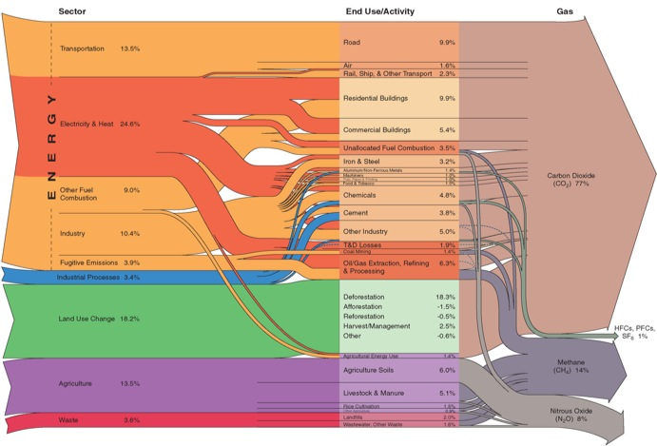
Low Carbon Development Strategies
Multiple emission sources vs. Multiple solutions
Know mitigation potentials of the economies
Will require holistic and bottom-up approaches
Inter-sectoral
Multidisciplinary
Developing countries can take advantage of international financing options
Potentialize national economic sectors competitiveness faced to a global economy influenced by carbon intensity standards
Increased efficiency of the economy
Notes:
Forestal y agrícola

Slide 8
Global goals for sustainable development
Three processes to define global goals for the environment, development and climate are running in parallel until 2015:
Sustainable Development Goals (SDGs) – Rio+20 process
Millennium Development Goals (MDGs) – UN Post-2015 Development Agenda
A New Climate Agreement – UNFCCC
The three processes are related but institutionally separate and aim to inspire actions and targets for implementation at national level supported by international institutions

Slide 9
Towards SD through LCDS and NAMAs

Slide 10
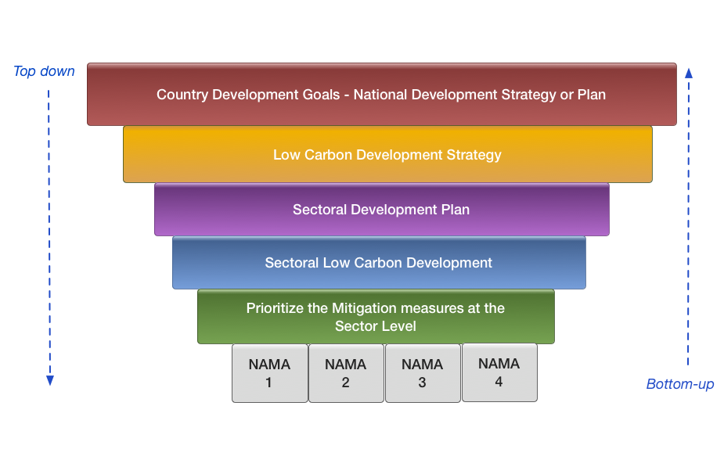
From LCDS to NAMAs

Slide 11
Transformation for SD
Change investment mindset in general – involve prinate sector
Elinor Ostrom, the latest Nobel laureate of economics, shows empirically across the world that we can govern the commons if we invest in trust, local action-based partnerships and cross-scale institutional innovations, where local actors, together, can deal with the global commons at a large scale.
Use crisis leading into opportunities. Let's use the crisis to build new partnerships, involve actors locally, transforming these into a key component of sustainable planning.
Invest in changing behaviour; in education
"What is the playing field on the planet? What are the planetary boundaries within which we can safely operate?" and then backtrack innovations within that. But of course, the drama is, it clearly shows that incremental change is not an option.

Slide 12
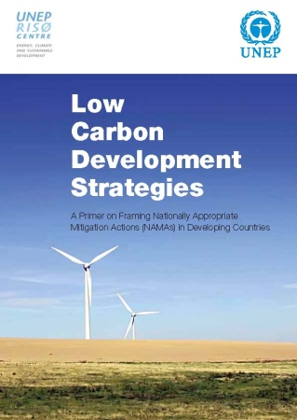
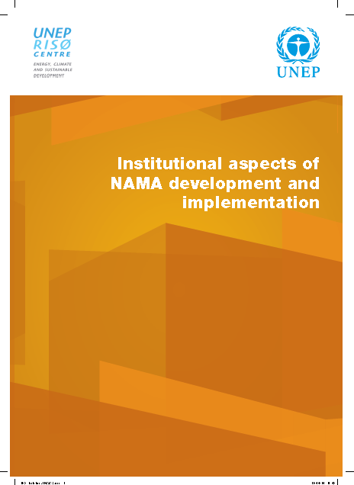
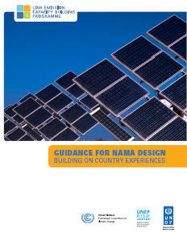
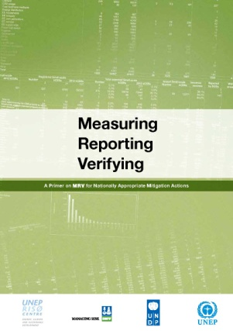
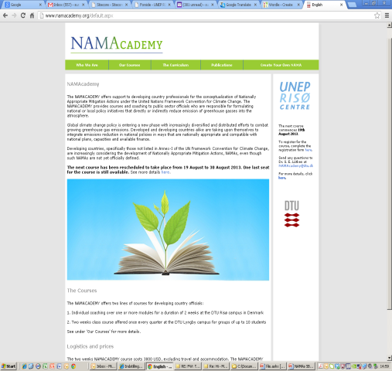
Thank you!!
http://www.unepdtu.org/
milh@dtu.dk

