Slide 1
Reporting on SD co-benefits using the new CDFM SD Tool and opportunities for monitoring to enhance the profile of CDM projects and CER price: what the buyers want!
Fatima-Zahra Taibi, UNFCCC secretariat
Regional Workshop on CDM and NAMAs for Latin America and the Caribbean (31 Aug – 2 Sep, 2014) Bogotá, Colombia

Slide 2
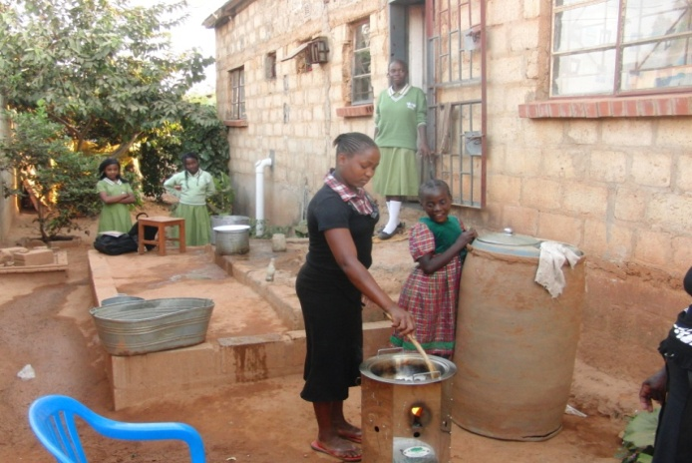
Background
The CMP, at its seventh session, requested the Board to continue its work and develop appropriate voluntary measures to highlight the co-benefits brought about by CDM projects and PoAs and report back to the CMP at its eighth session, while maintaining the prerogative of the Parties to define their sustainable development criteria
At EB 70 in Doha, the Board approved the voluntary tool for describing sustainable development co-benefits of CDM project activities and PoAs (SD Tool)
EB 80 request to the secretariat with
regard to monitoring of SD benefits

Slide 3
Details of the SD tool
The tool produces a sustainable development co-benefits (SDC) description report
Checklist approach
Three steps with menu of generic dimension, criteria and indicators
Indicators have been informed by relevant standards and identified based on what is reported in the PDDs of over 2500 registered CDM project activities
Seeks a balance between standardization and flexibility in the taxonomy
Incorporated inputs from stakeholders on drafts of the tool during 2012

Slide 4
Details of the SD tool
PPs and CMEs may request access to the online SD Tool through the UNFCCC website at https://cdm.unfccc.int/Reference/tools/index.html:

Slide 5
All published SDC description reports found at: http://cdm.unfccc.int/SDTools/index.html

Slide 6
Three steps in completing a description of sustainable development co-benefits
Select a project activity / PoA
Title, type, Ref. Num. or project cycle stage, SS, host country, location
Complete the level of sustainable development co-benefits of the project
3 categories: 1- Environment: air, land, water, natural resources
2- Social: jobs, health and safety, education, welfare
3- Economic: growth, energy, tech transfer, balance of payment
Third party assessment and contact information.
An independent third party could verify the statements made in the SD description.

Slide 7
Step 1

Slide 8
Step 2

Slide 10
Report – Output from SD tool

Slide 11
Benefits from the SD tool
The SD tool provides a structured, consistent, comparable and robust manner of highlighting the sustainable development co-benefits of CDM project activities and PoAs.
Comprises a check list of predefined criteria and indicators that help describe the impact of project activities and PoAs on the environment, society and economy of the host country.
Enabling PPs and CMEs to elaborate on the SDC of their projects in a consistent way, enhance transparency and credibility of the CDM as whole, while maintaining host countries’ prerogative to define their criteria for sustainable development.

Slide 12
Benefits from the SD tool
PPs and CMEs can use their published SDC description report to highlight and promote the sustainable development co-benefits of their project activities and PoAs.
SDC description reports will help buyers of CERs to easily identify projects with high sustainable development benefits.

Slide 13
Assistance to host parties on monitoring SDC
Background:
CMP.9 requested the CDM Executive Board to develop guiding tools to assist DNAs, voluntary and upon the request, in monitoring the sustainable development benefits in its territory of CDM projects, recognizing that the use of such guiding tools is the prerogative of Parties and subject to the availability of funds from Parties included in Annex I;
Aim: assist host parties in monitoring the sustainable development benefits of CDM projects, improving the reputation of the CDM and increasing its transparency with regard to this aspect that is one of its important pillars.

Slide 14
Assistance to host parties on monitoring SDC
Action Taken by Board as of date:
Developed and launched website in 1st week of May 2014
Communication sent to all DNAs. As to date only one DNA (Cambodia) expressed interest to receive technical assistance to develop guidelines.
EB 70 requested secretariat to create more awareness among DNAs including the regional workshops and at other events
Based on the request received from DNA Cambodia, EB 80 considered a concept note defining the approach to assist DNAs in monitoring SD for CDM project activities and PoAs in their countries.
EB 80 agreed on the approach outlined in the concept note and requested the secretariat to prepare an implementation plan.

Slide 15
Assistance to host parties on monitoring SDC
Action Taken by Board as of date:
Currently, the secretariat is assisting the DNA of Colombia in the development of guiding tools in monitoring sustainable development benefits.

Slide 16
Assistance to host parties on monitoring SDC
Next steps:
Should you wish to benefit from the assistance available in monitoring sustainable development benefits for CDM project activities in your countries, please contact the secretariat through the DNA Moderator email address: Moderator-DNA@unfccc.int
We invite DNAs once again to share with the secretariat their practices for monitoring sustainable development benefits, including the indicators they use, through the DNA Moderator email address: Moderator-DNA@unfccc.int

Slide 17
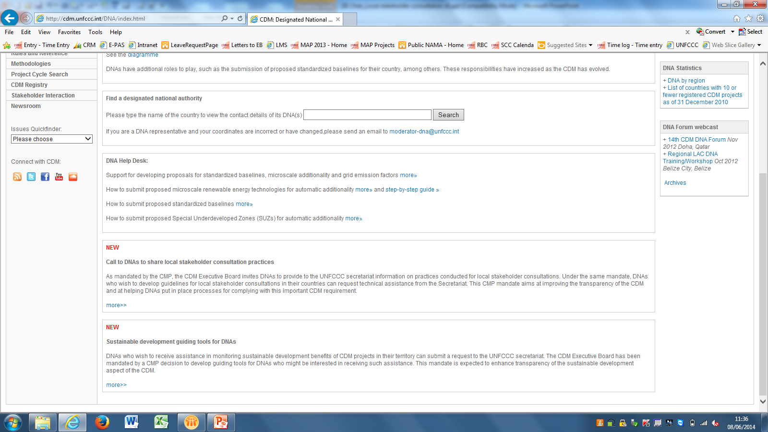
http://cdm.unfccc.int/DNA/index.html

Slide 18
EB 80 Request
At EB 80, the Board considered a proposal to introduce provisions on voluntary monitoring of the contribution to sustainable development and requested the secretariat to prepare a concept note in this regard for consideration by the Board at a future meeting.

Slide 19
Thank you

