Slide 1
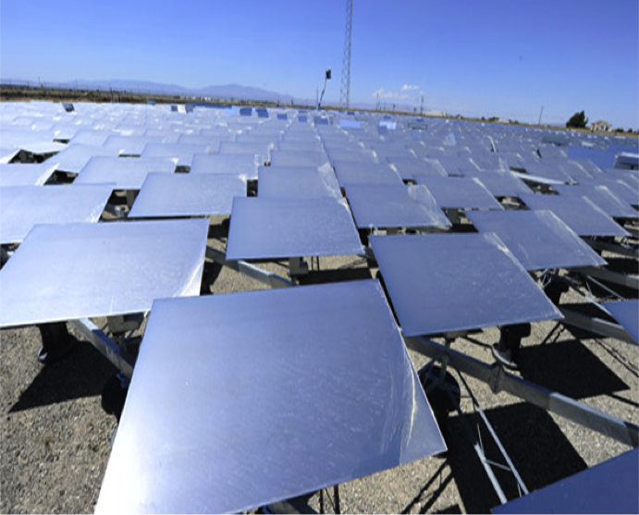
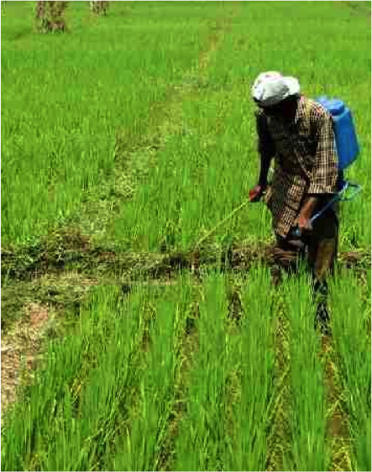
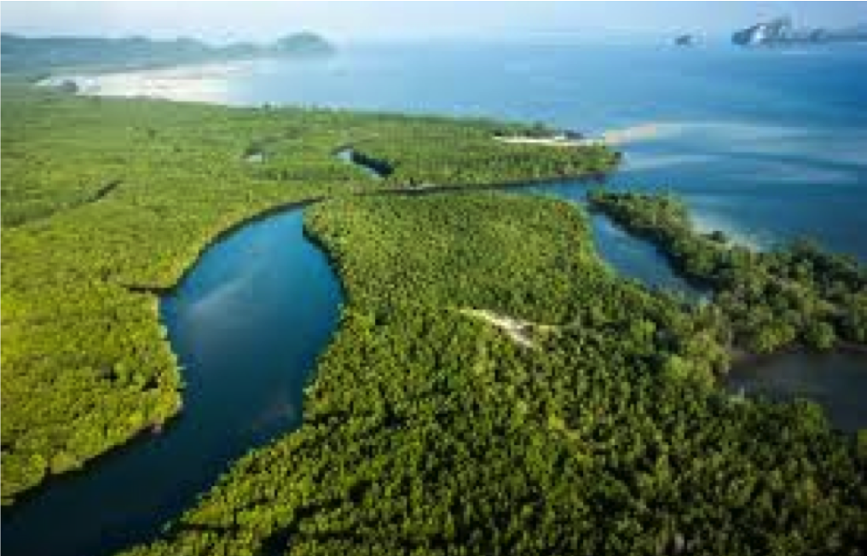
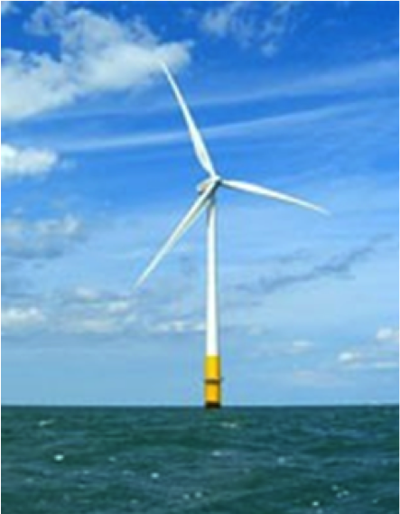

The Climate Technology Centre & Network:
Operational Arm of the Technology Mechanism

Slide 2

UN Framework Convention on Climate Change
The Conference of Parties mandates…
“that the Climate Technology Centre shall facilitate a network of national,
regional, sectoral and international technology networks, organizations and initiatives”
COP 15 (Copenhagen) 2009: agreement to establish a “Technology Mechanism”
COP 16 (Cancun) 2010: Technology Mechanism further elaborated (TEC and CTCN) and Technology Executive Committee created
COP 17 (Durban) 2011: establishment of the Climate Technology Centre and Network; selection procedure for host agreed
COP 18 (Doha): formal selection of UNEP as host of the Centre
Climate Technology Centre & Network Mission:
To stimulate technology cooperation and enhance the development and transfer of technologies to developing country parties at their request
2
Notes:
The CTCN concept was born out of an effort to address the known gaps in climate technology transfer for adaptation and mitigation purposes. Indeed, it is specifically mandated to serve as a hub for coordination of existing technology stakeholders and initiatives.

Slide 3
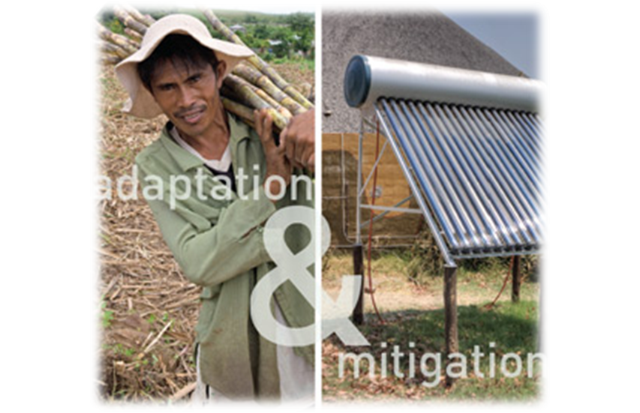
CTCN’s Core Services
  Provide technical assistance to developing countries to enhance transfer of climate technologies
  2. Provide and share information and knowledge on climate technologies
  3. Foster collaboration and networking of stakeholders on climate technologies
3

Slide 4
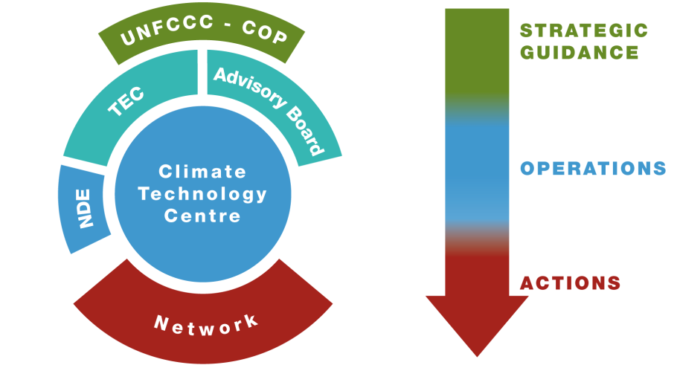
CTCN Structure
Core Centre co-managed by UNEP and UNIDO with the support of Consortium Members
Active engagement provided through the Network
4
Notes:
One of the main goals of the CTCN is to coordinate existing expertise and foster linkages between stakeholders at national, regional and international levels. We aim to accomplish this through a unique organizational structure. At it’s core, the Climate Technology Centre is supported by 11 regional Centres of Excellence – independent organizations around the world providing regional and sectoral expertise in the areas of adaptation and mitigation technologies.

Slide 5
CTCN Consortium
5
Notes:
Breadth and depth of expertise and experience in:
Adaptation and mitigation, along all steps of the technology cycle
Specific technology subject areas
Geographic understanding and language capabilities
Expertise in knowledge management
Network development and management

Slide 6
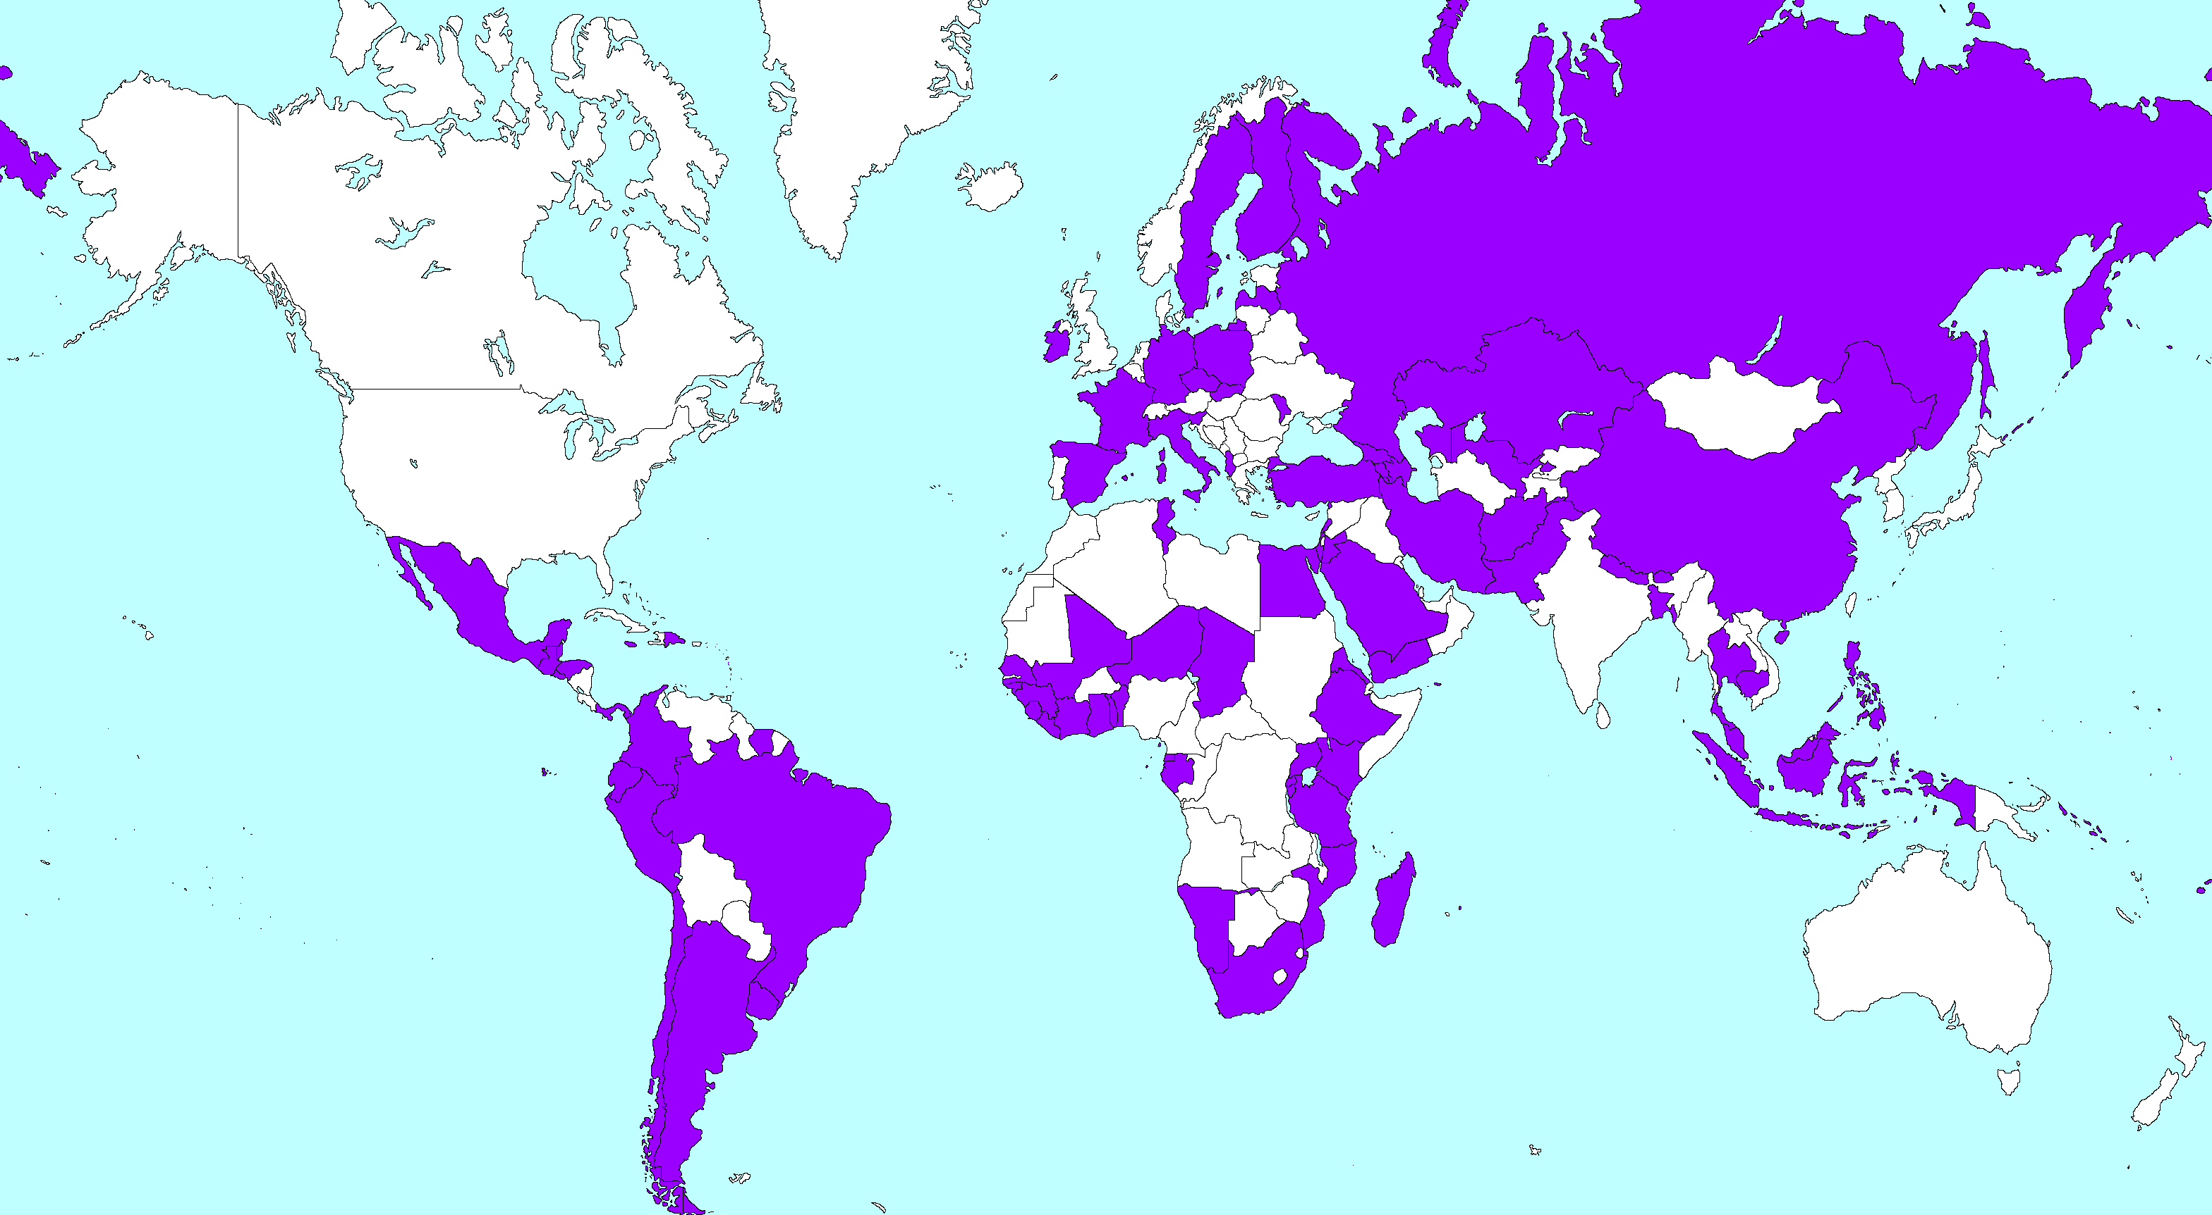
NATIONAL DESIGNATED ENTITIES (NDEs)
93 NDEs instated worldwide
World Map of NDEs, UNFCCC
6
Notes:
NDEs work with climate stakeholders in their countries to decide where technical assistance is needed and then conveys a request to the CTCN.
The success of the CTCN greatly depends on NDEs. There are still countries in East Africa who have not chosen their NDEs, and we encourage you to do so as this is the sole means to accessing CTCN technical assistance services.

Slide 7

What do we mean by “technology” ?
Definition of “technology” from IPCC report on technology transfer:
Any equipment, techniques, practical knowledge and skills needed for reducing greenhouse gas emissions and adapting to climate change
Includes hardware, software and orgware.
Notes:
Adapted from IPCC, 2000 - Bert Metz, Ogunlade Davidson, Jan-Willem Martens, Sascha Van Rooijen and Laura Van Wie Mcgrory (Eds.) Cambridge University Press, UK.

Slide 8
NETWORK MEMBERS
Benefits of joining
Gain access to new markets to provide technical assistance based on requests (paid for by CTCN)
Opportunities to share your expertise with a broader field
Opportunity to learn about cutting edge climate technologies through webinars, workshops and the clearing house platform.
How to join:
Submit a short membership request at www.ctc-n.org
How can join:
Public and private organisations developing and sharing climate technologies.
Notes:
Network members are climate technology experts from academia, multinational organizations, NGOs and the private sector, who contribute by sharing their expertise and networking with NDEs. In return, Network members can expand partnership opportunities and increase their global visibility to technology decision makers. Network members are also elligble to participate in bidding to provide technology solutions to CTCN country requests.

Slide 9


Examples of Network Members
Bionas BATC Development - Malaysia
Business Council for Sustainable Energy (BCSE) - USA
Climate and Development Knowledge Network (CDKN) – Global
Corporation Institute of Ecology and Biodiversity (IEB) - Chile
European Hydrogen Association (EHA) - Belgium
Global Carbon Capture and Storage (CCS) Institute - Australia
Global Environment Centre Foundation (GEC) - Japan
Agency for the Assessment and Application of Technology (TPSA-BPPT) - Indonesia
International Solid Waste Association - Austria
Kenya Climate Innovation Center (Kenya CIC) - Kenya
Renewable Energy Policy Network for the 21st Century (REN21) - Germany
Renewable Energy and Energy Efficiency Partnership (REEEP) - Austria
World Intellectual Property Organization (WIPO) - Global
Notes:
HAs you can see, Asian entities such as the Malaysian company Bionas and the Japanese Global Environment Centre Foundation are represented. The list of members continues to grow and we ask you to please encourage relevant academic, civil society and private sector stakeholders to apply.

Slide 10
Requests for Technical Assistance
Technical Assistance Requests at a glance
 | Countries | Adaptation | Mitigation | Both A & M
Responses being implemented: | 14 | 4 | 8 | 2
Requests under discussion: | 11 | 2 | 4 | 5

Slide 11
Country | Adaptation/ Mitigation | Sector | Request
Afghanistan | Adaptation & Mitigation | Agriculture/ Energy/ Water | Provide technical assistance to assess technology needs in selected priority sectors
Chile | Adaptation | Biodiversity | Design biodiversity monitoring network
Colombia | Adaptation | Cross-sectoral | Design monitoring system for national adaptation efforts
Colombia | Mitigation | Waste | Development of a Mechanical-Biological Treatment (MBT) pilot project
Colombia | Mitigation | Energy | Monitoring and Evaluation of national energy efficiency (EE) and renewable energy (RE) promotion policies
Côte d’Ivoire | Mitigation | Cross-sectoral | Development of an air pollution reduction strategy in Abidjan district
Ghana, Kenya, Mauritius, Namibia | Mitigation | Cross-sectoral | Green Cooling Africa Initiative
Honduras | Adaptation | Coastal zone/forestry | Build local capacity to monitor mangrove forests in Cuyamel Omoa
Iran | Mitigation | Energy | Technology of Photovoltaic Solar Cell Design and Manufacturing
Pakistan | Adaptation | Agriculture | Scale-up delivery of technical assistance on climate smart agricultural practices
Syria | Adaptation & Mitigation | Cross-sectoral | Technology Needs Assessment for Climate Change

Slide 12
Requests for Technical Assistance
Examples of technical assistance that CTCN can provide:
Development of a study to understand knowledge gaps on sustainable waste management and opportunities to fill the gaps for mitigating GHG emissions
Recommendations concerning specific climate-proof technologies for coastal protection using natural ecosystems
Market assessment to introduce the use and deployment of solar energy technology in industry
Drafting a national strategy for climate disaster resilience in small islands
Development of a training programme on sustainable agroforestry practices for local communities
Support in rolling out an approach to collecting, aggregating and monitoring the success of low carbon technologies for cattle farming in semi-arid regions
Development of a business plan for a new public agency that facilitates private sector investments in renewable energies
Notes:
You will see that Colombia has submitted three requests. Right now, countries are able to submit as many requests as they’d like. As the CTCN reaches its capacity for responding to technical requests, the number of requests per country/year may be limited, so I encourage you to engage with your NDEs to consider making use of this opportunity.

Slide 13

Knowledge Sharing
1400+ adaptation and mitigation information resources available
Navigation by region, country, sector or via keyword searches
Mobile friendly
Technical assistance
Capacity building
Will be launched in
4th quarter 2014
Notes:
In order to create greater access to climate technology knowledge, the CTCN is building a website that will provide adaptation and mitigation technology information searchable by region, country or sector (such as energy or agriculture). The site will be launched at the end of 2014.

Slide 14
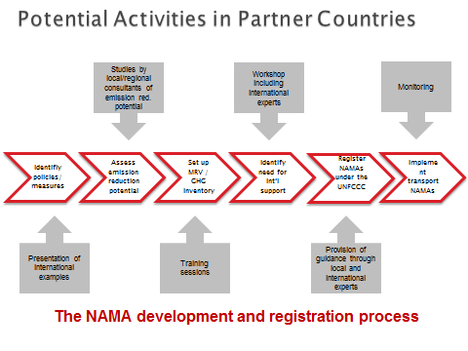
Options for CTCN support on NAMA development

Slide 15
Thank you
For further information, please visit http://ctc-n.org

