Slide 1
The NAMA Facility – Support for the Implementation of NAMAs

Slide 2
The concept of NAMAs: Background
“Nationally Appropriate Mitigation Actions (NAMAs) to be taken in the context of sustainable development and in a measurable, reportable and verifiable (MRV) manner”
(Bali Action Plan / UNFCCC 2007)
Voluntary climate protection measures taken by developing countries, embedded within their national development plans.
supported and enabled by financing, technology, and capacity building from developed countries.
potential to significantly contribute to global efforts to reduce greenhouse gas emissions
combine broad-based climate action with the achievement of sustainable development goals
Notes:
By moving countries towards a low-carbon development trajectory, NAMAs have the potential to significantly contribute to global efforts to reduce greenhouse gas emissions. Simultaneously, they offer developing countries and emerging economies a framework for combining broad-based climate action with the achievement of sustainable development goals.

Slide 3
The concept of NAMAs: Fundamental elements
Emerging consensus on some characteristics that serve to strengthen the transformational change potential of NAMAs:
Country-driven and anchored in national development strategies and plans
NAMAs should strive to be sector-wide programmes that are national in scope, even if regional or municipal elements could form part of the overall design
Combination of policy and finance: Policies should serve to create an enabling environment and channel financial flows into low-carbon investments. Financial mechanisms should address potential barriers for investment and leverage potential public support for mitigation activities.
Measurement, Reporting and Verification (MRV) of these actions is important to generate transparency on their effectiveness and facilitate decision-making.
Source: Worldbank
Notes:
All these elements are reflected in the selection criteria of the NAMA Facility (later)

Slide 4
Purpose and Facts of the NAMA Facility
Purpose:
Demonstrating a framework for providing tailor-made climate finance for developing countries in the field of mitigation.
Building on existing support by funding the implementation of transformational NAMAs seeking international support, thus delivering concrete results on the ground.
Raising ambition to close the global emissions gap and address the lack of NAMA climate finance.
Facts :
Officially announced by Germany and the UK at COP-18 in Doha
Germany and the UK jointly provided € 120m of funding
First pilot programme is the Mexico Housing NAMA: EcoCasa programme
Notes:
a. Purpose:
Being an innovative financing instrument the facility is an answer to funding needs of developing countries
Complements existing initiatives for NAMA development by support for the implementation of NAMAs, focusing on the mobilization of capital investments
Germany/UK aim to address the need to raise ambition and increase action to close the emission gap between the pledges made in Copenhagen and the required mitigation reductions to stay below a global temperature rise to 2° C or less.
We want to showcase that climate action pays of
b. Facts:
Announced 6 December 2012 in Doha by Federal Environment Minister Peter Altmaier and Edward Davey, Secretary of State for Energy and Climate Change in the UK
Germany and the UK jointly provided €120million of funding from the German Special Energy and Climate Fund and UK International Climate Fund (ICF) Part of industrialized countries commitment to mobilise $100 billion international climate finance per year by 2020
First project to be funded is the Mexico Housing NAMA. The NAMA project in Mexico will demonstrate the type of work the Facility has been designed for.

Slide 5
Means of Support
Provides support for the implementation of parts of a NAMA = NAMA Support Project
Uses full range of development cooperation instruments
Builds on existing channels of delivery
Notes:
Means of support:
In terms of the means of support, the NAMA Facility will provide support for parts (NAMA Support Project) of an overarching, sector-wide NAMAs.
The NAMA Facility uses the full range of development cooperation instruments (financial and technical cooperation in the form of “NAMA Support Projects”)
→ No set up of a new climate finance architecture – instead harnessing existing delivery channels including bi- and multilateral implementing agencies and institutions.

Slide 6
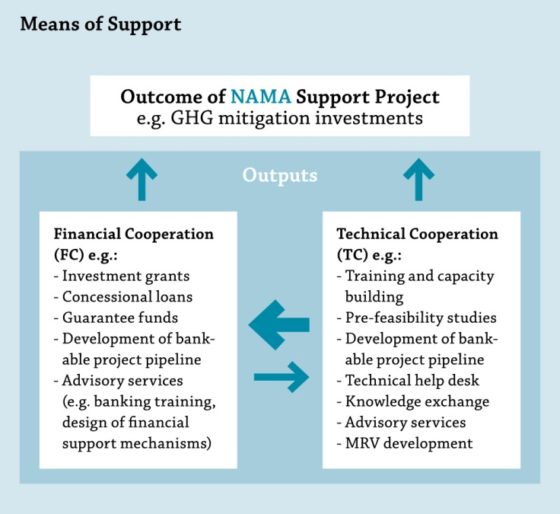
Means of Support
Notes:
Given their focus on implementation, NAMA Support Projects should focus on financial support (e.g. grants, concessional loans, guarantees), which serve to mobilize capital investments.
Technical assistance and capacity development for building up the relevant institutional and regulatory capacities in partner countries during NAMA implementation will be considered for support where they are combined with or closely linked to financial instruments
The wise combination of FC and TC should serve to maximise the transformational impact of the NAMA.

Slide 7
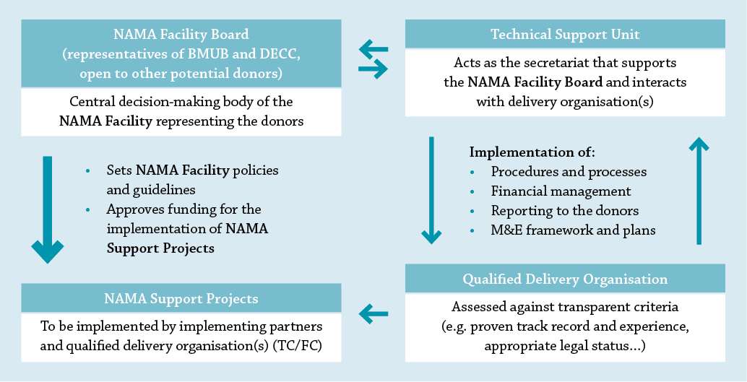
Governance of the NAMA Facility
Notes:
NAMA Facility Board formed by DECC and BMUB as central decision-making body (open to potential other donors)
Board takes all relevant decisions related to strategy, guidelines, allocation of funding
Technical Support Unit (TSU) to be staffed by KfW and GIZ with a secretarial function to support the Board in the management of the Facility.
NAMA Support Projects, which are approved by the Board will be implemented by qualified delivery organisations (incl. KfW and GIZ)
This allows a quick and flexible implementation structure

Slide 8
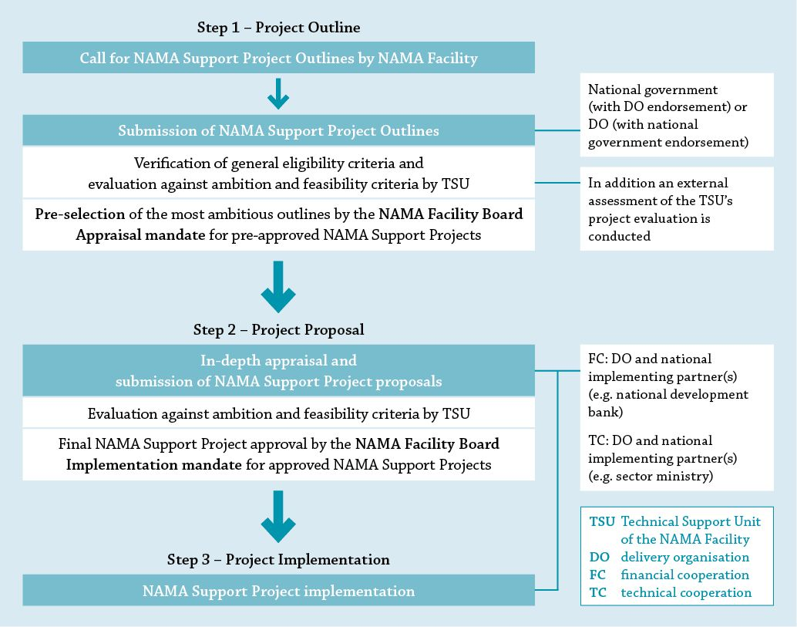
Project Cycle of the NAMA Facility
Notes:
NAMA Facility will be broadly accessible and aims to fund the most ambitious NAMA Support Projects available
In public calls the Board will ask national governments as well as qualified delivery organisations to submit outlines for NAMA support projects to the TSU
Generally, the selection and implementation of NAMA support projects follows a 3-step process
STEP 1: Based on submissions of Outlines for NAMA support projects → Project proposals are appraised by the Facility’s TSU against general eligibility criteria, ambition criteria as well as feasibility → Pre-approval and appraisal mandate of project outlines by the Board
STEP 2: For pre-approved projects: in-depth project appraisal by the delivery organisation and submission of proposals for NAMA support projects → Final approval of NAMA support project by the Board
STEP 3: NAMA support project implementation through delivery organisation

Slide 9
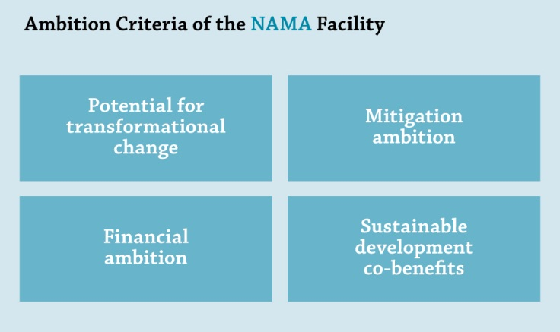
Selection Criteria of the NAMA Facility
The selection of NAMA Support Projects is based on three sets of criteria:
General eligibility
Ambition
Feasibility/readiness
Focus:
Notes:
The selection of NAMA Support Projects is based on three sets of criteria:
The general eligibility, (like project volume between 5-15 mio; involvement of qualified DO, letter of support, readiness to implement)
Ambition, consisting of potential for transformational change, mitigation ambition, financial ambition and co-benefits,
Feasibility, consisting of national and international embeddedness, project structure, log-frame and M&E as well as project finance
The selection criteria are published up-front an available online. To facilitate a common understanding of terms, sub-questions are provided.
Right now, I suggest looking a bit more into the details of the ambition criteria. The focus of the NAMA Facility is to support the implementation of truly ambitious NAMA which show a strong potential for transformational change.
There are four ambition criteria: potential for transformational change, mitigation ambition, financial ambition and sustainable development co-benefits.
Optional:
Potential for transformational change might be the most difficult concept to understand: It is the objective of the Facility to catalyse transformational change towards low-carbon development. Transformational change goes deeper than incremental improvements and should be able to deliver the changes necessary within the different (social) systems to move to a low-carbon development path. A list of guiding question in the documents of the NAMA Facility will help to operationalize the concept.
Mitigation ambition should be quite clear – the mitigation achieved by implementing the measures and its long-term impact to transform the sector
The financial ambitions looks into the mobilisation of additional funds, from national public sources, the private sector as well as other international donors.
The last criteria looks into the co-benefits of the NAMA as NAMAs are meant to not only mitigate GHG emission, but to have substantial positive sustainable development impacts.

Slide 10
The First Call for NAMA Support Projects
The NAMA Facility received lots of international attention.
During the first call, a total of 47 NAMA Support Project Outlines were received.
The bids submitted had a wide geographical and sectoral coverage.
The following NAMA Support Project Outlines have been pre-selected for funding from the NAMA Facility.
Chile - Self-Supply Renewable Energy in Chile (SSRE)
Colombia - Transport Oriented Development NAMA
Costa Rica - Low Carbon Coffee NAMA
Indonesia - Sustainable Urban Transport Program (SUTRI NAMA)
Pre-selected projects are currently undergoing an in-depth appraisal.
The TSU provided feedback to all countries and delivery organisations, whose NAMA Support Project Outlines were not selected during the 1st Call
Notes:
The first call of the NAMA Facility took place during the summer of last year-
A total 47 NAMA Support Project Outlines were submitted.
The bids submitted had a wide geographical and sectoral coverage.
Four NAMA Support Projects have been pre-selected during the first call :
Chile - Self-Supply Renewable Energy in Chile (SSRE)
Colombia - Transport Oriented Development NAMA
Costa Rica - Low Carbon Coffee NAMA
Indonesia - Sustainable Urban Transport Program (SUTRI NAMA)
Pre-selected projects will start their appraisal phase as soon as administrative steps are cleared out.
The TSU provided feedback to all countries and delivery organisations, whose NAMA Support Project Outlines were not selected during the 1st Call
NAMA Support Projects not successful during the first call are free to resubmit their outline to the NAMA Facility during a possible later call.
In detail: pre-selected projects:
Chiles Self Supply Energy NAMA aims to reduce greenhouse gas emissions by fostering Self Supply Renewable Energy systems (SSRE). The programme has been developed with two components: a financial component that develops a bankable project pipeline and provides incentives for financing of and investments in SSRE systems, and a technical support component which aims to improve awareness and local capacities in self-supply renewable energy system technologies.
The Colombia Transport Oriented Development (TOD) NAMA supports the transformation of urban development in Colombia. The Colombian government believes that a more holistic approach to transport planning and deployment is required, with better coordination of land-use and transport systems, and integration with social housing policy. By changing land use and travel patterns the NAMA will cut driving growth by 25%-36%, improve air quality and reduce annual greenhouse gas emission by 1-1.5 MMTCO2 compared to BAU in 2025.
The Costa Rica Low Carbon Coffee NAMA offers technical and policy advice to change production and processing practices and incentivize private sector investments as well as financial support instruments like grants, concessional loans or guarantees for coffee farmers and millers in order to acquire greenhouse gas-efficient fertilizer and milling technologies.
The Sustainable Urban Transport Program (SUTRI NAMA) will transform urban transport in Indonesia with a mix of capacity-building and investment measures. In selected cities, a Sustainable Urban Transport Fund (SUTF) will co-fund the implementation of transport demand management (TDM) measures, such as building ‘park and ride’ facilities, sidewalks and bicycle networks, and introduce private vehicle restrictions.

Slide 11
Lessons Learned from the First Call
Availability of support has encouraged the development of a significant project pipeline across different sectors and regions
Complex sectors like transport and agriculture, which were not well suited to being tackled by CDM/JI, are now effectively addressed through the concept of NAMAs
Project outlines generally rated higher on ambition than on feasibility criteria
More emphasis on the elaboration of a solid project structure as well as to set up financial mechanisms to leverage additional public and private finance needed
Notes:
The NAMA Facility conducted a lessons learned process after the first call and incorporated the lessons identified to improve ist documents, processes and procedures.
In general, it might be said, that the availability of support has encouraged the development of a significant project pipeline across different sectors and regions
Complex sectors like transport and agriculture, which were not well suited to being tackled by CDM/JI, are now effectively addressed through the concept of NAMAs. During the first call the Facility selected two transport NAMAs and one NAMA in the agricultural sector – the Low Carbon Coffee NAMA in Costa Rica.
If we look into the performance of the projects, outlines generally rated higher on ambition than on feasibility criteria.
In preparing NAMA proposals, we need to put more emphasis on the elaboration of a solid project structure as well as to prepare the set up of adequate financial mechanisms to leverage additional public and private finance.

Slide 12
Lessons Learned from the First Call
In preparation of the second call, the processes and documents were revised based on the lessons learned:
General Information Document (more detailed information)
Outline Template (restructured, more sub-questions)
Additional provision of information on the website
Learning lessons will be one of the constant areas of work of the NAMA Facility
It is one of the objectives of the NAMA Facility to analyse the project pipeline and to provide lessons learned, allowing the development and improvement of a pipeline of ambitious, transformational NAMA Support Projects.
Notes:
In preparation of the second call, the processes and documents were revised based on the lessons learned:
General Information Document (more detailed information)
Outline Template (restructured, more sub-questions)
Additional provision of information on the website
Learning lessons will be one of the constant areas of work of the NAMA Facility
It is one of the objectives of the NAMA Facility to analyse the project pipeline and to provide lessons learned, allowing the development and improvement of a pipeline of ambitious, transformational NAMA Support Projects.

Slide 13
Second Call for NAMA Support Projects
The € 70m from the initial replenishment has been fully committed
BMUB and DECC have committed additional funds of € 50 million in 2014
The second call ended on July 15th 2014
Information on the second call is available at www.nama-facility.org or write to contact@nama-facility.org
Call for projects
April 7 – July 15th
Evaluation of NAMA Support Projects according to criteria
Communication of results
4th quarter 2014
Notes:
What is on the agenda for 2014?
The initial replenishment of € 70 mio. have been fully committed.
In light of the successful first call, the governments of Germany and the UK decided to provide additional funds of € 50 million to enable the NAMA Facility to hold a second call.
The second call started on April 7th and will close on July 15th 2014.
Information on the second call as well as background documents with regard to the vision of the NAMA Facility are available on the NAMA Facility website.
This includes:
an up-dated version of the General Information Document
the template for NAMA Support Project Outlines to be used during the second call
Lessons Learned during the first call

Slide 14
Second Call: First results
49 outlines were received
A large variety of sectors and all geographic regions is represented
Evaluation of submissions ongoing
Eligibility
Ambition
Feasibility
The results of the second call will be communicated to the submitters of the NAMA Support Project Outlines after the conclusion of the evaluation process towards the end of the year

Slide 15
For further information please go to
www.nama-facility.org
or contact the Technical Support Unit at contact@nama-facility.org

