Slide 1
Financial engineering for leveraging private sector financing for mitigation actions
Pablo Benítez Ph.D. and Sarah Cardona
Group Climate Change, World Bank
UNFCCC Regional Workshop on CDM and NAMAs for Latin America and the Caribbean
31 August – 2 September, Bogota, Colombia

Slide 2
Overview
In this presentation, you will learn about:
Innovative finance approaches for leveraging the private sector
Specific instruments, including risk mitigation instruments and those used by multilateral development banks
Concrete examples of innovative finance supporting climate action
Notes:
In this presentation, you will learn the concept of financial engineering for climate finance, and innovative finance approaches for climate investment specifically leveraging private sector participation. In particular, you will learn what instruments are used and what are concrete examples of innovative finance supporting climate action.

Slide 3
Key Obstacles to Climate Investment
Higher Upfront Costs
Insufficient access to financing
Insufficient Returns
Excessive risk
Private Sector Participation
Climate Finance Investment
Notes:
We know that private sector investors face many obstacles when considering to invest in climate change mitigation and adaptation: listed are the usual suspects.

Slide 4
Financial Engineering: Innovative Finance
Innovative Finance
Generate additional funds
New funding sources
Solidarity taxes
Emerging donors
Institutional investors
Enhance efficiency of flows
Reduce delivery time and costs
Frontloading of development aid
Index-based risk financing
Link flows to results
Results-Based Financing
Advance Market Commitments
Source: IF for Development Solutions
Notes:
Because of the many obstacles to climate investment, a huge gap exists in current climate finance flows. To address this gap, development banks like the World Bank Group have launched innovative finance initiatives to help increase climate investment flows. At the World Bank Group, innovative finance includes any financing approach that aims to:
• Generate additional development funds by tapping new funding sources, like solidarity taxes, or emerging donors, like institutional investors
• Enhance the efficiency of financial flows, by reducing delivery time and/or costs, especially for emergency needs and in crisis situation
• Link financial flows to climate results, by using results-based financing or instruments linking flows to measurable performance on the ground

Slide 5
Innovative Climate Finance Approaches
Grants
Blending
Alternative source of financing for SMEs
Combined Finance
Leverage
Concessional
Debt
Mezz
Equity
Credit
Enhancement
Technology
Transfer
Revenue
Enhancement
Technical
Assistance
Notes:
To achieve the aims of innovative finance, four innovative climate finance solutions have emerged: leverage, blending, combined finance and alternative source of financing for Small and Medium enterprises (or SMEs). Each solution is enabled by a range of financing instruments to leverage and deliver climate finance, listed at the right.

Slide 6
Leverage
Blending
Alternative source of financing for SMEs
Combined Finance
Leverage
Leverage shows how much private money was mobilized on the back of a public dollar.
MDB experience: leverage factors in the range of 2 to 5 for non-concessional lending can be significantly higher where the public finance is concessional lending, grants or equity (8 to 10 or higher)
MDB flows and carbon offset flows could leverage around US$100-200 billion in 2020 in additional gross international climate-related private flows
Notes:
Leverage can be defined as the amount of private financing that can be mobilized per dollar of public or quasi-public support. Leverage shows how much money was mobilized on the back of a public dollar. In financial terminology, leverage refers to the ratio of equity to a blend of debt. The World Bank Group measures the project leverage of the group’s infrastructure financing defined as project cost divided by World Bank Group financing. The World Bank CF Unit in the context of delivering carbon finance refers to leverage as “the overall capital investment needed for the project to the net present value of the primary carbon finance unit.”
The experience of the Multilateral Development Banks suggests the leverage factors in the range of 2 to 5 for non-concessional lending can be significantly higher where the public finance component is in the form of concessional lending, grants or equity, running at 8 to 10 or even higher. MDBs’ flows and carbon offset flows could leverage around $100-200 billion in 2020 in additional gross international climate-related private flows and an equivalent amount of domestic private resources.

Slide 7
The Clean Technology Fund (CTF) Support to MENA Concentrated Solar Power Initiative
OVERALL OBJECTIVE: Reduce the costs of Concentrated Solar Power (CSP) technology through economies of scale and learning effects from replication, enabling the Middle East and North Africa (MENA) region to contribute to global climate change mitigation.
Financing: $750 million of highly concessional funding from the Clean Technology Fund (CTF) that acted as a catalyst to leverage public and private investments for CSP power plants and other related projects for over $4.85 billion in co-financing from private and public sources including: $1.3 billion from the private sector, $2 billion from the local government, and $1.5 billion from the African Development Bank and the World Bank.
Notes:
Background: The MENA region holds some of the largest CSP capacity in the world and will generate around 1 Gigawatt of CSP generation capacity, tripling current global installed capacity and investment in CSP . Four countries in the region—Egypt, Jordan, Morocco, and Tunisia—are participating in this initiative.

Slide 8
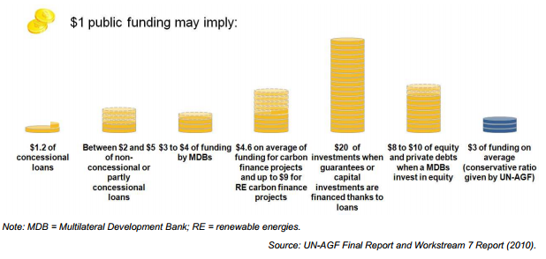
IFC’s Experience Understanding Leverage
There is great potential in leveraging private sector climate-related investment through multilateral development banks.
IFC’s experience has shows that 1 dollar of IFC climate-related investment brings in close to 3 additional dollars from other investors on average.
One dollar of IFC investment has itself been leveraged on the strength of IFC’s shareholder capital.
The private sector does not behave in a homogeneous fashion. There are variations depending on technology and market characteristics which determine the leveraging potential emerging from the private sector.
Notes:
The UN-AGF Report used this concept of leverage ration in 2010 in order to illustrate the kinds of funding available to combat climate change. The diversity of the methodologies used as well as the lack of transparency for some data makes an accurate comparison hard. Therefore, the aim is rather to compare orders of magnitude.

Slide 9
Climate finance in practice can refer to different investment needs
Blending
Alternative source of financing for SMEs
Combined Finance
Leverage
Blending
Funds invested at concessional, or below market, rates combined with an organization’s own funds.
Tailored to address the high cost of early market entrants
Typically provided to address issues of liquidity, tenor and cost of funds
Can be linked to achieving desired results through interest rate reductions, longer tenors, or with different rank and security packages
Range of products: risk sharing products, lower interest rates, longer tenors, subordinated rank in loans, or lower returns for equity investments.
Notes:
Blending finance refers to funds invested at concessional, or below market, rates combined with an organization’s own funds. Blending concessional funds helps to catalyze investments and accelerate impact that would not otherwise happen due to market conditions.

Slide 10
Clean Technology Fund support to Private Sector La Ventosa Wind in Mexico
OVERALL OBJECTIVE: Finance wind power technology through concessional debt to accelerate technology roll out, enabling Mexico to significantly reduce its CO2 emissions annually.
Financing: $15 million in CTF funds through the IFC (private sector arm), IFC provided $24 million commercial financing from its own account, and blended finance from the IDB and US Export-Import Bank, contributing to project costs of $195 million.
Notes:
Background: A 67.5MW Wind Farm with the aim to reduce +156,000 tons of CO2e/yr, displace new fossil-fuel generation, and improve air quality.

Slide 11
Stimulating Private Sector Participation in EE and Small-Scale RE in Turkey
OVERALL OBJECTIVE: TURSEFF, the Turkish Sustainable Energy Finance Facility, provides a combination of commercial-priced finance with concessional co-finance and substantial TA support to commercial banks in Turkey for on-lending to EE and small-scale RE.
Financing: TURSEFF loan package consists of:
EBRD loans, complemented by concessional financing
TA grant from the Clean Technology Fund
TA from the EU to support project implementation
Notes:
As in the case of the Turkish Sustainable Energy Finance Facility, the objective in blending climate finance was to provide an incentive to private sector banks to enter a new market. By reducing the costs of the loans for the private banks to support EE and small-scale RE, the combined finance covers their expenditure in establishing this new line of business. The use of TA further de-risks the market entry by ensuring that demand for the bank’s loan products is stimulated through project preparation by technical specialists and more general marketing.

Slide 12
Blended Finance Unit (BFU) at IFC Quick Facts
Since 2006, 39 investment transactions have been committed using blended finance deploying concessional resources managed by IFC and including an IFC investment alongside.
15 of these transactions have used guarantee instruments, 23 have used debt products, 1 project has used equity
A majority of the projects are investments made through Financial institutions
The leverage ratio for blended finance transactions through financial institutions is quite high: on average one dollar of concessional finance leveraged more than 13.8 dollars of investment on the ground, including 9 dollars of IFC investment, that would not have taken place without such risk mitigation support.
These projects often involve an emerging area (venture capital or early stage funding of cleantech) or activities that have not yet entered the mainstream FI environment. Leverage ratios for these projects, at an average of 19.4 for total project cost and 3.5 for IFC funds to donor funds, hide significant variation between technologies.
Notes:
The blended finance portfolio is still new and emerging. However, what is clear is that this instrument has the potential to leverage very high multiples of investment from both the IFC and other co-financiers for projects that they would not have financed in the absence of such support.

Slide 13
Combined Finance
Bundling different types of finance within a single project/program to make otherwise unattractive low-carbon projects attractive
resources can be combined through a national financial mechanism, such as a national development bank or a trust fund, where resources are allocated together side by side.
Blending
Alternative source of financing for SMEs
Combined Finance
Leverage
Combined Finance
Notes:
Combined finance bundles different types of finance within a single project or program. It can make otherwise unattractive low-carbon projects attractive. Combined finance entails few financial complications as no additional financial risk taking is required and results can be easily attributed to each financing source. For example, resources can be combined through a national financial mechanism, such as a National Development Bank, a National Carbon Fund, or a trust fund, where resources are allocated together side by side.

Slide 14
Combined Finance Mechanism: National Climate Fund (NCF)
Example: The China CDM Fund (CCDMF)
National fund that offers grants and loans
Supports China’s National Climate Change Program
Grants funded by revenues from CDM projects
Fast Facts:
More than USD 81 million in grants committed to support over 200 projects
Direct reduction of over 7 million tonnes of CO2 equivalent through funding enterprises, mobilizing market capital and achieving verified emission reduction effects
Government representatives from Brazil, Vietnam, and Cambodia have already visited CCDMF to learn more about this type of climate financing
Notes:
One mechanism that enables countries in combined finance for climate action is a National Climate Fund. The key goals of an NCF are the collection, blending, and coordination, as well as strengthening national ownership, of climate finance. An example of a NCF is The China CDM Fund. It combines capital from revenues and levies from CDM business operations, grants and other types of support from multilateral development institutions to advance climate action.

Slide 15
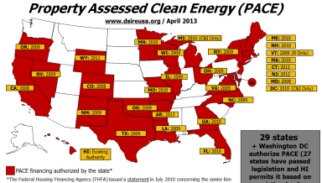
Alternative Sources of Financing for SMEs
Microfinance for energy
Blending
Alternative source of financing for SMEs
Combined Finance
Leverage
Property Assessed Clean Energy (PACE)
Pay-As-You-Save
Alternative source of financing for SMEs
Publicly-traded investment funds
Crowdfunding for energy
Notes:
For alternative source of financing for SMEs, the following are examples of innovative climate finance mechanisms that support private investments in renewables, like microfinance for energy, property assessed clean energy and Pay As You Save programs. Private households can also act as retail investors of renewable energy, thanks to the emergence of new renewable energy investment vehicles and business models, like publicly-traded investment funds and the cutting-edge crowdfunding for pooling private resources for green investments. The possible market potential for crowdfunding in developing countries could reach up to $96 billion a year over the next 25 years, making it a viable innovative climate finance solution for scaling-up climate action.

Slide 16
Crowdfunding Models
Donation-based crowdfunding: funders donate without expecting monetary compensation, average funding sought (US$) < $10,000, e.g.: http://Kickstarter.com
Reward-based crowdfunding: funders receive a token gift of appreciation or pre-purchase of a service or product, average funding sought (US$) < $10,000, e.g.: https://www.indiegogo.com/
Lending-based crowdfunding: Funders receive a debt instrument that pays a fixed rate of interest and returns principal on a specified schedule, average funding sought (US$) < $50,000, e.g. http://www.rangde.org
Equity-based crowdfunding: Funders receive equity instruments or profit sharing arrangements, average funding sought (US$) < $250,000, e.g. http://crowdfunder.com
Notes:
The following are 4 different crowdfunding models currently taking shape in the market.

Slide 17
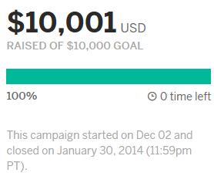
Reward-based Crowdfunding for energy independent school in Kaštel Lukšić, Croatia
OBJECTIVE: Create one of the first energy independent schools in the world
Financing solutions:
Source: School’s own budget+ contribution from the local community+ UNDP SEED funding+ crowdfunding+ co-financing from the Fund for Environmental Protection and Energy Efficiency;
Leverage finance through crowdfunding: Within two month, the project raised $10,001 from 189 funders which enables the school to take up actions planed for step one (small-scale). Crowdfunding was combined with local funding raising events at this stage;
Crowdfunding embedded co-financing model to scale-up climate actions: Crowdfunding has helped to identify, communicate with and receive funding from targeted investors and potential stakeholders. After the best model is tested, with co-financing from institutional investors such as Fund for Environmental Protection and Energy Efficiency, the solution can be scaled up in other countries.

Slide 18
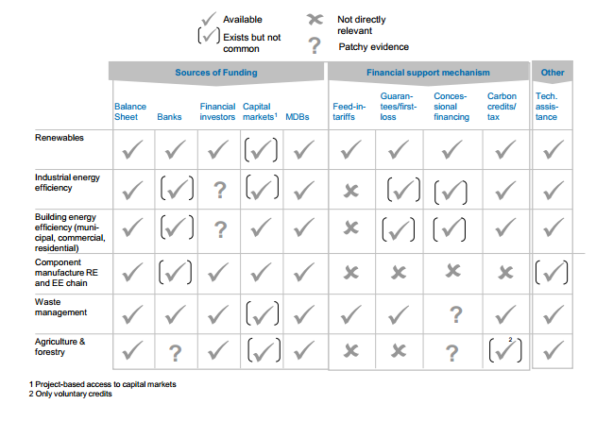
Moving forward: approaches differ by sector
Source: IFC, 2010
Notes:
The innovative finance approaches will also vary by sector. The chart here ties together various analyses based on MDB experiences. In general,the private sector will invest where it received an adequate return for the risk it bears in the underlying project activity. Many of these risks can be mitigated by the market, and governments can also create a welcoming investment environment through overall policies and financial instruments featured today that are geared to the ease of doing business.

Slide 19
Summary: Innovative Climate Finance Approaches
Grants
Blending
Alternative source of financing for SMEs
Combined Finance
Leverage
Concessional
Debt
Mezz
Equity
Credit
Enhancement
Technology
Transfer
Revenue
Enhancement
Technical
Assistance

Slide 20
References and Resources
Visit these links for more information:
IFC – Mobilizing Public and Private Funds for Inclusive Green Growth Investment in Developing Countries
IFC website – Blended Concessional Finance
IFC – Climate Finance: Engaging the Private Sector (Shilpa Patel, WRI)
Beyond the Sum of Its Parts – Blending Financial Instruments (2010)
CIF website
Blending Climate Finance through National Climate Funds
Crowdfunding's Potential for the Developing World
Catalizando el financiamiento para enfrentar el cambio climático
Innovative Climate Finance workshop by IDB
UNEP Innovative climate finance
infoDev’s report on crowdfunding
WRI’s Moving the Fulcrum: a primer on public climate financing instruments used to leverage private capital
The landscape of Climate Finance
Crowdfunding for Climate Change
Innovative Finance for Development Solutions

Slide 21
Thank you
Pablo Benítez, Ph.D.
pbenitez@worldbank.org Senior Economist, Climate Change T: +1 202 4730736 1818 H Street NW, Washington, DC 20433 USA

