Slide 1
Regional Collaboration Centres serving the Latin American & Caribbean regions
Karla Solís
Team Lead
Regional Collaboration Centre St. George’s
Regional Workshop on CDM & NAMAs
1st September 2014

Slide 2
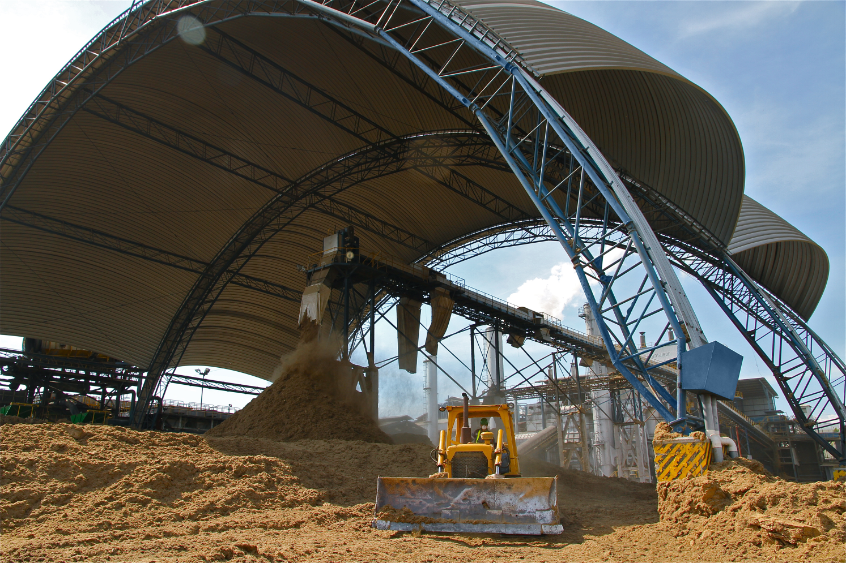
The RCC Initiative
Providing in kind technical support
Advising on CDM process or drafting proposals
Enabling an investment environment
Designing umbrella CDM projects for:
Renewables and waste technologies
Exploring synergies between the CDM and other mitigation actions
Collaborating with country & regional funding agencies to:
Develop standardized baselines- electricity sector
Improve the process by preparing policy inputs

Slide 3
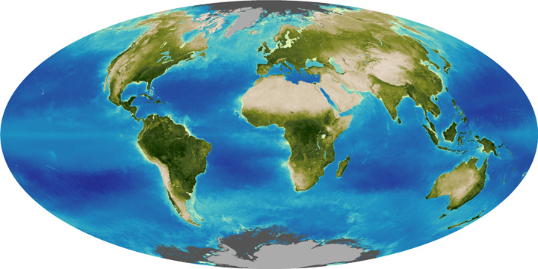
The RCC Initiative
RCC Bogotá
Colombia
September 2013
17 countries
RCC St. George's
Grenada
July 2013
16 countries
5th RCC in the Asia-Pacific region is being planned
RCC Lomé
Togo
January 2013
RCC Kampala
Uganda
May 2013
Notes:
Potential projects with GIZ
CARICOM-GIZ Renewable Energy and Energy Efficiency Technical Assistance (REETA) + RCC St. George’s

Slide 4
Current RCC activities in LA&C regions
Promoting clean technologies and opportunities under the carbon market
Stakeholder engagement
Government level -ministries of environment and energy
Private – developers, investors/entrepreneurs
International level – donors, technology providers
CDM cycle support
To CDM and non-CDM stakeholders
To process, CDM policy inputs
Drafting CDM proposals –PoAs
Developing standardized baselines
CERs demand activities
Finding niche markets Promoting voluntary cancellation of CERs
Synergies with non-CDM actions
MRV for NAMAs
Capacity building at CDM and technology levels : delivering trainings, promoting success stories, sharing information, & answering technical queries

Slide 5
RCC Bogotá activities 2013-2014
Activities | Products
Stakeholder engagement | Cooperating with national and international entities Regional directory CDM technical trainings: Ecuador, Mexico, Ethos Institute (Brazil), Comisión de Integración Eléctrica Regional (CIER)
CDM cycle support | Support to CDM activities & programmes; e.g. post-registration changes
Standardized baselines | Electricity, waste, transport and cement sectors: El Salvador, Uruguay, Ecuador, Peru
CDM policy input | Based on an extensive stakeholder study, via survey and interactions
CERs demand activities | Increase the awareness of Voluntary Cancellation (VC) of CERs process Proposals to improve & promote VC process Identification of potential demand. E.g: SCX, MexiCO2, CSR, FIFA 2014 World Cup

Slide 6
RCC St George’s activities 2013-2014
Activities | Products
Stakeholder engagement | Cooperating with national entities Cooperating with international organizations; UNEP DTU, IDB, WBI, EU, GIZ, 5Cs Regional directory CDM technical training; Dominican Republic
CDM cycle support | Support to DNAs – advice on roles Support to PPs – e.g. prior consideration letters Support to CHENACT/IDB PoA Create a PoA – DD pack for renewable energy CDM policy input for SIDS/LDCs
Standardized baselines | Baselines for electricity/waste sectors; Belize, Dominican Republic, Grenada, Trinidad, St Vincent, Antigua, Jamaica
Synergies | CDM-MRV for NAMA; WBI CDM SBL for energy efficiency (GEF); 5Cs

Slide 7
Further information, materials, CDM, SBL flyers in English/Spanish/French:
http://cdm.unfccc.int/stakeholder/rcc/index.html
GRACIAS ☺

