Slide 1
Institutional aspects of climate change and NAMAs
F I R M
Experience and knowledge sharing workshop
Copenhagen, 09-11 April 2014
Miriam Hinostroza

Slide 2
Why institutions?
"When people criticize me for not having any respect for existing structures and institutions, I protest. I say I give institutions and structures and traditions all the respect that I think they deserve. That's usually mighty little, but there are things that I do respect. They have to earn that respect. They have to earn it by serving people. They don't earn it just by age or legality or tradition.”
― Myles Horton, We Make the Road by Walking: Conversations on Education and Social Change
“If the misery of the poor be caused not by the laws of nature, but by our institutions, great is our sin.”
― Charles Darwin, Voyage of the Beagle

Slide 3
Quality of institutions
“Justice is the first virtue of social institutions, as truth is of systems of thought. A theory however elegant and economical must be rejected or revised if it is untrue; likewise laws and institutions no matter how efficient and well-arranged must be reformed or abolished if they are unjust. Each person possesses an inviolability founded on justice that even the welfare of society as a whole cannot override. For this reason justice denies that the loss of freedom for some is made right by a greater good shared by others. It does not allow that the sacrifices imposed on a few are outweighed by the larger sum of advantages enjoyed by many. Therefore in a just society the liberties of equal citizenship are taken as settled; the rights secured by justice are not subject to political bargaining or to the calculus of social interests.”
― John Rawls. A Theory of Justice

Slide 4
Framework for institutions
Defining a strategy in context of medium to long term development plans:
Development Plans
Monitoring & Evaluation
Low Carbon Development Strategies
Decouple economic growth from GHG emission growth
Reduce the carbon intensity of the economy
Leapfrog the high-carbon development path of today’s business-as-usual trajectory
LT Development goals
Emission sources
and sinks
Nationally Appropriate Mitigation Actions NAMAs
Emission reduction priorities
LT Development Priorities
Capacity &
Finance
Baseline &
MRV
Tech. transfer
Contribution to development goals
in the context of...
Sustainable Development
UNEP Risoe Centre© , 2011
Notes:
The ultimate aim of an LCDS is to catalyse concrete actions that support development, but with less emissions than without intervention.
Compared to other international climate instruments, an LCDS can provide a coherent framework for NAMA priorities and for measurement reporting a verification (MRV) needs

Slide 5
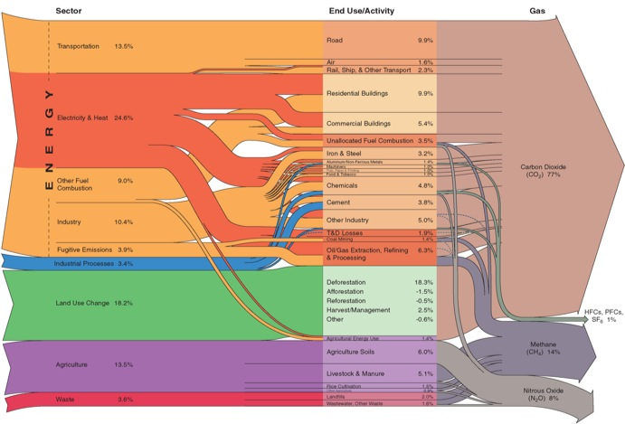
Low Carbon Development Strategies
Multiple emission sources vs. Multiple solutions
Know mitigation potentials of the economies
Will require holistic and bottom-up approaches
Inter-sectoral
Multidisciplinary
Developing countries can take advantage of international financing options
Potentialize national economic sectors competitiveness faced to a global economy influenced by carbon intensity standards
Increased efficiency of the economy
Notes:
Múltiples opciones para buscar el camino de desarrollo de baja intensidad en carbono:
ER: Solar, eólica, geotérmica …
EE: residencial industrial, municipal
Transporte: incentivos, estándares
Edificios – construcción: normas, estándares
Biocombustibles
Forestal y agrícola

Slide 6
The 2ºC goal
Linkages between national development plans; LCDS; NAMAs and MRVs is critical to effectively achieve the 2^{O}C goal in a nationally appropriate manner while satisfying international requirements.
National challenges
International requirements:
Nationally determined contributions
Reporting
MRV
Countries should develop institutional frameworks that encompasses national development priorities and deviation from BAU GHG emissions
While satisfactorily reporting on mitigation achievements to the UNFCCC.
Notes:
Understanding and addressing the linkages between national development plans; LCDS; NAMAs and MRVs is critical to effectively achieve the 2OC goal in a nationally appropriate manner while satisfying international requirements.
Countries therefore are faced with the need to develop institutional frameworks that encompasses national development priorities and deviation from BAU GHG emissions while satisfactorily report on mitigation achievements to the UNFCCC.

Slide 7
NAMAs operations
International Context
International Requirements
Governance: BAP/UNFCCC
Registry
NAMAs and Sustainable development
Reporting: BURs/ICA
NAMAs vs. LCDS
MRVs
Notes:
Understanding and addressing the linkages between national development plans; LCDS; NAMAs and MRVs is critical to effectively achieve the 2OC goal in a nationally appropriate manner while satisfying international requirements.
Countries therefore are faced with the need to develop institutional frameworks that encompasses national development priorities and deviation from BAU GHG emissions while satisfactorily report on mitigation achievements to the UNFCCC.

Slide 8
NAMAs operations: national challenges
NAMAs in the context of SD
NAMAs as transformational drivers of development to low-carbon pathways
Planning and management: the importance of leadership and participatory processes
The role of national and local governments
Learning from CDM: no need to reinvent the wheel
Notes:
Understanding and addressing the linkages between national development plans; LCDS; NAMAs and MRVs is critical to effectively achieve the 2OC goal in a nationally appropriate manner while satisfying international requirements.
Countries therefore are faced with the need to develop institutional frameworks that encompasses national development priorities and deviation from BAU GHG emissions while satisfactorily report on mitigation achievements to the UNFCCC.

Slide 9
NAMAs institutional set up
Empowered with capacities and skills for conducting dialogue consultative processes; effective coordination; submissions: finance and MRVs
Distributed roles and responsibilities within the existing structures and entities
Concentrating in four coordinating bodies:
Climate change policy coordination
NAMAs coordinating authority
MRV and international reporting unit
Climate finance coordination
Notes:
Understanding and addressing the linkages between national development plans; LCDS; NAMAs and MRVs is critical to effectively achieve the 2OC goal in a nationally appropriate manner while satisfying international requirements.
Countries therefore are faced with the need to develop institutional frameworks that encompasses national development priorities and deviation from BAU GHG emissions while satisfactorily report on mitigation achievements to the UNFCCC.

Slide 10
NAMAs institutional set up
Climate-change policy-coordination
Establishing the national climate change policy;
Putting in place periodic evaluation of implementation
Revising information received
Clear establishment of roles and responsibilities
Notes:
Understanding and addressing the linkages between national development plans; LCDS; NAMAs and MRVs is critical to effectively achieve the 2OC goal in a nationally appropriate manner while satisfying international requirements.
Countries therefore are faced with the need to develop institutional frameworks that encompasses national development priorities and deviation from BAU GHG emissions while satisfactorily report on mitigation achievements to the UNFCCC.

Slide 11
Planning
Inter-institutional
Across-sectors
Intra-National
Reporting
Instruments
Fiscal & Regulatory frameworks
Economic Instruments
Incentives and penalties
NCs
Inventories
MRV of NAMAs
National stakeholders
Climate Change Policy Coordination: Mitigation and Adaptation
Monitoring & Evaluation
Financing
Inter-institutional
Across-sectors
Intra-National
National and International Sourcing
Funds Management
Decentralized Coordination
National
Provincial (Federal; Regional, etc.)
District
Sector
Research, innovation, development and adjustment of climate technologies and strengthening of institutional capacities
&
Capacity Development

Slide 12
NAMAs institutional set up
NAMA management: coordination of development and implementation
Coordinating authority for NAMAs
Centrally placed at entity of country's preference
Accountable to the Climate Change Policy Coordination Unit
Clear roles and responsibilities
Notes:
Understanding and addressing the linkages between national development plans; LCDS; NAMAs and MRVs is critical to effectively achieve the 2OC goal in a nationally appropriate manner while satisfying international requirements.
Countries therefore are faced with the need to develop institutional frameworks that encompasses national development priorities and deviation from BAU GHG emissions while satisfactorily report on mitigation achievements to the UNFCCC.

Slide 13
International.
Registry
NAMAs Coordination Authority (NCA)
Means of Implementation: CD; Finance; TT.
National
Registry
MRV & Int. Reporting
Relevant Ministries
Relevant Ministries
UNFCCC
Relevant Ministries
International Reporting
NCs
BURs
MRV for NAMAs
Relevant Ministries
Relevant Ministries
Relevant Ministries
Relevant Ministries
ICA
Sector X
Sector X
Sector X
Sector X
Sector X
Sector X
Sector X
Sector X
Sector Specific Data Sources

Slide 14
NAMAs institutional set up
MRV management and international reporting
MRV Management Unit
MRV systems consistent with national needs and circumstances but also according to international reporting requirements (BURs; NCs and MRV of NAMAs
Addressing multiple benefits
Clear set of roles and responsibilities
Notes:
Understanding and addressing the linkages between national development plans; LCDS; NAMAs and MRVs is critical to effectively achieve the 2OC goal in a nationally appropriate manner while satisfying international requirements.
Countries therefore are faced with the need to develop institutional frameworks that encompasses national development priorities and deviation from BAU GHG emissions while satisfactorily report on mitigation achievements to the UNFCCC.

Slide 15
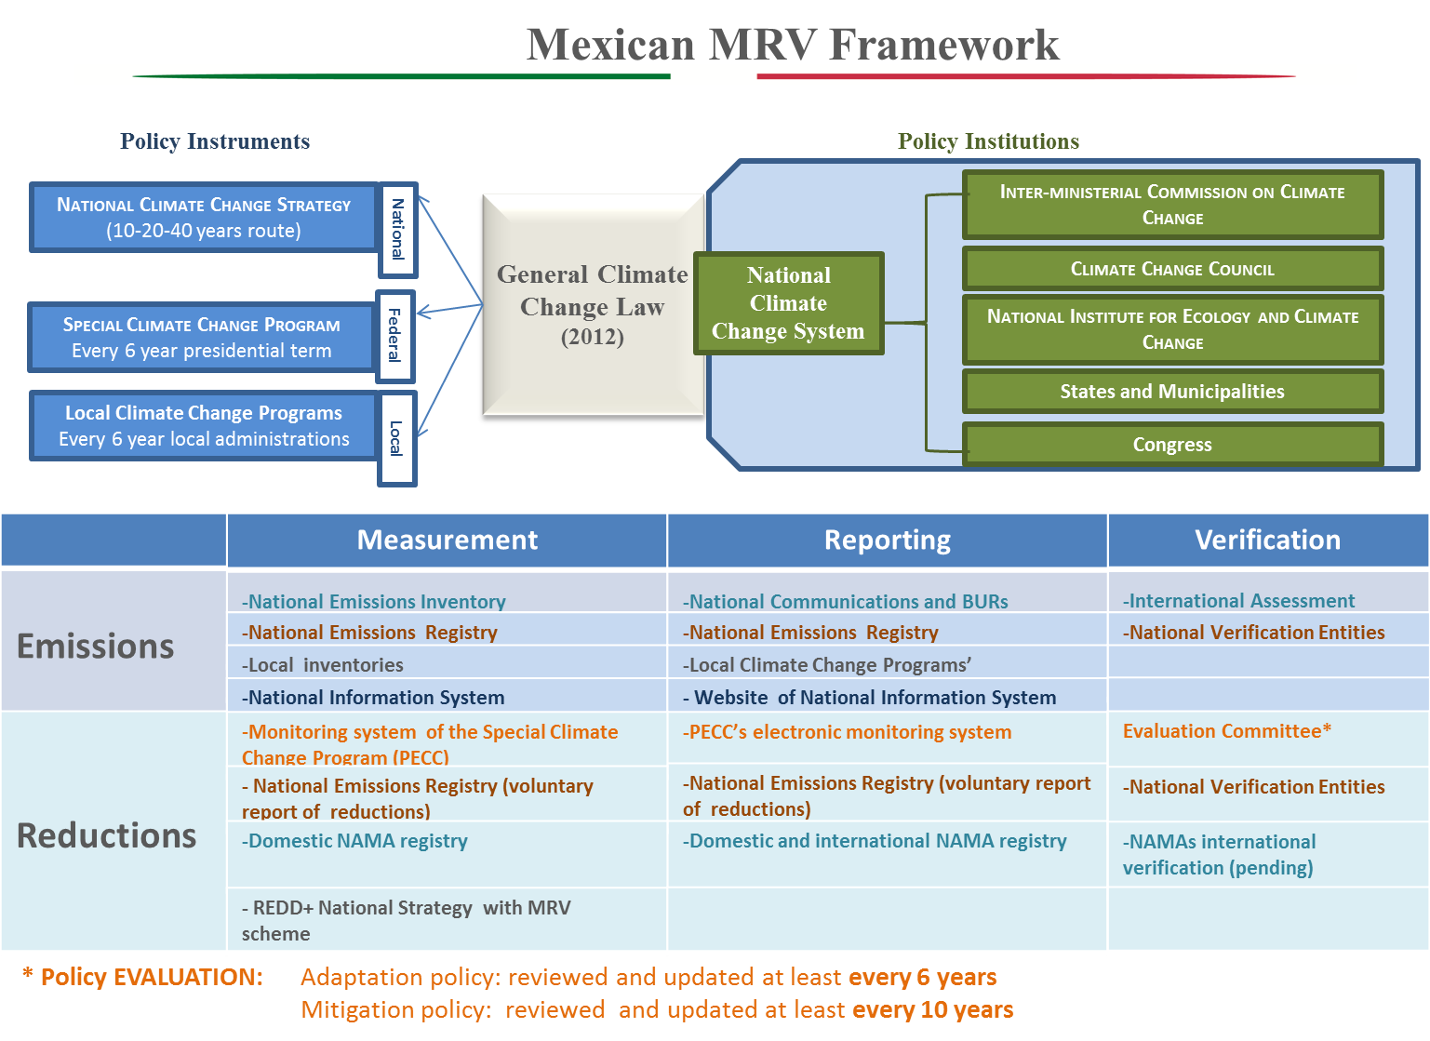
Source: SEMARNAT: PPT presented by Monica Echegoyen, PMR workshop, Mexico City, March 2014.

Slide 16
NAMAs institutional set up
Climate finance coordination Unit
Finance is expected to come from various sources
Ensuring adequate and effective allocation of financial resources
Transparent reporting is important in national and international context to:
increase the trust among stakeholders
to assess gaps in financing
Clear roles and responsibilities
Notes:
Understanding and addressing the linkages between national development plans; LCDS; NAMAs and MRVs is critical to effectively achieve the 2OC goal in a nationally appropriate manner while satisfying international requirements.
Countries therefore are faced with the need to develop institutional frameworks that encompasses national development priorities and deviation from BAU GHG emissions while satisfactorily report on mitigation achievements to the UNFCCC.

Slide 17
National Planning (Department, Council…)
Means of Implementation: CD; Finance; TT.
Climate Change Policy Coordination
Mitigation Management: LCDS &NAMAs
Adaptation NAPs
Intl.
Registry
NAMAs Coordination Authority (NCA)
Technology
Management Unit:
DNE
Finance
Management Unit
GCF Focal Point
National Registry
MRV & Int. Reporting
Relevant Ministries
Relevant Ministries
Relevant Ministries
UNFCCC
International Reporting
NCs
BURs
MRV for NAMAs
Relevant Ministries
Relevant Ministries
Relevant Ministries
Relevant Ministries
ICA
Sector X
Sector X
Sector X
Sector X
Sector X
Sector X
Sector X
Sector X
Sector Specific Data Sources
National Statistics Data Sources

Slide 18
Key Recommendations
Integration of NAMAs into development planning with the responsibility for implementation lying with the ministries responsible for policy-making
Coordination among responsible ministries to ensure synergies and alignment with the national climate change policies
Decentralization but common guidance on integrating policy into sectorial or regional planning
Suggested roles and tasks for four coordination units

Slide 19
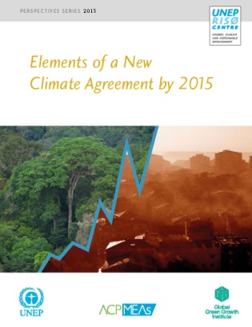
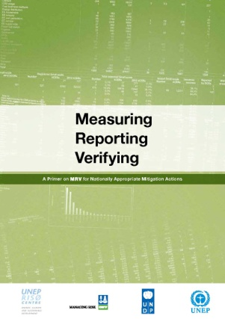
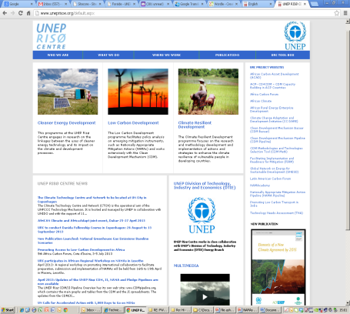
Thank you!!
For more information at
http://uneprisoe.org http://cdmpipeline.org
http://uneprisoe.org/publications http://acp-cd4cdm.org
http://namacademy.org http://cdm-meth.org
http://namapipeline.org http://cdmbazaar.net
milh@dtu.dk

