Slide 1
Regional Workshop on CDM and NAMAs
for Latin America and the Caribbean
Roles and Structure of Designated National Authorities (DNAs)
Bogota, Colombia
31 August, 2014
Federico Grullon
Head of Technical Department
National Council for Climate Change and CDM

Slide 2
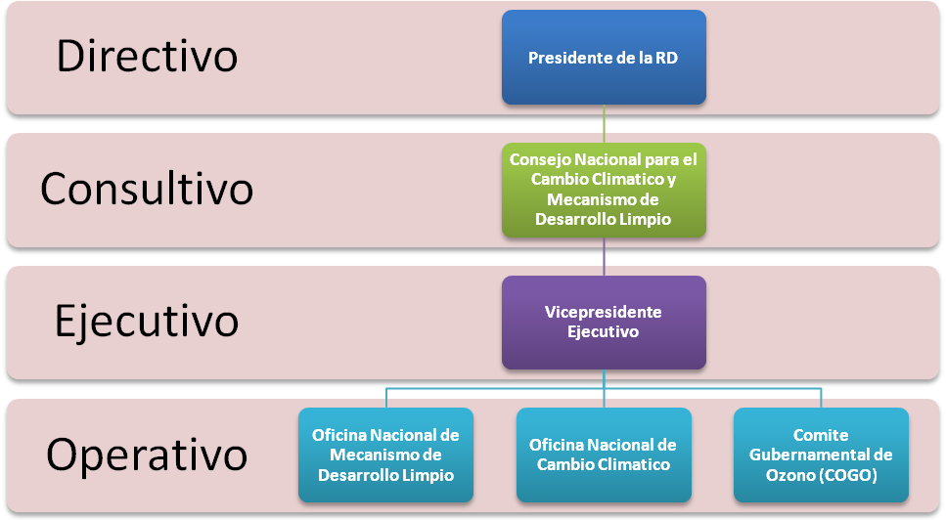
National Council for Climate Change
and Clean Development Mechanism
Administrative Structure:
Directive
President of the
Dominican Republic
Consultative
National Council
of Climate Change
and Clean
Development
Mechanism
Executive
Executive
Vice-President
Operative
National Office
of Clean
Development
Mechanism
National Office
of Climate Change
Ozone
Governmental
Committee

Slide 3
National Council for Climate Change
and Clean Development Mechanism
National Office
of Clean Development
Mechanism
MITIGATION strand (80% time)
National Office
of Climate Change
ADAPTATION strand (20% time)
National
Ozone Unit
National Council for Climate Change and Clean
Development Mechanism – 20 Permanent Staff
Ministry of Environment
– 3 Permanent Staff
Temporary project based supports are given by consultants and/or volunteers from Aid Agencies
14 Administrative
Staff (Director,
Assistants,
Drivers, Cleaner, etc.)
Executive
Vice-President
Manager
Technician
Technician
Technical Director
National Focal Point for Montreal Protocol
Technical Officer
Technician
Technician
Technician
National Focal Point (NFP) for Climate Change
Designated National Authority (DNA) for CDM
Nationally Appropriate Mitigation Action (NAMA) Focal Point
Article 6 (Education) National Focal Point

Slide 4
Council Members
Ministry of Environment and Natural Resources
Ministry of Economy, Planning and Development
Ministry of Agriculture
Ministry of Foreign Affairs
Ministry of Treasury
Ministry of Industry and Commerce
Ministry of Public Health and Social Affairs
Governor of Central Bank of the Dominican Republic
National Commission of Energy
Superintendent of Electricity
Executive Vice-president of Dominican Corporation of State Electric
Companies

Slide 5
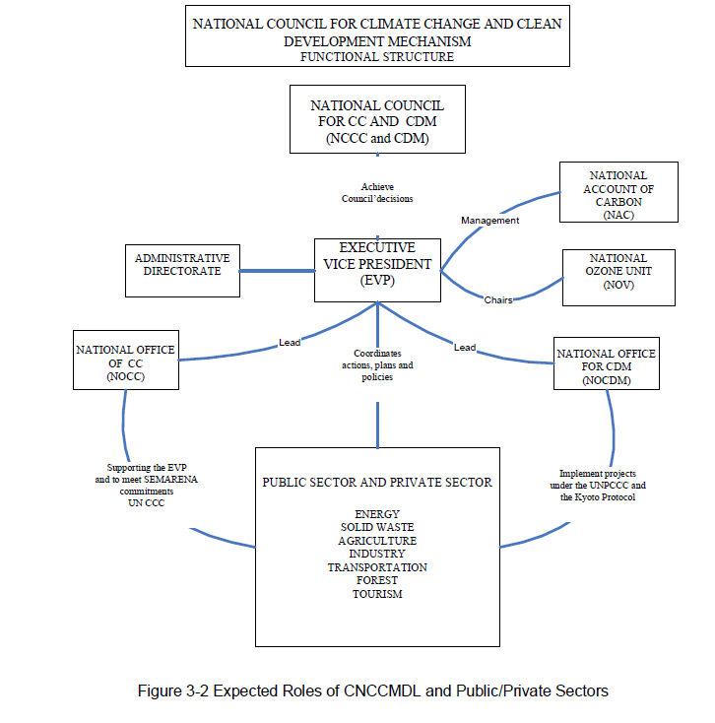
Functional Structure

Slide 6
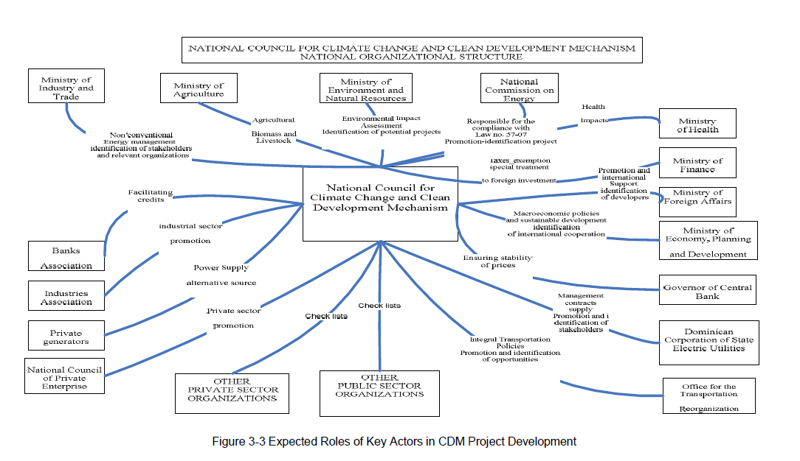
National Organizational Structure

Slide 7
Supervision and evaluation of the activities executed under the National Offices for Climate Change (NOCC) and Clean Development Mechanism (NOCDM)
Formulation, design and execution of public policies for mitigation and adaptation
to Climate Change;
Develop and approval of the Project’s investment strategies under the CDM;
Development of scientific and technical capacities for the formulation of CDM
projects in the government and the private sector;
Promotion the development of mitigation projects of climate change that
may generate Certified Emission Reductions (CERs), under the requirements of
international agreements; and
Establish the inter-institutional coordination needed to assure the implementation
of projects that will stabilize the emissions of GHG’s.
Functions

Slide 8
At the UNFCCC, the Council is the National Focal Point (NFP) for CC. The Council is also the Designated National Authority (DNA) for the CDM in the Dominican Republic (and the NAMA NFP).
Its objectives, among others, are:
Promote and facilitate the implementation of renewable energy, energy efficiency, methane capture, use of less carbon intensive fuels projects, etc.;
Facilitate the removal of barriers for the implementation of mitigation projects;
Advise the public and private sectors in the preparation of CDM projects;
Identify and promote initiatives in terms of Emission Reduction Purchase Agreements in the international market; and
Promote the creation and strengthen of local technical capacities for the preparation and development of GHG mitigation projects, following the environmental protection policy of the Dominican State.

Slide 9
Thank for your attention!
National Council for Climate Change and
Clean Development Mechanism
despacho@cambioclimatico.gob.do
Federico Grullón – Head of Technical Department
f.grullon@cambioclimatico.gob.do

