Slide 1
Overview and Status of Operation of NAMA Registry Regional Workshop on CDM and NAMAs for Latin America and the Caribean 31 August - 2 Spetember Bogota, Colombia
Notes:
Hello and welcome to this side event on the NAMA registry.

Slide 2
Presentation Outline
1. Background
Mandate for the registry
History of the registry development
Registry fundamentals
2. Operation of the registry
Overview of content
Secretariat activity
3. Challenges and opportunities
4. Role of the registry in the short, medium to long term
5. Q/A and feedback collection : Areas of improvements for successful operation of the registry to meet existing and future role
Notes:
I’ll start by going over a little background before discussing the operation of the registry in 2014 and highlighting some of the challenges and opportunities ahead for the registry in 2015

Slide 3
Mandate for the registry
to set up a registry to record nationally appropriate mitigation actions
the registry should be developed as a dynamic, web-based platform managed by a dedicated team in the secretariat
1/CP.16, paragraph 53
2/CP.17, paragraph 45
Participation is voluntary and the registry contains only information that has been submitted specifically for recording.
Notes:
The mandate to establish the NAMA registry came at COP 16
And at COP17 it was agreed that the registry would be developed as a dynamic, web-based platform managed by the secretariat

Slide 4
History of the registry development
August 2012
Interim facility
April 2013
Fully functional Prototype
October 2013
First release of the web-based registry
March 2014
Second release of the web-based registry
Notes:
The timeline for the registry is as follows………

Slide 5
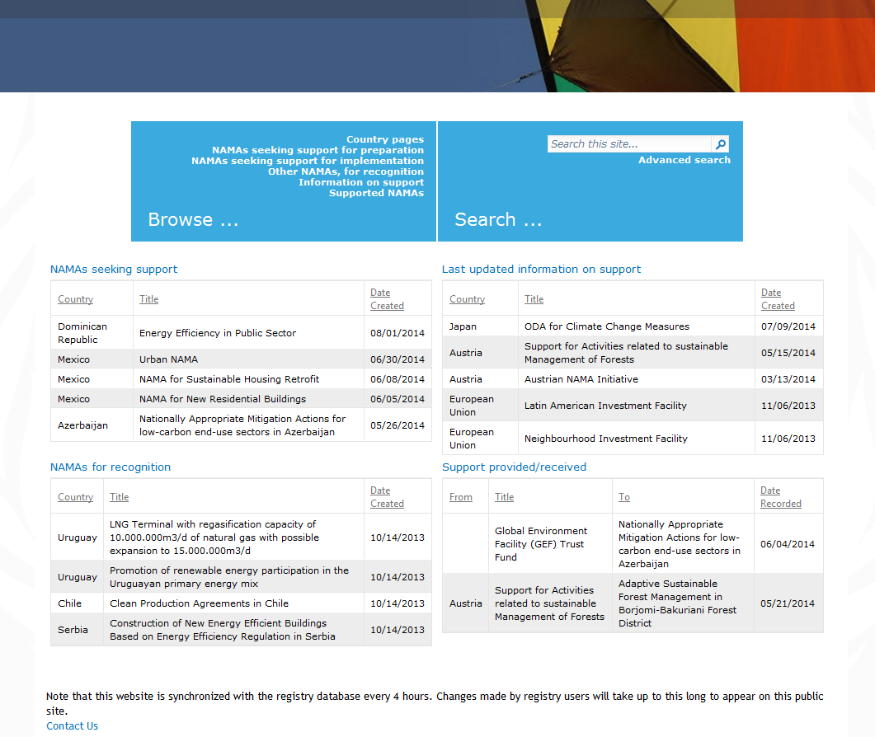
Registry fundamentals: Public registry
Notes:
This is what the public version of the registry looks like. Anyone with an internet connection can access the registry and browse and search the information that is there …

Slide 6
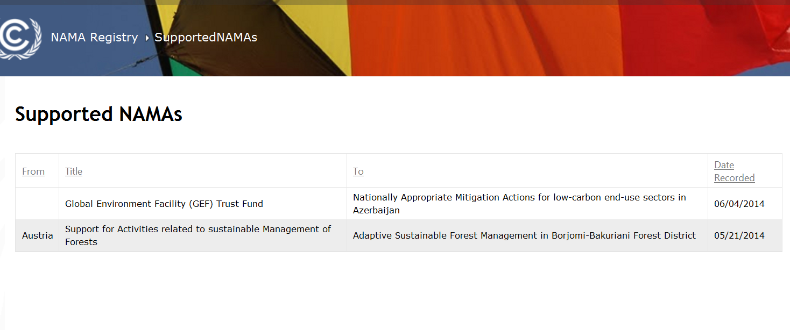
Registry fundamentals : Public registry
Notes:
This is what the registry looks like to

Slide 7
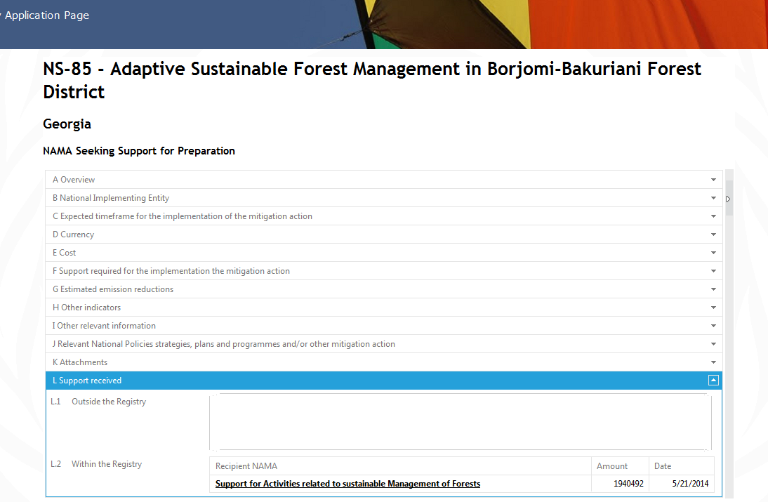
Registry fundamentals :Public registry
Notes:
This is what the registry looks like to

Slide 8
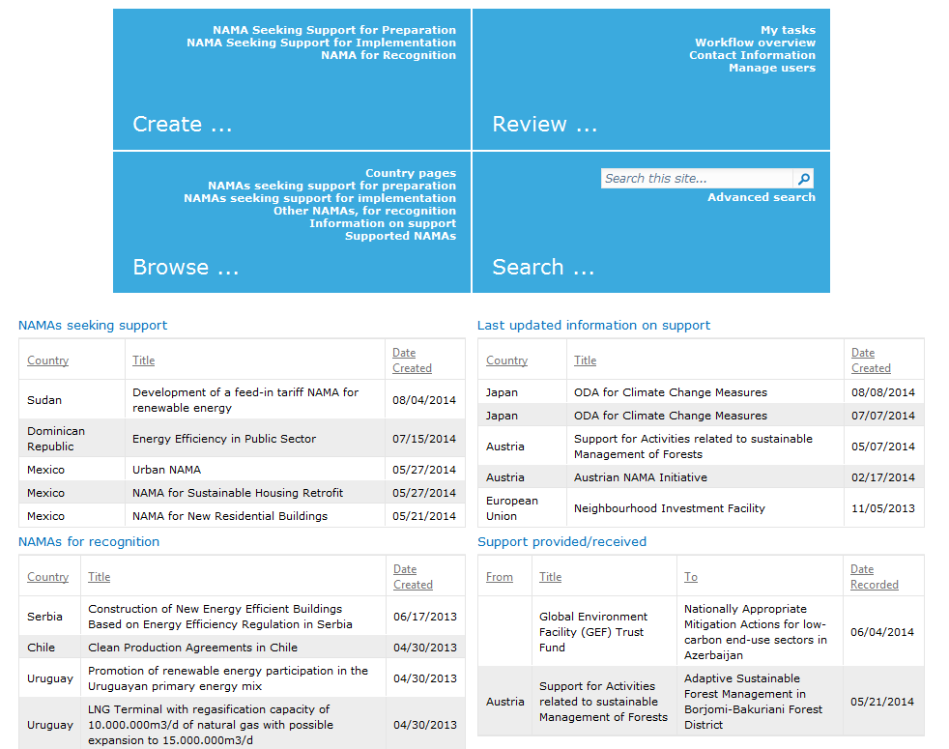
Registry fundamentals : Closed registry
Accessible to only users having access rights
Notes:
This is what the registry looks like to

Slide 9
Registry fundamentals: structure
Database
Interface
NAMAs for support
•
Submit
NAMAs
(support)
matching
NAMAs for recognition
•
Submit
NAMAs
(recognition)
•
Submit info on support
•
Browse information
Support
Support
•
Perform queries
Notes:
So looking at the fundamentals of the registry….. the registry consists of a data base that stores information on NAMAs and support and a user interface that allows the submission and searching of information contained in the database.

Slide 10
Registry fundamentals: Users
NAMA Approver
Create/edit NAMA entries
Approve entries from developers
NAMA Developer
Create/edit NAMA entries
Confirm receipt of support
Support editor
Create entries on support available
Confirm provision of support
Public
Browse & search all content
Confirm receipt of support
Notes:
There are three key types of user for the registry……

Slide 11
Operation of the registry in 2014
Overview of registry content in 2014
The statistics on users are as at 1 July 2014
The statistics on registry content are as 14 April 2014
Further analysis will be available in the second annual report of the registry scheduled for COP 20
Notes:
It is important to bear in mind that……

Slide 12
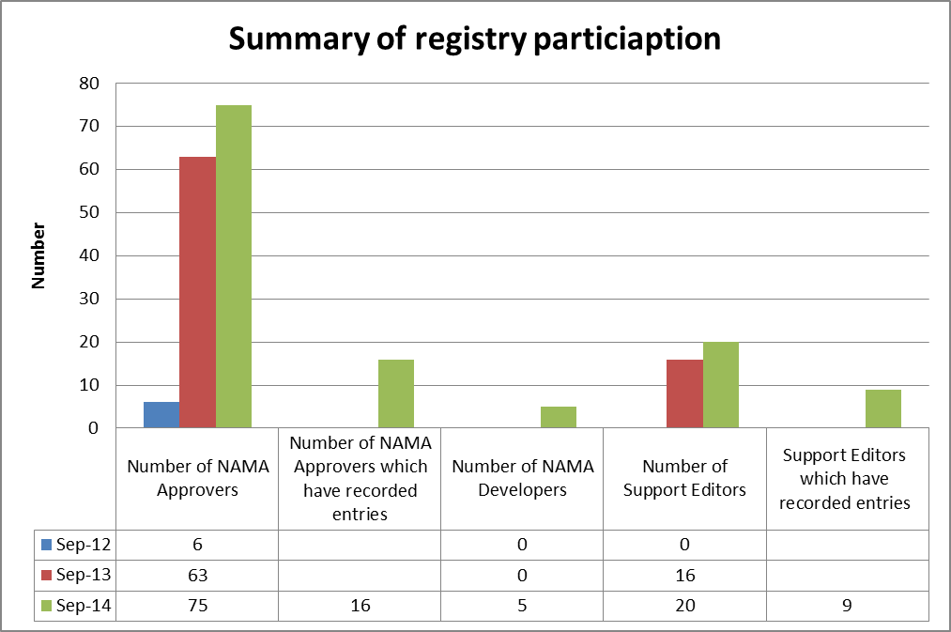
Summary of registry participation

Slide 13
Registry participation characterised by NAMA approver access rights
By region, 30%-60% of developing countries requested access rights
Notes:
By region between 30% and 60% of non-Annex I parties are participating.

Slide 14
Registry participation characterised by NAMA entries
Significantly fewer have gone the step further of creating an entry in the registry
Notes:
However, that level of interest is not yet translating into entries in the registry10% or less of Parties with entries by region. Note that this is a corrected figure from the one that appears in the report. There was an error in this graph.

Slide 15
Characterization of NAMA entries by type
The majority of NAMA entries are seeking support and the majority of these are seeking support for implementation
Notes:
The majority of NAMAs entries in the registry are those seeking support for implementation.

Slide 16
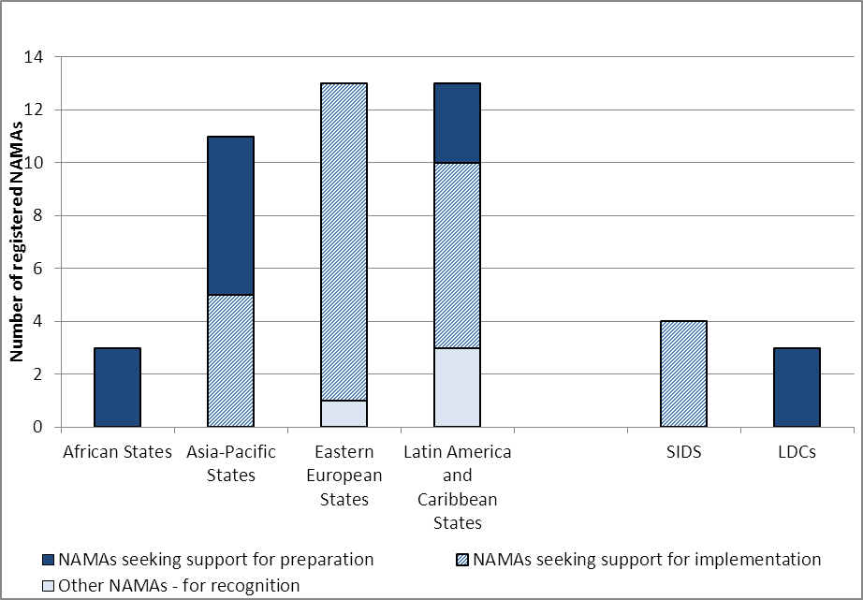
Characterization of NAMA entries by type
Types of support needed is different by region
Notes:
Different regions have different profiles in terms of the support they are seeking, African states are seeking support more for preparation whereas eastern european states are seeking support more for implementation

Slide 17
Characterization of NAMAs by sector
The energy supply sector is the sector relevant to most NAMA entries
Notes:
So looking in more detail at the types of NAMAs entered in the registry so far, the sectoral breakdown of entries shows that the energy sector is most relevant to most NAMA entries, over half of the NAMAs entered so far include the energy sector

Slide 18
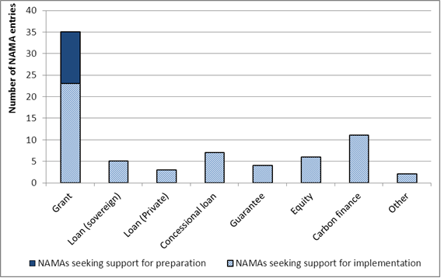
Type of financial support sought
Grant funding is the type of financial support most commonly sought by NAMAs
Notes:
Looking at the type of support sought, most NAMAs are seeking financial support in the form of grant funding. Note that this is a measure of frequency rather than a measure of quantity. We can’t separate out the amount of support by type because more than one type of support can be sought by a NAMA.

Slide 19
Extent of matching
For a match to be recorded, both the NAMA and the source of support should have an entry
Both Parties have to agree on the type and amount of support (e.g, the registry seeks confirmation from the counterpart)
To date, only two matches have been recorded in the registry:
NS-85 (“Adaptive Sustainable Forest Management in Borjomi-Bakuriani Forest District”), by Georgia, received support from Austria (EUR 1.940.492)
NS-95 (“Nationally Appropriate Mitigation Actions for low-carbon end-use sectors in Azerbaijan”), received support from the GEF (USD 100.000)
Notes:
Looking at the type of support sought, most NAMAs are seeking financial support in the form of grant funding. Note that this is a measure of frequency rather than a measure of quantity. We can’t separate out the amount of support by type because more than one type of support can be sought by a NAMA.

Slide 20
Secretariat activities to support the registry
Support activities
Deployment of fully operational registry platform and regular maintenance
Day to day technical support to registry users
Technical materials on the use of the registry
Training and demonstration on the use of the registry
Outreach activities to ensure critical mass of information in the registry
Notes:
From the secretariat’s perspective we can see three main challenges for the registry at this point.

Slide 21
Challenges and opportunities
Limited use and level of participation
the registry needs to contain a critical mass of information to be effective
Improving information accuracy and completeness
registry content needs to be reliable and complete
Limitations of final registry design
limited feedback from Parties on the design of the registry, in particular on the templates used for creating entries
Notes:
From the secretariat’s perspective we can see three main challenges for the registry at this point.

Slide 22
Challenges and opportunities
It is recommended that Parties and others who may benefit from the registry:
Find ways to increase their level of participation in the registry, including obtaining access rights and creating registry entries. For developing country Parties, the ability to decentralize the preparation of NAMAs through NAMA developer access rights may facilitate participation
Take steps to ensure that their entries in the registry are accurate, complete and up-to-date
Continue to provide the secretariat with suggestions for improving the registry, with their related capacity-building needs and to make use of relevant technical resources
Notes:
Our recommendation is that……Parties and others who may benefit from the registry.

Slide 23
Future activities to support the registry
The secretariat will continue to support for the registry, within the restrictions of mandate and budget:
Revamping of the registry platform and development of technical resources requested by Parties
Capacity building through regional NAMA workshops
Outreach activities with potential providers of support and proponents of supported NAMAs
Providing direct support to individual registry users
Improvement and maintenance of the registry platform
Notes:
Finally…….

Slide 24
The role and importance of NAMA registry in short to medium term
A clearing house between countries between seeking support for their NAMAs and countries that can deliver support
A platform to facilitate match and pool available and diverse resources to mitigation actions
Could provide an instrument to support/encourage the preparation of NAMAs
A platform to highlight and recognize the leadership undertaken by the developing Parties for designing and implementing concrete mitigation actions
A platform to highlight and recognize the support offered by the developed Parties and other agencies as per the objectives of the convention
Notes:
Finally…….

Slide 25
The role and importance of NAMA registry in short to medium term
Could provide information on developing countries’ climate finance need for mitigation actions
Could help to improve the transparency of financial support for climate change mitigation and foster trust between developing and developed Parties
Sharing of knowledge and best practices on mitigation actions
Recording data with a view to improving emissions statistics and projections
Could provide useful insights for future funding windows including Green Climate Fund
Notes:
Finally…….

Slide 26
The role of NAMA registry in long term
NAMAs can have several potential functions in a post 2020 climate regime
building blocks for domestic actions, low emission development strategies and targets
a convenient vehicle for concrete climate actions on the ground and associated international financial and technical assistance
an instrument for implementation of international support commitments under the 2015 climate
a basis for international reporting and/or articulation of commitments
The registry platform needs to evolve to facilitate the future role of NAMAs
Notes:
Finally…….

Slide 27
Annual report on registry operation: FCCC/CP/2013/INF.2 Report on the extent of matching: FCCC/SBI/2014/INF.10 To view the registry visit: http://unfccc.int/cooperation_support/nama/items/8184.php

Slide 28
Floor Discussion
What is your experience and feedback with respect to use of the NAMA registry ?
What you would like to suggest for further improvements in the registry with respect to technical, managerial and support aspect?
What would be required for the registry to play a more active role in facilitating the matching of NAMAs with support?
What are the main challenges preventing more active engagement in the registry of actors developing NAMAs and providing support for them? What actions could be taken by the UNFCCC to address those challenges to fulfil the objectives of the registry ?
What other uses/roles do you foresee for the registry in short, medium to long term beyond the facilitation of matching ?

