Slide 1

Japan’s Experience with Supporting NAMAs in a MRV manner and the Joint Crediting Mechanism (JCM)
Regional workshop on promoting international collaboration to
facilitate preparation, submission and implementation of NAMAs
<August 13-15, 2013>
Makoto Kato, Principal Researcher
Overseas Environmental Cooperation Center, Japan (OECC)

Slide 2
Outline
Summarizing Elements of NAMAs in a MRV manner in COP decisions and sorting out relevant information
Experience with developing NAMAs in a MRV manner under the MOEJ* Programme
Joint Crediting Mechanism (JCM) – a driver to implement NAMAs with technology, finance, and capacity-building
* Ministry of the Environment, Japan

Slide 3
１． Summarizing Elements of NAMAs in a MRV manner in COP decisions and sorting out information

Slide 4
As long as with these elements, NAI Parties can decide NAMAs as they like (while further elements may be agreed by the COP).
Summarizing Elements of NAMAs in a MRV manner in COP decisions
Elements of NAMAs
Subject to measurement, report, verification(MRV)
(differentiated MRVs for domestic and international finance)
Access to Support with technology, financing, and capacity-building
Aims (at least) at deviation from business-as-usual emission (BAU) in 2020
Reported together with GHG Inventory in BUR and described with quantitative goals and progress indicators
Encouraged to link with low carbon development strategies and planning
1/CP.13, 2/CP.15 Annex, 1/CP.16, and 2/17 and its Annex III

Slide 5
Summarizing Elements of NAMAs in a MRV manner in COP decisions
Current Illustration of mitigation actions in relation to BAU
BAU Emissions
New Market Mex
GHG Emissions
CDM
others
Domestic efforts
International support
Actual Emissions
Time
20XX
2020
(Target Year)
NB. The above graphic does not include how accounting of GHG should be sorted out, in relation to offset mechanisms.

Slide 6
NAMA Response by NAI Parties to UNFCCC (examples)
Country | Target | Sectors for NAMAs | Reference Level
China | 40-50% /GDP | 15% for the share of non-fossil fuel Forest Coverage 40,000,000 ha | 2005
Colombia | Depends on Unilateral Support Market | Unilateral - more than 7% RE in 2020 Support - Forest Market- CDM, NMM | BAU (depending on schemes)
Indonesia | 26-41% (26% reduction thru unsupported NAMAs) | Sustainable Peat land Deforestation Forestry, Agriculture Renewable Energy Waste Transport | BAU
Mongolia | N/A | Renewable Energy (PVs, Hydro etc.) Energy Supply (CHP, Building etc.) Industry (cement etc.) | N/A
Source: : Compilation of information on NAMAs (FCCC/AWGLCA/2011/INF.1)

Slide 7
MRV for describing the international process
* Guidelines decided by 2/CP.17 Annex III
** Details are not yet decided (subject to further decisions)
BUR*
Inventory
NAMA
etc.
UNFCCC
Developing Country
International Consultation & Analysis (ICA)**
MRV

Slide 8
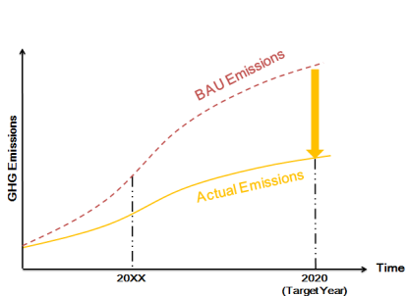
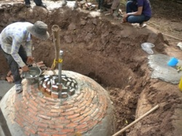
MRV describing Macrospective Review of Policy Action Implementation
National Committee (verification at macro level)
Possible Verification at macro level
Assumption of GHG calculation GHG quantification methodologies Use of different schemes UN Guidelines is being negotiated at SBSTA
MRV
Report
on
NAMAs
Verify
Secretariat of the Committee
Ministries and institutions in charge
Ministry
Ministry
Ministry
Ministry
Ministry
Ministry
NAMAs (to be designed and implemented as a package of policy or programme)
NAMAs (Reduction Plan against Sectoral baselines)
NB. Guidelines on domestic MRV is being developed at SBSTA. The structure is a suggested model for policy level MRV.

Slide 9


MRV at Activity level (Project or entity level)
Project Design
(Ex Ante GHG calculation)
Emission Reduction Activity
(Monitoring GHG )
Project complete
(Ex post GHG calculation)
Verification
MRV
* Guidelines on methodologies are not (yet) decided by the UN

Slide 10
2．Experience with developing NAMAs in a MRV manner under the MOEJ Programme

Slide 11
2. Experience with developing NAMAs in a MRV manner under the MOEJ Programme
Quantifying GHG Emissions Reduction
Climate Change Sectoral Strategy
Activity1:
Data and Info. collection
Energy Sector Strategy
Others
*Extract data and make fact sheets
Fig 1. Energy Development Plan in BAU and NAMAs
Activity2:
GHG Emissions
Calculation
 | 2012 | 2020
BAU
NAMAs | -
XXX MWh
X,XXX MWh
X,XXX MWh
Activity3:
Identify
Mitigation Action
- XX MW Solar
- XX units Boilers
Fig 2. GHG Emissions in BAU and NAMAs
 | 2012 | 2020
BAU
NAMAs | -
XXX t-CO2
X,XXX t-CO2
X,XXX t-CO2

Slide 12
Proposed Steps for NAMA Development
(1) Collection of Info on relevant policies and strategies
Collect and analyze relevant policy documents of development, climate change and related sector
(eg national power development plan)
(3) Quantification GHG emissions of BAU
Quantify GHG emissions based on (2) data, and
a) Identify the calculation formulas
b) Calculate respective emission in BAU
c) Aggregate respective emissions
(5) Quantification GHG emission reduction by NAMAs
Quantify GHG emissions with (4)NAMAs assumptions
a) Set the calculation formulas
b) Calculation
c) Aggregate potential with reduction by NAMAs
(2) Collection data for BAU in the sector
Collect data for calculating BAU emission with bottom-up approach
(eg. List all power plants in operation and planned, based on national power development plan)
(4) Examination and selection of NAMAs options
Select possible NAMAs options and technologies based on (1) policies and mitigation strategies and additional consideration.
Low-carbon technology survey
Examination MRV methods
Capacity-buildings in Vietnam for NAMAs implication
Source: OECC 2012

Slide 13
BAU: Energy Demand Projection in Cambodia
In case where sectoral development strategies is available, such information may be useful for projection a priori. (If not, application of model should be necessary)
(MW)
Source: OECC (Overseas Environmental Cooperation Center, Japan) 2012, modifying JICA Study

Slide 14
BAU: Power Development Plan in Cambodia
*Need to consider projects which may be developed in BAU out of the present plan.
No. | Project Name | Type | Capacity (MW) | Year | Condition as of Dec. 2011
1 | XXXX | Heavy Fuel Oil | 340 | - | Operating
2 | YYYY | Coal | 13 | -
3 | ZZZZ | Hydro | 13 | -
4 | AAAA | Wood, Biomass | 6 | -
5 | Kamchay | Hydro | 194 | 2012 | Under Construction
6 | Kirirom III | Hydro | 18 | 2012
7 | Stung Atay | Hydro | 120 | 2012
8 | Stung Tatay | Hydro | 246 | 2013
9 | Lower Stung Russei Churum | Hydro | 338 | 2013
10 | 100 MW Coal Fired Power Plant | Coal | 100 | 2013
11 | 270 MW Phase 1 of the 700MW Coal Fired Power Plant | Coal | 270 | 2014 ~2015 | PPA singed
12 | 100 MW Coal Fired Power Plant | Coal | 100 | 2016 | PPA singed
13 | 430 MW Phase 2 of the 700MW Coal Fired Power Plant | Coal | 430 | 2017 | FS completed
… | … | Coal | α* | 20XX | May be developed*
 | Total |  | 2188+α
Source: OECC 2012

Slide 15
Power Development Plan with mitigation options
No. | Project Name | Type | Capacity (MW) | Year
1 | XXXX | Heavy Fuel Oil | 340 | -
2 | YYYY | Coal | 13 | -
3 | ZZZZ | Hydro | 13 | -
4 | AAAA | Wood, Biomass | 6 | -
5 | Kamchay | Hydro | 194 | 2012
6 | Kirirom III | Hydro | 18 | 2012
7 | Stung Atay | Hydro | 120 | 2012
8 | Stung Tatay | Hydro | 246 | 2013
9 | Lower Stung Russei Churum | Hydro | 338 | 2013
10 | 100 MW Coal Fired Power Plant | Coal | 100 | 2013
11 | 270 MW Phase 1 of the 700MW Coal Fired Power Plant | Coal | 270 | 2014 ~2015
12 | 100 MW Coal Fired Power Plant | Coal | 100 | 2016
13 | 430 MW Phase 2 of the 700MW Coal Fired Power Plant | Coal | 430 | 2017
… | … | Coal | α* | 20XX
 | Total |  | 2188+α
Introduction of high- performance boiler
Promotion of renewable energy (hydro, solar, biomass
Source: OECC 2012

Slide 16
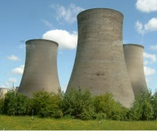
Preparing for Domestic Institutional Arrangement
Climate Change Committee
(verification at macro level)
GHG Inventory as a measurement pillar
Possible Verification at macro level
Assessment of Mitigation Plans Verification of the progress report Review of aggregated GHG emission reduction Assessment of challenges and further needs(PDCA cycle) Submission and Report to UNFCCC
Report
Secretariat of the Committee
Ministries and institutions in charge
Ministry
Ministry
Ministry
Ministry
Ministry
Ministry
Implementation and verification at micro level* (ER from individual activities/projects)
Verification varies by different financial schemes
Non-market | Regular monitoring and data collection procedure (such as that of energy regulatory committee’s)
JCM/BOCM | JCM meth, third party verification
CDM | CDM meth, monitoring, DOE verification
* For a policy measures not as a project-based(such as taxation policy, etc.) may be MRVed at the macro level but still need to have some ways for QA/QC of collected data within its programme.

Slide 17

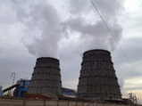
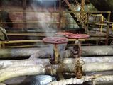
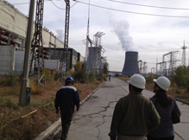
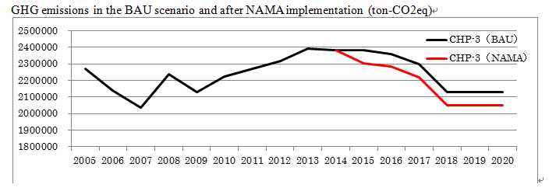
Mongolia
Selected Sector: Energy Supply Sector
NAMAs: Improvement of CHP Plants
Working Group: MEDG, Ministry of Energy, other key institutes and experts, chaired by Climate Change Special Envoy
Results:
Calculated BAU and ER by NAMAs ex ante both for power and heat supplies for CHP3 and CHP4
Sorted out reporting process of activity data (ie Energy Regulatory Committee)
Discussed technology options for application in NAMAs, including process diagnosis in CHP
Diagnosis by energy technology experts from Japan at CHP

Slide 18



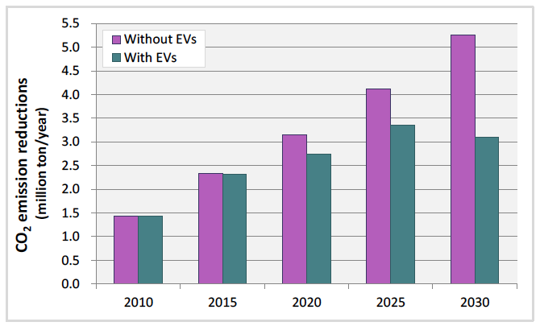
Lao PDR
Selected Sector: Transport Sector
NAMAs: Replacement of conventional vehicle with EV
Working Group: 7 Ministries participates, including MONRE, MPWT, MIME, MOIC, MOST, chaired by Results:
Calculated BAU and ER by NAMAs ex ante
Activity data (fuel economy data) originally collected and based on JICA Study
Proposed institutional arrangements are planned to be a part of technical WG under the National Climate Change Committee
 | Motorcycle | Passenger car | Tuk Tuk / Mini bus | Song Thew / Middle size bus | Large bus | Total
Baseline Emissions
Baseline fuel economy (km/liter) | 40 | 13.0 | 20 | 6.5 | 2.5
Baseline fuel economy (km/liter) (2020) | 43.3 | 14.1 | 21.7 | 7.0 | 2.7
Driving distance (km/day) | 16 | 25 | 45 | 85 | 120
CO₂ emission factor (kgCO₂/liter) | 2.18 | 2.18 | 2.70 | 2.70 | 2.70
Days per year | 365 | 365 | 365 | 365 | 365
Baseline emission (tCO₂/year/vehicle) | 0.3 | 1.4 | 2.0 | 11.9 | 43.8
Project Emissions
Driving distance (km/day) | 16 | 25 | 45 | 85 | 120
Project electricity economy (kWh/km) | 0.080 | 0.130 | 0.130 | 0.310 | 1.000
Grid electricity emission factor (tCO₂/MWh) | 0.135 | 0.135 | 0.135 | 0.135 | 0.135
Days per year | 365 | 365 | 365 | 365 | 365
Project emission (tCO₂/year/vehicle) | 0.1 | 0.2 | 0.3 | 1.3 | 5.9
Emission reduction (tCO₂/year/vehicle) | 0.2 | 1.3 | 1.8 | 10.6 | 37.9
Number of EV | 698000 | 45000 | 12000 | 4000 | 1000
Total Emission Reduction (tCO₂/year) | 161,204 | 56,280 | 21,065 | 42,537 | 37,887 | 318,973
NAMA
BAU
Source: Basic Data Collection Study on Low-emission Public Transport System in Lao PDR, JICA, modified by OECC

Slide 19

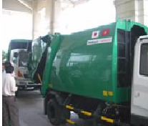
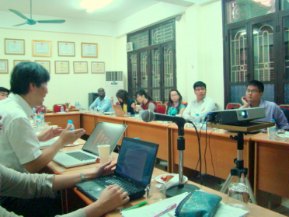
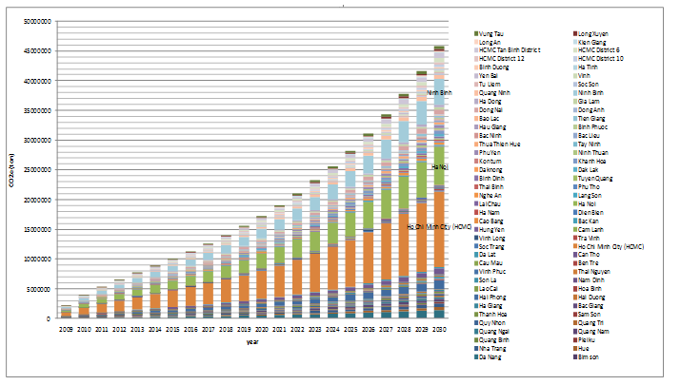
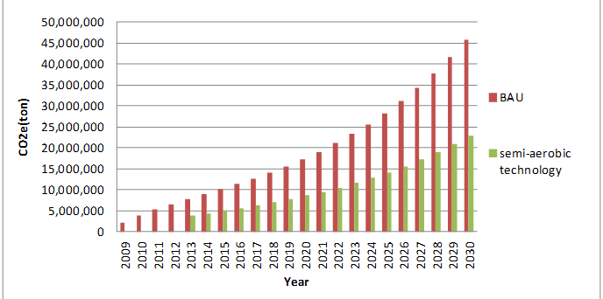
Viet Nam
Selected Sector: Waste Sector
NAMAs: CH4 Reduction from Landfill (semi aerobic technology)
Working Group: MONRE, MOC, MPI, VEA, IMHEN, chaired by IMHEN
Results:
Collected historical activity data from all landfills in Viet Nam
Calculated BAU and reduction by NAMA candidates
(Emission Reductions from Methane Emission from LFs)
Discussed possible reporting procedures

Slide 20

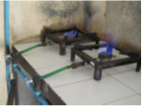

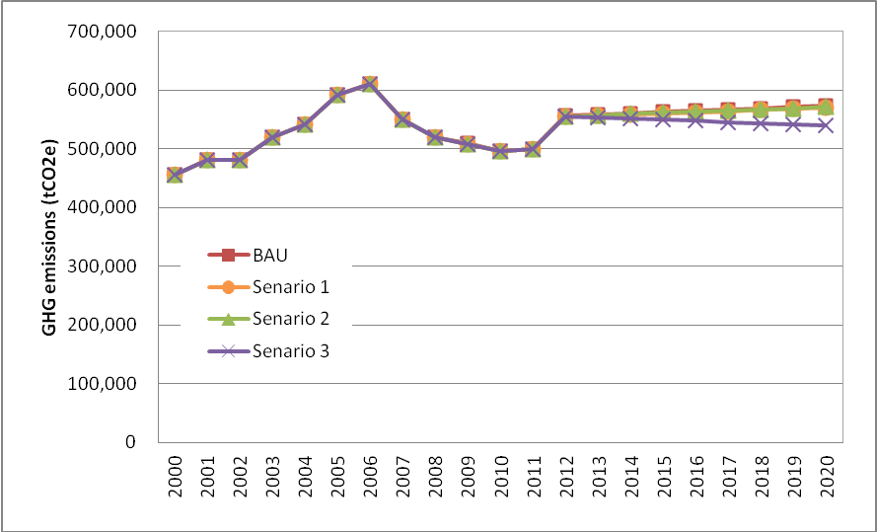
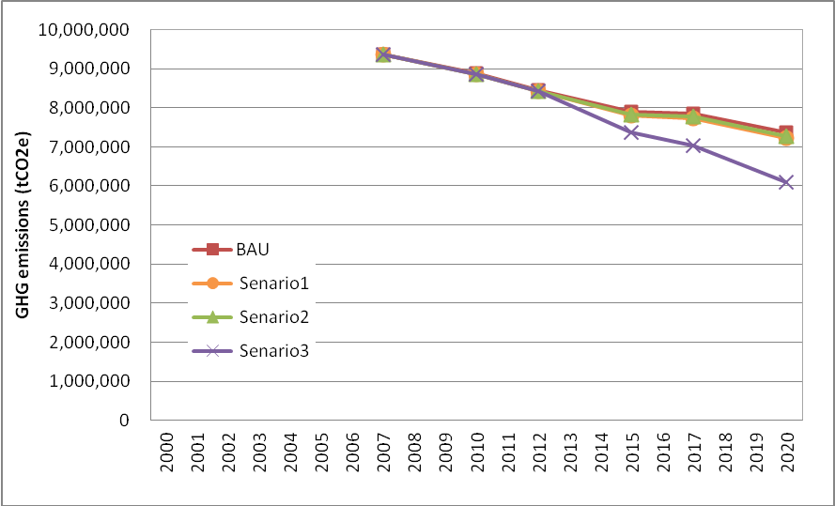
Cambodia
Selected Sector: Agricultural Sector
NAMAs: National Bio digester Programme
Working Group: MOE, MPWT, MIME chaired by MOE DG
Results:
Calculated BAU and ER by NAMAs ex ante
(Emission Reductions from Methane Reduction and NRB)
Sorted out reporting procedure
CH4 Emission from animal manure and its Reduction by biodigester Programme
CO2 reduction from non renewable biomass by different fuels

Slide 21
3．Joint Crediting Mechanism (JCM)
– a driver to implement NAMAs with technology, finance, and capacity-building

Slide 22
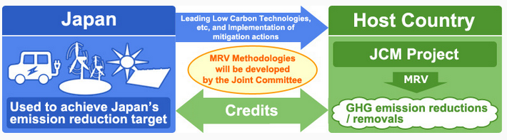
Basic Concept of JCM
Facilitating diffusion of leading low carbon technologies, products, systems, services, and infrastructure as well as implementation of mitigation actions, and contributing to sustainable development of developing countries.
Appropriately evaluating contributions to GHG emission reductions or removals from Japan in a quantitative manner, by applying measurement, reporting and verification (MRV) methodologies, and use them to achieve Japan’s emission reduction target.
Contributing to the ultimate objective of the UNFCCC by facilitating global actions for GHG emission reductions or removals, complementing the CDM.

Slide 23
Approach of JCM
The JCM is being designed and implemented, taking into account the followings:
Ensuring the robust methodologies, transparency and the environmental integrity;
Maintaining simplicity and practicality based on the rules and guidelines;
Promoting concrete actions for global GHG emission reductions or removals;
Preventing uses of any mitigation projects registered under the JCM for the purpose of any other international climate mitigation mechanisms to avoid double counting on GHG emission reductions or removals.

Slide 24
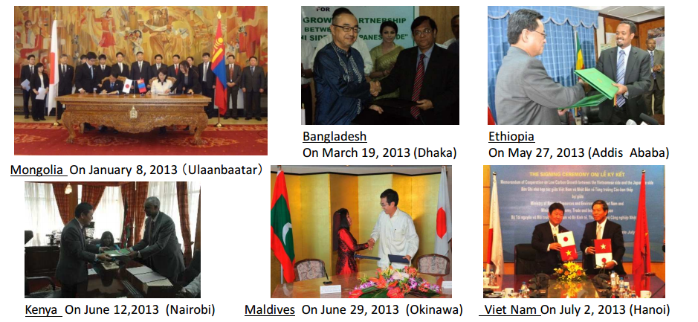
Japan has signed on bilateral documents with
developing countries
Japan has held consultations for the JCM with developing countries since 2011 and signed the bilateral document for the JCM with Mongolia, Bangladesh, Ethiopia, Kenya, Maldives, and Viet Nam.
Japan will continue consultations/briefing with any countries which are interested in the JCM
Japan and Mongolia held the 1st Joint Committee.

Slide 25
Roadmap for the JCM
JFY2011 | JFY2012 | JFY2013
Signing Bilateral Document
JCM Operation
Establishment of the JC
Development of rules and guidelines
Governmental Consultation
Feasibility Studies
Explore potential JCM projects/activities
Study feasibilities
Develop MRV methodologies
MRV Model Projects
Apply proposed MRV methodologies to projects in operation
Improve MRV methodologies by using them
Finalize MRV methodologies
JCM Model Projects
Further improve the institutional design of the JCM, while starting JCM operation
Capacity Building
UN negotiations on Framework for Various Approaches

Slide 26
JCM as a driver to implement NAMAs
with technology, finance, and capacity-building
In addition to support for readiness, NAMAs require resources for implementation in near term.
To implement a national mitigation plan (in which mitigation actions contained), different financial options in a portfolio may be applied, including JCM.
In JFY2013, concrete GHG reduction activities (with financial investments and technology transfer) are expected for registration in the Joint Committees.
Japan operates several support measures to accelerate the implementation of NAMAs by using JCM.

Slide 27
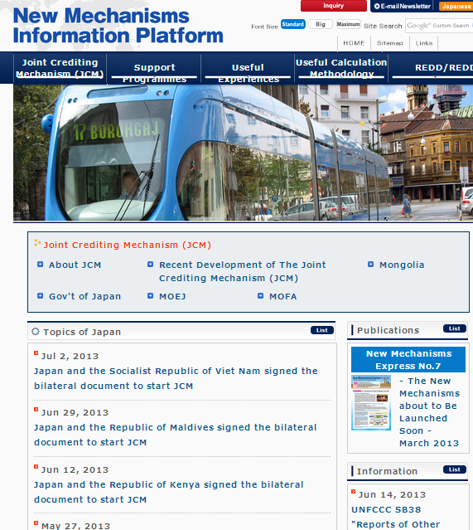
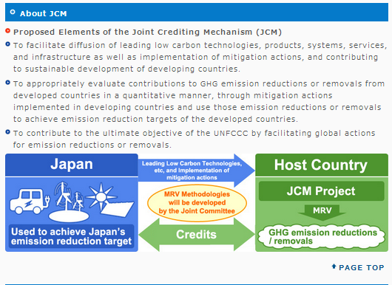
For more information on JCM please visit New Mechanisms Information Platform
(http://www.mmechanisms.org/e/)
[Procedural Documents]
MOU concluded by countries
Rules of Implementation
Project Cycle Procedure
Guidelines for Third Party Entities
Guidelines for Methodologies
Guidelines for Validation & Verification etc.
[Project Information]
[Japan’s Support Programme]

Slide 28
Thank you very much
http://www.mmechanisms.org/e/

