Slide 1
NAMA Facility Support for the Implementation of NAMAs
UNFCCC Regional Workshop 14-15 Sept. 2015, Santiago, Chile

Slide 2
Rationale of the NAMA Facility
Financial support for mitigation actions in developing countries
Learning lessons on NAMAs and climate finance
Feed back lessons learned into international climate negotiations
Enhancing developing countries engagement in the development of climate change mitigation measures
Promotion of national climate change policies in partner countries
Removal of barriers by supporting the implementation of NAMAs
Strengthening national ownership for GHG mitigation actions
Fostering transformational change: i.a. by catalysing the scaling up and replication of NAMAs

Slide 3
Purpose
Tailor-made support to countries that show leadership on tackling climate change and that want to implement NAMAs.
NAMA Support Projects (NSPs) are highly ambitious parts of broader, sector-wide NAMAs.
NAMA Support Projects (NSPs) shall demonstrate that climate finance can effectively support transformational change in partner countries.
Support combines full range of development cooperation instruments (financial and technical)

Slide 4
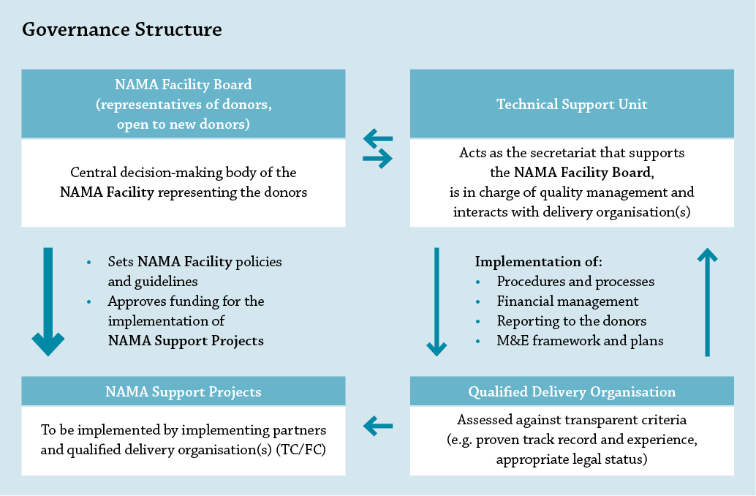
NAMA Facility governance

Slide 5
Peru
Tajikistan
Thailand
Burkina Faso
2012
BMUB (DE) and DECC (UK) establish the NAMA Facility
2013 – First Call
(€70 mio)
4 NAMA Support Projects (NSPs) selected
2014 - Second Call
(€50 mio)
4 NSPs selected
→ New Donors announce commitment at COP in Lima: MCEB (Denmark) and European Commission
2015 - Third Call
(up to €85 mio)
Announcement of newly selected NSPs at COP in Paris
Costa Rica
Indonesia
Chile
Colombia
Pilot Project in Mexico
Notes:
In 2012 German Ministry for the Environment (BMUB) and British Department of Energy and Climate Change (DECC) decided to establish the NAMA Facility to provide funding for what was then perceived as a long pipeline of ready NAMAs.
In 2013 a first Call for NAMA Support Projects (NSPs) was launched and 5 projects were selected.
With a second Call in 2014 together 120 m € were made available for funding.
In the same year two new donors – Denmark and the European Commission - announced that they would join the NAMA Facility for the third Call in 2015.
Hence in the current Call up to 85 m € funding were made available for NSPs.
It is expected that as in the former years the newly selected NSPs will be announced at the COP in Paris.

Slide 6
Land | NAMA Support Project | Funding Volume
Mexico | Sustainable Housing NAMA* | EUR 14 mio
Costa Rica | Low Carbon Coffee NAMA* | EUR 7 mio
Indonesia | SUTRI NAMA– Sustainable Urban Transport* | EUR 14 mio
Chile | Self-Supply Renewable Energy (SSRE) NAMA | EUR 15 mio
Columbia | Transit-oriented Development (TOD) NAMA | EUR 14.9 mio
Peru | SUT- Sustainable Urban Transport NAMA Support Project | EUR 9 mio
Tajikistan | Forestry NAMA Support Project | EUR 13 mio
Thailand | Refrigeration and Air Conditioning NAMA (RAC NAMA) | EUR 14.7 mio
Burkina Faso | Biomass Energy NAMA Support Project | EUR 13.5 mio
* funding for implementation has been approved
Notes:
Here you see the NAMA Support Projects (NSPs) that have been selected so far (in the first two Calls).
The broad geographical and sectoral scope reflects that the NAMA Facility has no regional or sectoral focus. The selection is solely based on the ambition and feasibility of projects.
You may notice that there are quite a lot of NSPs from Latin American countries on the list. This may also indicate the advanced stage of preparation and Readiness of NAMAs in Latin America.
Nevertheless up til today only three projects have actually passed the appraisal phase – that is that donors have approved funding for the full implementation based on a full fledged project proposal.

Slide 7
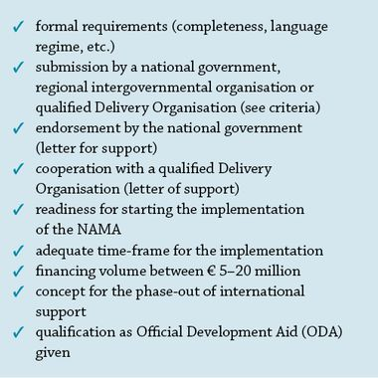
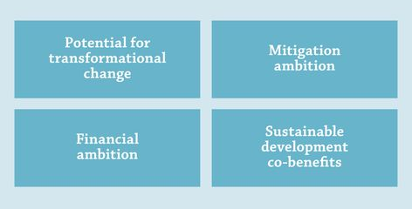
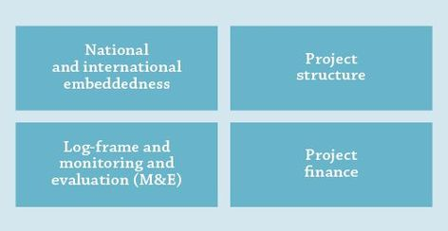
Assessment Criteria for NAMA Support Projects
I Eligibility Criteria
II Ambition Criteria
III Feasibility Criteria
Notes:
As mentioned before the selection of NAMA Support Projects is based on a set of criteria:
General eligibility
Ambition
Feasibility
The general eligibility refers to formal requirements but also the readiness of projects.
Only those projects found eligible are assessed against a set of ambition and feasibility criteria.
Ambition comprises the potential for transformational change, the mitigation ambition and financial ambition.
The feasibility criteria checks whether this transformation is likely with proposed project.

Slide 8
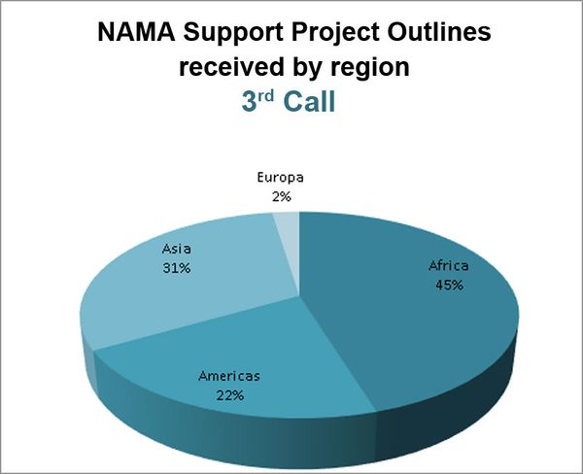
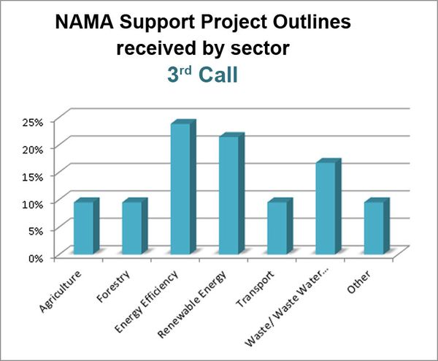
Third Call for NAMA Support Projects
Call closed 15 July 2015
In total 42 Project Outlines were submitted and are currently assessed.
Notes:
Just a few words on the current, third Call for NAMA Support Projects that closed in mid-July:
The NAMA Facility received 42 project outlines, out of which 12 Outlines have been re-submitted.
As in the Calls before there was a broad geographical and sectoral interest as you can see on the graphs.
The submitted outlines are currently assessed and results to be expected at the COP 21 in Paris.
In the beginning of next year the Technical Support Unit (TSU) of the NAMA Facility will provide individual feedback calls for all submissions.
If there should be a fourth Call the NAMA Facility very much encourages to make use of the advice on project preparation offered by the TSU but also the CTCN , UNEP-DTU, GIZ and other organisations offering advice on NAMA readiness.

Slide 9
Thank you for your attention!
Further information
on www.nama-facility.org
or contact the Technical Support Unit at contact@nama-facility.org

