Slide 1
Understanding the transformational change of the NAMAs
Mauricio Zaballa Romero and Søren Lütken
UNFCCC Regional Workshop 14-15 Sept. 2015, Santiago, Chile

Slide 2
Contents
Understanding the concept of transformational
Transformational impact requested in the NAMA Facility template
Examples on transformational change

Slide 3
1. Understanding the concept
What does transformational means?
One definition could be:
Any measure or “group of measures” that has/have potential to produce a deep change of the expected growth path of the sector. Therefore, it is a “significant deviation” of the expected baseline scenario or business as usual scenario.

Slide 4
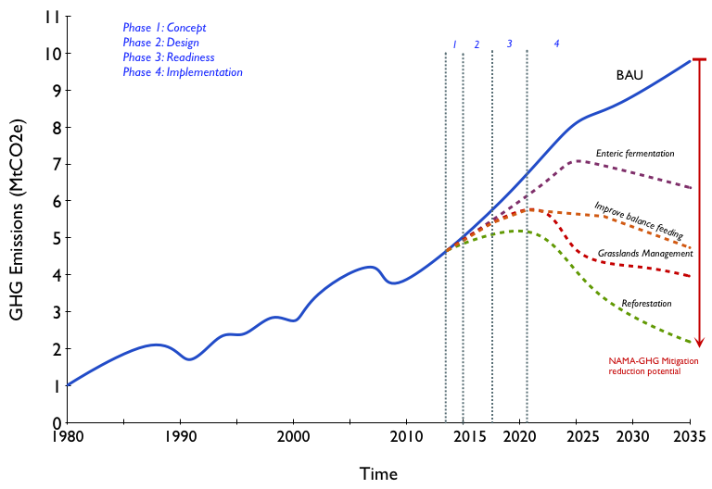
These measures altogether produces a “significant change” in the behaviour of the sector.

Slide 5
1. Understanding the concept
Nevertheless the question which arises is: how a group of measures could be qualified as “transformational”?
As we don’t have any “agreed” concept or definition on “transformational” and on how to assess it? Thus the “transformational” according to different institutions could be understood as:

Slide 6
1. Understanding the concept – NAMA Facility
contribute to enabling either a significant evolution in terms of scope (e.g. scaling-up or replication), or enabling a faster and/or a significant shift from one state to another;
have a catalytic effect and include mechanisms to ensure the sustainability of the impacts, local ownership and political will, the involvement of the private sector and the use of innovative technologies and approaches, and;
allow for systematic learning processes.

Slide 7
1. Understanding the concept – NAMA Facility
Transformational change as well as the objective of change is characterised by the process. The process towards low emission development must be self-reinforcing, and the goals of this process must contribute to long term sustainable development. The process must identify and address the agents of change, the innovation itself and how it fits into the framework conditions (economic, societal, environmental), as well as into the institutions of change.

Slide 8
1. Understanding the concept
Transformational change could be understood as a shift of predominant paradigms (modifying the “way of doing the things”). The last means the following for NAMAs:
that disrupts established high-carbon pathways, contributes to sustainable development and sustains the impacts of the change (goal dimension).
that is triggered by interventions of actors who innovate low carbon development models and actions, connect the innovation to day-to-day practice of economies and societies, and convince other actors to apply the innovation to actively influence the multi-level system to adopt the innovation process, (process dimension).
that overcomes persistent barriers toward the innovated low carbon development model and/or create new barriers which hinder the transformed system to relapse into the former state (sustains ‘low-carbon lock-in’).

Slide 9
GCF’s Paradigm Shift Potential
The concept of paradigm shift potential, one of the Fund’s six investment criteria, may be expanded to understand the transformational change in NAMAs Shift to low-emission development pathways
Potential for scaling-up and replication
Potential for contributing to achieving the 2 degree goal
Potential for knowledge and learning
Potential for contributing to the creation of an enabling environment
Potential for contributing to the regulatory framework and policies
Potential for supporting climate resilient development
Paradigm Shift Potential
Degree to which the proposed activity can catalyse impact beyond a one-off project or programme investment
Source: GCF

Slide 10
Transformation through NAMA Finance

Slide 11
Transformation
inside the red box (previous figure)
structuring the cash flows is what creates the real transformational change
the objective is to create a situation in which a change in the cash flows gives priority to those investments we would like to see – and discourages those that we would like to stop
when you have done that, you also know what kind of finance you need – and how much

Slide 12
2. Transformational impact requested in the NAMA Facility template
Is the outlined NAMA Support Project an element of a broader programme or policy framework that contributes to achieving an ambitious sectoral or national emission reduction target or implementing a low-emission development strategy?
With the NAMA Facility, the potential for transformational change of a NAMA Support Project is assessed at the outlining stage and forms part of the ambition assessment.
Would the achievement of the emission reduction target or implementation of the low-emission development strategies contribute to bringing the target country onto a low- carbon development path?

Slide 13
2. Transformational impact requested by the NAMA Facility
Does the outlined NAMA Support Project fit into a broader context of mitigation activities in the respective sector?
Does the outlined NAMA Support Project help to change the prevailing structures of the sector that contribute to high emission levels? Please refer to the starting situation of the country and the sector. Please describe the ‘window of opportunity’ for inducing the change?
Does the NAMA Support Project help to overcome systemic barriers to the reduction of emissions and if so, how?
What transformational impacts does the outlined NAMA Support Project have beyond the scope of the project?
Does the outlined NAMA Support Project develop capacities to reduce future GHG emissions beyond the scope of the project?

Slide 14
2. Transformational impact requested in the NAMA Facility template
Does the outlined NAMA Support Project serve to strengthen the institutional capacities of the national system, as described for example in the aid effectiveness criteria of the OECD/DAC?
Does the outlined NAMA Support Project envisage the participation and/or development of the private sector? What is the specific contribution of the private sector to transformational change potential?
Does the outlined NAMA Support Project adopt an innovative approach to reducing emissions, which can have impacts beyond the specific NAMA Support Project (e.g. technology transfer)?
Is the outlined NAMA Support Project repli- cable with respect to its applicability in other regions, countries and internationally?

Slide 15
3. Examples on Transformational

Slide 16
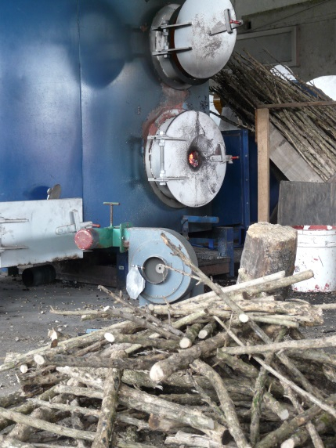
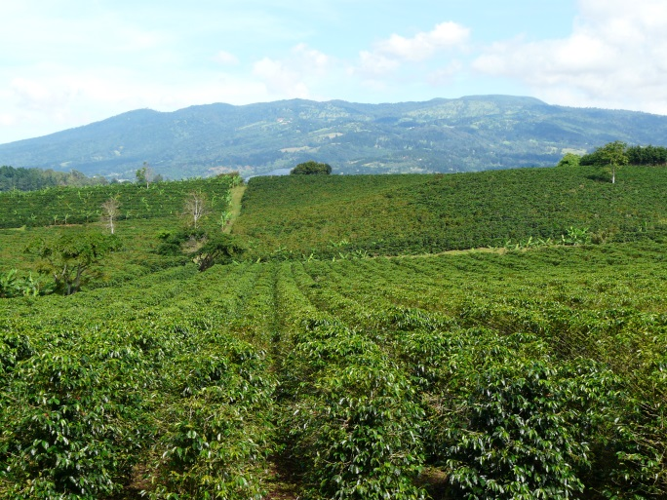
Transformational Change
Costa Rica
Transforming the entire value chain in the coffee sector: plantation management, processing of coffee up to and including distribution
Emissions reduction succeeds in all stages of the coffee production (e.g. fertilizer, water, roast etc.)
A major pull factor is an extra premium price for low emission coffee to be sold in prime coffee markets in Europe
Objective is to transform coffee production on a national scale towards minimum emissions

Slide 17
Transformational Change
Thailand
Transforming the market for AC and cooling technology
Supporting an accelerated phasing out of aggressive climate pollutants in AC manufacturing
Supporting the demand side in order to establish preferences for ACs with natural coolants
Addressing both the household and commercial sectors
Objective is to eliminate aggressive climate pollutants many years before the Montreal due date by 2030

Slide 18
Thanks for your attention, time for discussion!
Further comments or consultations, you can contact me
Mauricio Zaballa Romero
Climate Change Expert
mzaballa@icloud.com
Or to
Søren Lütken
Senior Climate Finance Advisor
NAMA Facility
soren.lutken@nama-facility.org

