Slide 1
NAMAs and INDCs: what are the interlinkages?
Asia Pacific and Eastern Europe Regional Workshop on Nationally
Appropriate Mitigation Actions
12 June 2015
Heiner von Lüpke, GIZ

Slide 2
Content
Background: Why dealing with NAMA-INDC interlinkages?
State of play: State of NAMAs – State of INDCs
Example of possible NAMA-INDC linkages
Conclusions

Slide 3
Background: Why dealing with NAMA - INDC connections?
Both INDCs and NAMAs are mitigation concepts, but rather loosely defined, clarification is needed as a foundation for implementation;
Confusion around new acronym INDC (“…is that yet another mechanism?”), lack of understanding how it links to NAMAs;
NAMAs are currently developed and implemented, INDCs are in the start up phase for post-2020: How to bring them together in a coherent mitigation strategy?

Slide 4
UNFCCC process: Run up to COP 21 and a global agreement
COP 17
COP 21
COP 20
COP 19
COP 13
COP 15
Bali 2007
Copenhagen 2009
Durban 2011
Warsaw 2013
Lima 2014
Paris 2015
NAMAs, MRV, REDD+
No follow up to Kyoto protocol, turnaround of process
Durban platform to negotiate a global, binding agreement
Intended nationally determined contributions (INDCs)
Warsaw REDD+ decisions
Lima call for climate action – draft text for COP 21
Global agreement 2020??
Notes:
I am going to say something that may sound a bit provocative for some: NAMAs were the original INDCs:
NAMAs originated as the centrepiece for developing countries to join a global agreement in Bali 2007;
In 2009 / 2010, NAMAs were submitted to UNFCCC (association with Copenhagen accord), but a global agreement was not reached: NAMAs were left without this global frame;
New start in Durban 2011 for a global agreement, the following year COP 19 in Warsaw deliberated that respective country contributions would be requested: INDCs;
So, in terms of what the NAMAs are in nature, they are not too different from INDCs, but developed & implemented in a period when a clear framework in form of a global agreement is still not there („pre-2020“).

Slide 5
Timeline: pre-2020 and post-2020 in the UNFCCC
Pre 2020: top-down emission reduction commitments for developed countries;
bottom- up individual country emission reduction targets, NAMAs, REDD+, MRV,
but no binding global agreement applicable to all Parties
COP 21: expected global climate change agreement (to enter into force 2020), applicable to all Parties, with INDCs at its core

Slide 6
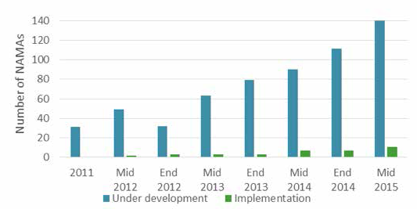
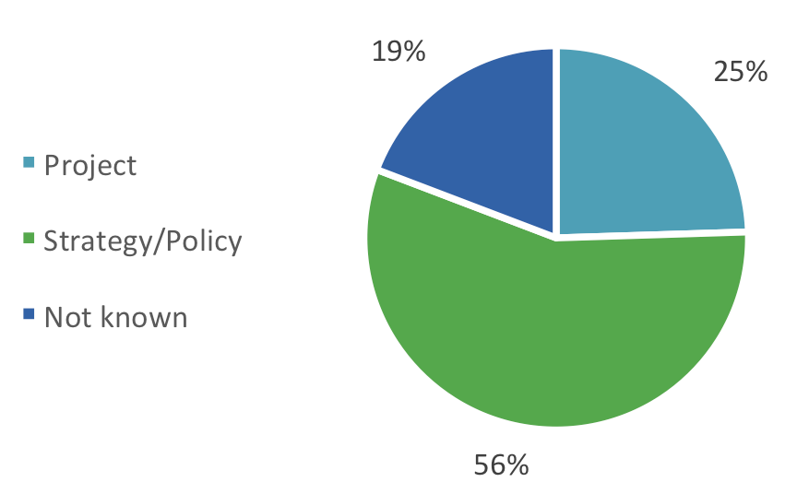
Background: Status of NAMAs
Internationally largely undefined, but different types of NAMAs emerge as they are implemented;
UNFCCC NAMA Registry contains 57 NAMAs: 21 seeking support for preparation and 36 seeking support for implementation;
Most NAMAs in registry seek support, but shadow figure likely high of unilateral NAMAs;
NAMAs spread across all sectors and continents, can be projects, policies or strategies.

Slide 7
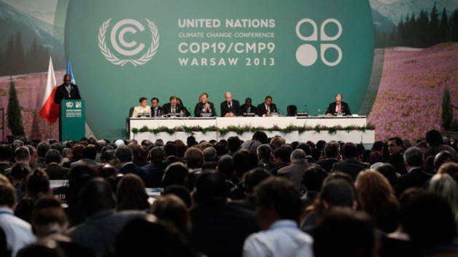
What are Intended Nationally Determined Contributions?
INDCs are contributions by all parties to the UNFCCC to reduce GHG emissions for the global agreement on climate change post 2020 period
Based on the understanding that further ambitious emission cuts are
needed to stay below 2 degrees global warming
INDCs should present a progression beyond current mitigation efforts
(‚no backsliding‘)
More clarity on the information to be provided with the INDC
Secretariat publishes INDCs on UNFCCC website and will prepare a synthesis report on the aggregate effects of INDCs communicated by
1 October 2015

Slide 9

Submissions till date (10th June 2015)
Switzerland 27. February
European Union 03. March
Norway 27. March
Mexico 30. March
U.S. of America 31. March
Gabon 01. April
Russia 01. April
Liechtenstein 24. April
Andorra 30. April
Canada 15. May
Morocco 05. June
Ethiopia 10. June
INDC portal by UNFCCC: http://www4.unfccc.int/submissions/indc/Submission%20Pages/submissions.aspx

Slide 10
…and information they typically contain:
Country background
INDC type (absolute target against base year, target relative to a business as usual scenario)
Base year, period, baseline scenario
GHG emission reduction level
Scope (sectors and GHG types)
Adaptation aspects
Planning process
Information on why the INDC
is fair and ambitious
Source: UNFCCC (2015): INDCs as communicated by Parties

Slide 11
Existing program,
no climate policy
Intervention of
climate policy (NAMAs)
Increased importance
of climate policy

Slide 12
Some observations regarding the transition of NAMAs to INDCs
Much technical work, readiness and capacity enhancement (concept) is being done for the NAMAs – valuable base for INDCs;
Climate policy framework still emerging in the NAMA context, however strong policies are needed for:
  Budgeting;
  Implementing & monitoring mitigation actions in a unilateral way which is precondition for the INDCs (overarching framework needed to involve stakeholders);
NAMAs need to be up scaled from project to wider level of programs / sectors in order to deliver impacts of sufficient scale
Are conditional INDCs by developing countries similar to supported NAMAs?

Slide 13
INDC –
NAMAs (post-2020)
NAMAs current stage
NAMA projects:
INDCs –
INDC policy targets:
Political leadership
Policy targets (e.g., +30 % renewables in energy mix)
Policy instruments (e.g., FIT, carbon standards)
Policy enforcement
Social-environmental, MRV /
GHG impact assessment
IRR
Legal conditions
Technical feasibility
Example:
Combining project based NAMAs with an INDC policy target

Slide 14
Conclusions
Strong need to bring together NAMAs and INDCs and see the big picture: Countries need long-term, coherent mitigation strategies and action programs
To generate momentum for implementation of NAMAs, clear policy signals from strong INDCs are much needed
In turn, NAMA implementation can inform about successes and results to those negotiating and developing INDCs
It will be worthwhile to look into the technicalities of linking up NAMAs and INDCs (e.g., harmonize metrics, time periods, assumptions and methods used), that way, NAMAs and INDCs can built conductively on each other
With all the similarities and need for integration of NAMAs & INDCs, one thing is different: INDCs should show a progression to what countries are doing currently, aka, raising the ambition level

Slide 15
Thank you!
Contact:
heiner.luepke@giz.de

