Slide 1
Overview of support needs for NAMAs
Sudhir Sharma, URC
11 November 2013
Warsaw, Poland
Sudhir Sharma
Senior Climate Change Expert
UNEP Risø Centre
Technical University of Denmark
sudr@dtu.dk

Slide 2
Session description
Financial, technological and capacity building support needs of developing countries to implement their NAMAs as well as of available sources of support.

Slide 3
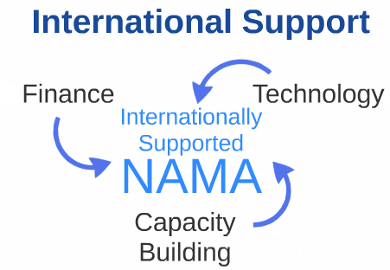
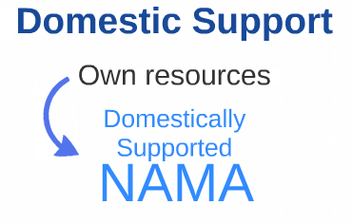
Financial architecture for NAMAs
NAMAs will be supported through finance, technology and capacity building – Internationally supported NAMAs.
Developing countries also to undertake NAMAs with own resources depending on their capacities – Domestically supported NAMAs.

Slide 4




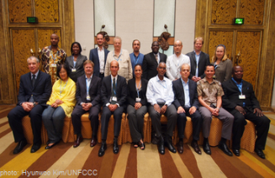
Financial architecture for NAMAs (2)
Cancun and Durban outcomes strengthened the existing Financing Mechanism of the Convention.
  Existing operating entity – GEF
  Created new operating entity – Green Climate Fund (GCF)
  Bilateral and Multilateral urged to provide support
Support architecture also includes:
  Registry as a platform to facilitate the matching of support
  Standing Committee to support COP in overall assessment and advice on Climate Finance

Slide 5
Financing instruments
Instrument | Typical providers
Equity | Private companies, individuals, venture funds, publicly funded venture funds (hybrids), pension funds
First-loss | Private companies, venture funds, publicly funded venture funds (hybrids)
Loans | Banks, development banks, publicly funded venture funds (hybrids), pension funds
Soft loans | bilateral donors (through commercial banks), multilateral development banks
Bonds | Financial arrangers like banks and credit institutions, large corporations, governments
Dedicated credit lines | Multilateral and bilateral development banks
Risk cover instruments, Guarantees | Export Credit Agencies, insurance companies, banks, governments, technology suppliers
Project Finance | All of the above
Grant | Bilateral donors, philanthropic funds
Blending mechanisms | The Green Climate Fund (GCF) has signalled the intent to provide several sorts of financial instruments

Slide 6
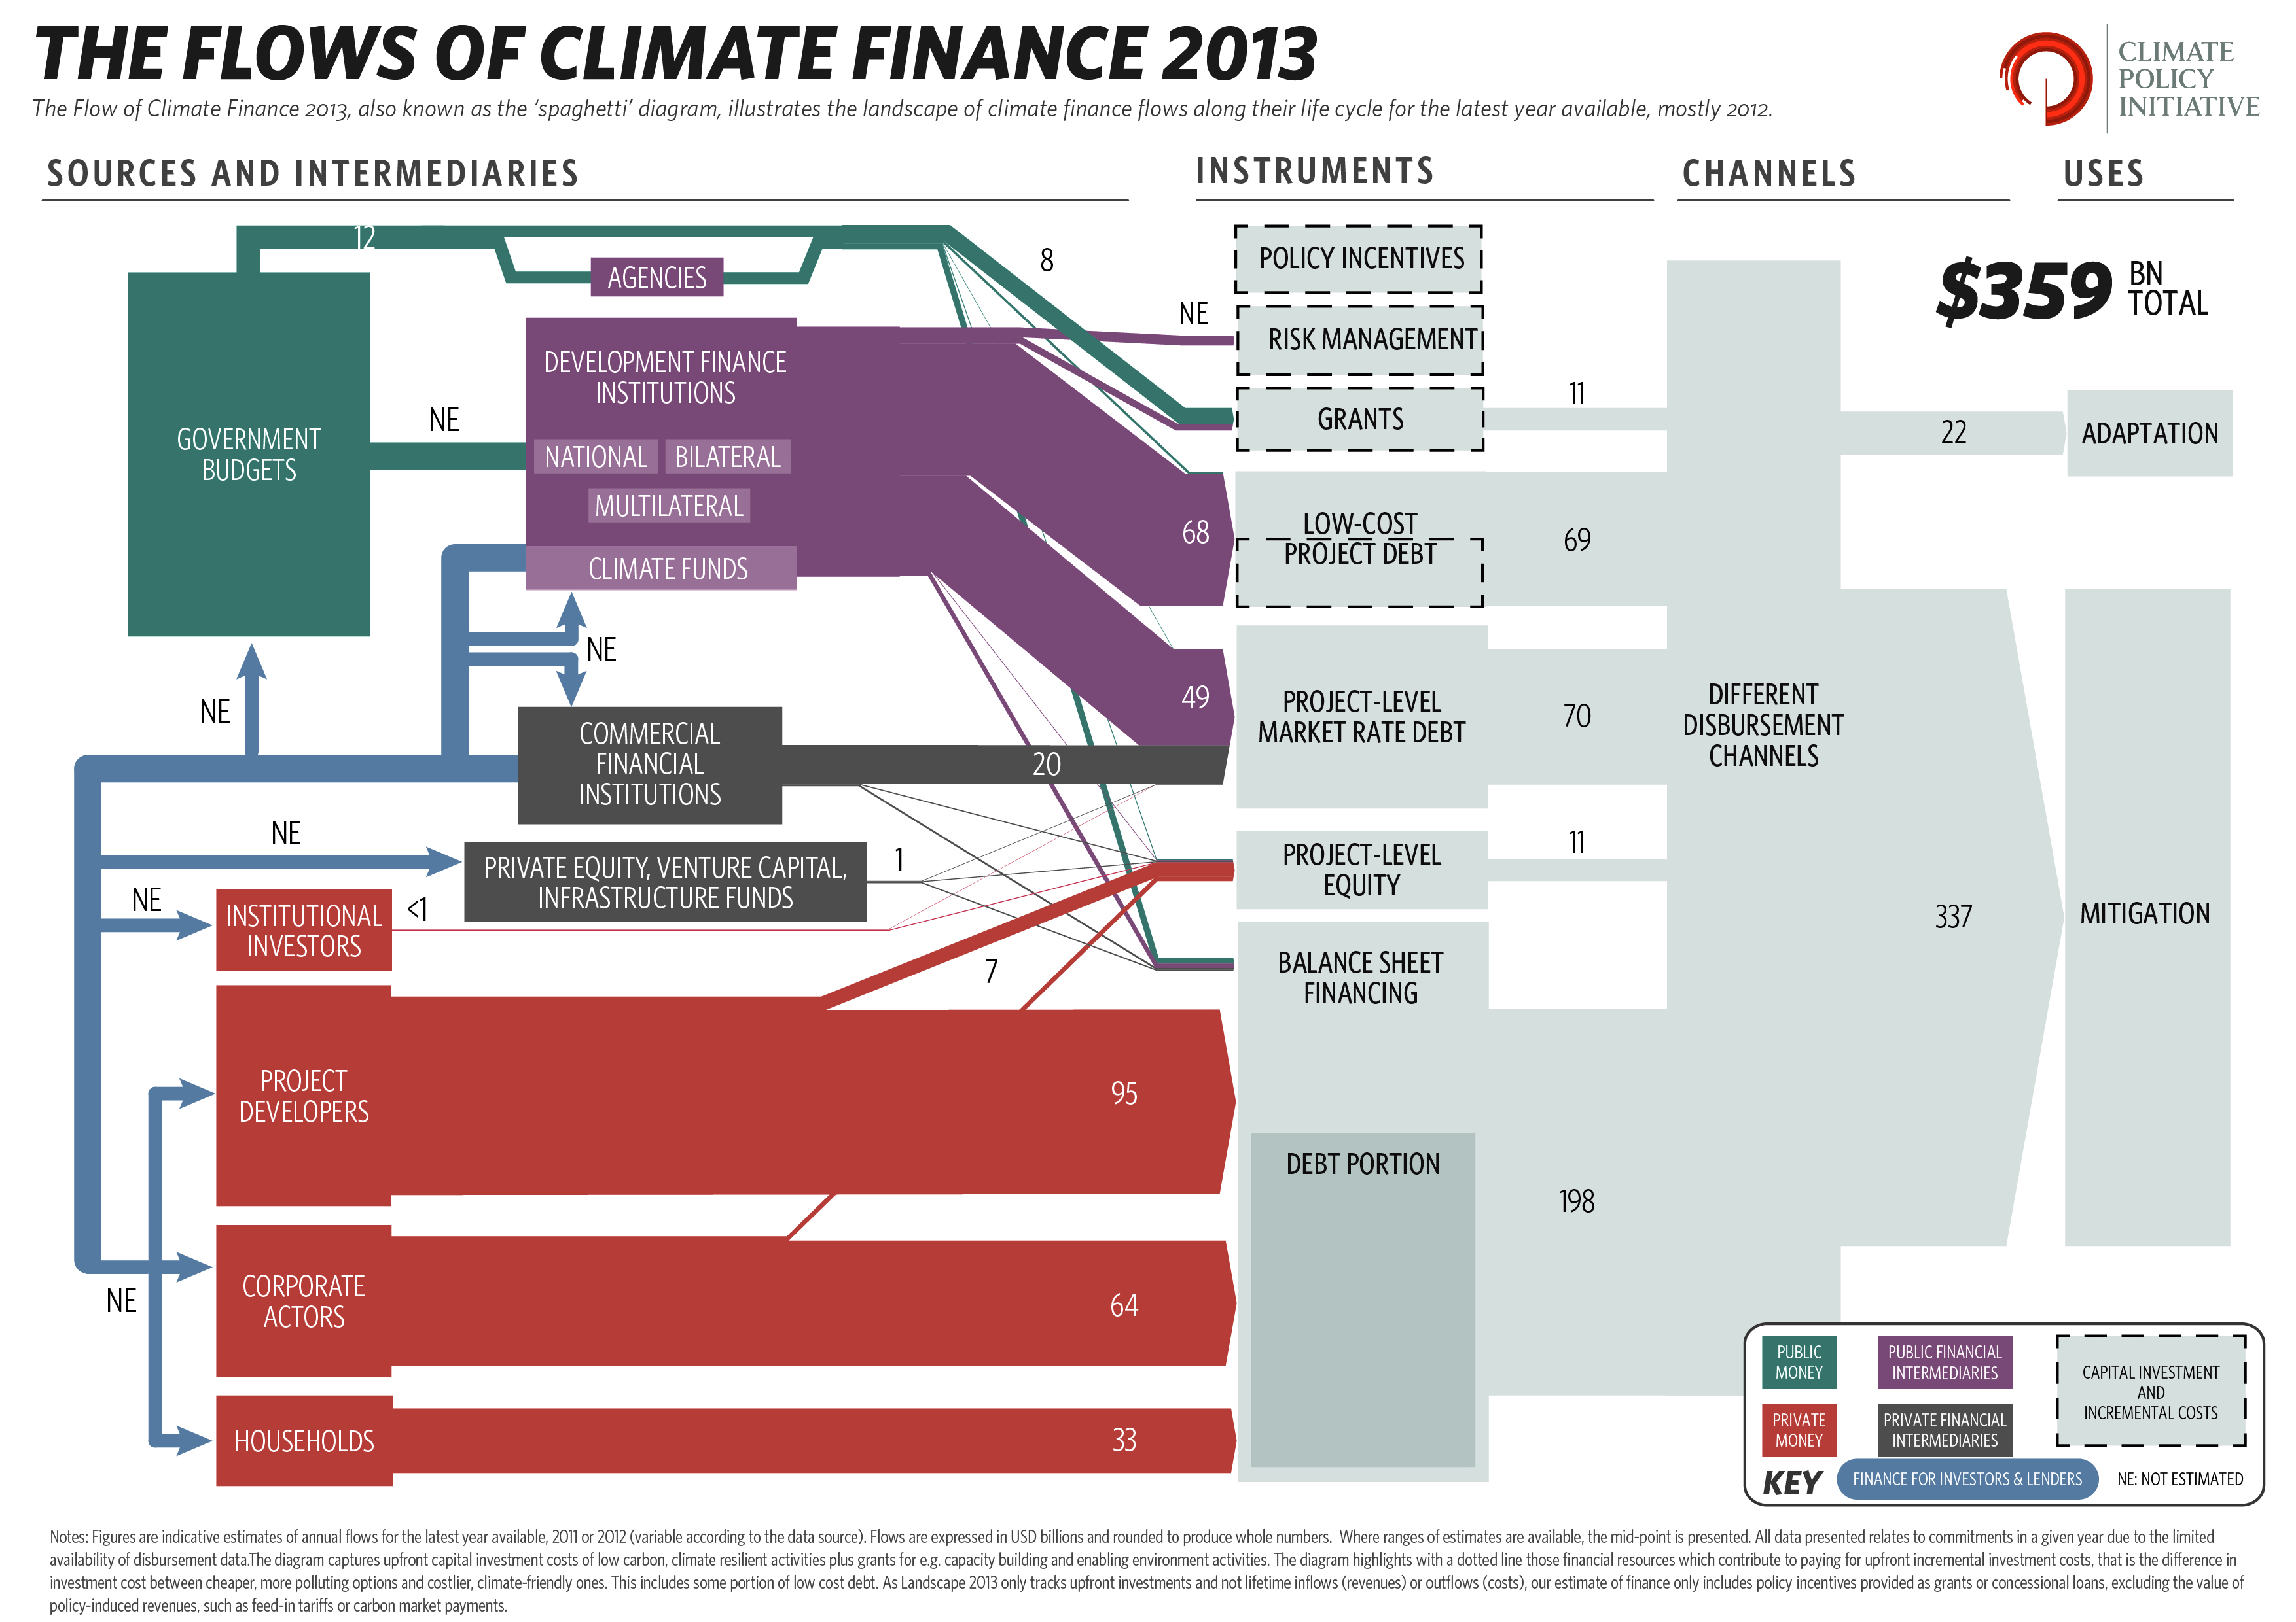

Slide 7


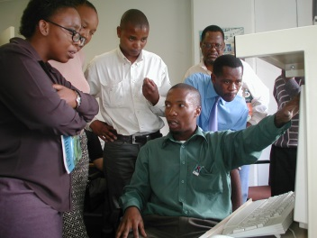
Finance sources and types of activities
A NAMA could include following combination of activities:
  Direct provision of physical and technical infrastructure (e.g., installation of wind power plants, energy efficiency equipment in industries, etc.);
  Technical assistance and capacity building support
    Development of regulation, policies, fiscal or financial incentive mechanisms and their implementation, etc.;
    Institutional infrastructure to support implementation of policies and regulations; and
    Planning, research and capacity building activities.

Slide 8
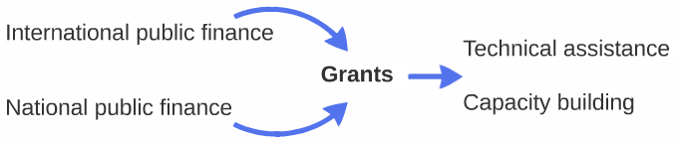
Finance sources and types of activities (2)
Financing for Technical assistance and Capacity Building through grants,
  Mostly from international public finance;
  But also national public finance.
Investments for physical and technological infrastructures
  Mostly through funds raised by investors (loans, FDI, equity);
  Could include governments seeking sovereign loans
  (e.g., MRTS construction)
  Line of credit for loans – where profitability is not an issue but high upfront costs makes access to finance difficult.

Slide 9
Finance sources and types of activities (3)
Investments may receive some grant support:
  Low returns compared to BAU options
    Either upfront to reduce investments costs through subsidies or lower than market interest rate loans; or
    During operational phase – such as higher service fee, feed-in-tariffs, carbon markets, etc.
  Higher (perceived risks) – guarantees, etc.

Slide 10
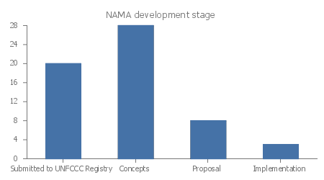
NAMAs submitted to UNFCCC
  58 countries submitted national efforts
  - NAMAs pursuant to decision 1/CP.16 - to address GHG emissions.
  36 NAMAs seeking support uploaded in the UNFCCC Registry
    12 seeking support for development.
    24 seeking support for implementation.
  NAMA - database reports (31st October 2013)
  - 81 NAMAs in various stages.
    The analysis covers only one submitted to UNFCCC Registry.
Notes:
Their aspirations consist of a range of Energy & Emission reduction goals
GHG emission reduction of 25% below 1990 levels by 2020
Efforts to remain GHG neutral
GHG reduction of 36.1 % - 38.9 % below its BAU emissions in 2020 (Brazil)
GHG reduction of 20% below its BAU emissions in 2020 (Chile)
Reduce CO2 emissions per unit of GDP by 40–45% by 2020 compared to 2005
77% of total electric capacity installed will be from renewable sources and 20 % of fuel consumption from biofuels by 2020.
Reduce CO2 emissions (except agriculture) per unit of GDP by 20–25% by 2020 compared to 2005
GHG emissions reduction by 26 % by 2020 (Indonesia)
GHG reduction of 20% below its BAU emissions in 2020 (Israel)
Long-term transformational effort to achieve carbon neutrality as a country by 2020 (maldives)
GHG reduction of 40% below 2009 level (Marshal Islands)
GHG reduction of 30% below its BAU emissions in 2020 (Mexico)
Renewable energy represents at least 33% of total energy used and zero net deforestation by 2020 (Peru)
GHG emissions reduction by 30 % below BAU by 2020 (south Korea)
GHG emissions reduction by 35 % compared with the base year 1990, by 2020 (Moldova)
GHG emissions reduction by 16 % below BAU by 2020 (Singapore)
GHG emissions reduction by 34 % below BAU by 2020 (South Africa)
GHG emission reduction of 28% below 1990 levels by 2020 (Serbia)
Develop a low-emission development strategy. Reduce transmission & distribution losses by 15% in 2030 (Gambia)

Slide 11
Finance needs - National Efforts
Most submission included in inf.12/Rev.2 are either national/sectoral goals or lists of programmes/projects as a collective national effort to address GHGs – equivalent to pledges.
Most have stated these actions are conditional on availability of support.
A few countries have clearly stated unilateral and internationally supported actions – Colombia.
A few countries submission makes no reference to need for international support.
Incremental cost – Only a couple of countries identified approximate incremental cost of its actions, India, South Africa.
For further analysis of these submissions see URC, 2013 publication “Understanding the Concept of NAMAs”.

Slide 12
NAMAs seeking Support for Preparation
Type of support |  | Nature of Support
Finance | 10 | Grant | 10
Capacity | 7 | In-Kind government support | 1
Technical Assistance | 4
All NAMA request grants.
1 indicated in-kind host country support in preparing a NAMA.
Many present a break-down of requested financial support into Finance, Capacity and Technical Assistance requirements.
Direct use of Financial support is requested for:
  Consultancy fees
  Buying equipment’s,
  Expenses for developing elements of the proposal – MRV, estimation of detailed costs and financing arrangements, GHG emissions estimation and defining activities of the proposal, including studies and analysis.
Technical support – focus is on policy and regulatory framework related work.
Details not sufficient to understand specific requirements for support in developing NAMAs.

Slide 13
NAMAs seeking Support for implementation
No information |  | Incremental cost/Full Cost | 8/19
 |  | Country contribution in total in Total Cost Country contribution in incremental cost | 4 3
Finance | 15 | Grant | 17
Capacity | 1 | FDI | 2
Technical | 2 | Loans (private) | 2
 |  | Concessional loan | 4
 |  | Loan (Soverieng) | 2
 |  | Equity | 2
 |  | Guarantee | 1
 |  | Carbon Finance | 7
All submissions provide information on full financial cost for implementation.
Some submissions also provide information on the incremental costs.
A few submissions also provide information on capacity building and technical support in terms of finance out of the total finance need expressed.
Type of financial support requested – covers a whole range from Grants to Loans.
Support requested for -
  Investments;
  Measures to create conducive investment environment;
  Developing and implementing policy/regulatory framework; etc.

Slide 14
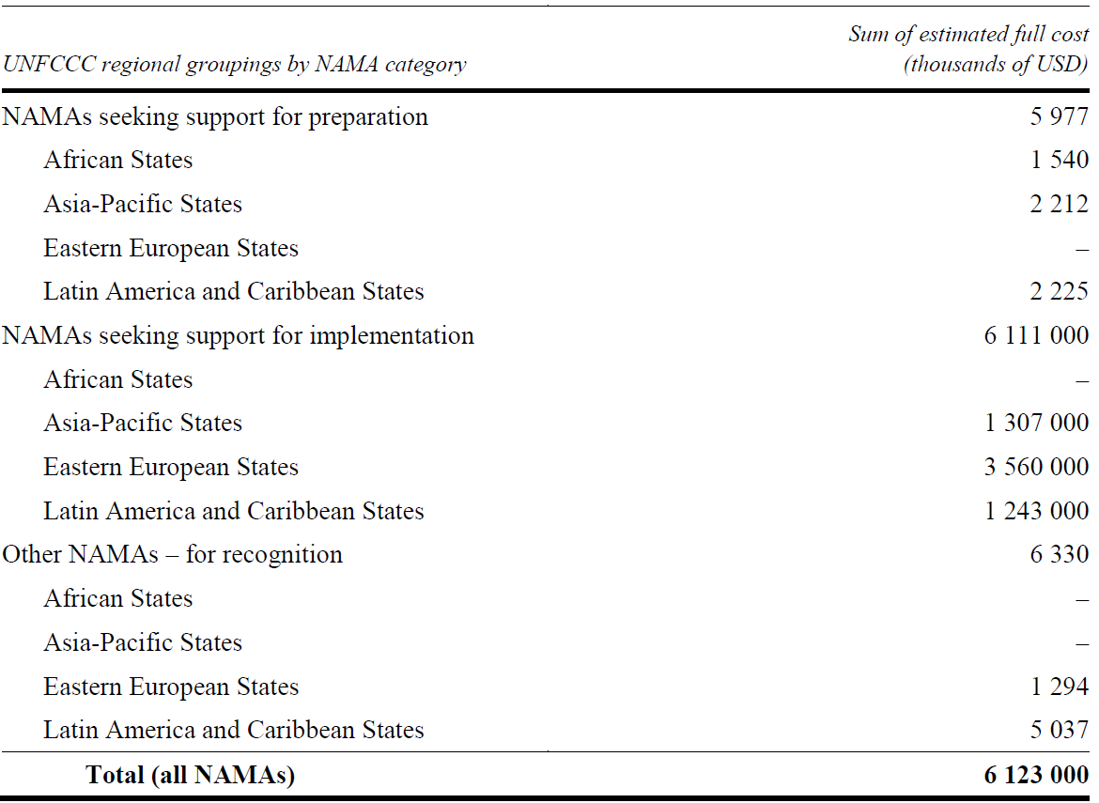
Total Cost of NAMAs

Slide 15
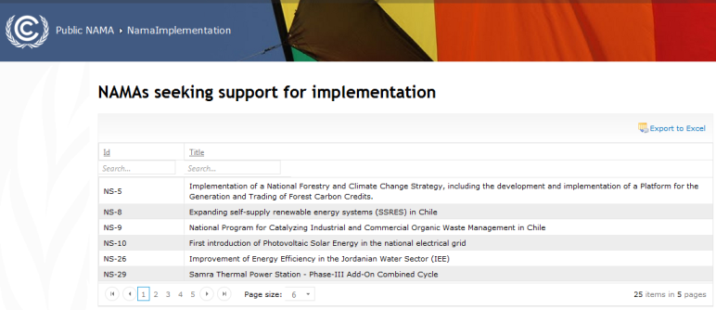
NAMAs seeking Support for Implementation
In some cases investment is requested for demonstration activities.
Grants requested for:
  Institutional and human capacity development
  Strengthening regulatory and policy framework,
  Creating infrastructure to implement regulations and
  policies, such as testing labs etc.
  Subsidizing the initial investment cost for new technologies.
Though clarity on NMM still to emerge
– a number of submission have considered carbon
finance to support certain components of NAMA.

Slide 16
Some observations
Support is needed not only for costs to achieve additional GHG reduction benefits but also for “base costs”.
Though submissions are not sufficiently clear on what type of finance is requested for which activities:
  It seems recognition exists that base costs will be covered by FDI, Loans (private sector), Equity etc; and
  Grants or guarantees for additional costs required for adopting low carbon options or covering risks of adopting low cost carbon options.
Those developed with support, have greater information.

Slide 17
Some observations (2)
Incremental cost – Some state incremental costs as zero and some have indicated part of this will be supported by government funds
Additional information to increase third party understanding:
  Further clarity on what kind of financial support is needed for actions included in NAMAs.
  Private sector role or involvement in implementing NAMAs.
  Though information on sustainable development benefits is provided – further clarity on country contribution to implementing NAMAs would provide clarity on country ownership.

Slide 18
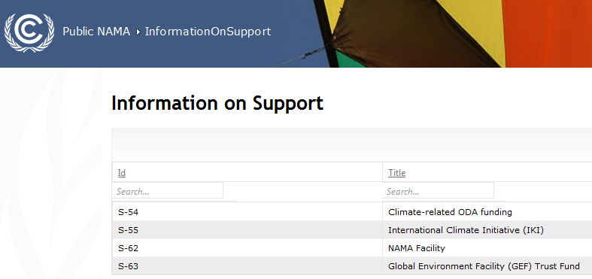


Support for NAMAs
Four entries in Registry for
support to NAMAs, including one from GEF.
Germany and UK have established NAMA facility
  – the only dedicated fund for NAMA implementation.
Germany has also listed ODA-Climate fund ICI as a source of funds for climate change, though not specific for NAMAs.
A number of initiatives to support NAMA development
– through bilateral and multilateral funds.

Slide 19
Understanding the financing –
What types of mitigation activities will GCF finance?
Objective - Promote the shift towards low-emission and climate-resilient development pathways.
Fund for implementation of mitigation actions:
  Project-based and programmatic approaches, emphasis on programmatic approach
  Should be aligned to strategies and plans, such as, Low emission development strategies (LEDS) or plans,
GCF will also support - preparation or strengthening of LEDS or plans, NAMAs, NAPs, NAPAs.
Special facility to fund private sector adaptation and mitigation initiatives.

Slide 20
GCF – Financing Instruments
Finance incremental costs for activities that address climate change.
Type of financial support
  Grants
  Concessional lending,
  Other financing modalities
  - guarantees, equity investment and other modes of innovative funding.

Slide 21
Information on Financing in NAMAs
Financial details of NAMA could benefit by including the following:
  Clear and realistic description of allocation of funds to projects / programs
  Clear evaluation of economic benefit to confirm financial feasibility (financial return),
  Clear estimates of necessary cost with a good explanation (justification of the required cost).
  Early integration of potential financiers in the design of NAMAs may be useful to ensure later funding.
  Private Sector engagement – as a source of investment but importantly as a vehicle of disseminating low carbon development measures and technologies.
All this information helps provide confidence that proposals can withstand due diligence of financial institutions before attracting investment from public, private and market financial sources.
Source: NAMA Finance Study - Examples from the UNEP Bilateral Finance Institutions Climate Change Working Group, UNEP, 2012.

Slide 22

Information on Financing in NAMAs (2)
KFW has put out following criteria to support NAMAs:
  The level of ambition in terms of the GHG reduction potential and transformative impacts
  The national interest and ownership in the national government beyond the borders of single ministries
  An adequate and cost-effective MRV system to provide for indicators, baselines and milestones
  The maturity and bankability of a NAMA concept to be financially viable and sustainable

Slide 23





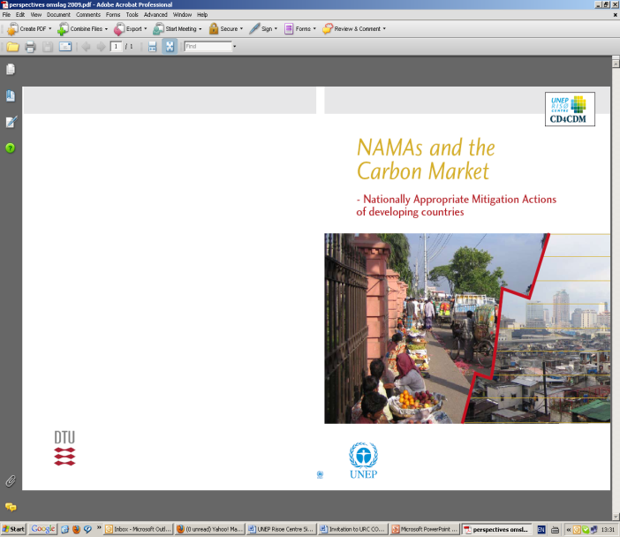








Thank you!!
More information:
http://uneprisoe.org
http://cd4cdm.org
http://cdmbazaar.net
http://cdmpipeline.org

