Slide 1
“NAMA Energy/Biomass - Costa Rica” NAMA Proposal
Group - Roundtable
September 2015
With support from:

Slide 2
Executive Resume
Country : | Costa Rica
Project: | Support project for the energy sector in Costa Rica
Implementation: | MINAE-DCC/ICE/MAG)
Working areas: | Mitigation, adaptation, energy efficiency, emission reduction and resiliency model under climate change
Support partners: | Spaniard Cooperation - AECID German Development Cooperation - GIZ
Direct beneficiaries: | Electrical and thermal users switching in the energy matrix
Stakeholders: | Private companies, Cooperatives and ICE.

Slide 3
Technical areas:
Dry biomass residues
Wet biomass residues
Organic agricultural residues
Focus:
Sugar cane, Pineapple, Rice, Palm oil, Bananas, Wood and Livestock (not limited…)

Slide 4
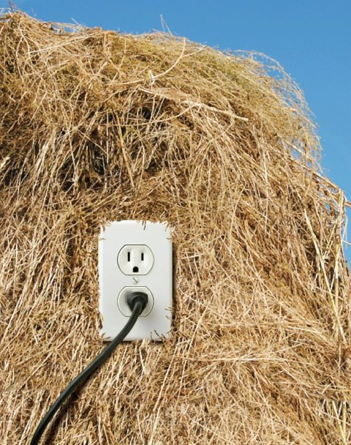
Objective
Facilitate the use of organic agricultural/forestry residues available with the best economically attractive technologies (BEAT) to increase the use of clean energy towards a low emission development path.

Slide 5
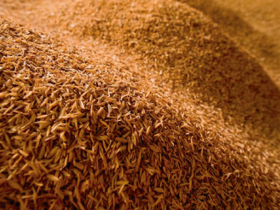
Specific objectives
Component 1: Promote best practices at the farm level in order to optimize the value chain in high potential activities.
Component 2: Improve the energy efficiency and energy production systems (thermal and electrical) in agroindustry as an opportunity to lower the product emissions.
Component 3: Develop an MRV system for the components 1 and 2.

Slide 6
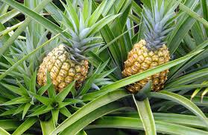
Specific objectives
Component 4: Incorporate product environmental labels for present and future markets.
Component 5: Promote financing schemes for the transformation of new business models with local and regional partners (private and public banks).

Slide 7
Enabling framework
Policy framework:
National Development Plan 2015-2018
VI National Energy Plan 2012-2030 (MINAE-DSE)
Biofuels Law (Proposal) No.18789.
V Non-Conventional Renewable Sources Plan (ICE)
VI Expansion Plan (ICE)
National Climate Change Strategy (MINAE-DCC)
Convention Ratification:
Law Nº 8219 Kyoto Protocol
Law Nº7414 Climate Change Framework
Costa Rica National Constitution:
Article 50
Others

Slide 8
Development steps
LEDS context NAMA design MRV requirements
10 steps to a NAMA
10. Good practices
9. Implement and MRV
Success factors
8. Send NAMAs to the registry
7. Support needs identification
6. Detail the NAMA planning
5. Design an MRV plan
4. Define a baseline
3. Identify the potential NAMAs
2. Evaluate the technical potential for emission reductions and co-benefits
1. Evaluate the policy gaps, framework conditions and identify required actions
Siglas

Slide 9
Identification of barriers
Financing:
Low involvement of the Development Bank initiative regarding low emissions production, transformation or retrofit.
Tariff implementation challenge with ARESEP.
Information and knowledge management:
Technology transfer and development are limited and not widely applied within the sector.
Unexpected potential from COMEX and PROCOMER on eco-labelling and the upcoming requirements in the EU (e.g. PEF)

Slide 10
Some barriers
Technical assistance:
Lack of specialized services (e.g. laboratories)
Capacity building needed on the productive uses of organic agricultural residues.
Little knowledge of productive associative benefits
Low awareness on processes to measure the carbon footprint (e.g. products)
Otros...

Slide 11
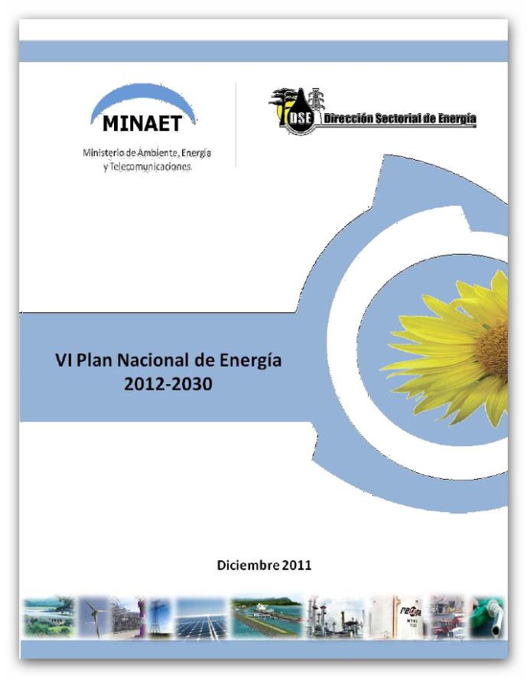
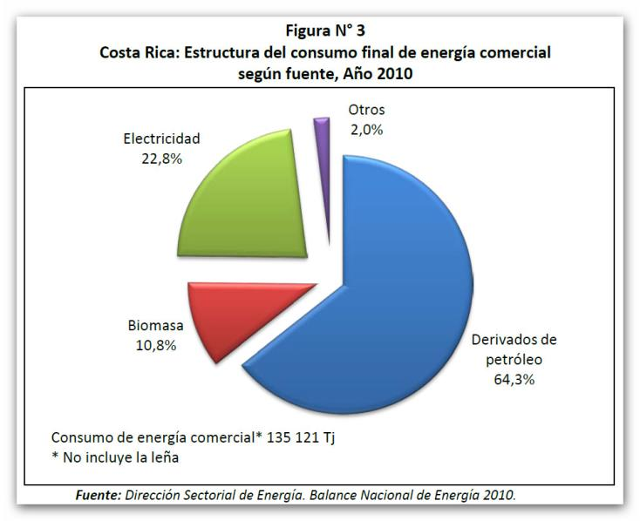
VI National Energy Plan 2012-2030

Slide 12
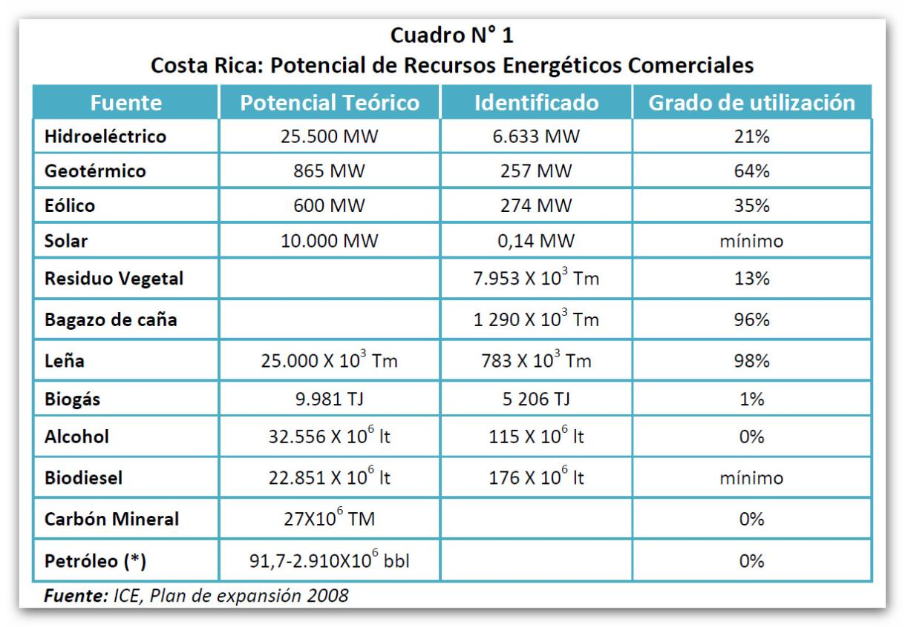
VI National Energy Plan 2012-2030

Slide 13
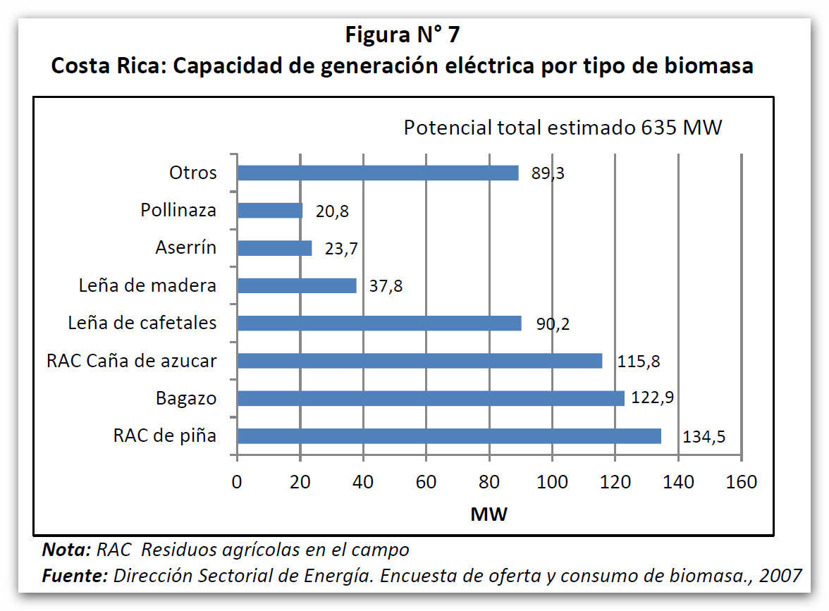
VI National Energy Plan 2012-2030

Slide 14
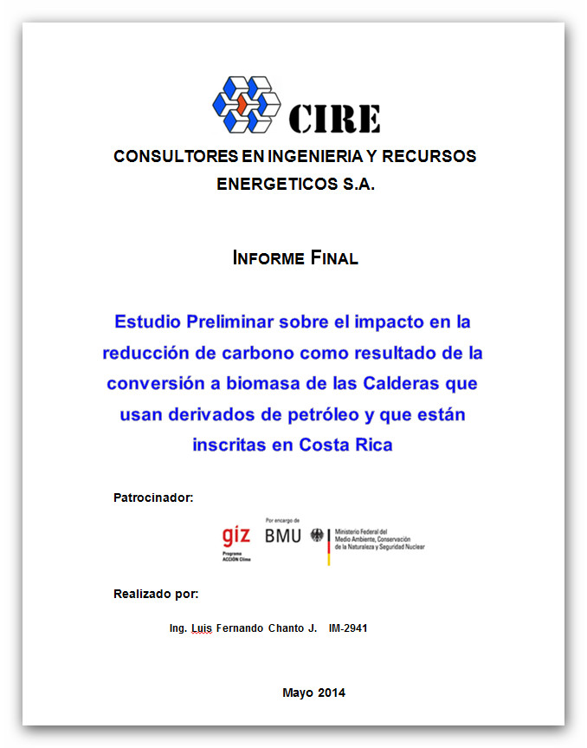
Dry biomass mitigation potential
Boiler
fuel
switching

Slide 15
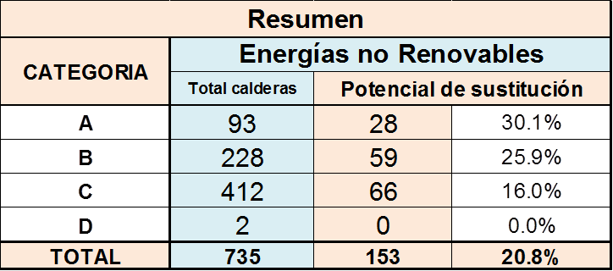
Dry biomass mitigation potential
Wood residues
Tabla 3.10 Resumen del potencial de sustitución de calderas

Slide 16
Dry biomass mitigation potential
Wood residues
With an average use of 50% per year and 50% load
Accounting 20% of the boilers registered
Savings switching from bunker to pellets ± 12%
Displacing fossil fuel with a CO₂ potential mitigation of 90,415 Kg/hr
For a total mitigation of 247,500 t CO₂ per year

Slide 17
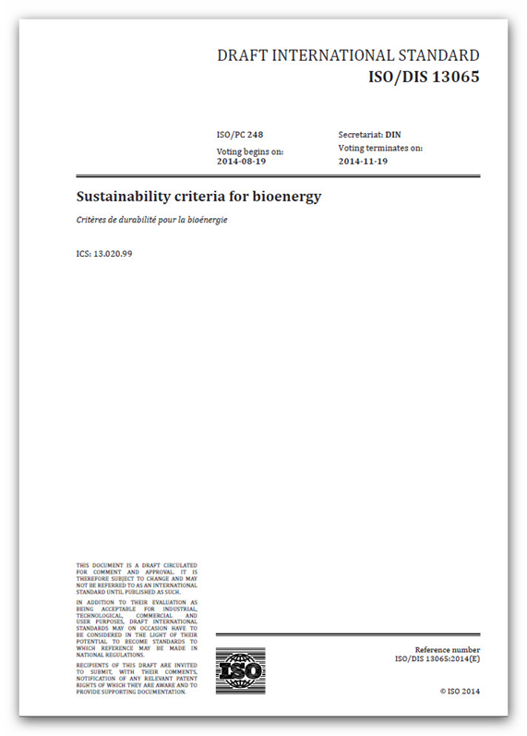
MRV System
ISO/DIS 13065 Sustainability criteria for bioenergy
The production and use of bioenergy have potential roles in mitigating climate change, promoting energy security and fostering sustainable development.
Virtually every country in the world uses some form of bioenergy. Various types of biomass are used for the production of bioenergy through many types and sizes of economic operations. The characteristics of bioenergy production therefore are heterogeneous and depend on several factors, such as geographic location, climatic conditions, level of development, institutional frameworks and technological issues.

Slide 18
MRV System
6.6 Functional and delivered units
Functional units are used as reference units to quantify the performance of a product system. A system can have a number of possible functions; functional unit(s) selection depends on the goal and scope of the GHG assessment.
Examples of functional units:
— 1 kWh of electricity provided by a power plant to the grid
Delivered units may be used when reporting a partial carbon footprint.
Examples of delivered units are:
— Volume of liquid bioenergy
— Mass of pellets
GHG emissions should also be reported on the basis of 1 MJ of energy delivered.

Slide 19
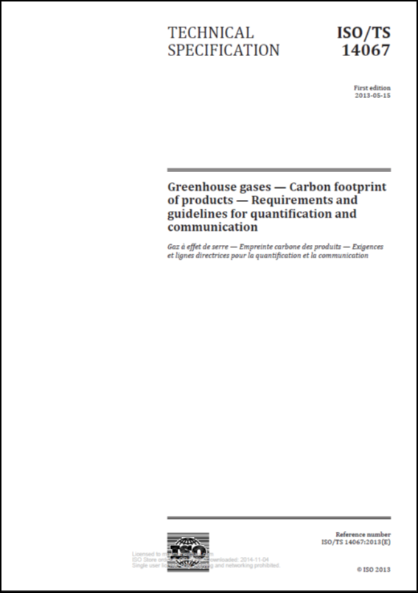
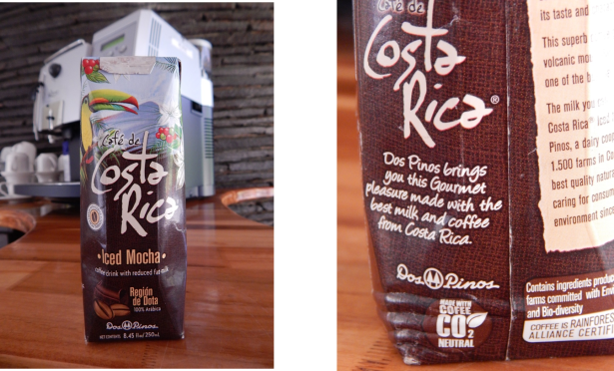
Product GHG emissions
ISO/TS 14067 Greenhouse gases – Carbon footprint of products – Requirements and guidelines for quantification and communication
Include the bioenergy contribution to the mitigation of final agricultural and livestock products GHG emissions.
Check for consumer interest and market sensitivity for low carbon emission products.

Slide 20
Next steps:
Obtain the allocation of funds from local and regional banks for investments and match making with international resources in a negotiated ratio
Consider the boundaries for a program with international support and the proper synergies with present NAMA initiatives (e.g. NAMA Coffee)
Define the steps to have the capacity for product certification with GHG emissions and claims in agricultural and livestock products
Develop the final proposal to the interested parties in supporting the initiative (e.g. NAMA FACILITY, EURO CLIMA, AECID among others)

Slide 21
Grupo MESA NAMA Energía-Biomasa
Thank you!!!
With support from:

Slide 22
National Development Plan 2015-2018

Slide 23
National Development Plan 2015-2018

Slide 24
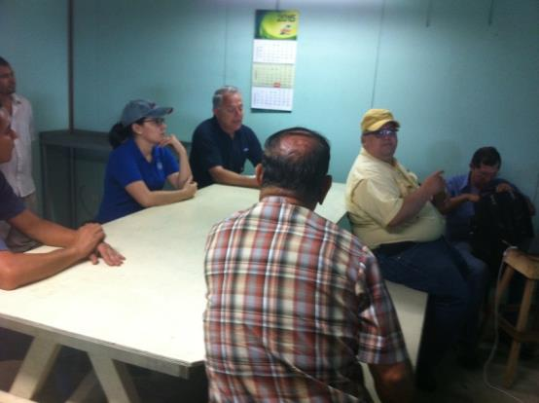
Proceso a realizado…
3 Talleres de consulta realizados
1 Encuesta al sector de grandes productores
1 Documento de sistematización de posibles arreglos de las brechas y esquemas tarifarios
20 sesiones de trabajo de la MESA con distintos actores de los sectores

