Slide 1
Status of NAMA preparation and Implementation
Gerardo Canales
Manager, Latin America Projects

Slide 2
Outline
CCAP’s MAIN program
Status of NAMAs
  Colombia TOD NAMA
  Chile Self Supply Renewable Energy NAMA
  Thailand Refrigerators and A/C NAMA
  Renewable Energy: Kenya Geothermal NAMA
  Waste NAMA
  Green Resilience
Shared Vision of Transformational NAMAs
NAMA Finance is Flowing
Conclusions on NAMAs

Slide 3


Mitigation Action Implementation network
Goals:
Create regional networks of policymakers involved in NAMAs (Asia, Latin America)
Build national capacity to identify, design and develop financeable NAMAs
Facilitate financing for implementation of early NAMAs
Impact the design of the GCF and other NAMA/climate finance programs
Components:
Regional dialogues of policymakers, experts, potential funders
Video conferences with policymakers
Harvesting of best practices, case studies, policy analysis, policy papers
4. On-the-ground support for NAMA design, in-country workshops
5. Global dialogues, policy lunches for negotiators

Slide 4
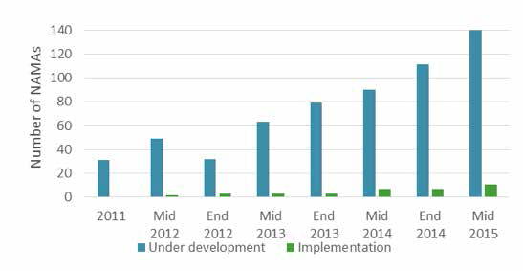
Status of NAMAs
Source: Ecofys/ECN NAMA Status Mid Year update 2015
Source: Ecofys NAMA Database September 2015
The number of NAMAs under development is rising
Latin America has been most active in NAMA development
The number of NAMAs under implementation is growing though small
Funding has primarily come from the path breaking UK-Germany NAMA Facility
  The GCF presents a major new opportunity

Slide 5
Status of NAMAs
Energy and transport NAMAs represent more than half of the portfolio
As of 2015, around 158 NAMAs are developed or in process, with at least 124 seeking implementation support
Source: Ecofys NAMA Database September 2015

Slide 6
Transformational NAMAs
  Are host country-driven efforts to reduce GHGs and advance sustainable development.
  Apply technical assistance to surmount implementation barriers and foster replication.
  Finance catalytic projects for short-term results.
  Transform policies to sustain GHG reductions.
  Mobilize private investment through financing mechanisms that change the risk-return equation.
  Leverage public investments (e.g., infrastructure)
  Create a pipeline of investments for private sector, development banks and climate financiers.

Slide 7

Colombia transit-oriented development
(TOD) NAMA
TOD focuses public and private development
around transit stations to create neighborhoods
where people ca walk, live, work, shop and play.
Colombia TOD NAMA
Catalytic local pilots and transformative policies
“CIUDAT” housed in Findeter governed by Executive Board
(Transport, Environment, Housing, Planning, Findeter, CCAP)
Increase return on public and private investments
  Leverage $16 billion investments in public transport, social housing
  Help focus $500 million in Sustainable Cities funds (IDB)
  Help attract private real estate investment
Annual savings of 3.6 to 5.4 MMTCO2e by 2040
NAMA gives Colombia ability to choose best projects that meet criteria to maximize GHG mitigation and financial leverage– a model for direct access
Status: Pre-selected by NAMA Facility, finalizing appraisal
ITDP
DOs: KfW, CCAP
Implementing: FINDETER

Slide 8






Chile Self Supply Renewable Energy NAMA
Structure
Components
Activities
Expected Outputs
Institutions
Development of a bankable project pipeline
Training and advisory services for financial sector
Investment grants
Guarantee fund
Leverage of around USD$100 million
GHG reduction of 1.5 million tons of CO2e
develop a bankable project pipeline
Financial Component
KfW
SSRE NAMA
CORFO
Centre for Innovation & Promotion of Sustainable Energy (CIFES)
Outreach and awareness
Training and capacity building
Technical help desk
Monitoring, reporting and verification
800 people outreached
300 people trained
200 projects supported trough the technical help desk
Rise a project pipeline of 200 MW for Financial Component
All SSRE projects incorporated into de MRV platform
Technical Component
GIZ

Slide 9
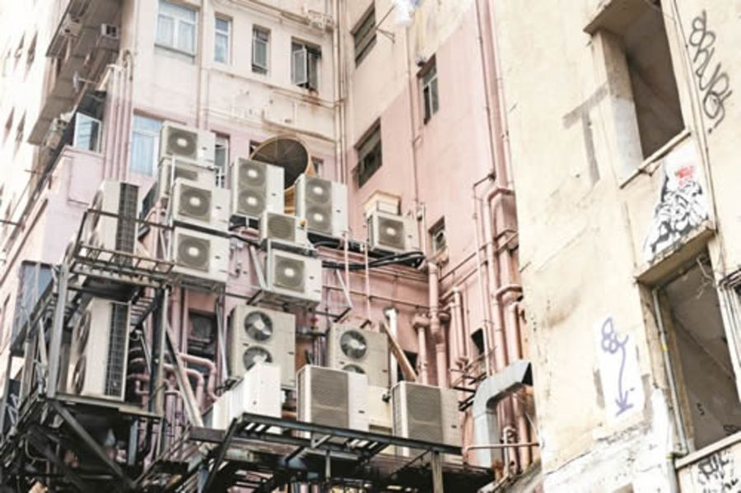
thailand refrigerator and a/c
Emissions account for 20% of country total
Four areas of activity
  Production of green equipment
  Servicing and use
  Revisions to policy and Financial Framework
  GreenRAC Innovation Fund:
  7 X NAMA Funding
  Raising awareness
Anticipated GHG Mitigation:
  2 MtCO₂e per year by 2020
  46 MTCO / year by 2030
Status: In Appraisal
Source: NAMA Facility
DO: GIZ
Implementing: DEDE and EPPO

Slide 10

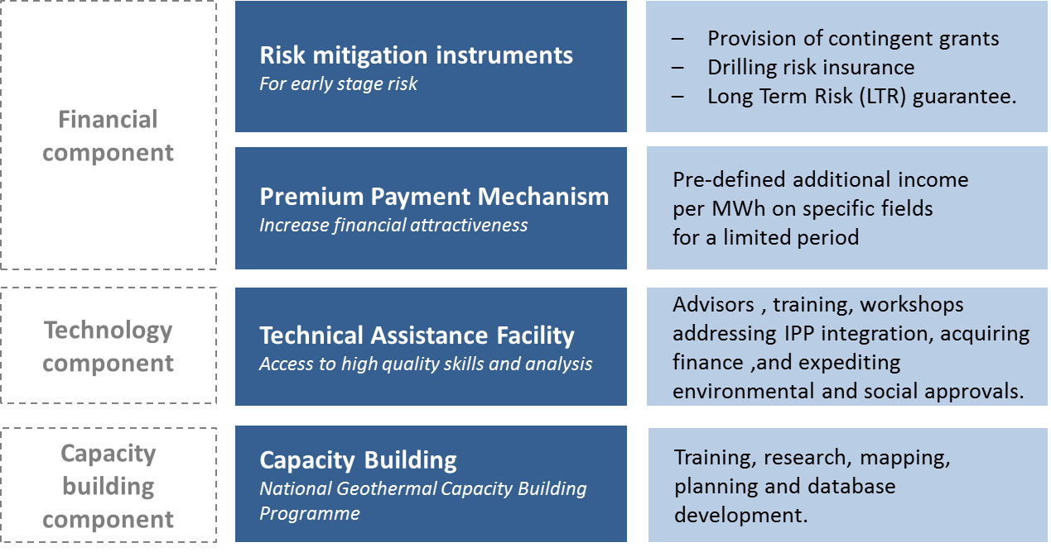
kenya geothermal nama
Geothermal is best technology to keep Kenyan energy sector low-carbon
NAMA Supports 850 MW expansion of private geothermal capacity by 2020
Employs technical assistance, risk guarantees for costly drilling, and capacity building
3.8 MtCO2e/yr in 2020
Enhance climate resilience
Status: In Development
Source: NAMA Facility
Partner:
ECN Policy Studies

Slide 11
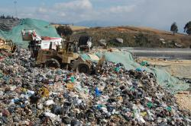
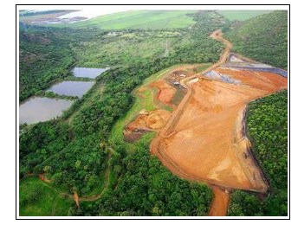
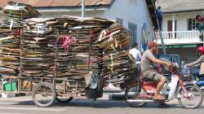
Waste NAMAs
Source: Mitigation Partnership
Source: CCAP
Source: Mitigation Partnership
Shift Solid Waste Management to waste reduction alternatives to reduce landfilling
Create equity fund to support alternative projects
Regulatory changes (e.g., increased tariffs, landfill tax charges) to make alternative technologies economic
Mitigation: significant sectoral reduction if fully implemented
Status: Under development in several countries

Slide 12
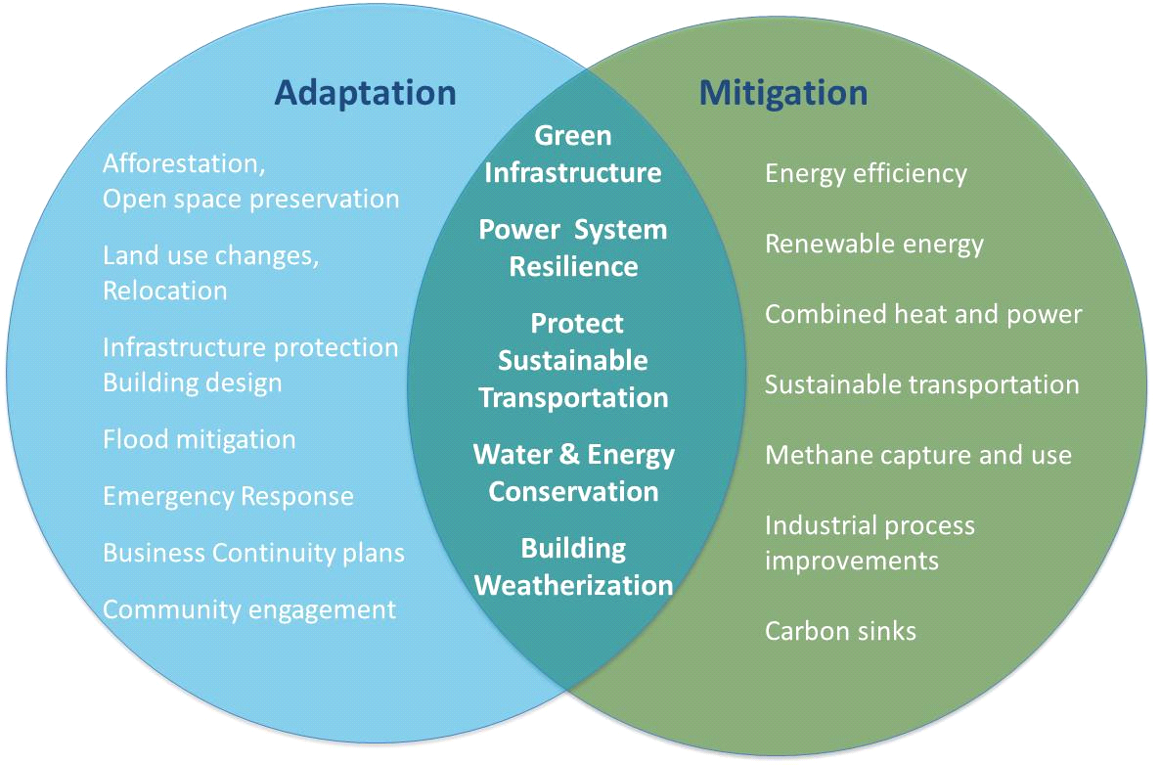
Green resilience opportunities:
Adaptation + mitigation Synergies

Slide 13

Climate Finance is Flowing
NAMA Facility
  Pre-selected 4 projects in its 2nd round, announced in Lima:
    Burkina Faso – Biomass Energy
    Peru – Sustainable Urban Transport
    Tajikistan – Forestry NAMA
    Thailand – Refrigeration and AC
  Denmark and EC have joined to support €85 million 3rd round
  Third call for proposals was opened through July 15, 2015. 42 project proposals submitted, of which 45% from Africa, by far the most of the three rounds.
  Has demonstrated demand for NAMA finance
Green Climate Fund (GCF)
  GCF operationalization holds great promise for NAMAs
  $10.3 Billion USD pledged to date
  Board expected to select first programs/projects in fall 2015
  $6 billion of initial resources need to be spent by 2017 to start next replenishment.
    200 x $ 10 million projects = $2 billion
    25 x $ 40 million programs = $ 2 billion
    10 x $200 million programs = $ 2 billion

Slide 14
GCF and Uk-German Nama Facility have similar selection criteria
  Both selection processes are competitive with similar criteria:
    Paradigm Shift / Transformational ambition
      strong regulatory framework
    Sustainable Development
    Country Ownership
    Catalyze private sector investment
    GHGs
    Need (GCF only)
  GCF requires 50% of finance flows to adaptation and half of that to LDCs (NF finances only mitigation)

Slide 15
Conclusions on namas
NAMAs should be bold – They should transform existing structures that prevent mitigation (e.g. fossil fuel subsidies, anti-competitive regulations, etc.) and create policies that drive low carbon outcomes
NAMAs should be at a program scale – By funding programs, rather than specific projects, the funder can achieve greater scale, replication, and overall ambition.
  Programs should incorporate policy changes, new financial mechanisms, and some bankable projects.
  Host country institutions should be empowered to select additional domestic projects, based on program criteria that the funder has approved (rather than the funder making investment decisions on each specific project)
NAMAs should not only leverage private sector and other funding but also demonstrate “paradigm shift”. Need to avoid business as usual proposals that show leverage but not transformation.

Slide 16
Namas in a post-2015 context
NDC
Investment Strategy
Selection for funding
INDCs
Many INDCs are likely to be quantitative but may not include specifics on sector-specific policies
Some developing countries are likely to propose INDCs with elements conditional on international support
Conditional INDC elements will likely need to be translated into investment strategies after Paris for consideration by GCF and others
The NAMA Facility has served as an important laboratory – it could continue to test bold ideas on financing and NAMA design in the future
To increase ambition, need a competitive “race to the top” -- GCF provide the “carrot” for transformation

Slide 17
Thank you
For more information,
please visit us at
www.ccap.org

