Slide 1
Best practices and approaches to identify, quantify, monitor and report the SD benefits of NAMAs
Miriam Hinostroza & Karen Olsen
UNEP DTU Partnership
Latin American Carbon Forum
31 August – 2 Setpember, 2014

Slide 2
Outline:
Issues and challenges
Overview of approaches to measure SD benefits:
  CDM SD tool applied to NAMAs
  A co-benefits approach to NAMAs
  Development Impact Assessment (DIA) Visual
  Methods to monetize the SD co-benefits – by the Gold Standard & South Pole
Exercise and discussion
  Apply an expanded CDM SD tool to analysis of a NAMA
  Discuss the needs & challenges for quantification of SD benefits

Slide 3
Issues and Challenges
Development First!
  “We should cooperate in achieving the peaking of global and national emissions as soon as possible, recognizing that the time frame for peaking will be longer in developing countries and bearing in mind that social and economic development and poverty eradication are the first and overriding priorities of developing countries and that a low-emission development strategy is indispensable to sustainable development” (Source: 2/CP.15, paragraph 2)
How to identify, design and assess the SD co-benefits of NAMAs to achieve the most development benefits?
How to ensure private and civil society stakeholder involvement in government-driven NAMAs?
How to MRV the impacts of GHG reductions and co-benefits for transformational change towards low carbon and sustainable development?

Slide 4
Overview of approaches to measure
SD co-benefits – CDM and NAMAs
 | CDM SD Tool | A co-benefits approach to NAMAs | DIA Visual | Gold Standard | South Pole
Data | CDM Project Design Document (PDD) | Technology options - Stakeholder prioritization | Technology options - Expert judgement and available data | Categories of CDM projects | Empirical data for waste projects
Method | SD indicators - qualitative description | Multi Criteria Analysis (MCA) | SD indicators - structured prioritization | Monetary valuation - transfer pricing | Valuation -willingness to pay
Key stakeholder | CDM Project developer | NAMA developer | LEDS/NAMA developer | Experts | Experts

Slide 5
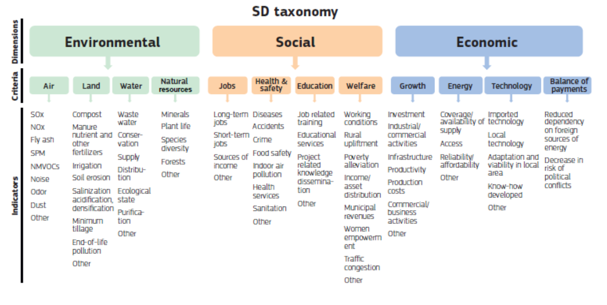
CDM SD Tool
  Source: Approved at CDM EB70: https://www.research.net/s/SD_tool_vers7

Slide 6
Example of SDC report: - air quality
Improved cook stoves programme in India

Slide 7
A co-benefits approach
Source: Dubash et. al. (2013): “Indian Climate Change Policy. Exploring a Co-benefits Based Approach”, Economic & Political Weekly, June 1, 2013

Slide 8
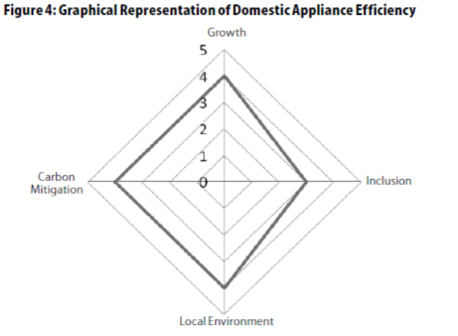
Example of co-benefit assessment

Slide 9
DIA Visual
Source: Cameron et al. (2014): “Visualising Development Impacts: Experiences from country case studies.” Conference Paper, MAPS, January 2014, Cape Town

Slide 10
Gold Standard –valuation of co-benefits
Source: The Gold Standard, (2014): “The real value of robust climate action”. A Net Balance Report for the Gold Standard Foundation

Slide 11
Method of valuation – benefit transfer
Valuation and monetisation are assumed to bring interesting perspectives and new angles to assess the merits of mitigation actions and how to manage them
Non-market valuation techniques remain the only currently widely accepted way to put a value on intangible benefits
‘Benefit transfer’ requires a strict control of the similarity between the two environments, where the value is transferred and is based on case by case studies

Slide 12
South Pole –monetizing approach to waste sector NAMAs
Mitigation actions are driven by sustainable development benefits that need to be monetized:
Identify who is willing to pay for the SD co-benefits
Determine the willingness to pay per unit of created co-benefit
Facilitate a transaction of this willingness to pay to the producer of the co-benefits
“Willingness to pay” for co-benefits is determined as the existing spending within the current public budget or if privately generated through private spending.
Source: Draft discussion paper presented at side event in Bonn, 7 June 2014 titled: ‘Quantifying and monetizing NAMA co-benefits’

Slide 13
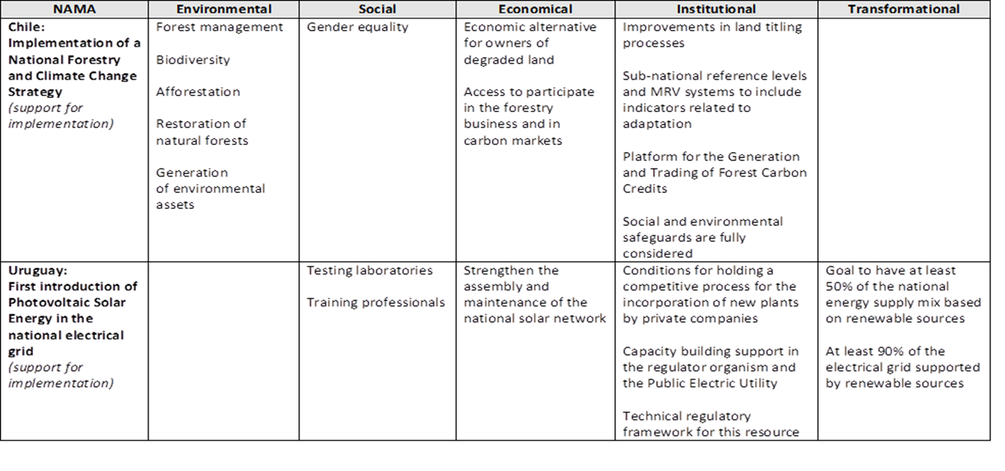
Exercise:
Apply the CDM SD Tool to NAMAs

Slide 14
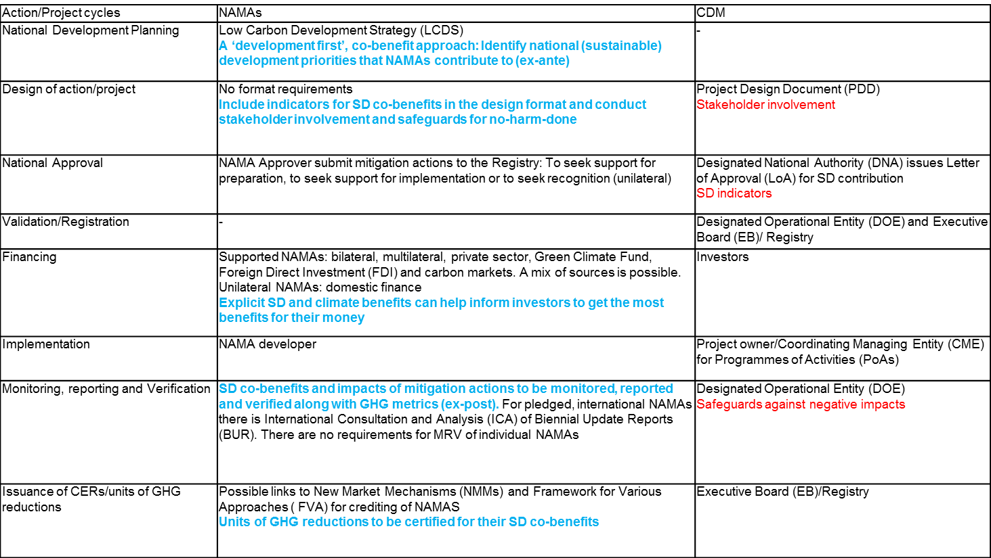
An integrated approach
comparing the CDM and NAMA action cycles three elements are proposed for ex-ante and ex-post assessment : 1) SD indicators, 2) Stakeholder involvement & 3) Safeguards

Slide 15
Case example
Steps:
Split into groups
Read the NAMA case example
Identify SD co-benefits using the CDM SD Tool with two more dimensions: 1) Institutional and 2) Transformational
Identify country needs for SD co-benefit assessment: 1) ex-ante (NAMA preparation – design stage) and 2) ex-post (NAMA implementation – impact assessment)

Slide 16
Discussion
How applicable is the CDM SD Tool to NAMAs? – what is missing?
What are the needs for quantification/valuation of SD co-benefits of NAMAs?
Which stakeholders should be involved at what stage in the NAMA cycle to assess co-benefits and possible negative impacts?
How to ensure mitigation actions do not have negative impacts for local communities and the environment?

