Slide 1









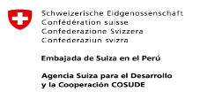




Long Term Mitigation Scenarios for Peru
Maria Elena Gutierrez
Research Coordinator
mgutierrez@libelula.com.pe

Slide 2
CONTENT
PLANCC: structure and results
NAMA - initiatives in Peru
INDC in Peru
Private initiatives on mitigation

Slide 3
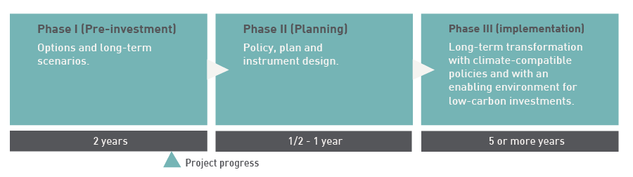
PlanCC Phases
PlanCC has as main objective build the scientific bases, policies and capabilities to explore the feasibility of an "clean" or "low carbon" economy and incorporate the approach to climate change in the planning of the country

Slide 4








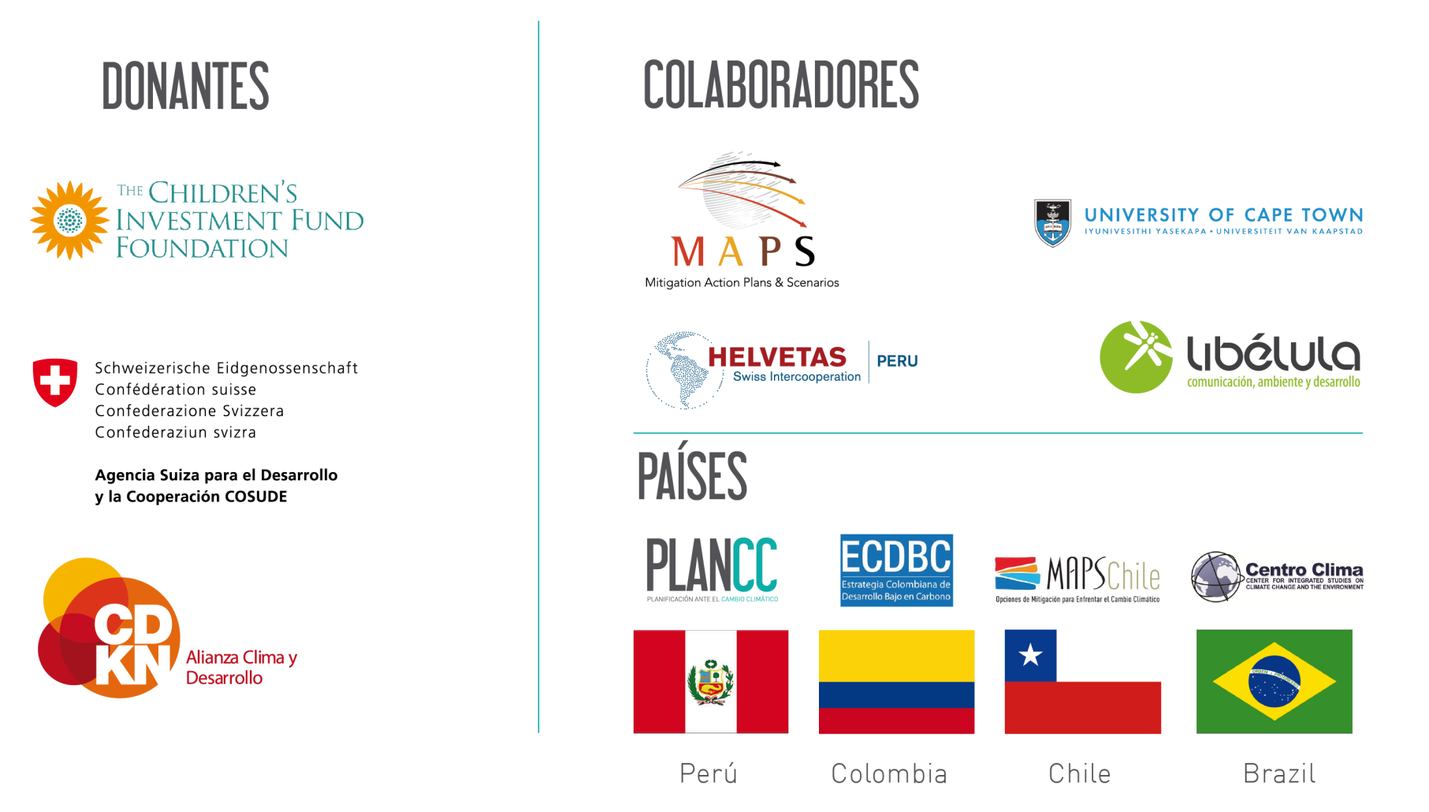
Comunidad PlanCC
INVESTIGACIÓN
DONANTES
COLABORADORES
PAÍSES

Slide 5
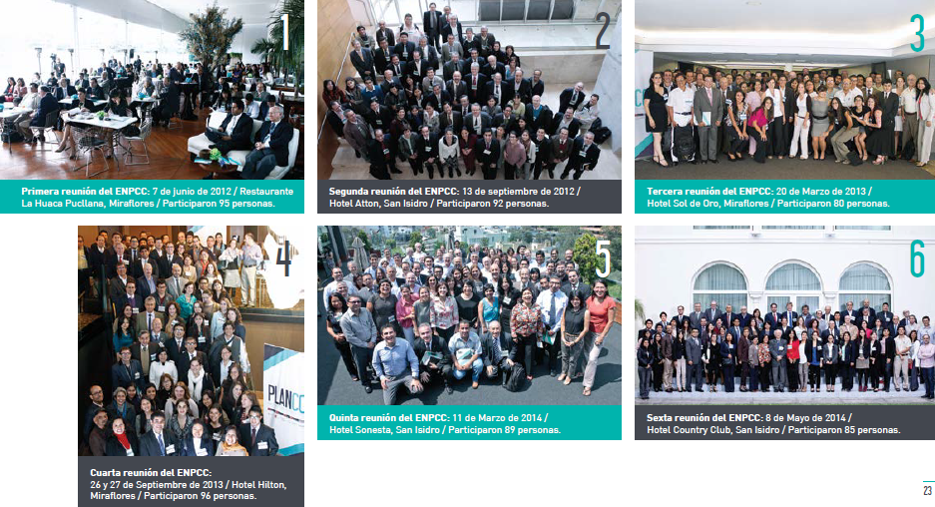
National Prospective Team (ENPCC)
January 2012 – July 2014

Slide 6
Reference Scenario (BAU)
ESCENARIO BAU – ANALISIS DE SENSIBILIDAD

Slide 7
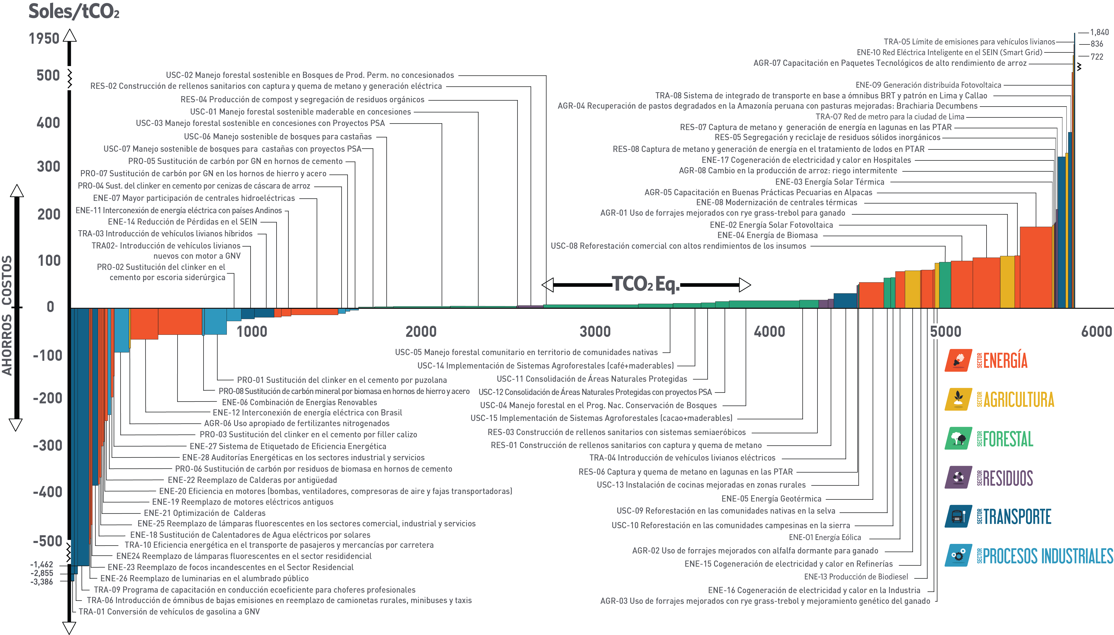
Marginal Abatement Cost Curve (MACC)

Slide 8
PLANCC: Long Term Mitigation Scenarios 2050
MtCO2eq
BAU 9,932 MM
Fast Sc. ↓ 10%
Savings Sc. ↓ 20%
Sustainable Sc. ↓ 41%
RBS Sc.
Sustainable Scenario was recommended

Slide 9
Computable General Equilibrium Model (CGE)
BAU Projections
Social Accounting Matrix (SAM)
General Equilibrium Model
Mitigation Scenarios
GDP and Population Projection
Matriz IO Matrix, National Accounts
Model Structure
Emission Reductions
Emission Projectios
SAM
Calibration
CGE
Results
Emission Inventory
Emissions
Mitigation Measures
Socio economic Impacts
BAU Scenario replica
Bottom-up and top-down methodologies
SAM 2007 with emissions by sector
Quasi-dynamic CGE including LULUCF sector
Scenarios

Slide 10
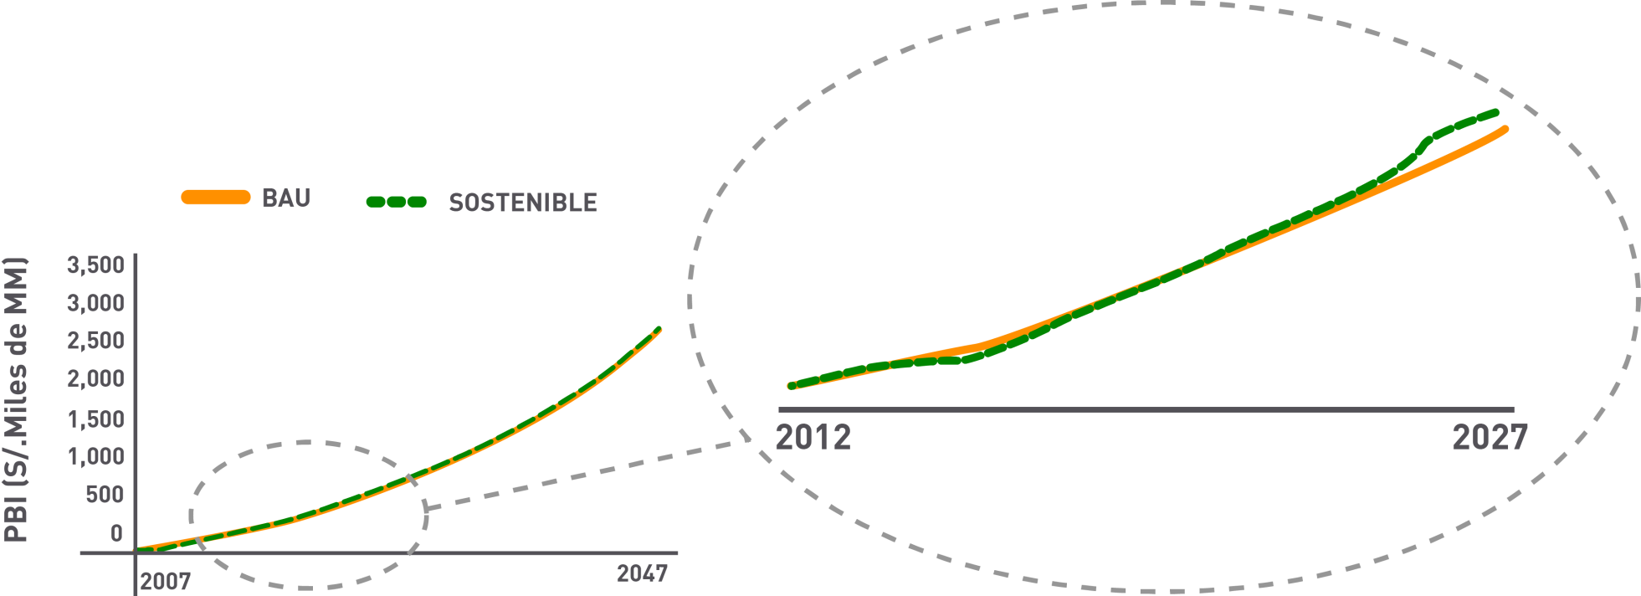
Impacts on GDP (sustainable scenario)
sustainable
In the Sustainable Scenario, the GDP would rise annually between 0.3% and 0.8% in addition to BAU projection from the year 2022 until 2050.

Slide 11
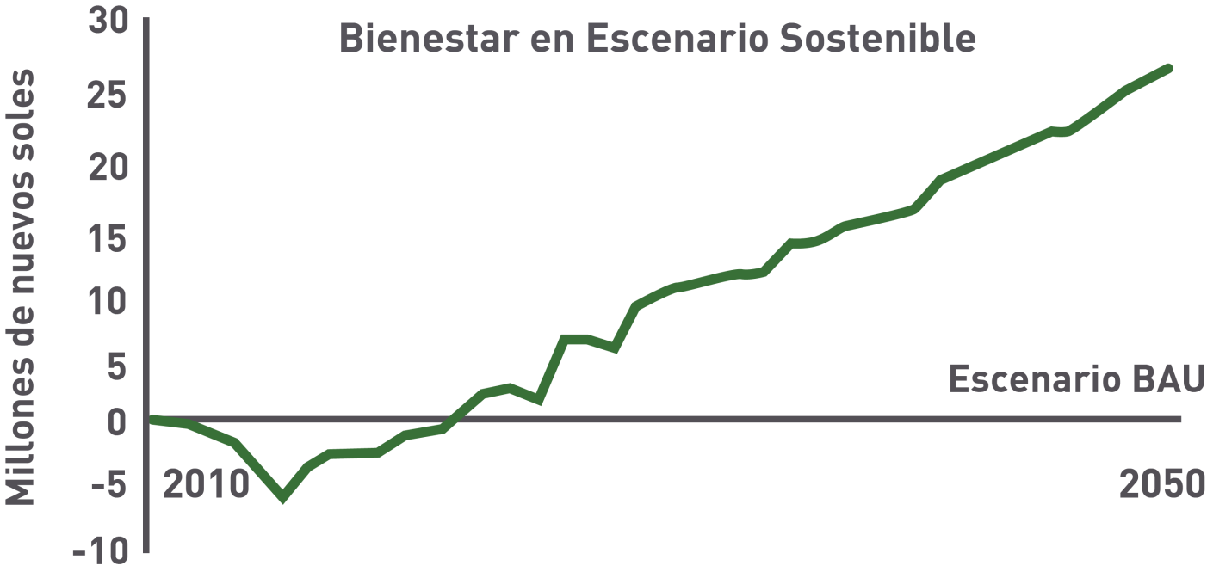


Cobenefits Analysis
Welfare improved of population in the long term
2050 → Urban population will increase by 60% while their solid waste will increase in 180%
The appropriate disposal of solid waste will increase from 38.8% to 51% in the sustainable scenario
Decrease of travel time in urban transport in Lima

Slide 12
Competitiveness of Mitigation Actions (ongoing study)
Índice de competitividad por países
On Process. By Apoyo Consultoría/CDKN

Slide 13
Competitiveness of Mitigation Actions (ongoing study)
On Process. By Apoyo Consultoría/CDKN

Slide 14
2. NAMAS INITIATIVES
Sector | Initiative | Executor | Status | In accordance with sectoral goals
Housing | Sustainable Construction NAMA | Ministry of Housing and Construction | Proposal | High
Housing | Sustainable Buildings NAMA | Ministry of Housing and Construction | Proposal | High
Industry | Bricks Production NAMA | Ministry of Production | Design | High
Industry | Cement NAMA | Ministry of Production | Concept | High
Industry | Iron and Steel NAMA | Ministry of Production | Concept | High
Energy | Bioenergy NAMA | Ministry of Energy and Mines | Proposal | High
Energy | Energy Generation and End Use | Ministry of Energy and Mines | Design | High

Slide 15
2. NAMAS INITIATIVES (cont.)
Sector | Initiative | Executor | Status | In accordance with sectoral goals
Transport | Transport NAMA - Transfer II Project | Ministry of Transport and Communication | Negotiation (Pre implementation) | High
Agriculture | Coffee NAMA | Ministry of Agriculture | Concept | High
Agriculture | Cacao NAMA | Ministry of Agriculture | Concept | High
Agriculture | Palm NAMA | Ministry of Agriculture | Concept | High
Agriculture | Livestock NAMA | Ministry of Agriculture | Concept | High
Waste | Waste NAMA | Ministry of Environment | Design | High

Slide 16
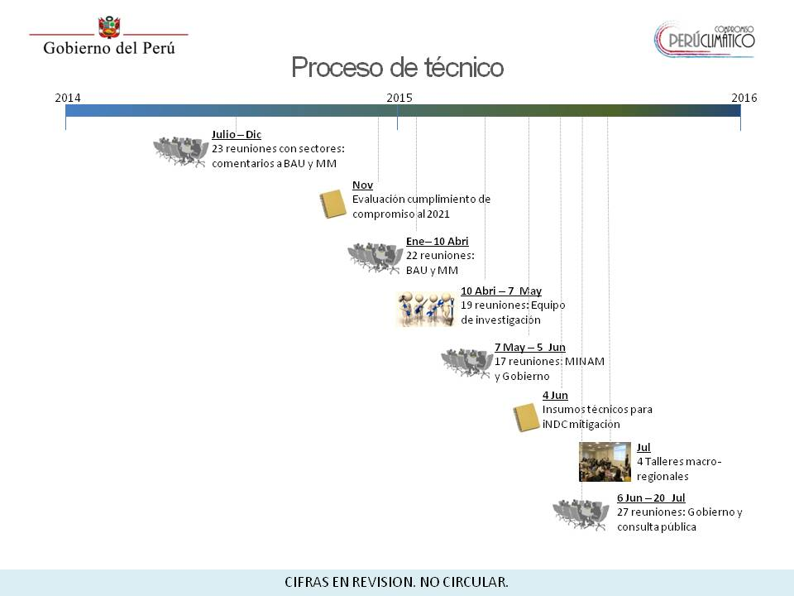
3. INDC IN PERU
Considering PlanCC outputs, a new process started in July 2014 in order to propose a national INDCs on mitigation. New data was considered, including NAMA initiatives

Slide 17
3. INDC IN PERU
Ministry of Environment released a INDC proposal for public consultation (July 2015)
71 mitigation options were taken from PlanCC.
11 additional mitigation options were included.

Slide 18
3. INDC and NAMAS: Comparability
iNDC
(PLANCC)
COMPARABILITY
NAMAS and other initiatives
iNDC (supported by PlanCC) comprise wide information about different sectors, with emissions and costs estimated annually until 2050 .
Reference for comparison/validation of similar initiatives, e.g. NAMAs.
Construction Sector: Wastewater mitigation options (NAMA) vs PlanCC BAU
Waste Sector: Emission comparison for use of IPCC 2006 guidelines (NAMA) vs IPCC 1996 guidelines (PlanCC)
Forestry Sector: Deforestation – reference baseline

Slide 19


4. PRIVATE INITIATIVES ON MITIGATION
Climate Corporate Commitment is a private initiative that aims to build a community of enterprises with commitment on climate change action.
The initiative includes a platform based on a voluntary reporting system that allows to identify how many enterprises are performing actions toward a low-carbon development, who they are, and what they are doing.
www.7c.com.pe

Slide 20

http://www.planccperu.org/

