Slide 1
Workshop on the implications of the implementation of decisions 2/CMP.7 to 4/CMP.7 and 1/CMP.8 on the previous decisions on methodological issues related to the Kyoto Protocol, including those relating to Articles 5, 7 and 8 of the Kyoto Protocol
SBSTA Technical Discussion on Articles 5, 7 & 8
Bonn, Germany, 7 November 2014

Slide 2
Overview of the status of the work as of June 2014 (SBSTA 40)
SBSTA Technical Discussion on Articles 5, 7 & 8
Bonn, Germany, 7 November 2014

Slide 3
Mandate
Initiation of the work at SBSTA 36 (requested by CMP7, Durban)
Initial work to assess and address the implications of the implementation of decisions 2/CMP.7 to 5/CMP.7 on the previous CMP decisions on methodological issues related to the Kyoto Protocol, including those relating to Articles 5, 7 and 8.
Decision 2/CMP8
Continuation by SBSTA to assess and address the implications of the implementation of decisions 2/CMP.7 to 4/CMP.7, as well as those of decision 1/CMP.8, on the relevant decisions adopted for the first commitment period.
Continuation of the work agreed by SBSTA 40
SBSTA 40 agreed to continue its consideration of this agenda item at SBSTA 41 with a view to finalizing draft decisions for consideration and adoption at CMP 10.

Slide 4
Status of work as at June 2014
Decision 2/CMP.8 :
defined the timing and content of the report to facilitate the calculation of the assigned amount for the second commitment period
defined the information relating to the reporting of KP-LULUCF activities that needs to be submitted together with the annual GHG inventory in CP2
Time of submission of the 1st SEF tables for CP2

Slide 5
Status of work as at June 2014
Decision 6/CMP.9 :
adopted the guidance for submission of information on anthropogenic GHG emissions by sources and removals by sinks from LULUCF activities under Article 3, paragraphs 3 and 4, pursuant to Article 5, paragraph 2, of the Kyoto Protocol in the second commitment period,
including the common reporting format (CRF) tables for KP-LULUCF activities

Slide 6
Status of work as at June 2014
Progress of negotiations:
Warsaw: CMP 9 requested SBSTA to continue consideration of the relevant implications on the basis of the “In-session discussion text relating to item 12(a) of SBSTA 39 and item 3(a) of CMP 9”;
Bonn: SBSTA 40 agreed to continue to work on the basis of:
the in-section discussion text (Warsaw), and
the text contained in the “Note by the co-facilitators – elements of text relating to review and adjustment”

Slide 7
Status of work as at June 2014
The in-session discussion text covers:
References regarding CMP 1 decisions 13, 15, 18 and 19
Addresses issues related to the report to facilitate the calculation of the assigned amount
Proposed the adoption of:
Revision to the modalities for the accountings of AA, including
Calculation of the AA pursuant to Article 3.7bis, 8 and 8bis
Cancellation pursuant to 3.7ter
Share of proceeds
CAD and ITL
SEF tables and instructions, registry requirements and additions and subtractions from the Assigned Amount (decision 14/CMP.1)
Revisions to the guidelines for the preparation of the information required under Article 7 (decision 15/CMP.1)
Extends the code of practice for the treatment of confidential information for reviews

Slide 8
Status of work as at June 2014
Note by the co-facilitators covers :
References regarding decisions 20/CMP.1 and 22/CMP.1
Review guidelines under Article 8
Issues related to the review of the report to facilitate the calculation of the AA
Issues related to the review of national system and national registry
The Standard Independent Assessment Report in the review guidelines
Adjustments under Article 5, para. 2, of the Kyoto Protocol

Slide 9
Status of work as at June 2014 - Overview
Negotiations progress and issues not yet adopted
Implications | Decision(s) already adopted | Covered in the in-session discussion text (SBSTA 39/CMP 9) | Covered in the note by the co-facilitators (SBSTA 40)^{b} | Decision at CMP 10 needed? | Outstanding issues to be discussed
References to Articles of the Kyoto Protocol, methodologies of the Intergovernmental Panel on Climate Change and decisions, and any other consequential changes related to references | 1/CMP.8 2/CMP.8 6/CMP.9 | Yes | Yes | Yes | Yes (presentation on the technical paper)
Calculation of the initial assigned amount and the review of the initial report to facilitate the calculation of the assigned amount for the second commitment period | 2/CMP.8 | Yes | Yes | Yes | Yes (presentation on the technical paper)
Carry-over and previous period surplus reserve accounts | 1/CMP.8 | Yes | No | Yes | Yes (presentation on the technical paper)

Slide 10
Status of work as at June 2014 - Overview
Negotiations progress and issues not yet adopted
Implications | Decision(s) already adopted | Covered in the in-session discussion text (SBSTA 39/CMP 9) | Covered in the note by the co-facilitators (SBSTA 40) | Decision at CMP 10 needed? | Outstanding issues to be discussed
Article 3, paragraph 7 ter, in the Doha Amendment | 1/CMP.8 | Yes | No | Yes | Yes (presentation on the technical paper)
Share of proceeds | 1/CMP.8 | Yes | No | Yes | Yes (presentation on the technical paper)
Increases in ambition as referred to in decision 1/CMP.8, paragraphs 7 and 8, and Article 3, paragraphs 1 ter and 1 quater, in the Doha Amendment | 1/CMP.8 | Yes | No | Yes | –

Slide 11
Status of work as at June 2014 - Overview
Negotiations progress and issues not yet adopted
Implications | Decision(s) already adopted | Covered in the in-session discussion text (SBSTA 39/CMP 9) | Covered in the note by the co-facilitators (SBSTA 40) | Decision at CMP 10 needed? | Outstanding issues to be discussed
Land use, land-use change and forestry issues not covered in decisions 2/CMP.8 and 2/CMP.7 or the common reporting format tables | 2/CMP.8 6/CMP.9 | No | No | No | –
Clarification of reporting requirements for Parties included in Annex I to the Convention without a quantified emission limitation and reduction commitment for the second commitment period | 2/CMP.8 | Partly | Partly | Yes | Yes (presentation on the technical paper)

Slide 12
Status of work as at June 2014 - Overview
Negotiations progress and issues not yet adopted
Implications | Decision(s) already adopted | Covered in the in-session discussion text (SBSTA 39/CMP 9) | Covered in the note by the co-facilitators (SBSTA 40) | Decision at CMP 10 needed? | Outstanding issues to be discussed
Implications for the “Guidelines for review under Article 8 of the Kyoto Protocol” | – | No | Partly | Yes | Yes (presentation on the technical paper)
Implications for adjustments under Article 5, paragraph 2, of the Kyoto Protocol | – | No | Partly | Yes | Update of conservativeness factors and use of the 2006 IPCC Guidelines addressed in the technical paper

Slide 13
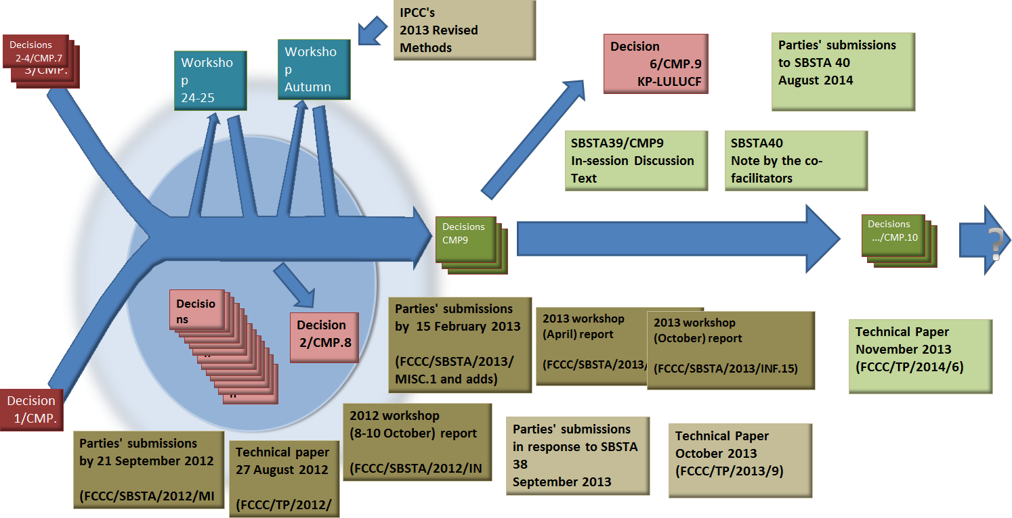

Slide 14
Thank you

Slide 15
Introduction of the technical paper SBSTA 40 conclusions, para. 137(a)

Slide 16
Mandate for the updated technical paper
Technical paper - FCCC/TP/2014/6
To facilitate the finalization of the work for consideration at CMP 10, SBSTA 40 requested the secretariat to update and extend the technical paper FCCC/TP/2013/9 :
reflecting the status of work as at June 2014,
addressing the update of the conservativeness factors contained in appendix III to the annex to decision 20/CMP.1,
reflecting any submissions from Parties on related matters.

Slide 17
Previous versions of the technical paper
Technical paper - FCCC/TP/2012/6
SBSTA 36 requested the secretariat to prepare a technical paper that includes a comprehensive identification of such implications.
Technical paper - FCCC/TP/2013/9
Technical paper mandated by SBSTA 38 and reflecting the progress achieved through the adoption of decisions 1/CMP.8 and 2/CMP.8
Technical paper - FCCC/TP/2014/6
Available at : <http://unfccc.int/resource/docs/2014/tp/06.pdf>

Slide 18
Scope of the update of the technical paper
The previous technical paper (FCCC/TP/2013/9) reflects the progress achieved by adoption of decision 2/CMP.8.
The present technical paper focuses on reflecting the progress in the negotiations achieved through decision 6/CMP.9 and the in-session text and the note by the co-facilitators
Distinction is made between :
the issues resolved by the adoption of decisions 2/CMP.8 and 6/CMP.9, and
the issues advanced but not yet adopted (the in-session discussion text and the note by the co-facilitators from SBSTA 40)
Notes:
In-session comments:

Slide 19
Contents and structure of the technical paper
Technical paper FCCC/TP/2014/6 addresses:
Addressing references (decisions, Articles of KP, IPCC methodologies, etc)
Substantive implications of decisions 2/CMP.7 to 4/CMP.7, 1/CMP.8 and 2/CMP.8. The following subsections were updated:
Calculation of the initial assigned amount and review of the report to facilitate the calculation of the assigned amount
Carry-over and previous period surplus reserve accounts (PPSR)
Article 3, paragraph 7 ter
Share of proceeds;
Any increases in ambition related to Article 3, paragraphs 1 ter and 1 quater
LULUCF issues not covered in decisions 2/CMP.8 and 2/CMP.7 (no pending issues)
Clarification of reporting and review requirements for Parties included in Annex I to the Convention (Annex I Parties) without a QELRC for CP2
Notes:
In-session comments:

Slide 20
Contents and structure of the technical paper
Technical paper FCCC/TP/2014/6 addresses new issues:
The relevant implications for the review process under Article 8 of the Kyoto Protocol;
The issues relating to adjustments and conservativeness factors.
The issues relating to training programme established under decision 8/CMP.5
Notes:
In-session comments:

Slide 21
References
The approach for addressing references has been consistent in adopted decisions (2/CMP.8 and 6/CMP.9) and working documents
Defining general changes and updates in the overarching part of the decisions
Identifying changes to specific references in the annexes whenever these apply to a single previous decision
Progress has been made in identifying the remaining consequential changes to references
both the in-session discussion text and the note by the co-facilitators
Notes:
In-session comments:

Slide 22
References
However, the TP identify 3 additional updates of references to ensure full comprehensiveness:
In paragraph 3 of the note by the co-facilitators, decisions 18/CMP.1, 19/CMP.1, 20/CMP.1 and 22/CMP.1 should be included in the update of references identified under that paragraph;
In paragraph 69(b) of the annex to decision 22/CMP.1, the reference to the IPCC Good Practice Guidance and Uncertainty Management in National Greenhouse Gas Inventories (hereinafter referred to as the IPCC good practice guidance) should be replaced by a reference to the 2006 IPCC Guidelines;
In paragraph 14(a) of the annex to decision 19/CMP.1, the reference to chapter 7, paragraph 7.2, of the IPCC good practice guidance should be replaced by a reference to chapter 4.3 of the 2006 IPCC Guidelines.
Notes:
In-session comments:

Slide 23
Calculation of the initial assigned amount
Decisions and the in-session document have addressed some related issues:
Report to facilitate the calculation (decision 2/CMP.8)
Calculation of the AA pursuant to Article 3, paragraphs. 7 bis, 8 and 8 bis;
Cancellation pursuant to Article 3, para. 7 ter;
Recording of the assigned amounts
Additions/subtractions from, the AA and basis for the compliance assessment
Share of proceeds
Carry over and previous period surplus reserve accounts (PPSR)
Notes:
In-session comments:

Slide 24
Calculation of the initial assigned amount
Issues that may need to be addressed relate to:
Review of these issues in the modalities of the review of the report to facilitate the calculation of the assigned amount and implications on adjustments
Information to be reviewed
Notes:
In-session comments:

Slide 25
Review guidelines and adjustments
Proposals related to review and adjustments are included in the note by the co-facilitators:
Review of the report to facilitate the calculation of the initial assigned amount;
Review of national system and national registry;
The use of SIAR reports in reviews.
Notes:
In-session comments:

Slide 26
Review guidelines: UNFCCC review guidelines
UNFCCC guidelines for technical review of GHG inventories from Annex I Parties
The review guidelines under the Convention and those under the Kyoto Protocol cover common areas such as:
Organization of reviews (desk reviews, centralized reviews and in-country reviews)
The scope of the review phases, and
The timing of the reviews.
Submission by Parties:
Any agreement under the Convention should also apply under the Kyoto Protocol;
Keeping the same approach to organizing the reviews would allow inventory reviews under the Convention to continue to be conducted in conjunction with those under the Kyoto Protocol;
When addressing procedural issues, the KP review guidelines should only refer to the review guidelines under the Convention review guidelines.
Notes:
In-session comments:

Slide 27
Review guidelines: identified issues for consideration
The technical paper and submissions by Parties identified the following issues for particular consideration
Objectives;
Expert review teams, including the composition, competencies and role of experts and lead reviewers
The role of the secretariat;
General procedures;
periodicity of the reviews;
The stages;
The scope, timing and reporting procedures for each review stage;
Timing and procedure of the initial review;
Issues related to the review of national inventory systems and national registries and adoption of decision 9/CMP.9 (national communications);
Adjustments: see next presentation;
Notes:
In-session comments:

Slide 28
Reporting requirements for Annex I Parties without QELRC for CP2
Some CMP decisions have clarified the scope of the application of the provisions:
Report to facilitate the calculation of the assigned amount;
Calculation of the assigned amount and linked calculations;
SEF tables;
Reporting on LULUCF activities;
The national system in accordance with Article 5, paragraph 1;
Methodologies for estimating emissions/removals and global warming potentials;
The scope of participation in market-based mechanisms (Decision 1/CMP.8).
Notes:
In-session comments:

Slide 29
Reporting requirements for Annex I Parties without QELRC for CP2
Issues for further consideration:
Article 3, paragraph 1 bis: the overall emissions;
Article 3, paragraphs 1 ter and 1 quarter;
Article 3, paragraph 7 ter;
Applicability and calculation of the CPR
Carry-over of units to subsequent commitment periods
Provisions related to registry requirements, the issuance of removal units (RMUs) and the cancellation of units
Notes:
In-session comments:

Slide 30
Reporting requirements for Annex I Parties without QELRC for CP2
Issues for further consideration (cont.)
Submission of supplementary information required under Article 7 of the Kyoto Protocol, including:
Information on ERUs, CERs, RMUs and AAUs not reported in a SEF table: decision 15/CMP.1, annex, paragraphs 12–20;
Changes in national systems;
(Changes in national registries;
Minimization of adverse impacts in accordance with Article 3, paragraph 14;
Reporting of supplementary information under Article 7, paragraph 2;
The modalities for review and the calculation of adjustments
Notes:
In-session comments:

Slide 31
Thank you

Slide 32
Update of the conservativeness factors methodology and results

Slide 33
Conservativeness factors
Use of the conservativeness factors (para. 54 of the annex to decision 20/CMP.1)
“To ensure conservativeness for the purpose of adjustments, a conservativeness factor should be applied to the specific component of the estimation method used by the Party or to the emission/removal estimate generated by the basic adjustment methods described in section III.A of this technical guidance. For illustration purposes, this approach may be expressed as:
M × CF = Adjusted estimate
Where M is the component of an estimation method used by a Party, or the emission or removal estimate generated by a basic adjustment method in this technical guidance, and CF is the conservativeness factor. “
Notes:
In-session comments:

Slide 34
The need for the update in conservativeness factors
Taking into consideration:
Revised categories and GHGs
Revised UNFCCC reporting guidelines; decision 4/CMP.7
The use of the new IPCC Guidelines, as implemented in accordance with decisions 24/CP.19 and 6/CMP.9
2006 IPCC Guidelines,
IPCC 2013 Revised Supplementary Methods
2013 Wetlands report
Revised rules on KP-LULUCF activities arising from decisions 2/CMP.7 and 6/CMP.9

Slide 35
Overview of the methodology
The conservativeness factors for EFs and AD are derived from the IPCC Guidelines, using, in some cases, rules for experts judgment, such as:
Uncertainties for tier 1 are preferred ;
If the IPCC Guidelines provide an uncertainty range, the maximum uncertainty is used;
For some subcategories, a combined uncertainty range for calculated from the uncertainty values and/or ranges of the input parameters using tier 1 (e.g. solid waste disposal);
In cases other cases an assessed uncertainty range is determined taking into consideration the uncertainty ranges available for other subcategories.
CF for emissions calculated from uncertainties for AD and EF using the error propagation rules (equation 3.1 of chapter 3 of 2006 IPCC Guidelines)
Notes:
In-session comments:

Slide 36
Overview of the methodology
The Technical Paper followed a similar approach to decision 20/CMP.1
CF are based on the 25 and 75 percentile of the range of uncertainty values
Limited number of uncertainty values: uncertainty values and corresponding CF have been grouped into five sets of uncertainty bands
CFs for a category may be defined by using the most stringent available CFs for its subcategories
This CF for the category may be used for the subcategories for which no uncertainty values were available (e.g. other categories) or if the used of detailed CF for sub-categories is not used
Notes:
In-session comments:

Slide 37
Assigned Uncertainty Band and possible conservativeness factors
Estimated uncertainty range (%) | Assigned uncertainty band (%) | CF for emissions in the BY and/or removals in a year of the CP | CF for emissions in a year of the CP and/or removals in the BY
<= 10 | 7 | 0.98 | 1.02
10 > and <= 30 | 20 | 0.94 | 1.06
30 > and <= 50 | 40 | 0.89 | 1.12
50 > and <= 100 | 75 | 0.82 | 1.21
> 100 | 150 | 0.73 | 1.37
Notes:
In-session comments:

Slide 38
Overview of the methodology
Revision of the category/subcategory structure
In accordance with CRF tables and 2006 IPCC guidelines
Determination of the uncertainty values for EF and AD
In accordance with the IPCC Guidelines
In accordance with error propagation rules
Calculation of the emissions uncertainty
Determination of the Uncertainty Assigned Band
In accordance with table 1 in the Technical Paper
Conservativeness factors for base year and CP year
Notes:
In-session comments:

Slide 39
Results: tables with proposed conservativeness factors
Tables included in Annex II in the Technical paper, correspond to different cases of adjustments:
Table 3: BY for sources in Annex A to the KP
Table 4: year of CP for sources in Annex A
Table 5: net emissions for the LULUCF sector during the initial review
Table 6: net removals for the LULUCF sector during the initial review
Table 7: KP-LULUCF activities: removals in a year of CP and emissions in BY
Table 8: KP-LULUCF activities: emissions in a year of CP and removals in BY
Notes:
In-session comments:

Slide 40
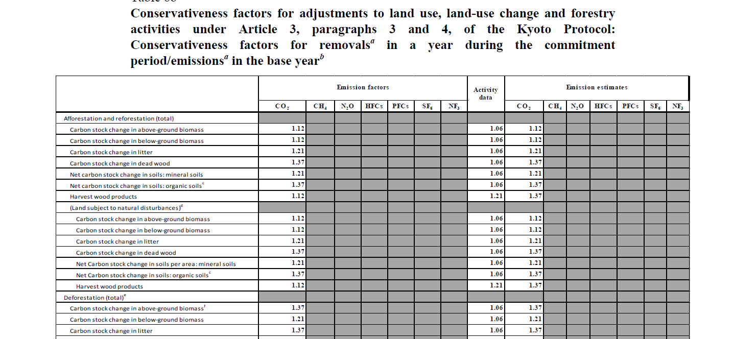
Results: tables with proposed conservativeness factors
Notes:
In-session comments:

Slide 41
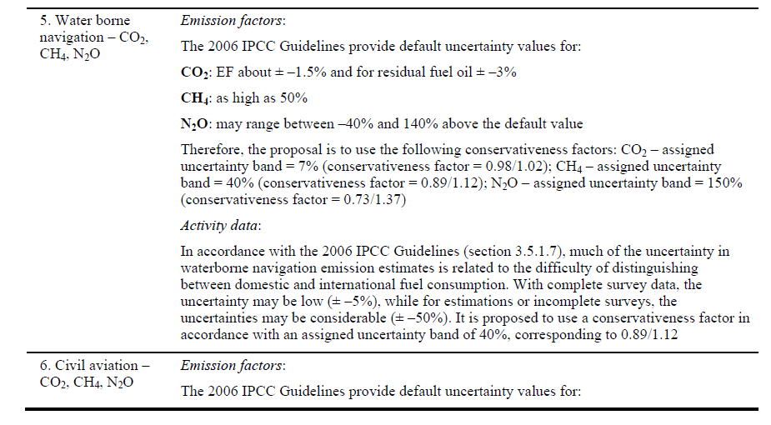
Annex III – background information: illustrative example
Notes:
In-session comments:

Slide 42
Thank you

