Slide 1
CDM‘s contribution to global climate action; its sucesses and further contribution
Fatima-Zahra Taibi, UNFCCC secretariat
Regional Workshop on CDM and NAMAs for Latin America and the Caribbean Bogotá, Colombia

Slide 2
Background
The CDM was established as a “flexible mechanism” by the Kyoto Protocol, to help ANNEX I Parties to meet their emission reduction commitments, while bringing sustainable development benefits to the CDM host countries.
It was the first undertaking of its kind in the world. The first truly global mechanism in a new carbon market.
Source: http://serendip.brynmawr.edu/exchange/node/11993
No experience existed on the ground, no trail to follow, no manual.
Additional (would not happen without CDM incentive)
Environmental integrity (reductions are real)
Complexity was inevitable at start

Slide 3
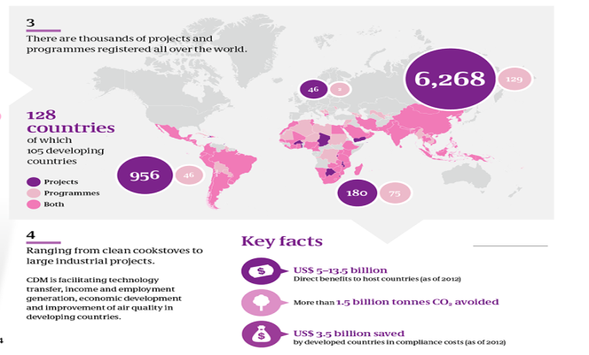
Achievements of the CDM
During its 10-year history, a first-of-its-kind approach to climate change mitigation under administration of the United Nations, CDM has been able to:
Develop 200+ methodologies in 25 different sectors
Establish 125+ Designated National Authorities
Accredit 40+ validators/verifiers (Designated Operational Entities)
Involve 4,500+ institutions in CDM projects
Establish four Regional Collaboration Centers (Africa, Latin America, and the Caribbean)
Develop countless CDM development experts worldwide
Develop an experienced secretariat

Slide 4
Achievements of the CDM in big numbers
Over 7,750 registered projects and PoAs in 100 countries in less than 10 years = average over 2 projects per day!
155 countries involved in the CDM = over ¾ of the countries in the world!
1.5 billion CERs issued and €4-20 billion saved by EU ETS installations from 2008 to 2012 through CER purchases
Approximately US$215 billion investment in GHG reduction activities > total annual ODA flow in 2011
US190 million contribution to the Adaptation Fund
Around 200 GW of installed renewable energy capacity = more than twice the total installed capacity of the UK

Slide 5
Achievements of the CDM
But the CDM has even gone beyond that. It has:
Identified and initially addressed the low hanging fruits for mitigation, indicating a clear way to get started and to continue developing mitigation
Developed capacity to identify and develop those mitigation opportunities worldwide, and in the developing world in particular
Placed climate change mitigation in the agenda of developing countries, by requiring the establishment of DNAs with LoA procedures etc...

Slide 6
Achievements of the CDM
It has also:
Built capacity of developing country authorities, some of which are now pursuing their own mechanisms based on experiences gained with CDM
Developed the interest of the private sector, mobilizing a very significant investment (US$150 billion at least, with potential for more)
Demonstrated that global approaches to mitigation CAN work
Contributed to adaptation through the Adaptation Fund
CDM has delivered offsets, but also capacity, know-how, finance, adaptation funding and sustainable development co-benefits

Slide 7
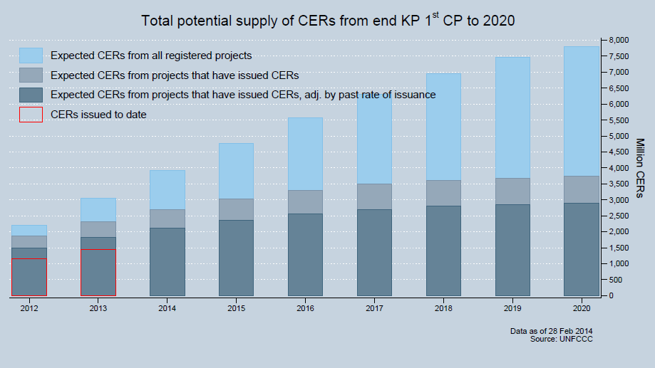
Potential of the CDM
Facing challenging times: due to domestic policy decisions and lacking ambition, supply exceeds demand in the carbon markets.
CER prices dropped 95% in past few years. Current price ~0.10 Euros/CER. Difficult for most projects to continue the project cycle.
But the CDM has much potential:
8 billion tons
CDM is doing what CDM was set up to do.
Potential for action is significant once Parties (countries) get serious about the 2 C target.
Notes:
Net mitigation benefits: CERs are calculated based on conservative approaches and factors. It is estimated that actual reductions are higher than those recognized by the methodologies, producing net mitigation. Also, many CDM projects will possibly operate beyond their crediting period, also contributing net mitigation.

Slide 8
Potential of the CDM
In addition:
CDM is primarily a monitoring, reporting and verification (MRV) system for mitigation actions, excellent for results-based financing
CDM has already undergone and overcome the trials and difficulties all new mechanisms must endure. It has therefore passed the phase of the learning by doing and acquired more maturity
CDM has addressed most of the criticism regarding transparency, responsiveness and processing time, and has taken on wide standardization and simplification. It has evolved greatly.
It can easily contribute to net mitigation, under revised provisions.
CDM is a multilateral mechanism, with the credibility and transparency required to ensure that reductions are real. It has wide recognition. It is the model for new mechanisms.
A mature, advanced and recognized mechanism with potential to contribute to further mitigation ambition and net mitigation.

Slide 9
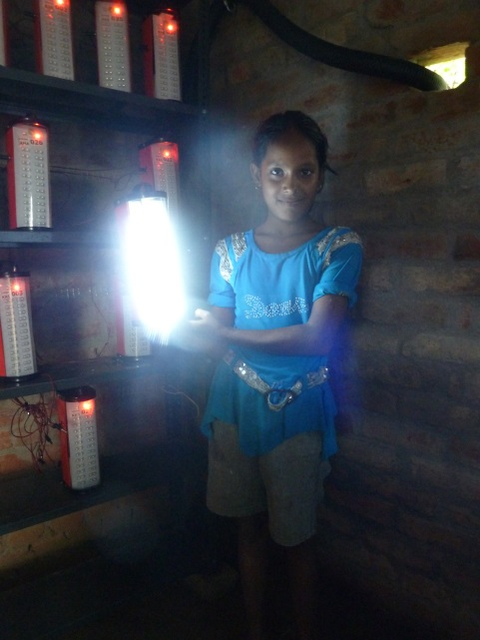
In conclusion
CDM is a successful ready-made tool, tested, improved and apt to further evolve as required.
CDM has the potential to continue contributing to mitigation worldwide, both through offsets and net mitigation
CDM is not only an offsetting mechanism, but also a fully developed system for MRV of mitigation action (and finance)
CDM is the basis for mechanisms growing worldwide and could link all of them (model for new mechanisms)
Potential for continued contribution to mitigation and adaptation, with strong MRV, linking global markets and expanding mitigation action and delivery of finance

